Slide 1
Introduction Machine Learning and AI
Dantong Yu
Professor

Slide 2


Value-added in predictive science analysis
Hurricane Irma
What is needed in addition to Wood board, bottle water.
What about strawberry poptarts, under-ware?
Did you hear Signet Bank in Virginia?
Customer Churn
Notes:
Wal-Mart Stores decided that the Hurricane situation offered a great opportunity for their newest data-driven decision making… predictive technology.
To ensure that local Wal-Marts are properly stocked, they need to mine the data and reveal a particular item will be sold out in the hurricane’s path.
It turns out Stawberry Poptarts are the most popular items.
The second story is about the Signet Bank that great exemplifies data science capability as a strategic asset. Around 1990, two strategic visionaries (Richard Fairbanks and Nigel Morris) realized that information technology was powerful enough that they could do more sophisticated predictive modeling and offer different terms (nowadays: pricing, credit limits, low-initial-rate balance transfers, cash back, loyalty points, and so on). These two men had no success persuading the big banks to take them on as consultants and let them try. they succeeded in garnering the interest of a small regional Virginia bank: Signet Bank.
You may not have heard of little Signet Bank, but if you’re reading this book you’ve probably heard of the spin-off: Capital One. I do not have to repeat the success of Capital One bank in customer credit industry.

Slide 3
Data Mining and Machine Learning
A set of principles, concepts, and techniques that structure thinking and analysis of data
Extracts useful information and knowledge from large volumes of data by following a process with reasonably well-defined steps
Changes the way you think about data and its role in business
A common understanding: you have valuable data, and you have an edge in the competition
Data is an asset once you can extract non-obvious insight from data. It is an asset playing a vital role.

Slide 4
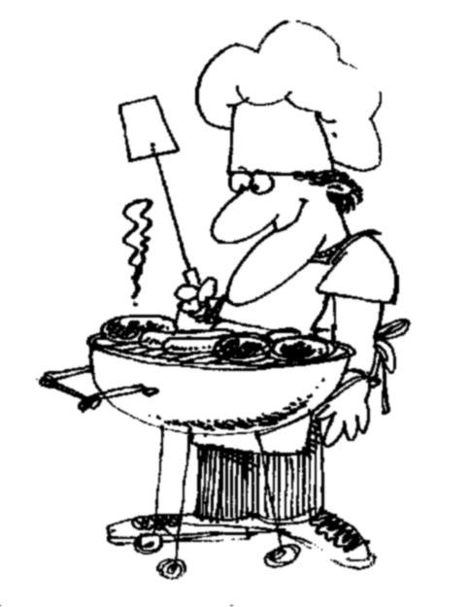
How do you want that data?
I ♥
data
Notes:
Chemistry is not test tubes and elements. Data Science is not about tools and data. Culinary is not about food and cooking utensil. Data science commonly includes analytical skills and techniques for understanding data, popular tools used (You have to master some tools to have practical experience), and good quality of data, most important (creation, theory, principals). Different peoples derives different results from the same set of data.

Slide 5
Machine Learning is a process
science + craft + creativity + common sense
a new business process
Notes:
The science here: complexity, data structure, algorithmic details, domains specific (market efficiency theory and efficient market hypothesis (EMH), Black-Scholes model)
Craft: Particular tools, algorithms, and data mining systems
Creative: from your business sense (which signal is essential)?
Common Sense: Whether you approach, data selection and the outcomes make sense? It is a trade-off between trivially obvious and profoundly specific.

Slide 6
Data Opportunities
Volume of data
Variety of data
Powerful computers
Better algorithms
Notes:
Everyone talks about the big data, Vs,
Powerful computers, Nvidia GPUs, Moore Laws, Neural Chips for hardware accelerations.
Better algorithms: power statistical optimization algorithms, deep neural networks for feature extractions, classifications and regressions.

Slide 7
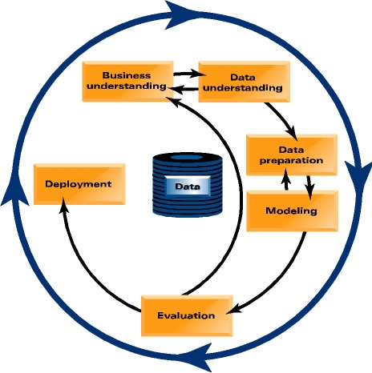
Data Mining/Machine Learning Process
Business Understanding
Data Understanding
Data Preparation
Modeling
Evaluation
Deployment

Slide 8

From Data Mining to Machine Learning
Data Mining ≈ Big Data ≈ Predictive Analytics ≈ Data Science ➔ Machine Learning
Data mining overlaps with:
Databases: Large-scale data, simple queries
Machine learning: Complex models (Deep Neural Networks)
CS Theory: (Randomized) Algorithms
Different cultures:
To a DB person, data mining is an extreme form of analytic processing – queries that examine large amounts of data
Result is the query answer
To a ML person, data-mining process is the inference of models
Result is the parameters of the model
In this class we will do both!
CS Theory
Machine Learning
Data Mining
Database systems

Slide 9
Different Between Data Mining and Machine Learning
Mining/Extractions/Distill
Learning/Fitting
Data Mining
Machine Learning
Data Mining normally produces models/rules/patterns that tender to be self-explainable
Machine Learning produces a model that best fits with data (neural networks) and might be a black box.

Slide 10
Machine Learning
Supervised v.s. Unsupervised
Unsupervised Algorithm
Cluster Algorithm
Principal Component Analysis
Spectrum analysis and Manifold learning

Slide 11


Predicting Whether Customer will purchase Electric Car
You just landed a great analytical job with Tesla, one of the largest electric car companies in the US
They are having a major problem: who will purchase an electric car, and who will purchase an ICE car?
In US, 10%~15%, of car customers leave when their contracts expire and change to other brand of car. Car manufacture companies are now engaged in battles to attract each other’s customers while retaining their own
Marketing has already designed a special promotion offer
Your task is to devise a precise, step-by-step plan for how the data science team should use Tesla’s vast data resources to solve the problem

Slide 12

Predicting Electric or ICE Customer
What data you might use?
How would they be used?
How does Tesla choose a set of customers to receive their offer in order to best reduce churn for a particular incentive budget?

Slide 13







Terminology
Model:
A simplified representation of reality created to serve a purpose
Examples: map, prototype, math formula, etc.
Machine Learning example:
“formula” for predicting the probability of customer attrition at contract expiration
→ “classification model” or “class-probability estimation model”
Predictive Model:
A formula for estimating the unknown value of interest: the target
The formula can be mathematical, logical statement (e.g., rule), etc.
Prediction: Estimate an unknown value (i.e. the target)
Instance / example:
Represents a fact or a data point
Described by a set of attributes (fields, columns, variables, or features)

Slide 14
Terminology
Model induction:
The creation of models from data
Training data:
The input data for the induction algorithm
Consists of attributes
Which attributes (features) are informative, correlates with what you want to know (targets)?

Slide 15
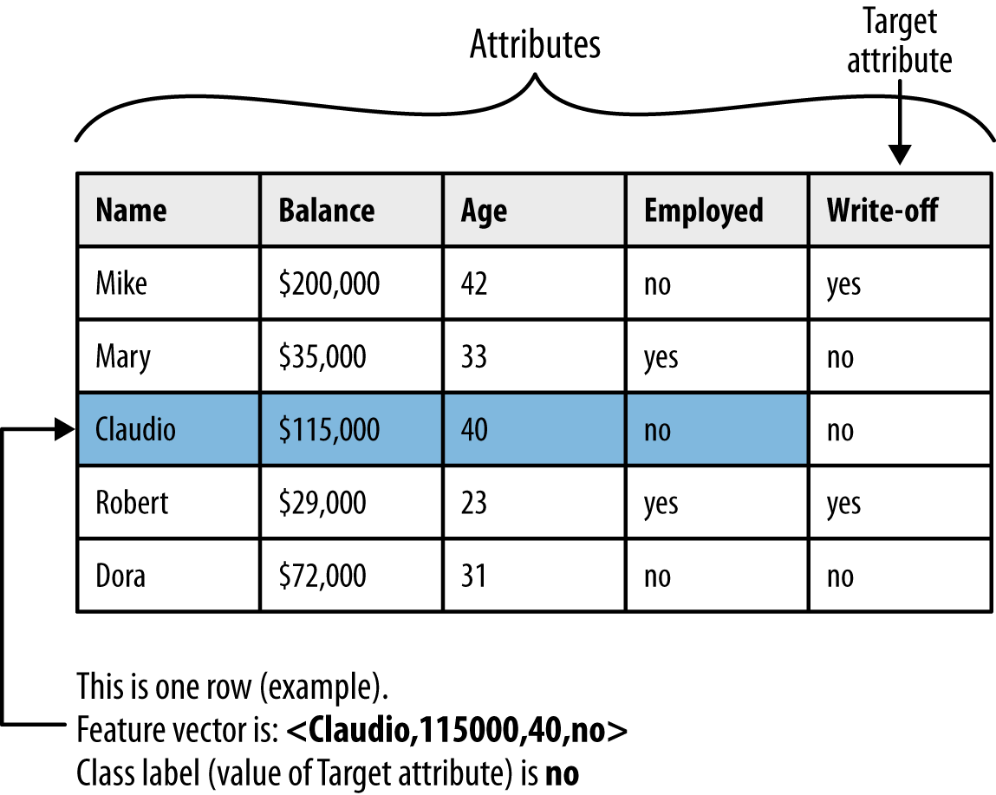








Terminology

Slide 16
Feature Types
Numeric: anything that has some order
Numbers (that mean numbers)
Dates (that look like numbers …)
Dimension of 1
Categorical: stuff that does not have an order
Binary
Text
Dimension = number of possible values (-1)
Food for thought: Names, Ratings (good, excellent, diamond), Standard Industry Classification (https://en.wikipedia.org/wiki/Standard_Industrial_Classification)

Slide 17
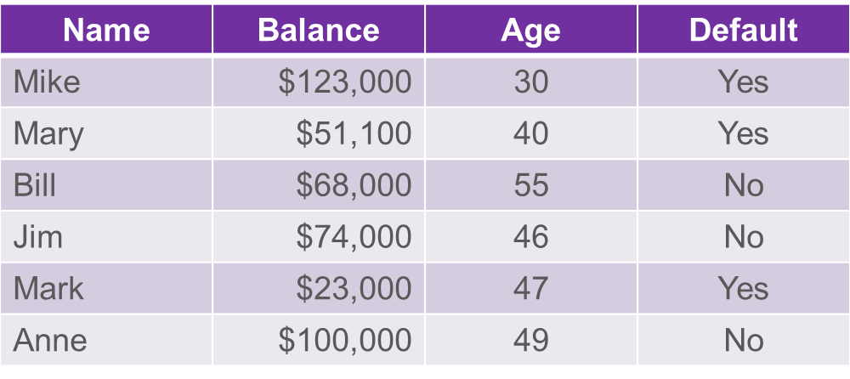
Dimensionality of the data?
Attributes / Features
Dimensionality of a dataset is the sum of the dimensions of the features
The sum of the number of numeric features and ~ the number of values of categorical features

Slide 18







Common Data Mining Tasks
Classification and class probability estimation
How likely is this consumer to respond to our campaign?
Regression
How much will she use the service?
Similarity Matching
Can we find consumers similar to my best customers?
Serves as the base for many other data mining tasks.
Clustering
Do my customers form natural groups?

Slide 19

Common Data Mining Tasks
Co-occurrence Grouping
Also known as frequent item set mining, association rule discovery, and market-basket analysis
What items are commonly purchased together?
Profiling (behavior description)
What does “normal behavior” look like? (for example, as baseline to detect fraud)
What is characteristic of a population, subgroup, and even individual
How do you describe a credit card fraud?
Data Reduction
Explicit Feature Selections
Which latent dimensions describe the consumer taste preferences?

Slide 20

Common Data Mining Tasks
Link Prediction
Since John and Jane share 2 friends, should John become Jane’s friend?
Causal Modeling
Why are my customers leaving?
Target Ad: is my treatment (targeting) effective, or is my model that identify whom will purchase anyway (regardless targeted or not)?
Assumption: For example, Viral market: consumers actually influence each other.
Notes:
targeted ad is relevant to the audience

Slide 21
Supervised versus Unsupervised Methods
“How do our customers naturally fall into different groups?”
No guarantee that the results are meaningful or will be useful for any particular purpose
“Can we find groups of customers who have particularly high likelihoods of canceling their service soon after contracts expire?”
A specific purpose
Much more useful results (usually)
Different techniques
Requires data with the target
The individual’s label
Notes:
Z'

Slide 22
Supervised Data Mining & Predictive Modeling
Is there a specific, quantifiable target that we are interested in or trying to predict?
Think about the decision
Do we have data on this target?
Do we have enough data on this target?
Need a min ~500 of each type of classification
The result of supervised data mining is a model that predicts some quantity
A model can either be used to predict or to understand

Slide 23
Recap: Supervised Machine Learning
Classification
Categorical target
Often binary
Includes “class probability estimation”
Regression
Numeric target

Slide 24
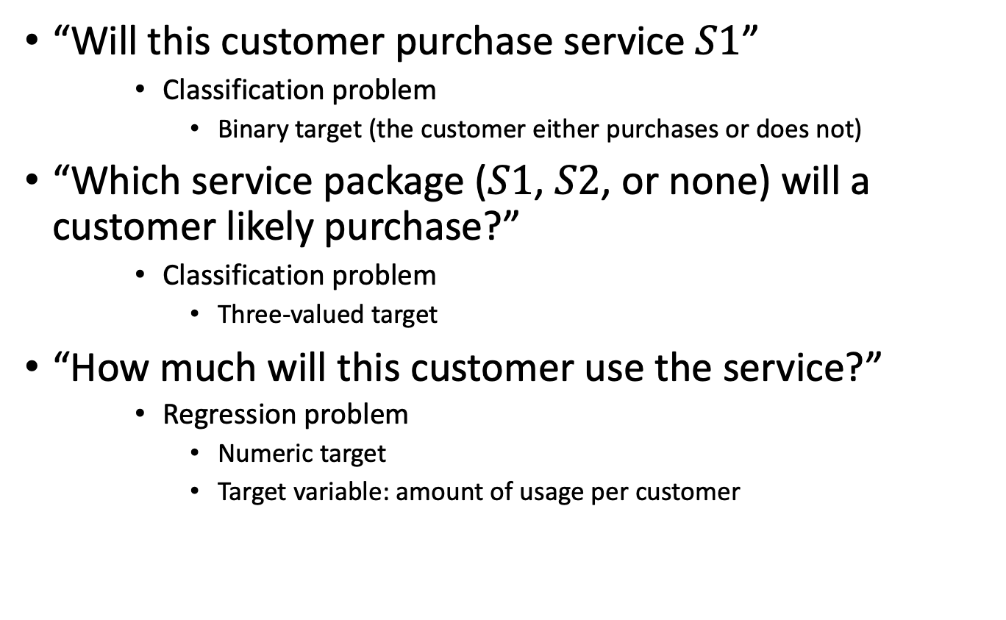
Subclasses of Supervised Data Mining
“Will this customer purchase service $S1$”
Classification problem
Binary target (the customer either purchases or does not)
“Which service package ($S1$, $S2$, or none) will a customer likely purchase?”
Classification problem
Three-valued target
“How much will this customer use the service?”
Regression problem
Numeric target
Target variable: amount of usage per customer

Slide 25
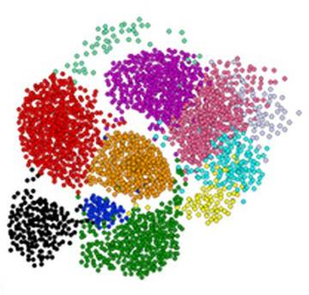
Clustering is a hard problem!

Slide 26
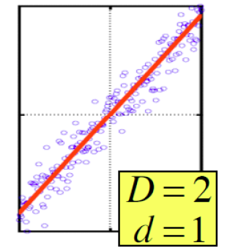







Dimensionality Reduction
Goal of dimensionality reduction is to discover the axis of data!
Rather than representing every point with 2 coordinates we represent each point with
1 coordinate (corresponding to the position of the point on the red line).
By doing this we incur a bit of error as the points do not exactly lie on the line

Slide 27
Supervised Learning
Linear Regression. (target is a continuous value)
y
X

Slide 28
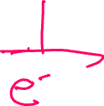


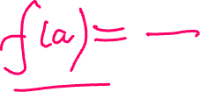

Classification (target is a label)
Logistic Regression. (target is a discrete value)
y

Slide 29
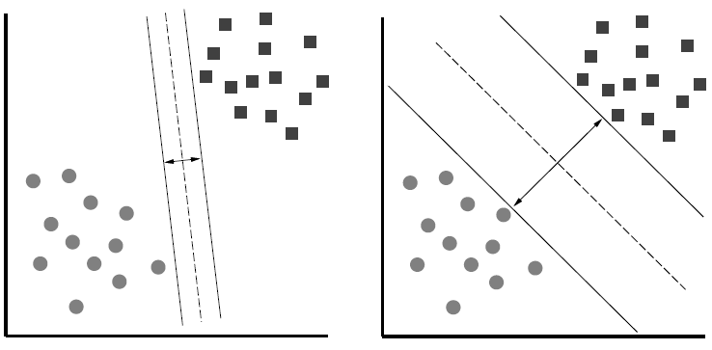
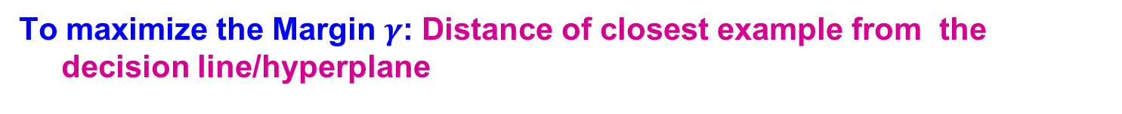
Support Vector Machine
To maximize the Margin $γ$: Distance of closest example from the decision line/hyperplane
Notes:
Why define margin as distance to the closest example, why not avg. or something else?
Purely theoretical

Slide 30

Decision Tree Induction: An Example
Training data set: Buys_computer
The data set follows an example ID3
Resulting tree:
age?
<=30
overcast
>40
31..40
student?
yes
credit rating?
no
yes
excellent
fair
no
yes
no
yes

Slide 31
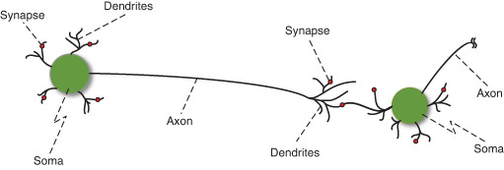

Neurons

Slide 32
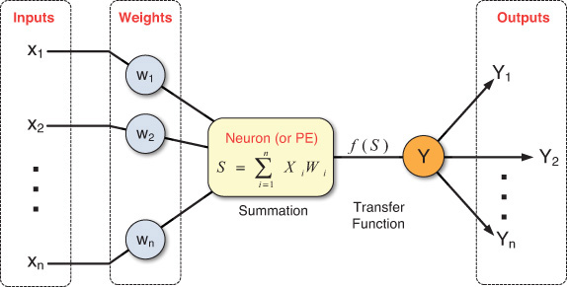





Artificial Neuron
From Real-World Data Mining: Applied Business Analytics and Decision Making by Dursun Delen, Ph.D. (0133551075) Copyright © 2015 Pearson Education, Inc. All rights reserved.
Figure 5.4 Processing Information in an Artificial Neuron

Slide 33
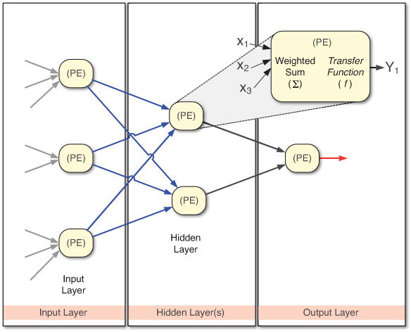



Artificial Neural Networks
Figure 5.5 Structure of a Feed-Forward Neural Network

Slide 34
Deep Neural Networks

Slide 35
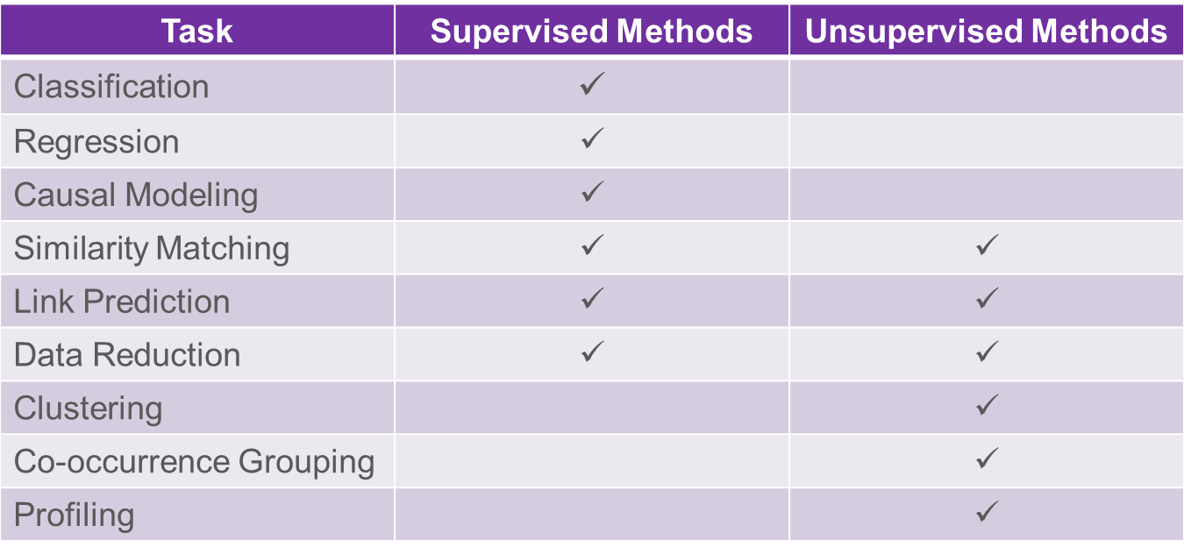





Common Data Mining Tasks

Slide 36

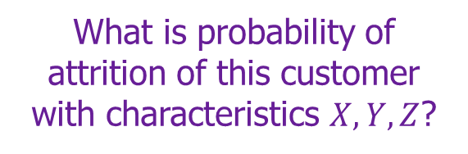
Data Mining Model in Use
What is probability of attrition of this customer with characteristics $X, Y, Z$?
$$p(C|X,Y,Z) = 0.85$$

Slide 37
Machine Learning Training versus Use of the Model
“Supervised” modeling:
“Training” data have all
values specified
Model in use:
New data item has some value unknown (e.g., will she leave?)

Slide 38
Classical Pitfalls in DM setup
The training data is NOT consistent with the use
Bad sample
Bad features

Slide 39
Sample: “Looking Under the Streetlight”
Target Proxy
I do not see if a person after seeing an ad bought the book, so lets model clicks …
Sample Proxy
I want to run a campaign in Spain but only have data on US customers

Slide 40
Sample: “Survivorship issues”
Lending club wants to have a model to take over the screening process that selects applications and deny those that are likely to default
Data of past loans and the outcomes are provided
Bad:
Use the data they currently have to predict default while ignore the population that was rejected initially.

Slide 41
Sample: Different Sources
Things go really bad if the positive and negative are treated differently
Looking for drivers of diabetes: how do you assemble the training data?
Bad:
Go to a specialized hospital and get records from people treated for diabetes
Go somewhere else to get records for healthy people

Slide 42
Digression on features: It is all about the timing in use!
Training Data
T_{d} Decision has to be made
T_{t} Target is known
Features
Leakage

Slide 43
Summary on bad habits
You are missing all the applications that were turned down already
The sick people came from a very artificial subset
Your target is NOT really your target
No way of telling how the model will perform
No way of testing either
Information Leak
The training sample should be as similar as possible to the USE data

Slide 44

Thank you
https://docs.google.com/forms/d/e/1FAIpQLSfVanMSRe5ej1abngIQlN9LvSQmu1iiII1s9qM2Dvj4Hq6p5Q/viewform

