Slide 1
Migration to CodeArtifact

Slide 2
Agenda
Objectives
AWS CodeArtifact
Solution
Migration
Using CodeArtifact
Publishing to CodeArtifact

Slide 3
Objectives

Slide 4
Objectives
Decommissioning of the legacy hosting
Operating on artifacts as AWS resource
Securing fetching/publishing
Minimal affection on the current build processes
Using modern, scalable, and secure repository

Slide 5
AWS CodeArtifact

Slide 6


CodeArtifact: Glossary
Repository is a set of package versions, each of which maps to a set of assets (individual files stored in CodeArtifact).
Domain is a higher-level entity, repositories are aggregated into. Domains expose the repositories' endpoints and allow managing the permissions of the repositories.
https://domain-123456789012.d.codeartifact.us-east-1.amazonaws.com/maven/repo/

Slide 7
CodeArtifact: Access
Get a token. If the token is expired, generate a new one.
Send a request to fetch the file from the CodeArtifact repository.
AWS CodeArtifact redirects to the pre-signed S3 URL.
Download the file from the S3 by the provided URL.

Slide 8
Solution

Slide 9
Solution
Do not change the current building processes
Allow developers to downloads artifacts
Publish custom libraries only from the GitHub

Slide 10
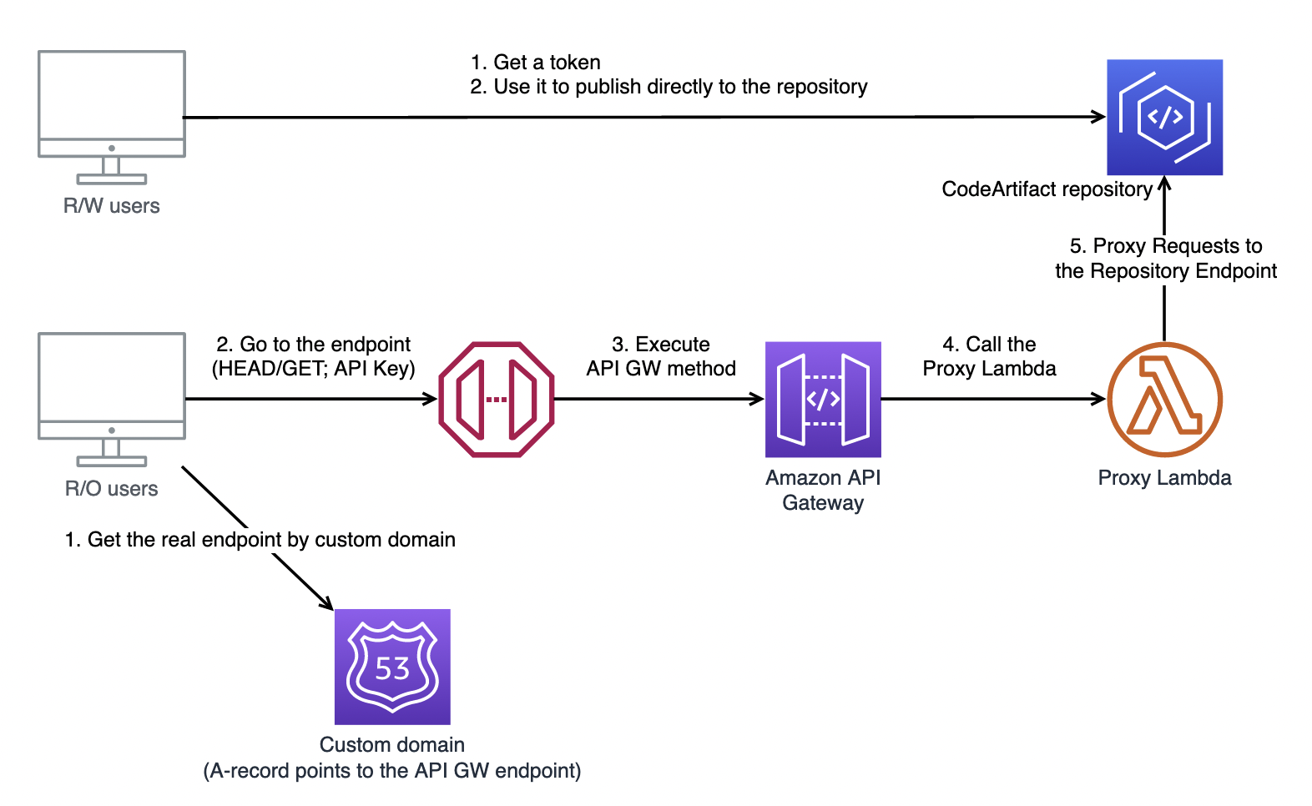
Solution

Slide 11
Migration

Slide 12
Migration
Migrating artifacts from Artifactory
Apps and Services to start using CodeArtifact
Libraries to start publishing to CodeArtifact

Slide 13
Migration: Artifacts
The migration script:
Collects domain name, repo name, API Key, CodeArtifact URL
Gathers all the needed dependencies
For each dependency
Download its assets: binaries, sources, javadocs, poms, gradle metainfos
Publish assets as a package version to the CodeArtifact
The token should be generated. Maven settings should be defined to use the token as a password.

Slide 14
Migration: Fetching Artifacts
maven {
url "https://maven.dls-test.com"
credentials(HttpHeaderCredentials) {
name = "X-Api-Key"
value = "…"
}
authentication {
header(HttpHeaderAuthentication)
}
}

Slide 15
Migration: Publishing Artifacts
Adjust build.gradle to publish to CodeArtifact (wiki doc)
Provide the version in the gradle.properties
Add publish.yml to the .github/workflows

Slide 16
Using CodeArtifact

Slide 17
Using CodeArtifact
No changes. Good old
./gradlew bootJar/boorWar/…

Slide 18
Publishing to CodeArtifact

Slide 19
Publishing: Three Ways
By merging into master
By running workflow manually
By requesting a snapshot publishing in the PR

Slide 20
Publishing: Process
Identifies the Artifact Version
Notifies if it’s a in-PR run
Tags if it’s a release publishing (v1.2.3)
Publishes
Untags if publishing failed
Notifies about success/failure

Slide 21
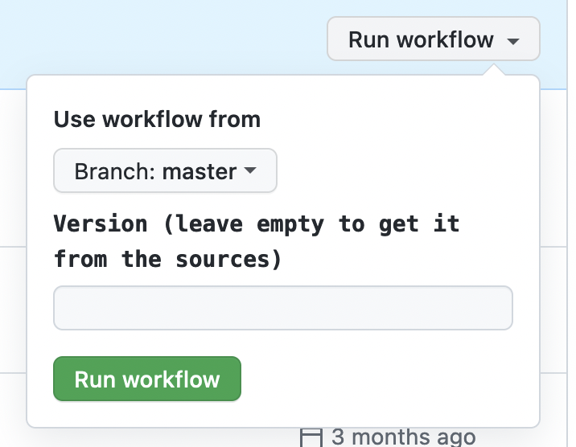
Publishing: Manually

Slide 22
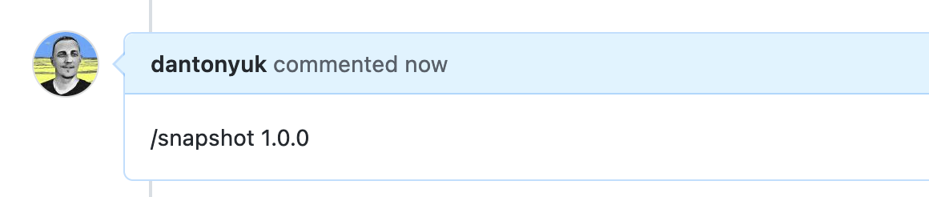
Publishing: Snapshot from PR

Slide 23
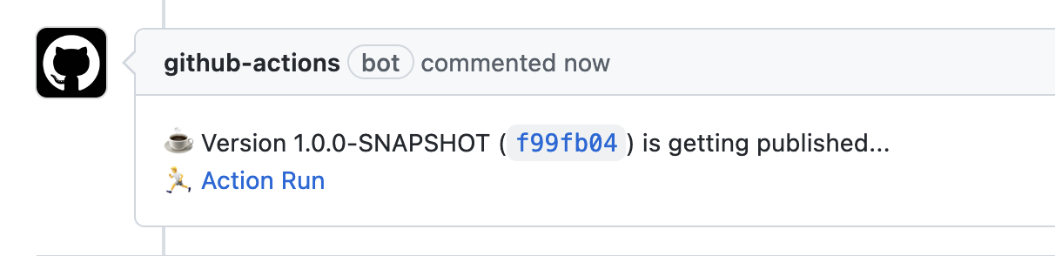
Publishing: Snapshot from PR

Slide 24
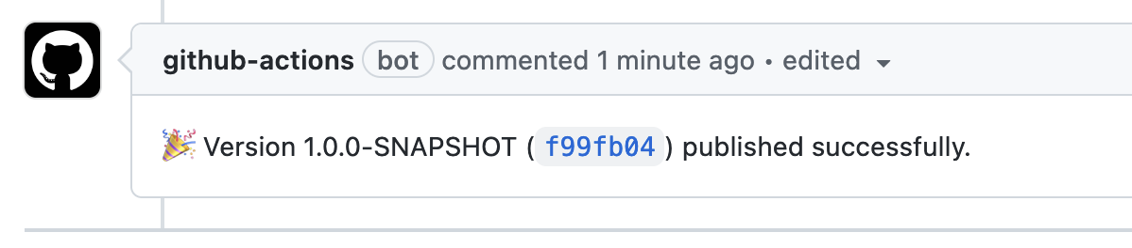
Publishing: Snapshot from PR

Slide 25
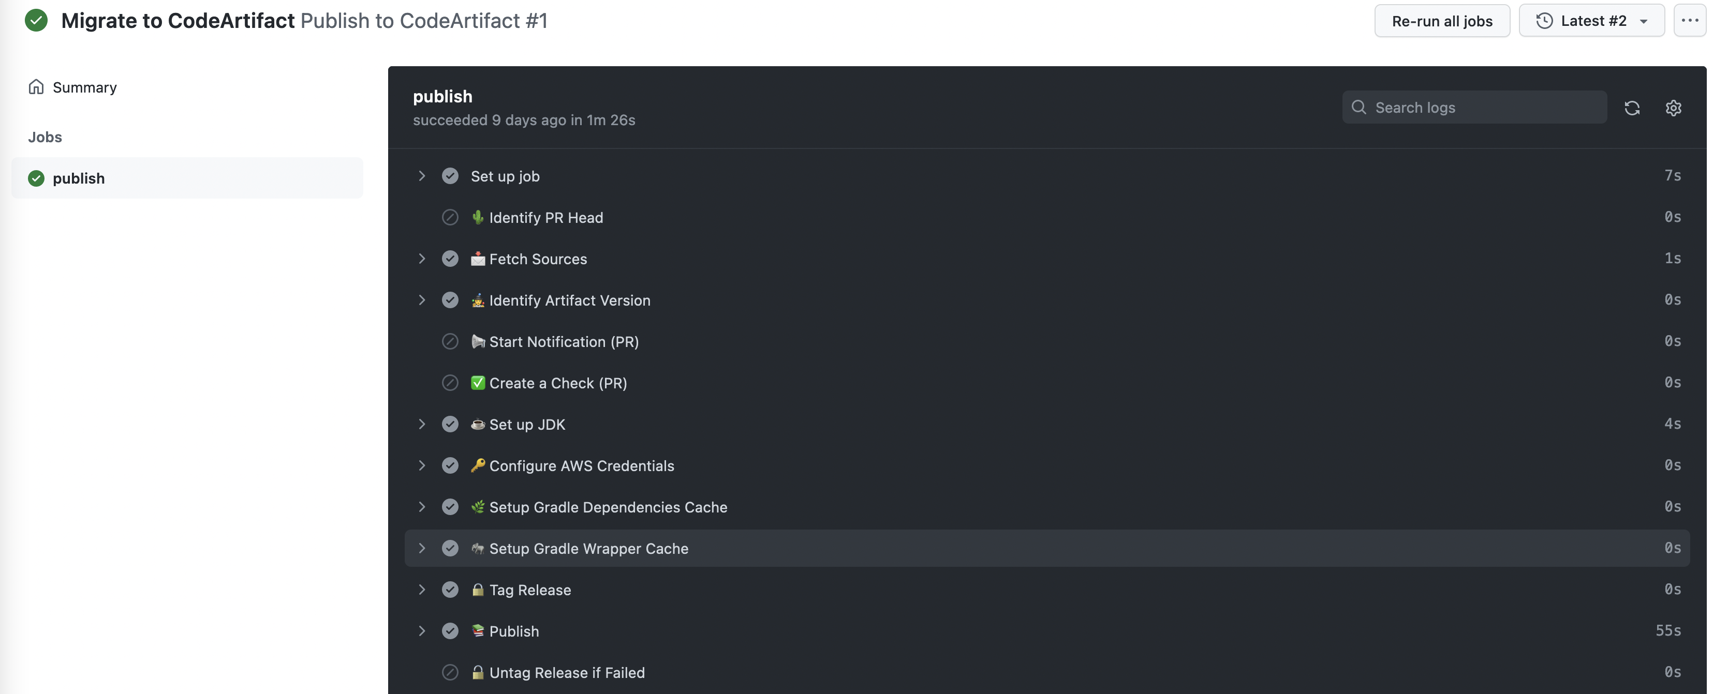
Publishing: Action Run

Slide 26
Links
Migrating from Artifactory to AWS CodeArtifact
How to Create a CodeArtifact Repository
How to Work with the CodeArtifact Repository

Slide 27
Questions?

