Slide 1
Technical Debt
Better Money Habits

Slide 2
The Definition
The term was coined by Ward Cunningham in 1992
It's analogue of financial debt
Borrow time now, repay later
Examples
Borrowing money – implementing quick&dirty solution
Paying back debt – refactoring or code replacement
Paying interest – new features require more effort

Slide 3
Reasons
Business Pressure
Business is Blind to the Concept of TD
High Coupling
Lack of Tests
Lack of Documentation
Ignoring Standards
…

Slide 4
Types
Architectural Debt
Design Debt
Code Quality Debt
Testing Debt
Documentation Debt
Environmental Debt

Slide 5
Example
You're assigned to add a new feature to a product.
The codebase is messy.
If the codebase were clean, it would take three days.
With the current codebase, it takes four days.
So the interest is one day.
Refactoring codebase takes a week.
Is it worth it?

Slide 6
Checkpoint
Technical Debt is not necessarily evil.

Slide 7
Two Projects
Technical Debt
Design Payoff Line

Slide 8
The Danger
We can not measure productivity
We can not predict time to pay off

Slide 9
Risks
Costs money! Also time and effort to the business.
Becomes dangerous if it's not paid
Hides problems
Uncontrollable codebase
Developers get extremely specialized
Product gets more inflexible
We talk about more important risk later

Slide 10
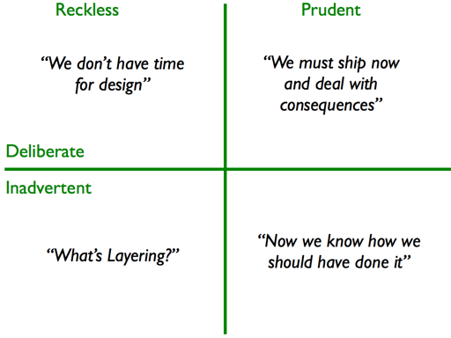
TD Quadrant (Fowler Version)

Slide 11
More Axis
Short-term / Long-term
High-interest / Low-interest
Trackable / Untracked
etc.

Slide 12
Checkpoint
But What We Really Need
Move Inadvertent to Deliberate
Move Untracked to Tracked

Slide 13
Untracked to Trackable
TD tickets
Code Coverage
Code Duplications
Cyclomatic Complexity
Coupling

Slide 14
Inadvertent to Deliberate
Evolving product gets more complicated.
It absorbs more technical debt.
The development slows down.
Team releases less features.
Management hires more developers.
More developers incur more debt.
Wash, rinse, repeat.

Slide 15
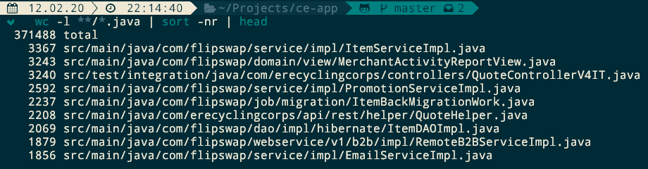
Example

Slide 16
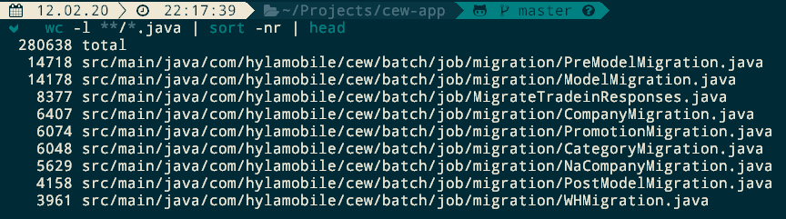
Example

Slide 17
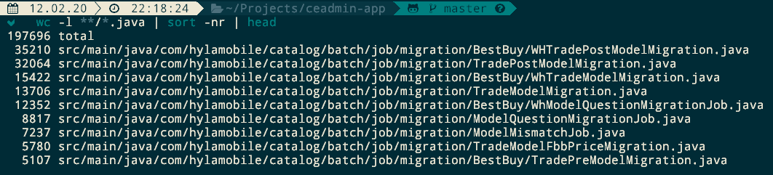
Example

Slide 18
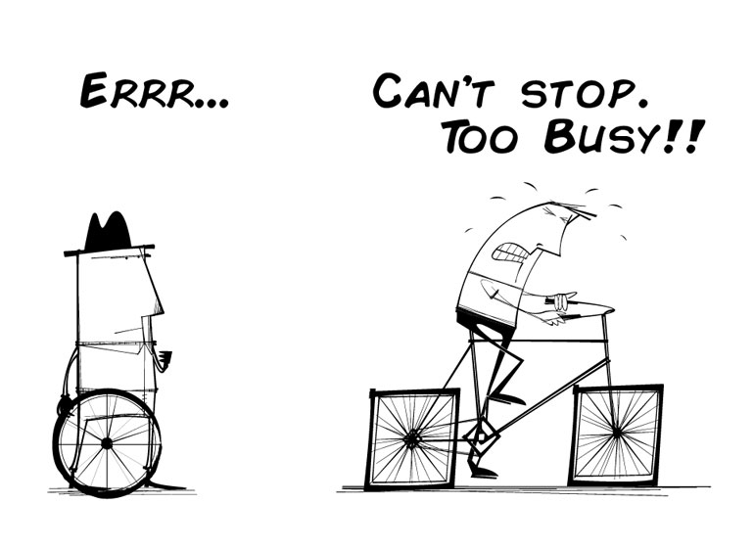
How to Fix Technical Debt

Slide 19
How to Identify Technical Debt
Adding new feature is getting slower.
Increasing testing, especially manual.
The loss of productivity/motivation.
Postponed releases.
Getting scared of changing anything.
Sonar Reports
Low Code Coverage

Slide 20
How to Identify Technical Debt
Code Smell
Hacks / Bad Design
Improper Technology/Library
Unreadable Code

Slide 21
Checkpoint
Important signal: developers gut feeling.

Slide 22
What to Do with Technical Debt
Ignore and pay interest
Pay the debt
Claim the bankruptcy
Move it to Trackable!

Slide 23
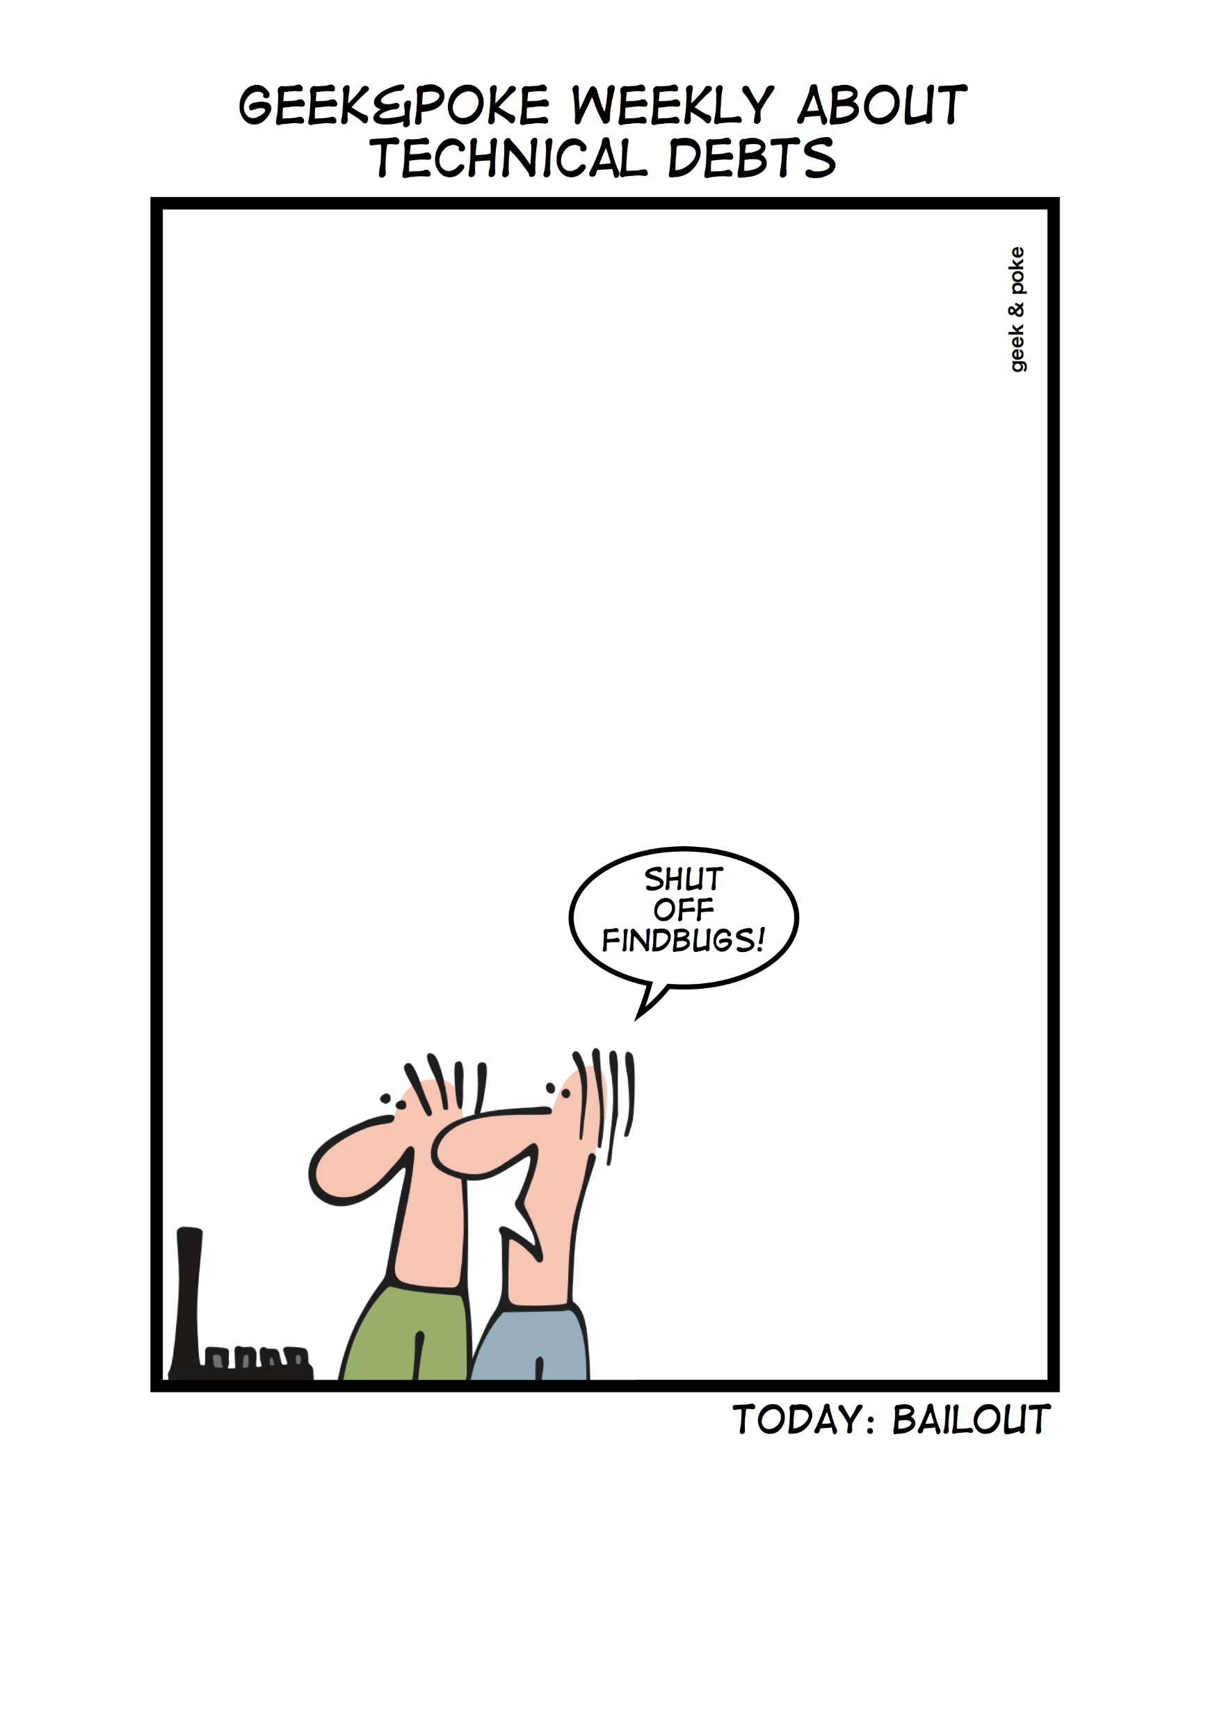
What to Do with Technical Debt

Slide 24
How to Avoid Technical Debt
Merciless Refactoring
Fast Automation
Share Knowledge
Clean Code Principles
Fail Fast (Peer Review, Code Review, Tests first)
Fix Constantly

Slide 25
The Most Important Risk
Developers hate tackle messy codebase.
Good developers are sensitive to unaesthetic code.
Messy code signals "no one cares".
Good developers hightail it out of such place.
Team loses motivation and morale.

Slide 26
Checkpoint
No woman no cry

Slide 27
Checkpoint
Good developers won't come!

Slide 28
Good News
Good news is that we know the mother of all evils.
It's low level of development culture.
This is what the team should focus on.

Slide 29
First Things to Apply
Environmental Resistance: «I dislike Confluence, hate to create documents there that's why I suck at documenting things»
Solution: «Create an appropriate environment!»

Slide 30
First Things to Apply
Business Pressure: «I have to release it ASAP! No time to design, no time to write tests»
Solution: «Well, there is no guy you have to ask permissions to do your job well»

Slide 31
First Things to Apply
Testing Debt: «I can't refactor this code now 'cause tests are broken and I'm not confident enough»
Solution: «You can try to fix test, or, in case of lack of them, write some of them. A few.»

Slide 32
Checkpoint
The Boyscout Rule:
«Always leave the campground cleaner than you found it»

Slide 33

First Things to Apply

Slide 34
Takeaway
Technical Debt is not inherently bad.
Move Inadvertent to Deliberate.
Trust your hunches! Code smells and you can feel it.
Good developers avoid messy code.
Don't give them a chance! Improve the culture!
No reason to ignore the Boyscout Rule.
Let's roll our sleeves up!

Slide 35

We are Engineers. We (most likely) can.

Slide 36
Post-Credits Scene

Slide 37
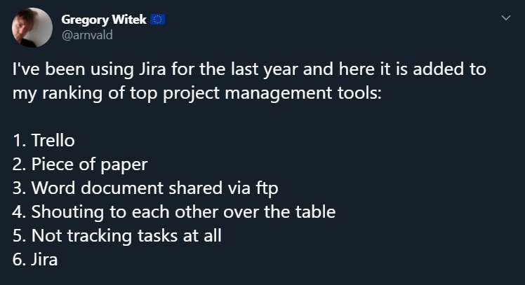
Use Proper Tools

