Slide 1
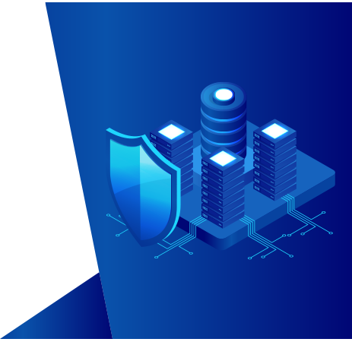

A UBA-driven
change auditor
Keep your Active Directory, Windows
servers, ﬁle servers, and workstations
secure and compliant

Slide 2
What is ADAudit Plus?
ManageEngine ADAudit Plus is real-time change auditing and reporting software that can:
Monitor your Active Directory (AD), Azure AD, Windows ﬁle servers, member servers, and workstations,
and help you adhere to regulations such as HIPAA, GDPR, SOX, CCPA, GLBA, and more
Transform raw and noisyꢀevent log data into actionable reports that show you who did what, when, and
from where in your Windows ecosystem in just a few clicks
Identify anomalous activity and detect potential threats to your enterprise using its user behavior analytics
(UBA) capabilities

Slide 3
How ADAudit Plus can help your organization
With ManageEngineꢀADAudit Plus, you can:
1. View detailed reports on changesꢀmade toꢀon-premises and Azure AD
2. Gain visibility into Windowsꢀuser logonꢀactivity
3. Report on, analyze, and troubleshoot ADꢀaccount lockouts
4. Closely monitor privileged user activities in your domain
5. Trackꢀlogons/logoffs, changes to users, groups, etc.
6. Audit ﬁle activity inꢀWindows, NetApp, EMC, Synology, Huawei, and Hitachi storage
7. Enhance threat detection with user behavior analytics (UBA)
8. Get prepackaged audit reports for SOX, HIPAA, PCI DSS, GDPR, and other regulations

Slide 4
Highlights of ADAudit Plus
1. AD and Azure AD change auditing and reporting
2. File server auditing (Windows, NetApp, EMC, Synology, Huawei, Hitachi)
3. Group Policy settings change auditing
4. Windows server and member server auditing and reporting
5. Workstations auditing
6. User behavior analytics (UBA)
7. Privileged user monitoring

Slide 5


Active Directory
auditing
Report on changes made to AD objects
and GPOs; track user logon activity,
analyze account lockouts, and more

Slide 6
AD auditing
Audit all AD object changes: Track changes made to OUs, users, groups, computers, and other AD objects
with details such as the old and new values of the changed attributes
Track GPO setting changes: Audit changes made to GPOs and their settings, including computer
conﬁguration changes, password and account lockout policy changes, etc.
Monitor user logon activity: Get detailed reports on users' successful and failed logon attempts
Troubleshoot account lockouts: Detect account lockouts quickly with alerts, and identify their source from
an extensive list of Windows components
Gain visibility into privilege use: Keep a close eye on privilege use in your enterprise by continuously
auditing privileged user accounts and maintaining a detailed audit trail
Audit hybrid AD environment: Get a single, correlated view of all activities happening across hybrid
environments with alerts for critical events

Slide 7

File server
auditing
Audit and report on ﬁle accesses and
modiﬁcations across Windows, NetApp,
EMC, and Synology storage devices

Slide 8
File server auditing
Monitor ﬁle and folder accesses: Track all ﬁle activity—including read, delete, modify, copy-and-paste,
move, and more—in real time
Detect failed ﬁle access attempts: Receive reports on failed attempts to access ﬁles or folders
Audit permission changes: Track NTFS and share permission changes along with details such as their old
and new values
Monitor ﬁle integrity: Easily detect critical events such as changes made to a speciﬁc ﬁle, by a particular
user, or more with email and SMS alerts on these events
Audit ﬁle shares: Track every access and change made to shared ﬁles and folders in your domain with
details on who accessed what, when, and from where

Slide 9

Group Policy
settings change
auditing
Audit changes made to Group Policy settings,
including password and account lockout policy
changes, computer changes, etc.

Slide 10
Group Policy settings change auditing
Audit Group Policy Objects: Audit and report on Group Policy Object (GPO) creation, deletion,
modiﬁcation, and more
Track changes to GPO settings: Keep a close eye on who changes what GPO settings, when, and from
where with comprehensive reports
Conﬁgure alerts for critical changes: Receive instant email and SMS alerts for critical changes, such as
computer conﬁguration changes, password and account lockout policy changes, etc.
Maintain an audit trail: Generate reports on the values of GPO settings before and after every change to
instantly spot unwanted changes

Slide 11

Windows
server auditing
Monitor member servers with real-time
reports and alerts to keep a close eye on
activity in your Windows network

Slide 12
Windows server auditing
Audit Windows servers: Monitor changes to local administrative group memberships, local users, user
rights, local policies, and more
Track scheduled tasks and processes: Audit the creation, deletion, and modiﬁcation of scheduled tasks
and processes
Monitor removable device usage: Identify USB plug-ins and ﬁle transfer activities to removable storage devices
Audit PowerShell processes: Monitor PowerShell processes that run on your Windows servers along with
the commands executed in them
Audit AD federation services (ADFS): Report on successful and failed ADFS authentication
attempts in real time

Slide 13
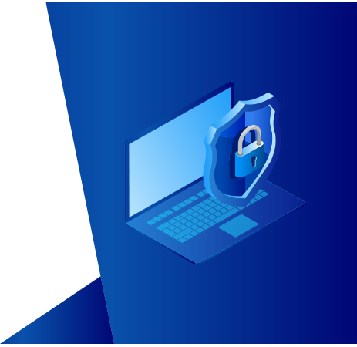
Workstation
auditing
Track users' logon and logoff information,
productive hours, logon history details,
removable storage use, and more

Slide 14
Workstation auditing
Audit logon and logoff activity: Track logon and logoff activity across your Windows network, record
logon duration, and identify users who are currently logged on
Track user logon history: Record every logon activity, identify users logged on to multiple machines,
monitor RADIUS logons, and more
Identify logon failures: Track all failed logon attempts with information on who attempted to log on, what
machine they attempted to log on to, when, and the reason for the failure
Monitor ﬁle integrity: Receive detailed reports on all changes made to system and program ﬁles
Measure employee productivity: Track employees' idle time and actual work hours to ensure high
productivity across your enterprise

Slide 15

User behavior
analytics
Detect and mitigate threats like malicious
logins, lateral movement, privilege abuse,
data breaches, and malware

Slide 16
Threat hunting with UBA
Process logs from across your environment: Collect and process logs from conﬁgured DCs, member
servers, and workstations
Identify a safe baseline: Processed log data is used to create a user-speciﬁc baseline of normal logon, ﬁle,
user management, and process activities
Identify anomalies and alert admins: Incoming log data and processed baselines are compared to detect
anomalies and notify admins, so they can investigate further
Detect potential security threats: Quickly spot potential cases of malicious logons, privilege abuse,
privilege escalations, data exﬁltration, malware attacks, and more
Automate incident responses: Reduce the time it takes to mitigate damage by instantly shutting down
devices, terminating user sessions, or more based on the security incident

Slide 17

Privileged user
monitoring
Audit privileged user accounts across
your domain and maintain an audit trail
to quickly detect suspicious behavior

Slide 18
Privileged user monitoring
Audit administrator activity: Track administrative user actions on Active Directory (AD) schema,
conﬁguration, users, groups, organizational units (OUs), Group Policy Objects (GPOs), and more
Review privileged user activity: Comply with various IT regulations by maintaining an audit trail of
activities performed by privileged users in your domain
Detect privilege escalation: Identify privilege escalation with reports documenting users' ﬁrst-time use of
privileges, and verify if they are necessary for the user’s role and duties
Spot behavioral anomalies: Identify actions deviating from normal access patterns to ﬁnd attackers using
the stolen or shared credentials of privileged accounts
Receive alerts on suspicious activity: Rapidly spot and respond to critical events, such as the clearing of
audit logs or accessing critical data outside business hours, by conﬁguring alerts

Slide 19
Most popular
features
A birds-eye view of the features that
our customers love

Slide 20
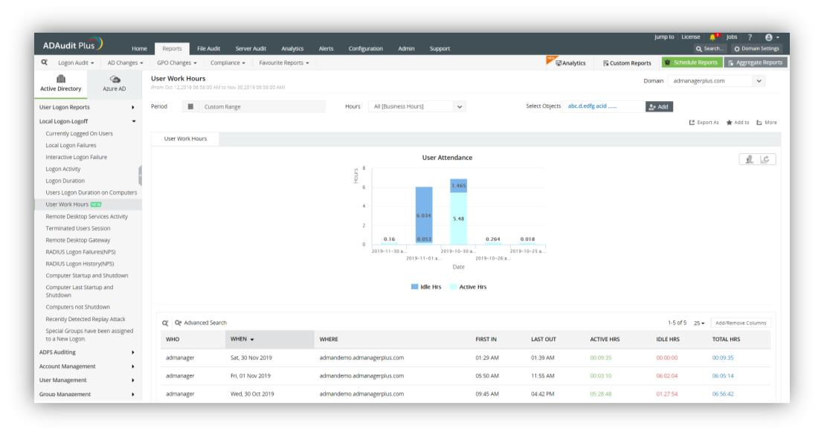
More features our customers love
User work hours monitoring: Track attendance, active hours, idle hours, and productive hours of
employees using any computer within your environment

Slide 21
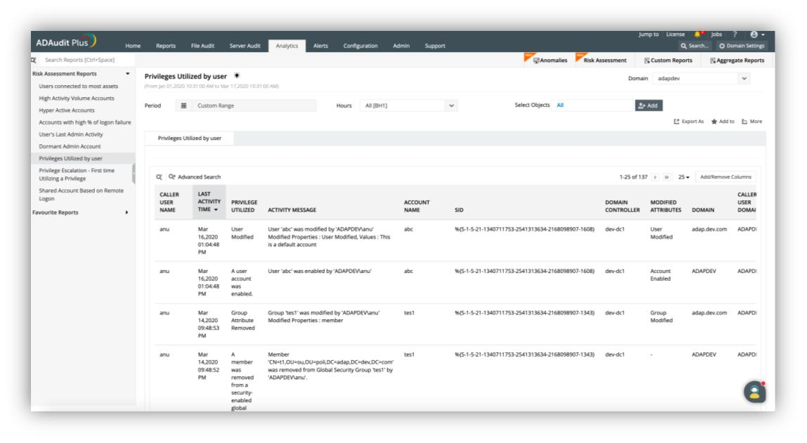
Insider threat detection: Instantly spot insider threat indicators like malicious logins, privilege abuse,
lateral movement, data mishandling, and more

Slide 22
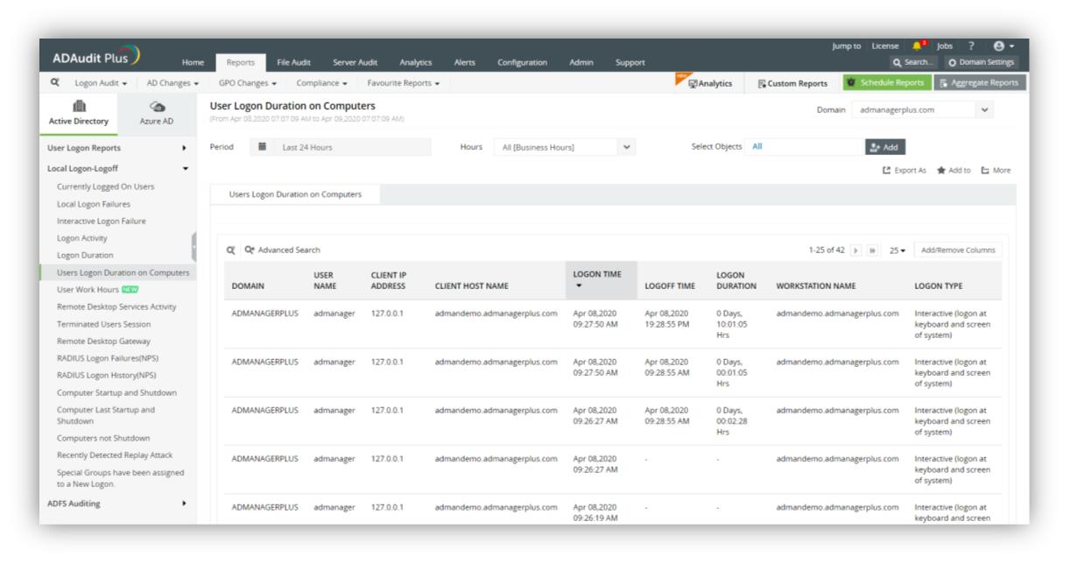
Logon/logoff tracking: Get user-speciﬁc information on logon and logoff actions, see which users are
logged on to multiple computers, and view the IP addresses and logon times

Slide 23
Why ADAudit Plus stands out
Instant alerts: Receive instant email and SMS notiﬁcations about critical events or activities by a critical user
Threat detection and response: The UBA engine quickly detects privilege abuse, insider attacks, malware,
and other threats, and executes tailor-made responses
Over 250 reports: Streamline compliance with multiple regulations, including PCI DSS, HIPAA, SOX, GDPR,
GLBA, ISO 27001, and more with audit-ready reports
Log archiving and forensic analysis: Archive audit data at a user-deﬁned location, and generate reports
based on it when needed
Top-notch customer support team: Our efﬁcient support team is only an email, phone call, or chat away

Slide 24
Supported platforms
DC and member server auditing | File auditing | Other components
Windows Server versions: 2003/2003 R2 | Windows ﬁle server auditing: Server 2003 and above | AD FS auditing: AD FSꢀ2.0 andꢀabove
2008/2008 R2 | EMC auditing: VNX, VNXe, Celerra, Unity, Isilon | Workstation auditing: Windowsꢀ10, 8, 7, Vista, andꢀXP
2012/2012 R2 | Synology auditing: DSM 5.0 and above | PowerShell auditing: PowerShell version 4.0, 5.0ꢀ
2016/2016 R2 | NetApp Filer auditing: Data ONTAP 7.2 and above
2019 | NetApp Cluster auditing: Data ONTAP 8.2.1 and above
DC and member server auditing
Other components

Slide 25
Available editions
Standard
Standard | Professional | Free
Reports and alerts on event log data collected from the below licensed components: | Includes all the features of the standard edition, along with:
Domain controllers Azure AD tenants Windows servers Workstations Windows ﬁle servers Synology NAS servers NetApp ﬁlers Huawei file storage Hitachi NAS storage
Professional
Free
Includes all the features of the
professional editionꢀfor 30 days
from the date of installation.
It also:
Account lockout analysis
Group Policy setting change tracking
Never expires
Before and after values of AD
object/attribute changes
Provides audit reports for
up to 25 workstations
AD permission change auditing
DNS change tracking
Allows report generation
for event log data collected
during the evaluation/
license period
AD schema and conﬁguration
change tracking, etc.

Slide 26
Licensing details
ADAudit Plus' licensing for the Active Directory Auditing component is based on the number of domain controllers.
Other add-ons are based on the number of:
Azure AD tenants
File servers
EMC ﬁle servers/NetApp Filers/Synology NAS servers/ Huawei NAS/ Hitachi NAS servers
Member servers
Workstations

Slide 27
Evaluation assistance
There are a number of ways we can help youduring your evaluation of ADAudit Plus. These include:
A fully-functional 30-day free trial
Extension of evaluation license, if needed
24x5 technical support and guided demo options
A live demo hosted at demo.adauditplus.com
Detailed installation and configuration guides
An extensive knowledge base

Slide 28

Nine of every ten Fortune 100 companies
trust us to manage their IT

Slide 29
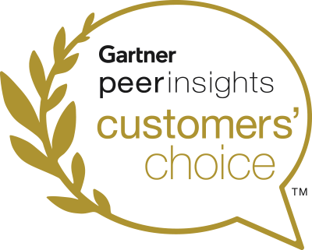
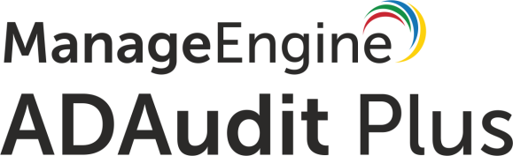
And we have the credentials to prove it
ADAudit Plus was named a 2019 Gartner Peer Insights Customer's Choice for SIEM

Slide 30


In their own words
A good web based and cost effective solution. We like the auditing option on
NetApp Filer. Also, it has partially to do with our satisfaction with other products that
ManageEngine has excelled in.
Ricky Chand
Systems Engineer, Bank of South Paciﬁc, Fiji
Prior to ADAudit Plus, we had no visibility into our AD infrastructure. Now we’re able
to monitor all AD transactions as far as group changes, User creation, security,
authentication logs and much more.
Callixtus Muanya,
Windows administrator, Harvard Medical School
Read more of our customers' testimonials here.

Slide 31
Contact details
Telephone
Email the support team
Visit our website
+1-925-924-9500
support@adauditplus.com
www.adauditplus.com
Mailing address
ZOHO Corporation 4141 Hacienda Drive, Pleasanton, CA 94588, USA
Get a fully-functional, 30-day free trial
Download now

