Slide 1
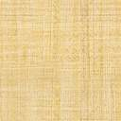


Faculty Connect
Foundations of Data Analysis for Business
June 22, 2021: Cluster Analysis

Slide 2
Live Session Reminders
To have the best session experience possible remember to:
Log in using your Northeastern credentials. This will give you full access to the chat and other meeting activities.
Cameras on! It is easier to build connections when you can see who you’re working with. Please keep cameras on during whole group and breakout room activities.
Open and download the materials affiliated with this session. In Teams go to Live Sessions→ Files→ Week # Materials (Date).

Slide 3
Checking In
How was the Regression analysis?
What were some of the challenges?
What are your observations?

Slide 4



Course Outline
Part 1
Part 2
Part 3
Python & Data Science
3 weeks
Statistics
1 week
Predictive Analytics
3 weeks

Slide 5

Course Outline
Part 1
Part 2
Part 3
Python & Data Science
3 weeks
Statistics
1 week
Predictive Analytics
3 weeks
Simple OLS Regression
Multivariate OLS Regression
Cluster Analysis

Slide 6
Course Outline
Part 1
Part 2
Part 3
Python & Data Science
3 weeks
Statistics
1 week
Predictive Analytics
3 weeks
Simple OLS Regression
Multivariate OLS Regression
Cluster Analysis

Slide 7
Concepts
Unsupervised Learning
Let the Data do the Talking
Group by Cluster

Slide 8

Project Deliverables

Slide 9
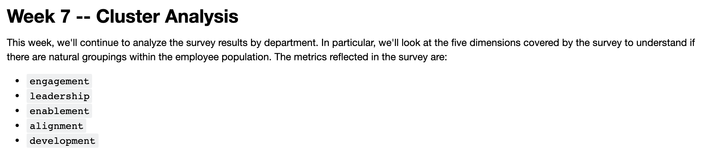
Project Deliverable

Slide 10
Live Session

Slide 11
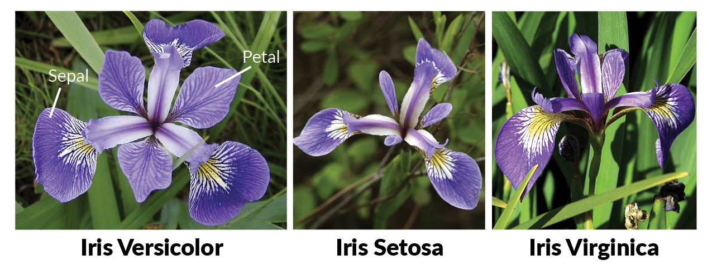
Iris Dataset
The Iris dataset was used in R.A. Fisher's classic 1936 paper, The Use of Multiple Measurements in Taxonomic Problems, and can also be found on the [UCI](https://archive.ics.uci.edu/ml/datasets/iris) Machine Learning Repository.
It includes three iris species with 50 samples each as well as some properties about each flower. One flower species is linearly separable from the other two, but the other two are not linearly separable from each other.
We will perform a cluster analysis on this dataset.

Slide 12
Steps
Step | Deliverable | Format
1 | Load & inspect | Demonstrate Loading
2 | Correlation Analysis | Breakouts / Demonstrate
3 | K-Means Clustering | Demonstrate
4 | Evaluate Results | Demonstrate
4 | Hierarchical Clustering | Demonstrate
5 | Evaluate Results | Breakouts / Demonstrate
6 | Assessment | Discussion

Slide 13
Exit Poll
I feel comfortable applying cluster analysis:
Strong Disagree
Disagree
Neutral
Agree
Strongly Agree

Slide 14
Questions?

