Slide 1
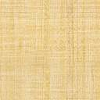


Faculty Connect
Foundations of Data Analysis for Business
June 22, 2021: Cluster Analysis

Slide 2
Live Session Reminders
To have the best session experience possible remember to:
Log in using your Northeastern credentials. This will give you full access to the chat and other meeting activities.
Cameras on! It is easier to build connections when you can see who you’re working with. Please keep cameras on during whole group and breakout room activities.
Open and download the materials affiliated with this session. In Teams go to Live Sessions→ Files→ Week # Materials (Date).

Slide 3
Checking In
How was the Regression analysis?
What were some of the challenges?
What are your observations?

Slide 4



Course Outline
Part 1
Part 2
Part 3
Python & Data Science
3 weeks
Statistics
1 week
Predictive Analytics
3 weeks

Slide 5

Course Outline
Part 1
Part 2
Part 3
Python & Data Science
3 weeks
Statistics
1 week
Predictive Analytics
3 weeks
Simple OLS Regression
Multivariate OLS Regression
Cluster Analysis

Slide 6
Course Outline
Part 1
Part 2
Part 3
Python & Data Science
3 weeks
Statistics
1 week
Predictive Analytics
3 weeks
Simple OLS Regression
Multivariate OLS Regression
Cluster Analysis

Slide 7
Concepts
Unsupervised Learning
Let the Data do the Talking
Group by Cluster

Slide 8
More Concepts
Normalize Data
Z-Score
K-Means
Distance
Number of Clusters
Hierarchical Clustering
Top Down
Bottom Up

Slide 9
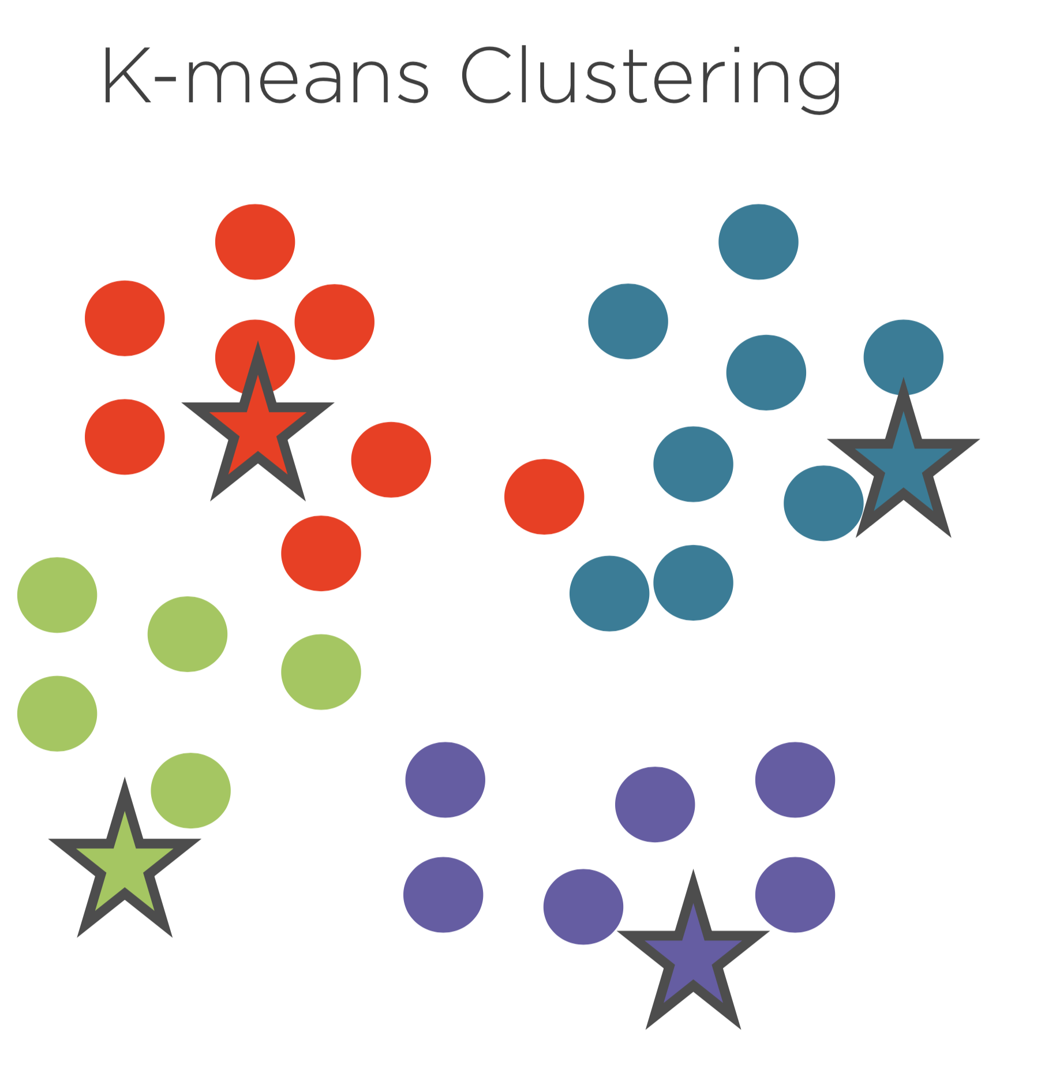
K-Means
Between Clusters
Maximize Distance
Within Clusters
Minimize Distance
Key Concepts
Centroids
Euclidean Distance

Slide 10
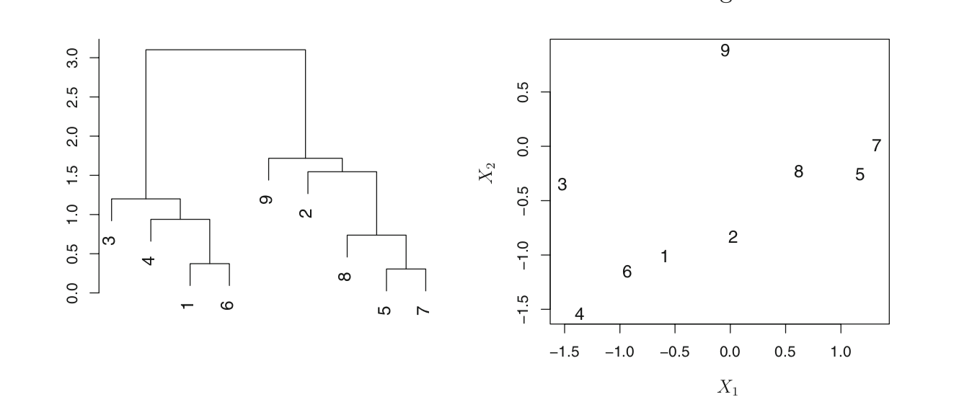
Hierarchical Clustering
Dendrogram
Measurement Space
James, Witten, Hastie, Tibshirani; An Introduction to Statistical Learning; Springer, 2017, Page 393

Slide 11
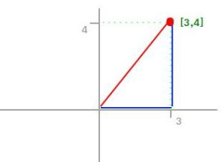
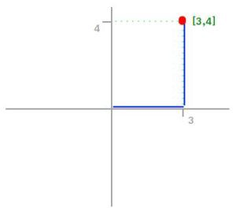
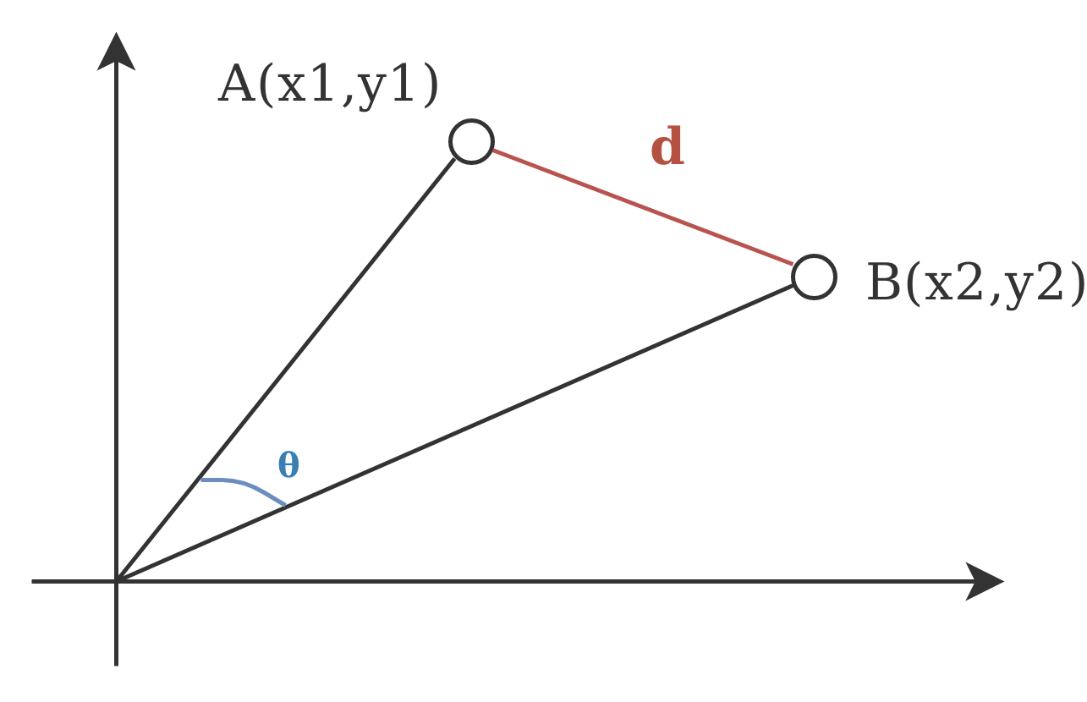


Common Measures of Distance
Euclidean Distance
Straight Line
Manhattan Distance
City Blocks
Cosine Distance
Angular Distance
https://montjoile.medium.com/l0-norm-l1-norm-l2-norm-l-infinity-norm-7a7d18a4f40c

Slide 12
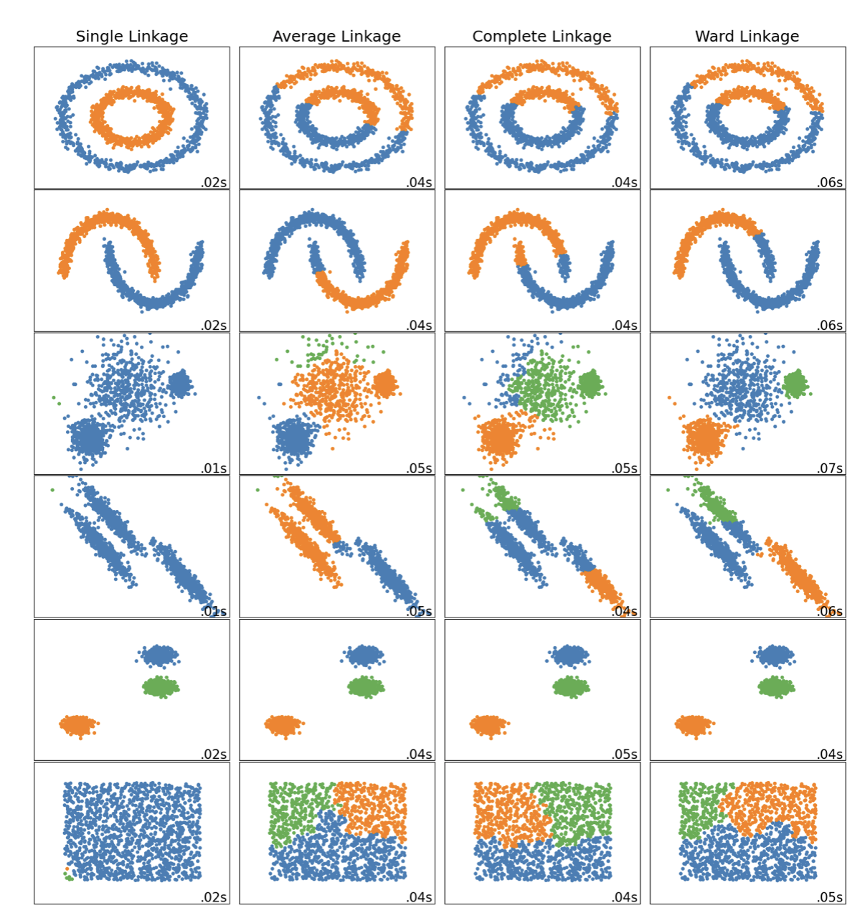
Linkage
Distance between groups of observations
Ward
Minimize sum of squared differences within clusters
Complete
Minimize maximum of distances between pairs
Average
Minimize average of distances between all points
Single
Minimize distance between closest observations from a pair of clusters

Slide 13
Assessment
Measures To Be Used with Labeled Data
Homogeneity
Within Cluster Accuracy
Similar to Precision
Value between 0 and 1
Completeness
All members of a class should be within the same cluster
V-Measure
Harmonic Mean of the two

Slide 14
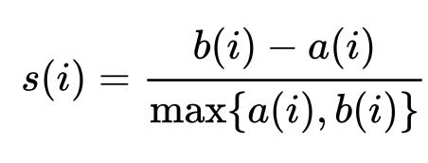
Assessment
Without Labeled Data
Silhouette Score
b(i) is the distance between clusters
a(i) is the distance within clusters

Slide 15

Project Deliverables

Slide 16
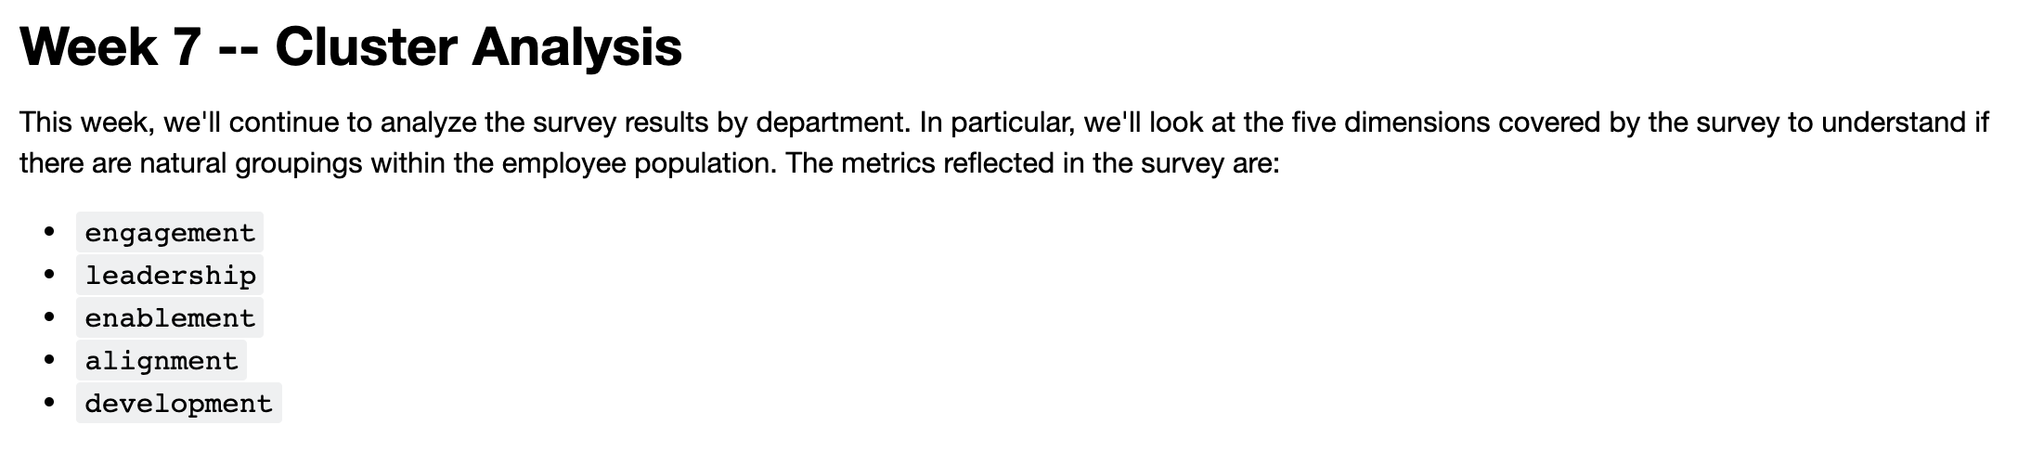
Project Deliverable

Slide 17
Live Session

Slide 18
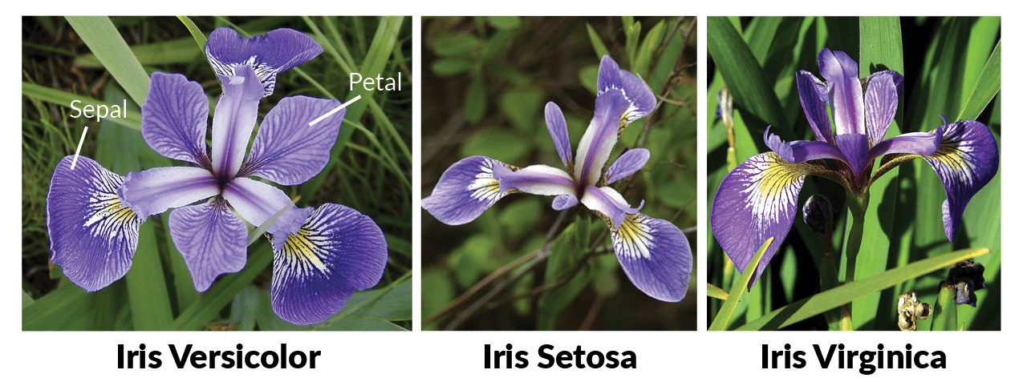
Iris Dataset
The Iris dataset was used in R.A. Fisher's classic 1936 paper, The Use of Multiple Measurements in Taxonomic Problems, and can also be found on the [UCI](https://archive.ics.uci.edu/ml/datasets/iris) Machine Learning Repository.
It includes three iris species with 50 samples each as well as some properties about each flower. One flower species is linearly separable from the other two, but the other two are not linearly separable from each other.
We will perform a cluster analysis on this dataset.

Slide 19
Steps
Step | Deliverable | Format
1 | Load & inspect | Demonstrate Loading
2 | Correlation Analysis | Breakouts / Demonstrate
3 | K-Means Clustering | Demonstrate
4 | Evaluate Results | Demonstrate
4 | Hierarchical Clustering – Ward Linkage | Demonstrate
5 | Hierarchical Clustering – Complete, Average, Single | Breakouts / Demonstrate
6 | Assessment | Discussion

Slide 20
Exit Poll
I feel comfortable applying cluster analysis:
Strong Disagree
Disagree
Neutral
Agree
Strongly Agree

Slide 21
Questions?

