Slide 1



Faculty Connect
Foundations of Data Analysis for Business
May 11, 2021: NumPy and Pandas

Slide 2
Live Session Reminders
To have the best session experience possible remember to:
Log in using your Northeastern credentials. This will give you full access to the chat and other meeting activities.
Join the Teams desktop app instead of the browser version.
Connect your audio and video from the same source. Logging in with your computer video but phone audio will prevent you from joining breakout rooms.
Open and download the materials affiliated with this session. In Teams go to Events→ Files→ Week # Materials (Date).

Slide 3
Learning Elements
Asynchronous Content
LoanTronic Project
Live Sessions
Office Hours
Skills Portfolio

Slide 4
How was the bootcamp?
Anaconda installed?
Jupyter notebook OK?
Comfortable with Python?

Slide 5



Course Outline
Part 1
Part 2
Part 3
Python & Data Science
3 weeks
Statistics
1 week
Predictive Analytics
3 weeks

Slide 6

Course Outline
Part 1
Part 2
Part 3
Python & Data Science
3 weeks
Statistics
1 week
Predictive Analytics
3 weeks
NumPy & Pandas
Cleaning & Wrangling
Visualization

Slide 7

Course Outline
Part 1
Part 2
Part 3
Python & Data Science
3 weeks
Statistics
1 week
Predictive Analytics
3 weeks
NumPy & Pandas
Cleaning & Wrangling
Visualization

Slide 8
Project Deliverable
Week 1: Load and Clean Data
Summary
The first assignment is to load and clean the data. Your data consists of two different files:
questions.csv
responses.csv
These files are straight from the client and were not scrubbed for consistency. Each file has its own risks of problems. The questions will guide you through the process of cleaning the data.

Slide 9
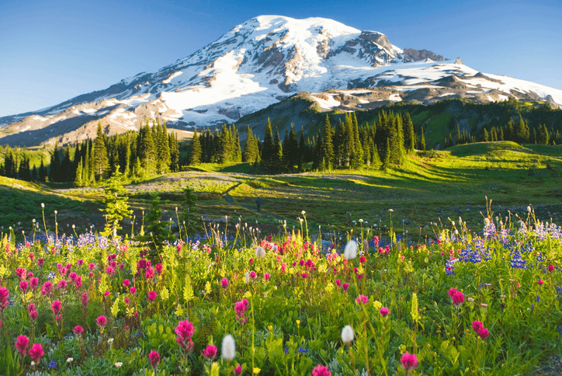

Live Session Example
Mount Rainier Weather Data

Slide 10
Steps
Step | Deliverable | Format
1 | Load & inspect the dataset | Demonstrate / <optional tech support breakouts>
2 | Identify the Problem | Breakouts + Share
3 | Group By Year & Month + Plot | Demonstrate
4 | Compute Average of Max and Min Temp / day | Demonstrate + Breakout to compute range

Slide 11

Questions?

