Slide 1



Faculty Connect
Foundations of Data Analysis for Business
May 18, 2021: Cleaning and Wrangling

Slide 2
Live Session Reminders
To have the best session experience possible remember to:
Log in using your Northeastern credentials. This will give you full access to the chat and other meeting activities.
Cameras on! It is easier to build connections when you you can see who you’re working with. Please keep cameras on during whole group and breakout room activities.
Open and download the materials affiliated with this session. In Teams go to Live Sessions→ Files→ Week # Materials (Date).

Slide 3
Checking In
Thoughts on the course materials?
Dataquest other?
Comfort with python?
Increasing?
Thoughts on Loan Tronic Project
Project #1?
How much effort?

Slide 4



Course Outline
Part 1
Part 2
Part 3
Python & Data Science
3 weeks
Statistics
1 week
Predictive Analytics
3 weeks

Slide 5

Course Outline
Part 1
Part 2
Part 3
Python & Data Science
3 weeks
Statistics
1 week
Predictive Analytics
3 weeks
NumPy & Pandas
Cleaning & Wrangling
Visualization

Slide 6

Course Outline
Part 1
Part 2
Part 3
Python & Data Science
3 weeks
Statistics
1 week
Predictive Analytics
3 weeks
NumPy & Pandas
Cleaning & Wrangling
Visualization

Slide 7
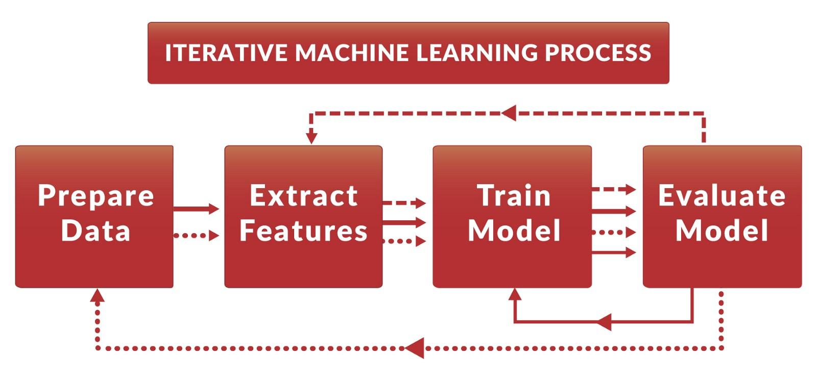
Cleaning Data
Data Science is iterative
https://www.kdnuggets.com/2017/05/data-version-control-iterative-machine-learning.html

Slide 8

Live Session

Slide 9

NASDAQ Cross
NASDAQ Market Opens and closes with Auctions
with a two sided auction for every stock
The Opening Auction
Orders are accepted when the system opens
Imbalance Messages Published at 9:28 Eastern
Market makers offer liquidity
Market Opens at 9:30
The Closing Auction
Orders are accepted when the system opens
Imbalance Messages Published at 15:50 Eastern
Market makers offer liquidity
Market Closes at 16:00
https://data.nasdaq.com/pdf/noii_support.pdf

Slide 10
Steps
Step | Deliverable | Format
1 | Load & inspect the dataset | Demonstrate Loading
2 | Identify Issues | Breakouts + Share
3 | Fix Issues | Demonstrate
4 | Inspect | Breakout for Top 10 Largest at Open and Close Share + Do Rest Together

Slide 11
Project Deliverables

Slide 12
Project Deliverable
Week 2: Load and Clean Data
Summary
This week, you will continue cleaning data. The new data is:
roster.csv
This file is maintained by multiple LoanTronic employees. Unfortunately, no one has stepped up to clean and maintain this file. You are likely to find multiple issues and you’ll need to clean these for us to do our work.

Slide 13
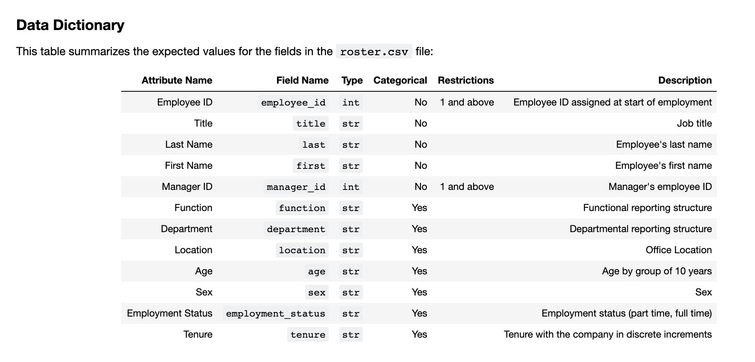
Data Dictionary
Describes All Fields in a Dataset

Slide 14
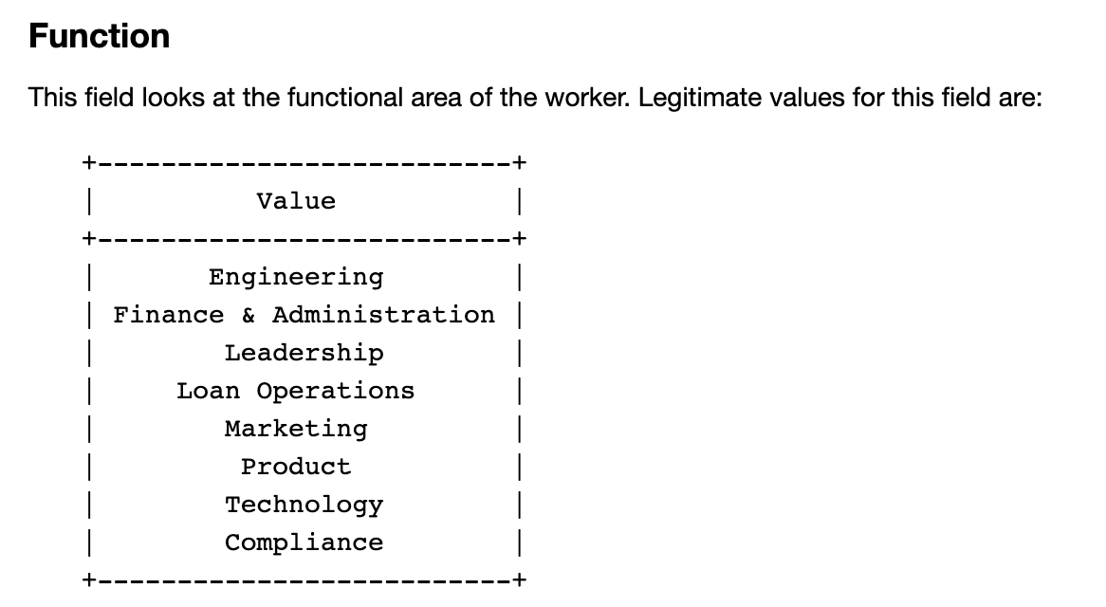
Data Dictionary (2)
Allowable values

Slide 15
Questions?

