Slide 1



Faculty Connect
Foundations of Data Analysis for Business
May 25, 2021: Merge & Visualize Data

Slide 2
Live Session Reminders
To have the best session experience possible remember to:
Log in using your Northeastern credentials. This will give you full access to the chat and other meeting activities.
Cameras on! It is easier to build connections when you can see who you’re working with. Please keep cameras on during whole group and breakout room activities.
Open and download the materials affiliated with this session. In Teams go to Live Sessions→ Files→ Week # Materials (Date).

Slide 3
Checking In
How much time cleaning roster.csv?
Below 2 hours?
2 to 4 hours?
4 to 6 hours?
More than 6 hours?
What were some of the challenges
Comfort with Python?
Increasing?
Steady?

Slide 4



Course Outline
Part 1
Part 2
Part 3
Python & Data Science
3 weeks
Statistics
1 week
Predictive Analytics
3 weeks

Slide 5

Course Outline
Part 1
Part 2
Part 3
Python & Data Science
3 weeks
Statistics
1 week
Predictive Analytics
3 weeks
NumPy & Pandas
Cleaning & Wrangling
Visualization

Slide 6

Course Outline
Part 1
Part 2
Part 3
Python & Data Science
3 weeks
Statistics
1 week
Predictive Analytics
3 weeks
NumPy & Pandas
Cleaning & Wrangling
Visualization

Slide 7




Visualization
Multiple Tools
Matplotlib (built into Pandas)
Seaborn
Plotly
Bokeh

Slide 8

Project Deliverables

Slide 9
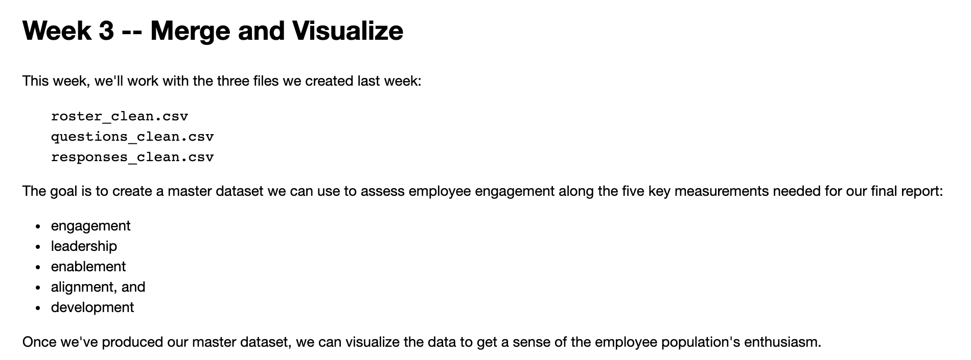
Project Deliverable

Slide 10
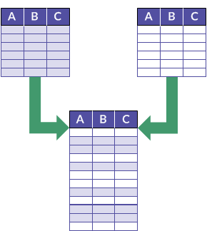
Merging Data (1)
Same columns
Need to append rows

Slide 11
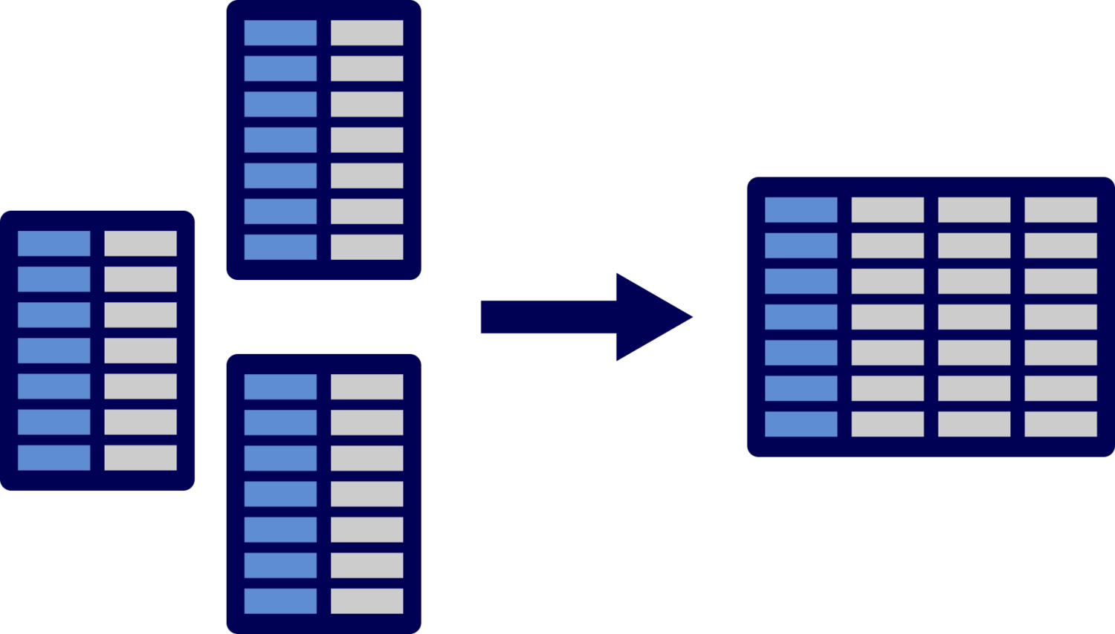
Merging Data (2)
Same key adds columns to data

Slide 12
Live Session

Slide 13

COVID-19 Dataset
We’ve all been getting exposed to COVID data over the last year. Arguably, the U.S. population has become much more data-literate as a result. We’ve all become familiar with flattening the curve, 7 day moving averages, and other metrics.
Here we will merge data from the CDC and the U.S. Census Bureau. The goal is to produce plots that show cases over time and cases per capita.

Slide 14
Steps
Step | Deliverable | Format
1 | Load, inspect, and plot U.S. CDC Data | Demonstrate Loading
2 | Produce Massachusetts Plot | Breakouts + Share
3 | Load and inspect Census Data | Demonstrate
4 | Merge Data – Highlight Challenges | Breakouts + Share
5 | Making It Work | Demonstrate
6 | Produce Box Plots | Demonstrate

Slide 15
Exit Poll
I feel ready to take on this week’s project?
Strong Disagree
Disagree
Neutral
Agree
Strongly Agree

Slide 16
Questions?

