Slide 1



Faculty Connect
Foundations of Data Analysis for Business
June 8, 2021: Simple OLS Regression

Slide 2
Live Session Reminders
To have the best session experience possible remember to:
Log in using your Northeastern credentials. This will give you full access to the chat and other meeting activities.
Cameras on! It is easier to build connections when you can see who you’re working with. Please keep cameras on during whole group and breakout room activities.
Open and download the materials affiliated with this session. In Teams go to Live Sessions→ Files→ Week # Materials (Date).

Slide 3
Checking In
The Chi Square test of Likert responses went well:
1 to 5
What were some of the challenges
What are some observations?

Slide 4



Course Outline
Part 1
Part 2
Part 3
Python & Data Science
3 weeks
Statistics
1 week
Predictive Analytics
3 weeks

Slide 5

Course Outline
Part 1
Part 2
Part 3
Python & Data Science
3 weeks
Statistics
1 week
Predictive Analytics
3 weeks
Simple OLS Regression
Multivariate OLS Regression
Cluster Analysis

Slide 6
Course Outline
Part 1
Part 2
Part 3
Python & Data Science
3 weeks
Statistics
1 week
Predictive Analytics
3 weeks
Simple OLS Regression
Multivariate OLS Regression
Cluster Analysis

Slide 7
Concepts
Covariance / Correlation Coefficient
OLS Regression
Machine Learning Process
Residual Analysis

Slide 8

Project Deliverables

Slide 9
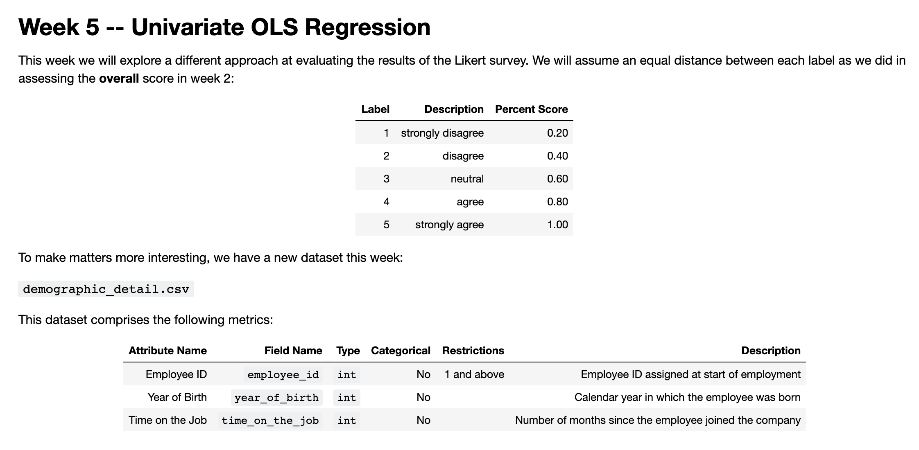
Project Deliverable

Slide 10
Live Session

Slide 11
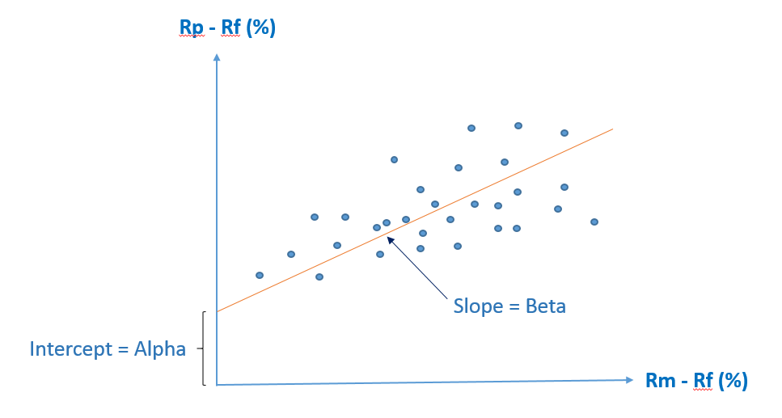
Computing Beta and Alpha
Beta
Beta is a measure of a stock's volatility in relation to the overall market. ... If a stock moves less than the market, the stock's beta is less than 1.0. High-beta stocks are supposed to be riskier but provide higher return potential; low-beta stocks pose less risk but also lower returns.
Alpha
Alpha (α) is a term used in investing to describe an investment strategy's ability to beat the market, or it's "edge." Alpha is thus also often referred to as “excess return” or “abnormal rate of return,” which refers to the idea that markets are efficient, and so there is no way to systematically earn returns that exceed the broad market as a whole.
https://www.investopedia.com/investing/beta-know-risk/
https://www.investopedia.com/terms/a/alpha.asp

Slide 12

Assignment
Let’s compute the beta and alpha for Apple

Slide 13
Steps
Step | Deliverable | Format
1 | Load & inspect | Demonstrate Loading
2 | Merge the data | Breakouts / Demonstrate
3 | Compute Covariance / Correlation | Demonstrate
4 | Run / Evaluate Regression | Demonstrate
5 | Inspect Residuals | Breakouts / Demonstrate
6 | Analysis | Discussion

Slide 14
Exit Poll
I feel comfortable running regressions on my own:
Strong Disagree
Disagree
Neutral
Agree
Strongly Agree

Slide 15
Questions?

