Slide 1



Faculty Connect
Foundations of Data Analysis for Business
June 8, 2021: Multi Variate OLS Regression

Slide 2
Live Session Reminders
To have the best session experience possible remember to:
Log in using your Northeastern credentials. This will give you full access to the chat and other meeting activities.
Cameras on! It is easier to build connections when you can see who you’re working with. Please keep cameras on during whole group and breakout room activities.
Open and download the materials affiliated with this session. In Teams go to Live Sessions→ Files→ Week # Materials (Date).

Slide 3
Checking In
The Simple OLS Regression test of Likert responses went well:
1 to 5
What were some of the challenges?
What are your observations?

Slide 4



Course Outline
Part 1
Part 2
Part 3
Python & Data Science
3 weeks
Statistics
1 week
Predictive Analytics
3 weeks

Slide 5

Course Outline
Part 1
Part 2
Part 3
Python & Data Science
3 weeks
Statistics
1 week
Predictive Analytics
3 weeks
Simple OLS Regression
Multivariate OLS Regression
Cluster Analysis

Slide 6
Course Outline
Part 1
Part 2
Part 3
Python & Data Science
3 weeks
Statistics
1 week
Predictive Analytics
3 weeks
Simple OLS Regression
Multivariate OLS Regression
Cluster Analysis

Slide 7
Concepts
Multicollinearity
Missing Variables
Adjusted R-Square
Residual Analysis

Slide 8

Project Deliverables

Slide 9
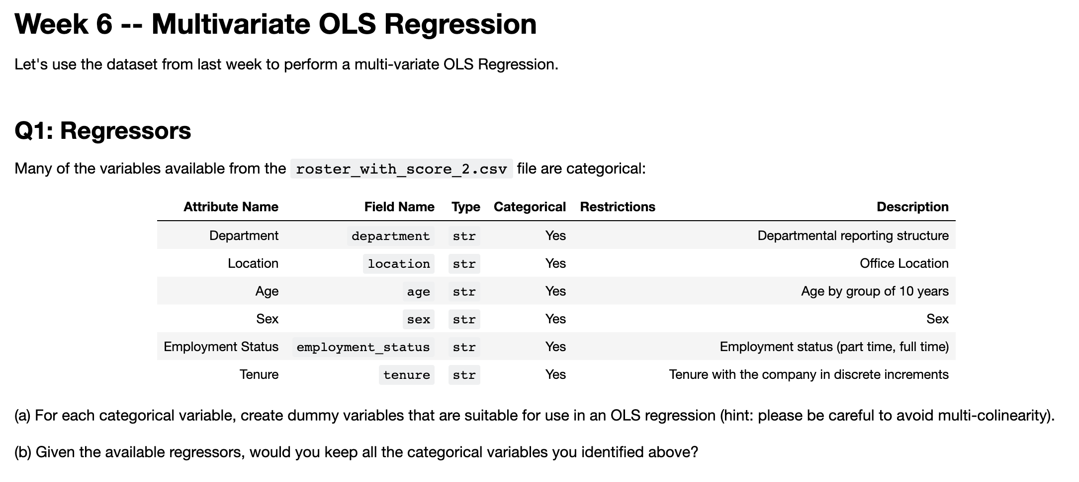
Project Deliverable

Slide 10
Live Session

Slide 11

HR Dataset
We have a simple HR dataset where we are trying to predict salary from a number of variables:
Competence Rating
Sex of the candidate
Sex of the assessor
Age of the assessor
The department the candidate is looking to join: biology, chemistry, or physics

Slide 12
Steps
Step | Deliverable | Format
1 | Load & inspect | Demonstrate Loading
2 | Kitchen Sink Regression | Breakouts / Demonstrate
3 | Identify Issues | Demonstrate
4 | Fix Issues | Breakouts / Demonstrate
5 | Review / Analyze | Discussion

Slide 13
Exit Poll
I feel comfortable running a multi variate regression on my own:
Strong Disagree
Disagree
Neutral
Agree
Strongly Agree

Slide 14
Questions?

