Slide 1

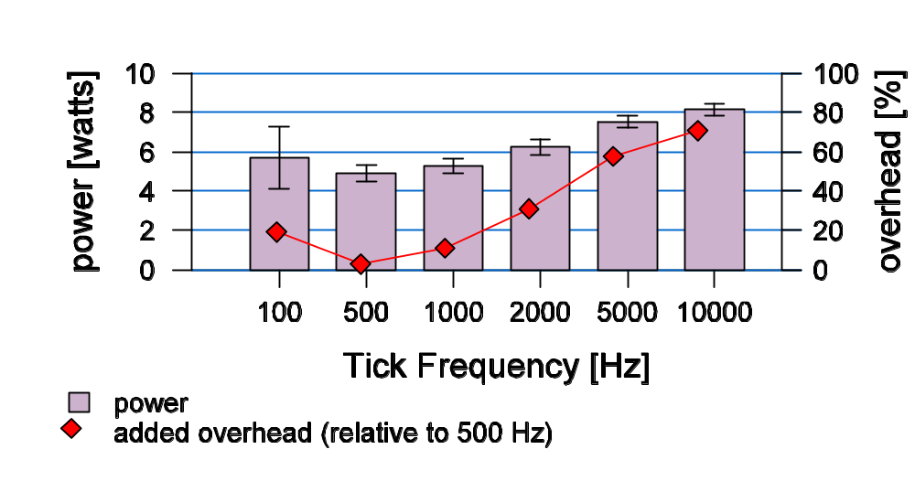
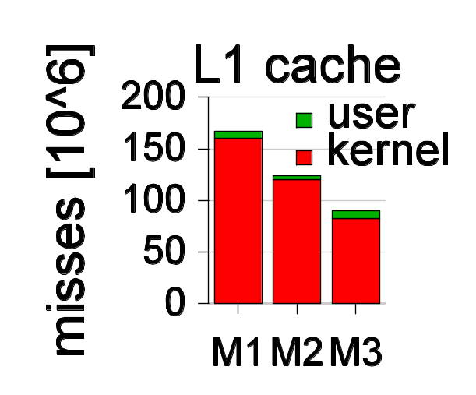
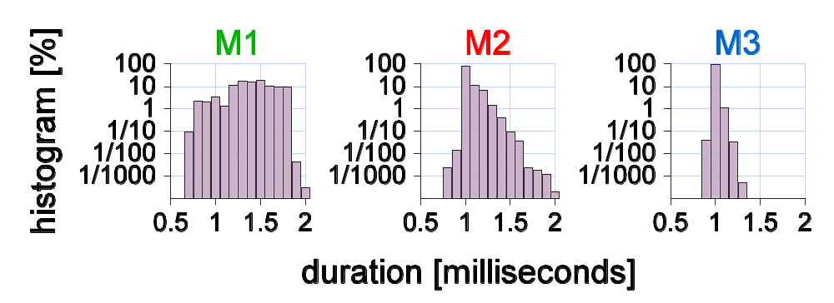
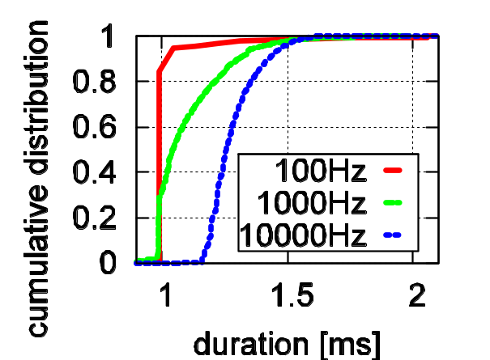
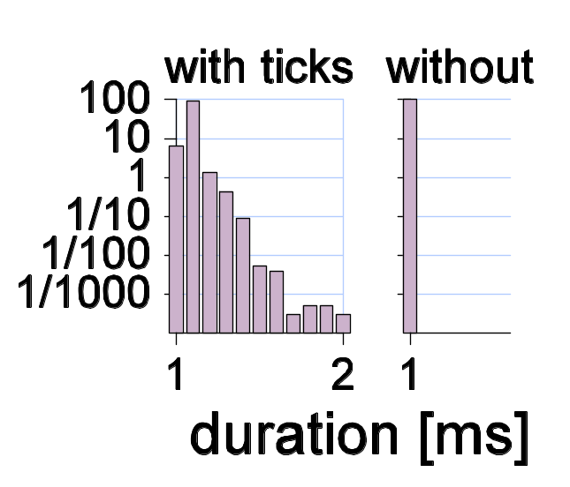
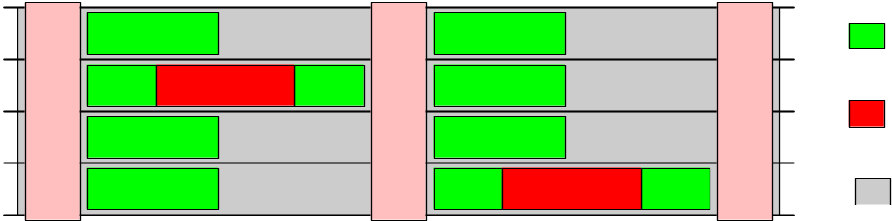
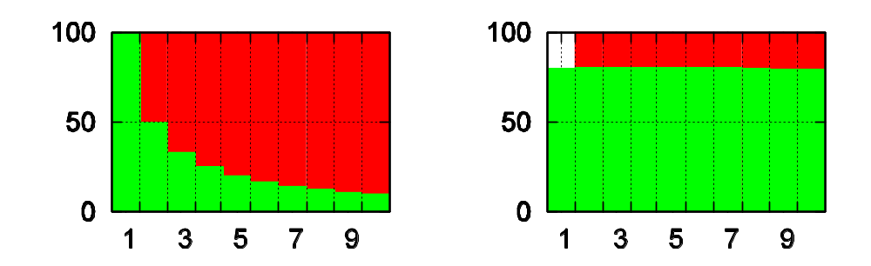

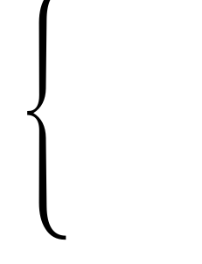
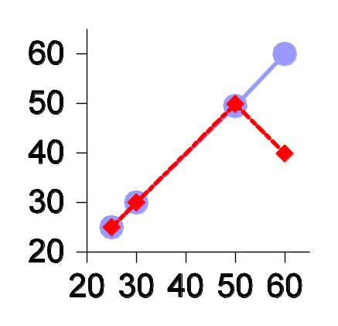
Stop Polling! The Case Against OS Ticks
Dan Tsafrir*, Yoav Etsion and Dror G. Feitelson
The Hebrew University of Jerusalem (*current affiliation: IBM Watson Research Center)
i
Ticks are…
ii
1
Abstract
Unwarranted
power consumption
The general purpose operating system (OS) wakes up HZ times a second
“Tick” = Every time the OS wakes up
All general purpose OSs use ticks as means of maintaining control (see previous panel). The decision to use ticks was made ~40 years ago, in the late 1960s [Dijkstra’s “THE” system, 1968]
Ticks always happen, even if the system is otherwise idle (thus using ticks <=> polling)
Our case: drawbacks of ticks accumulate into a critical mass suggesting it’s time for a change
Our solution: switch to one-shot timers (set only for specific needs) while avoiding the potentially huge overheads they entail to allow general use
This poster presents our case against ticks: many, often surprising, drawbacks; last panel outlines the solution
OS
Windows
Linux2.4
Linux2.6
FreeBSD
power [watt]
overhead [%]
HZ
100
1000
250
1000
every
10ms
1ms
4ms
1ms
tick frequency [Hz]
The role of ticks:
Do alarm signals (movie-player wants to display 50 frames-per-second? Windows will wake it up every 2 ticks; FreeBSD every 20)
2) Do CPU billing (bill current process as if it ran since the last tick, even if it didn’t)
3) Do Context switch (if the quantum of the current process is exhausted)
power
added overhead (relative to 500 Hz)
Measuring power consumption of an idle laptop (with disabled screen and hard disk)
Higher Hz => more tick handling => more power consumption
100Hz is worse than 500Hz, because 100Hz has enough time to complete HALT
2a
2b
2c
Desktop slowdown
Desktop slowdown – evidence
Desktop slowdown – reason
Let’s run an empty-loop that is supposed to take 1 millisecond
Let’s do it a million times, and measure the actual duration each loop takes:
Results are bad (histogram of the ‘time’ array)…
The only activity other than our program is OS interrupts (mostly ticks, some network)
There are lots of cache misses, and they are due to kernel interrupts.
(As in panel 5, weaker machines suffer more)
Indeed, reducing the Hz has a stabilizing effect
Finally, disabling the cache and subtracting interrupts’ direct overhead (from the duration of the loops in which they occurred) reveals all variability is accounted for
L1 cache
misses [10⁶]
user
kernel
M1
M2
M3
for( i = 1 … 10⁶ ) :
start = cycle_counter
for(…) /* one ms work */
;
end = cycle_counter
time[i] = end – start
histogram [%]
M1 M2 M3
duration [milliseconds]
cumulative
distribution
… considering our program is the only process allowed to run while measuring (realtime priority)
Example: M2’s average duration is 1.08 ms
  8% slowdown relative to 1ms, and…
  60% relative to the minimal duration!
duration [ms]
Let’s do it on these machines:
with
ticks
without
processor | ID | clock [MHz] |  | cache [K μops]
 |  | main mem | bus | L2 | L1
 |  |  |  |  | data | code
Pentium-IV-2.4 | M1 | 266 | 533 | 512 | 8 | 12
Pentium-IV-2.8 | M2 | 400 | 800 | 512 | 8 | 12
Pentium-IV-3.0 | M3 | 400 | 800 | 1000 | 16 | 12
histogram
Conjecture by Avi Mendelson [Intel Haifa]:
“durations that are shorter than 1ms might occur because the processor possibly works faster from time to time”…
3
4
5
duration [ms]
Cluster slowdown
Security breach
CPU denial of service
The slowdown penalty is amplified for clusters:
Parallel programs’ structure often dictates that each task repeatedly computes for a short while and then (barrier) synchronizes with it peers
Thus, the duration of each compute-phase is
determined by the task that is late the most:
CPU billing is based on sampling (see panel 1):
If a process runs while a tick takes place
=> the process is billed for the entire tick
We discovered that a “cheater” process can easily escape this sampling (see next panel)
=> it looks as if it consumes 0% CPU !
Thus, a “cheater” won’t show up on CPU-usage monitoring tools (like the UNIX ‘top’ utility)
It’s therefore possible your computer is secretly running nuclear simulations for…
As all general purpose OSs prioritize processes based on their (lack of) CPU consumption, …
The fact a cheater looks as if it uses 0% CPU can be exploited by it to get as much CPU as it wants!
This is true regardless of the number of running processes in the system:
computation
all are honest
one is cheating
barrier n
barrier n+1
barrier n+2
noise
sum of others
processors
wait
CPU [%]
sum of all
the others
one “cheater” (wants and
gets 80%)
time
one process
“Noise” = unrelated OS activity
More processors => greater noise
“The noise law”: we empirically observe and analytically prove that this chance is linearly proportional to the number of processors
Panels 2* show ticks are a major source of noise
total number of (CPU-intensive) processes in the system
The above “works” for many OSs:
Linux
Windows
Solaris
FreeBSD
6
7
fin
Soft realtime & multimedia:
insufficient resolution
Hard realtime:
problematic predictability
The solution
Xine movie player discards 1/3 of its frames due to low res.
This time, 1000Hz was enough
But other apps. require more, and OSs & CPUs can deliver
1000 Hz
Hard-realtime computing requires the execution-time of tasks to be predictable & deterministic
Panels 2a-c show it’s far from it, for very short tasks, due to ticks
The OS can request the hardware to wake it up only when there’s something to do using one-shot timers such as Pentium’s APIC or HPET
But OSs cannot just allow user-processes to use one-shot timers for alarms…
Otherwise, any process would be able to easily bring down the system by generating numerous events with nanosecond differences
We suggest the “smart timers” mechanism that
1) eliminates useless periodic ticking , and
2) provides accurate timing with a settable bound
on alarm latency (equivalent to “HZ”), and
3) reduces overhead by aggregating near-by
events (by HZ alignment or overshoot param.)
This solves all above problems and makes the “general-purpose” OS more general…
achieved
frames/sec.
100 Hz
8
desired frames/sec.
9
Virtual machines overhead
Microkernel complexity
Virtual machines (VMs) are used to multiplex hardware resources between multiple OS instances
Overhead of “virtualized” ticks is obviously bigger
Further, a VM server can be overwhelmed by ticks:
  Example: an IBM S/390 mainframe for which servicing the ticks of multiple idle OSs led to 100% utilization of the physical processor
Microkernels are at the heart of the effort to make computer systems more reliable:
much smaller kernel => much less fatal bugs
Ticks are traditionally part of the microkernel due to overhead considerations (happen too frequently)
Eliminating ticks would means further reduction of the kernel size (e.g. in MINIX-3)

