Slide 1
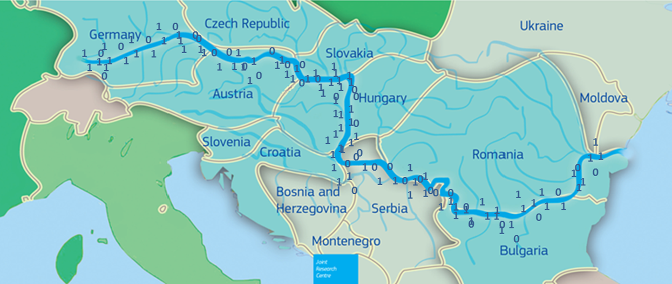
WASTE2FUEL (Biomass optimisation app)
Josip Lisjak
Hrvoje Tomić
Saša Vranić
Tomaš Kliment

Slide 2


Need for the app
DRDSI – study on Citizen Science – lack of data on bioenergy
Relation to ongoing JRC project – complement and support ongoing projects

Slide 3
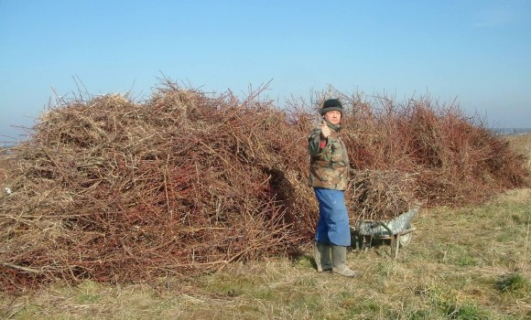
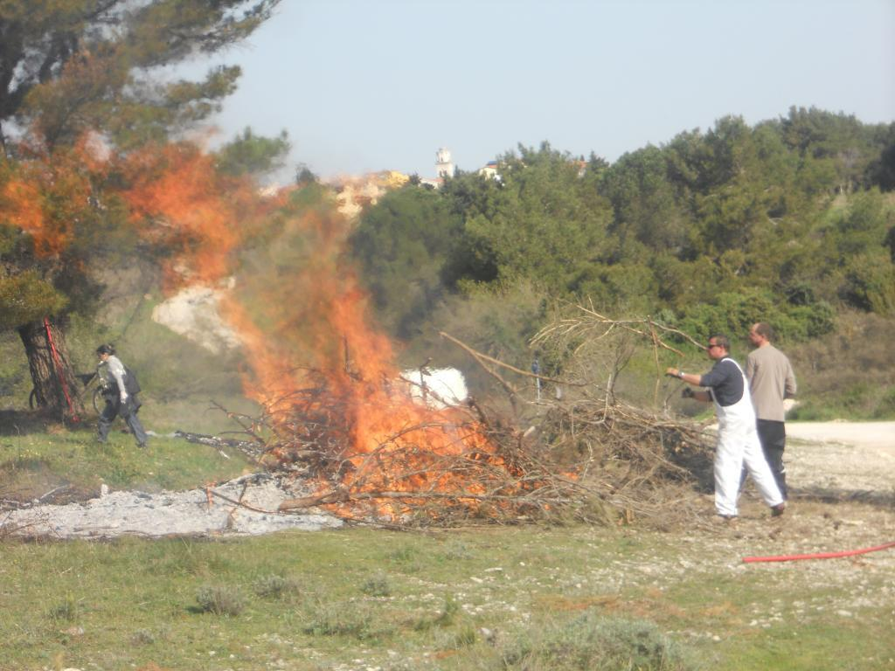
Description - problem
Agriculture region – many vineyards and orchards
Many bio waste after prunning
Many insecure burning activities – pollution from combustion
Additional work for owners

Slide 4
Description – solution
Owners
Collect data on branch piles locations
Using webapp or mobile phone
Biomass producers
See the available biomass location and estimated volume
See the photo and pick up the biomass

Slide 5
Additional functionality
Risk management
Alarm the owner – vicinity of forest
Dataset - CLC

Slide 6
Data and Technology
OpenLayers/Geoserver/PostgreSQL
HTML5, jQuery, Bootstrap
OpenStreetMap
CORINE LC
ARKOD – LPIS
Open Land Use Map
LUCAS
DRDSI platform
New dataset – Biomass sites Citizen Science

Slide 7
Benefits
Institution – helps to close some data gaps and supports ongoing work
Citizens – owners – less work
Industry – biomass producers have more biomass
Community – increased security – less uncontrolled burning activities, less pollution, environment protection – less healthy trees needs to be cut down

Slide 8
https://www.pg.geof.unizg.hr/biomass/

