Slide 1
Copernicus webapp
Client-side raster viewer & calculator
Gergely Padányi-Gulyás

Slide 2

Why?
Free, full and open access to environmental data
Benefits of multispectral images: ANALYSES
Lack of quick web viewer & analyzer

Slide 3



How?
MANGOL web mapping GUI framework
Angular2 + OpenLayers3
TypeScript, SCSS
Responsive
Under heavy development...
New module: Raster calculator

Slide 4

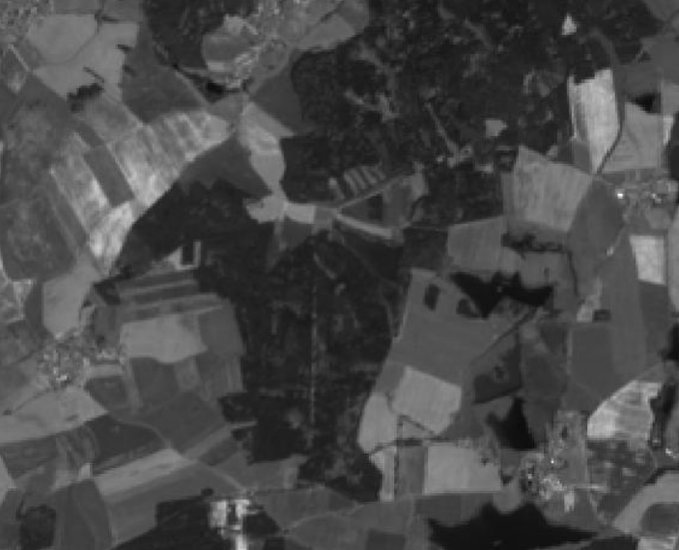
Preprocessing
2 single-band raster images for NDVI calculations
Put in GeoServer as GeoTiff store, create WMS service
Problem:
Data is not normalized
Image painted on canvas (OL3) is RGB
Different brightness with different zoom levels: not representing real values!
Normalizing was necessary (0-255)

Slide 5
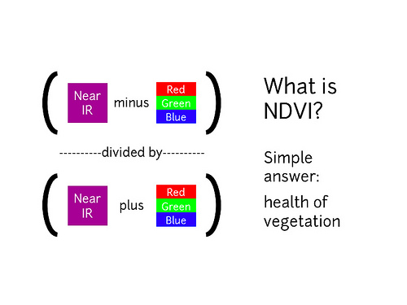
Development
New module: Raster calculator
ol.source.Raster is awesome!
Only one calculation so far: NDVI index (Normalized Difference Vegetation Index)

Slide 6

Results

Slide 7
Future
Add more data
Add more calculations
Some debugging (Firefox issue)

