Slide 1

P2 - Viewer for Stat Data
Coping with the Complexity

Slide 2
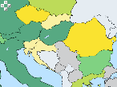
Viewer Mockup
Sources:
Number Asylum Appl.
Add Source
+

Slide 3
Viewer Mockup
Select Measure:
Population
Select Age Classification:
0-20
Select Gender Classification:
Total

Slide 4
Viewer Mockup
Sources:
Number Asylum Appl.
Population, Age[0-20], Gender [Total]
Add Source
+
Define Calculation:

Slide 5
Viewer Mockup
Sources:
Number Asylum Appl.
Population, Age[0-20], Gender [Total]
Add Source
+
Define Calculation:
1. / 2.

Slide 6

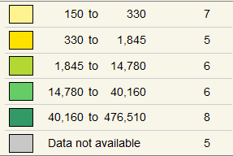
Viewer Mockup
Asylum App / Population <20

Slide 7
Architecture
OGC Services
INSPIRE (WFS):
Statistical Units (SU)
Population Distribution (PD)
Additions:
Simple Feature SU (for WMS)
Simple Feature: Measures for PD
Simple Feature: Classifications for Measure PD
Defined Query: PD by measure and country
Web Viewer - Visualize PD Data by SU:
One Measure
Aggregate Measures, i.e. measure1/measure2
GeoServer
Simplifier: return values for one classification set
PostGIS

Slide 8
Thanks for your attention!
Kathi Schleidt
Kathi@DataCove.eu
Tomas Kliment
Tomas.Kliment@gmail.com
Christoph Fink
Christoph.Fink@gmail.com

