Slide 1

Copernicus Hackathon
@ Danube Hack 2018
Light pollution modeling
Urban vegetation changes based on Sentinel 2 data
Mgr. Martin Gális
Ing. Jozef Nováček
Mgr. Peter Pastorek

Slide 2
Copernicus Hackathon @ Danube Hack 2018
Inputs
EU DEM 1.1 - Coperniucs Land Service 25m, ETRS89 LAEA
OSM Building (filtered by their purpose) cca 55000 features
Building types included: without defined type, apartments, barn, cabin, commercial, detached, farm, farm_auxiliary, hotel, house, hut, industrial
public, residential, retail, service, shed, train_station, trasnportation, University, warehouse
Building types excluded: chapel, church, construction, garage (most common defined type :)), kindergarden, roof, ruins, school, transformer_tower
Sentinel 2A data
Band 2, Band 3, Band 4, Band 8

Slide 3
Copernicus Hackathon @ Danube Hack 2018
Processing
1. OSM building layer preparation (tst area crop, building filtering)
2. Light source point layer creation 2m heigh,10km radius (experimental script Qgis)
2m light source height (1 floor buildings) - h0
10km radius (short radius because of processing power)
0.13 atmospheric refraction (default value)
Earth curvature included in the script
3. Visual analysis script (experimental script Qgis)
Output :)

Slide 4
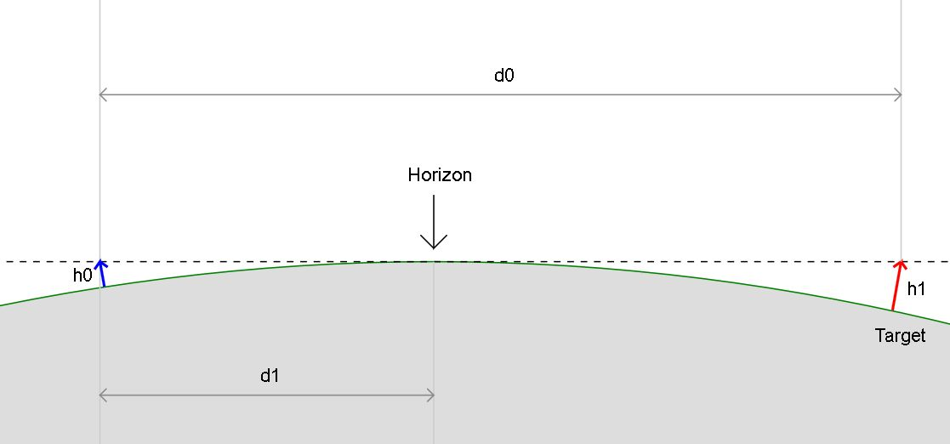
Copernicus Hackathon @ Danube Hack 2018

Slide 5
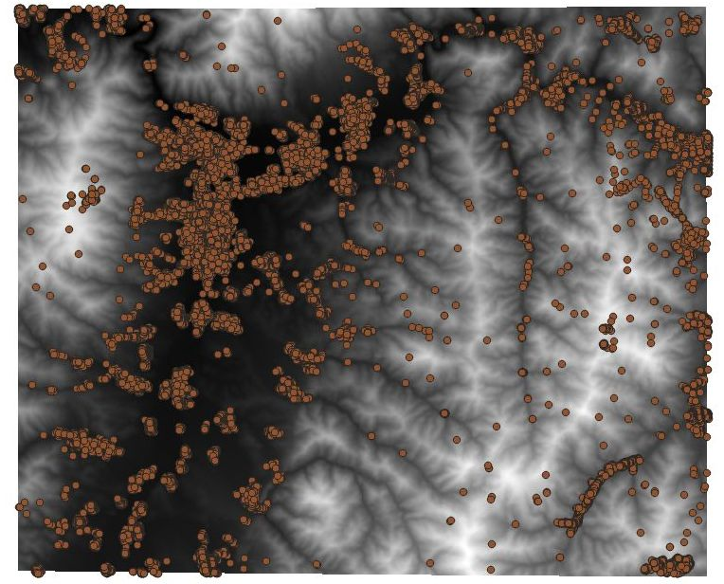
Copernicus Hackathon @ Danube Hack 2018
Input data
EU DEM
OSM Buildings

Slide 6
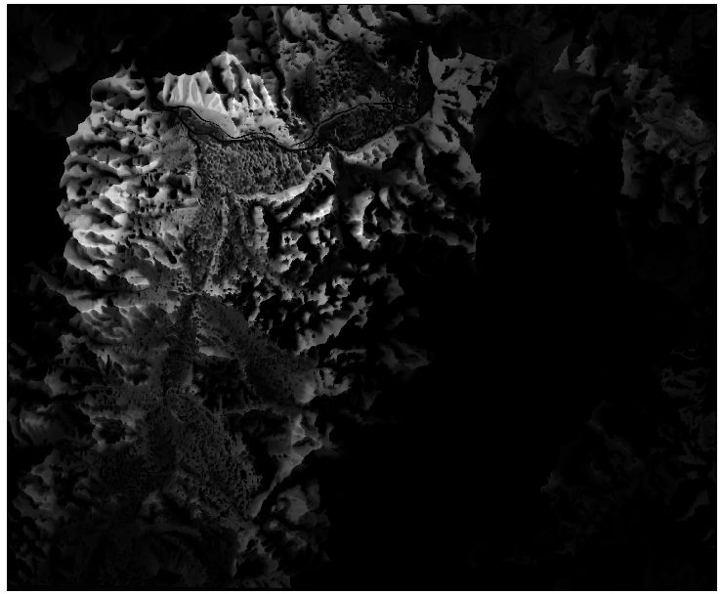
Copernicus Hackathon @ Danube Hack 2018
Output
Light pollution

Slide 7
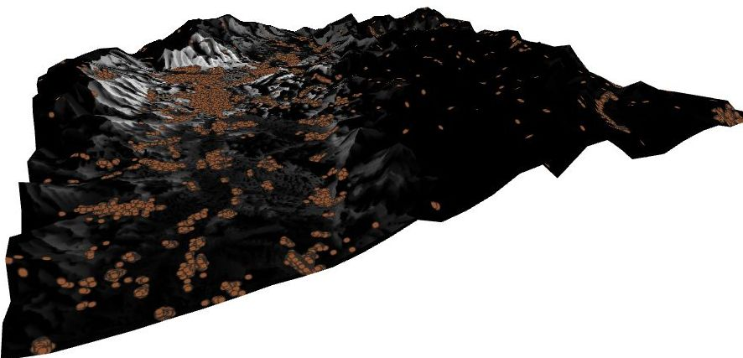
Copernicus Hackathon @ Danube Hack 2018

Slide 8
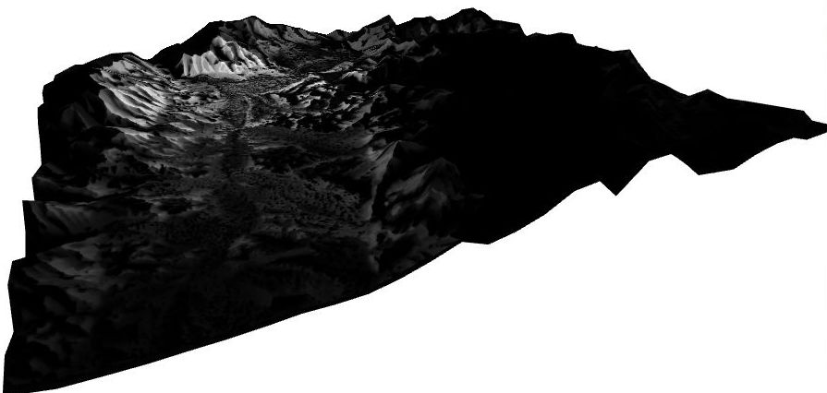
Copernicus Hackathon @ Danube Hack 2018

Slide 9
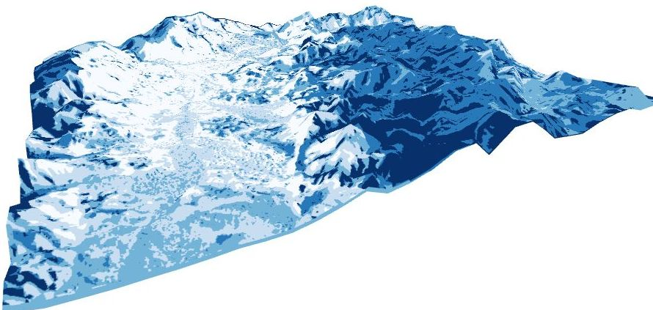
Copernicus Hackathon @ Danube Hack 2018

Slide 10
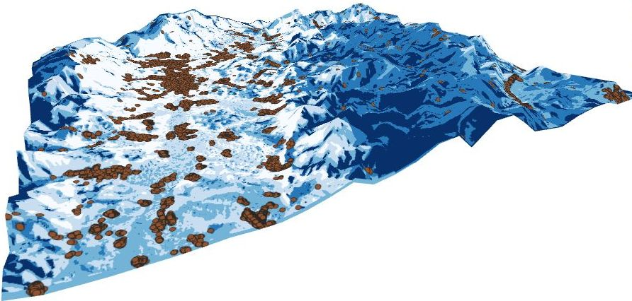
Copernicus Hackathon @ Danube Hack 2018

Slide 11
Copernicus Hackathon @ Danube Hack 2018
Possible future enhancements
better sources of local inputs (streetlight etc.)
different heights of local imputs (higher objects have more range)
landcover data based on S2 data (vegetation height and density parameter)
fulltime/partime light polution sources classification
atmospheric refraction change according to weather conditions
Potential USAGE
Nature protection (inpact of light polution on small animals, definiton of biocenters)
Tourism (sky observation, wilderness hiking)

Slide 12
Copernicus Hackathon @ Danube Hack 2018
Possible future enhancements
better sources of local inputs (streetlight etc.)
different heights of local imputs (higher objects have more range)
landcover data based on S2 data (vegetation height and density parameter)
fulltime/partime light polution sources classification
atmospheric refraction change according to weather conditions
Potential USAGE
Nature protection (inpact of light polution on small animals, definiton of biocenters)
Tourism (sky observation, wilderness hiking)

Slide 13
Copernicus Hackathon @ Danube Hack 2018
Possible future enhancements
better sources of local inputs (streetlight etc.)
different heights of local imputs (higher objects have more range)
landcover data based on S2 data (vegetation height and density parameter)
fulltime/partime light polution sources classification
atmospheric refraction change according to weather conditions
Potential USAGE
Nature protection (inpact of light polution on small animals, definiton of biocenters)
Tourism (sky observation, wilderness hiking)

Slide 14
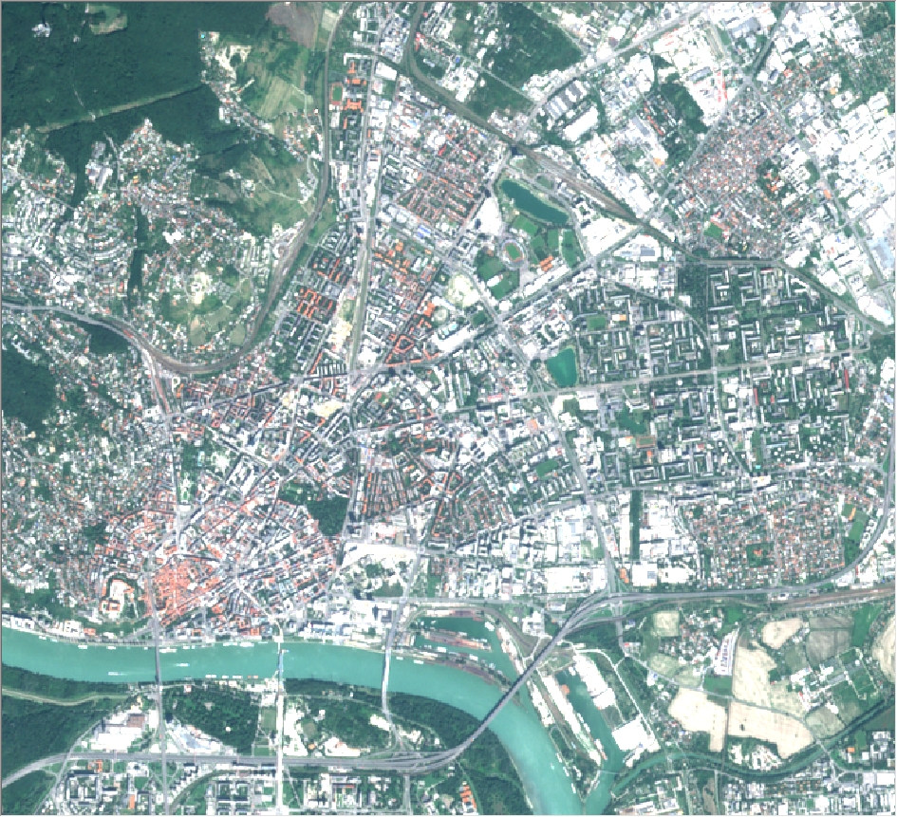
Copernicus Hackathon @ Danube Hack 2018
RGB
2016 Sentinel 2A
B4,B3,B2

Slide 15
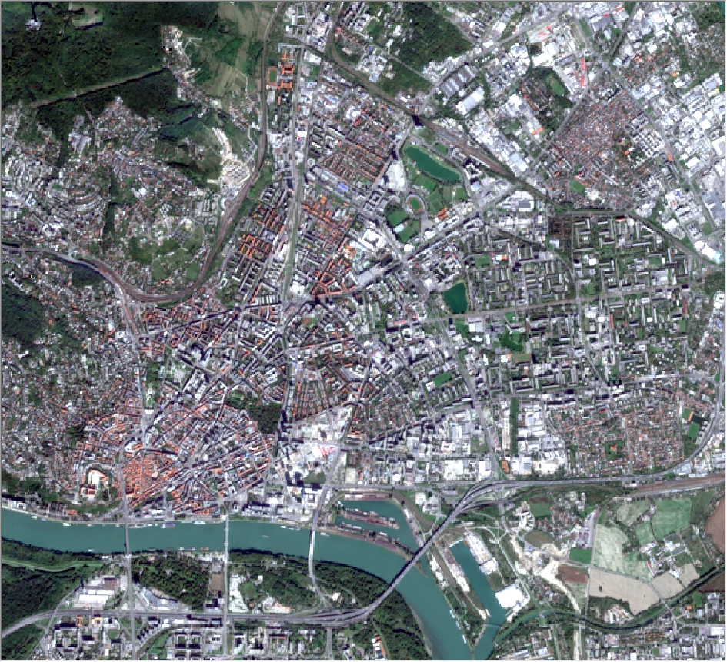
Copernicus Hackathon @ Danube Hack 2018
RGB
2018 Sentinel 2A
B4,B3,B2

Slide 16
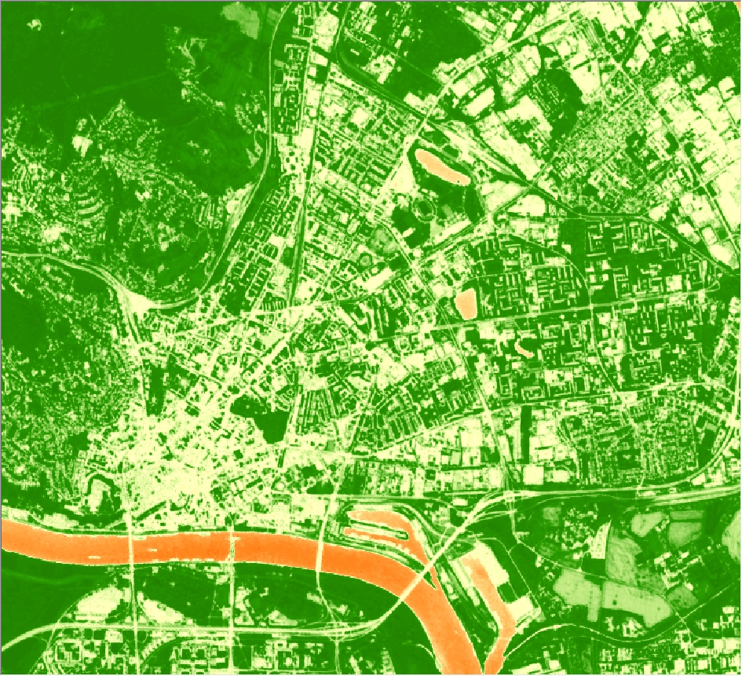
Copernicus Hackathon @ Danube Hack 2018
NDVI
2016 Sentinel 2A
B4,B8

Slide 17
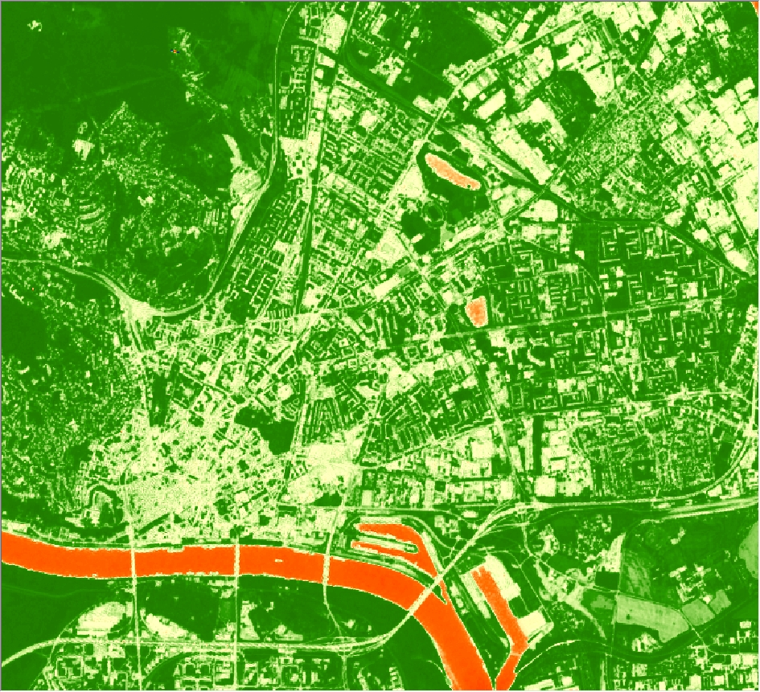
Copernicus Hackathon @ Danube Hack 2018
NDVI
2018 Sentinel 2A
B4,B8

Slide 18
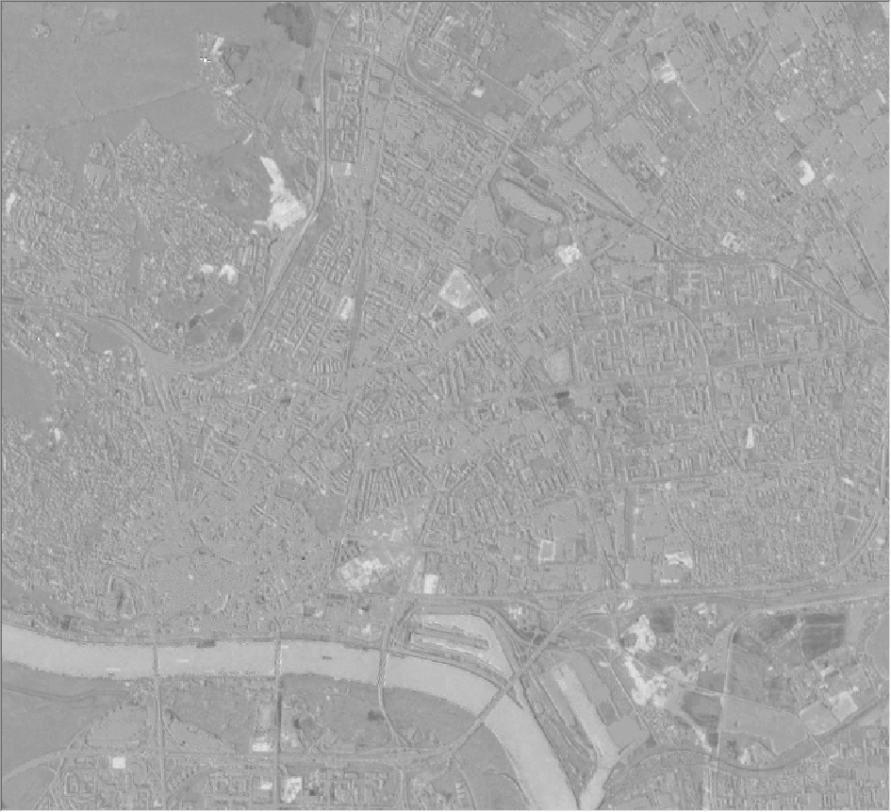
Copernicus Hackathon @ Danube Hack 2018
NDVI difference
NDVI 2016
NDVI 2018
for vegetation changes detection
(NDVI exploration for possibility of vegetation type classification is ongoing)

Slide 19
Thank you very much
http://copernicus.danubehack.eu
copernicus@danubehack.eu
Organised by
Notes:
Contact Folie

