Slide 1
Mermaid Diagrams
native editable shapes · full-fidelity PNG for every mermaid type

Slide 2
render=native — flowchart (editable shapes + connectors)
Start
Input
Decision
yes
no
Process
Database
Subroutine
Prepare
Done

Slide 3
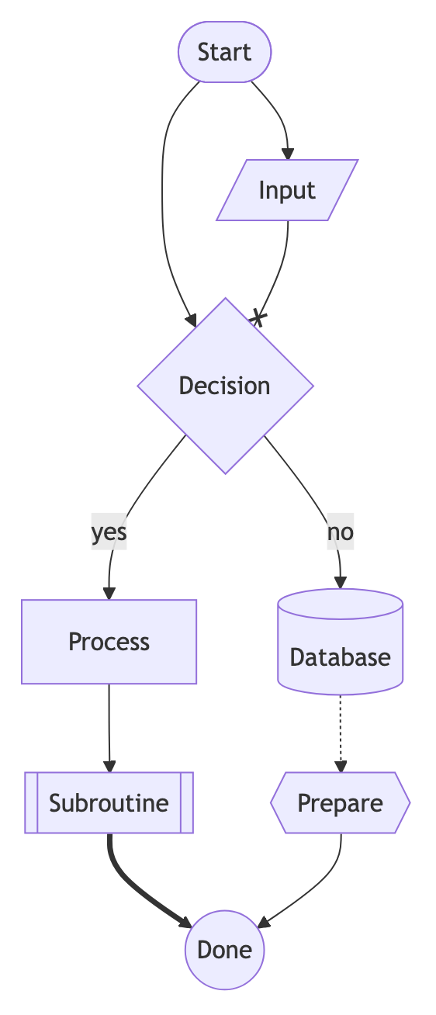
render=image — the same flowchart as a full-fidelity PNG

Slide 4
render=native — sequenceDiagram
User
Server
Database
Login request
Validate credentials
OK
Session token

Slide 5
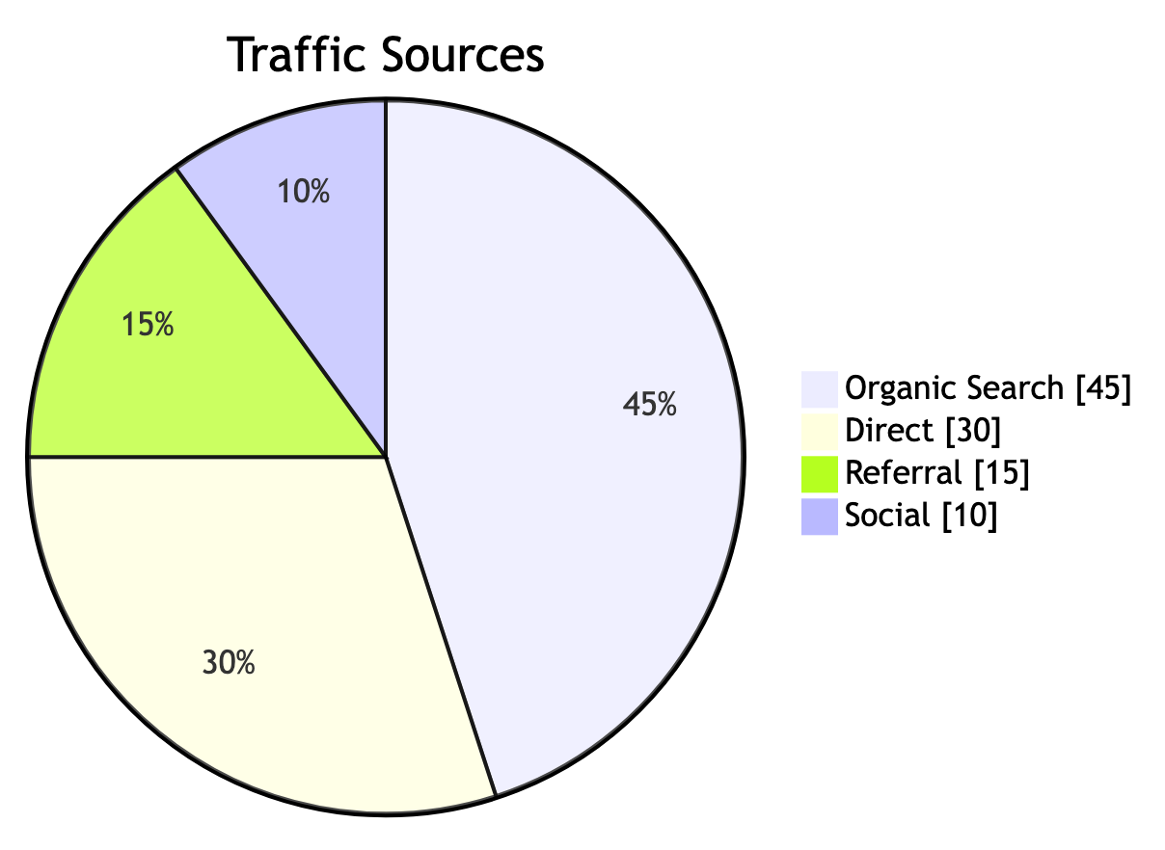
render=image — pie — proportions

Slide 6
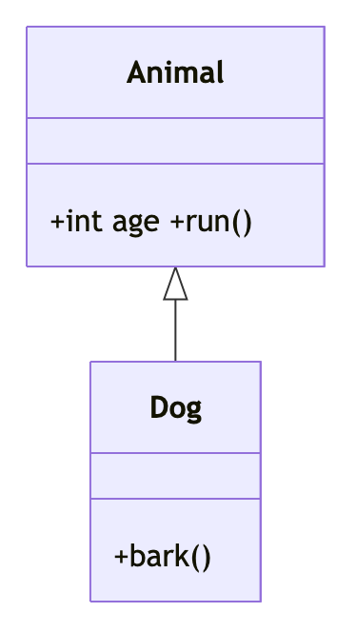
render=image — classDiagram — UML classes

Slide 7
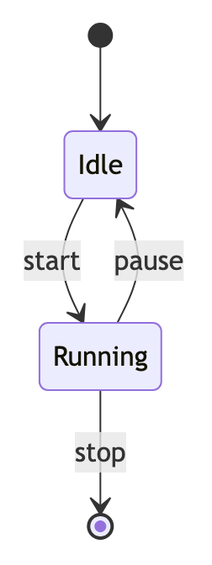
render=image — stateDiagram-v2 — states

Slide 8
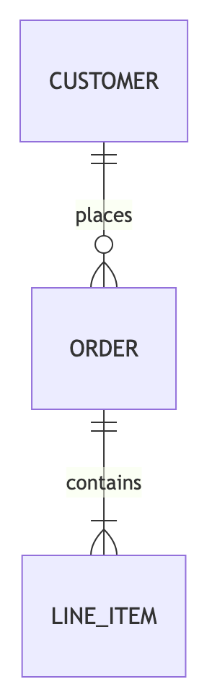
render=image — erDiagram — entities & relations

Slide 9
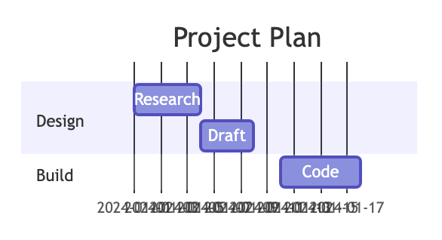
render=image — gantt — project schedule

Slide 10
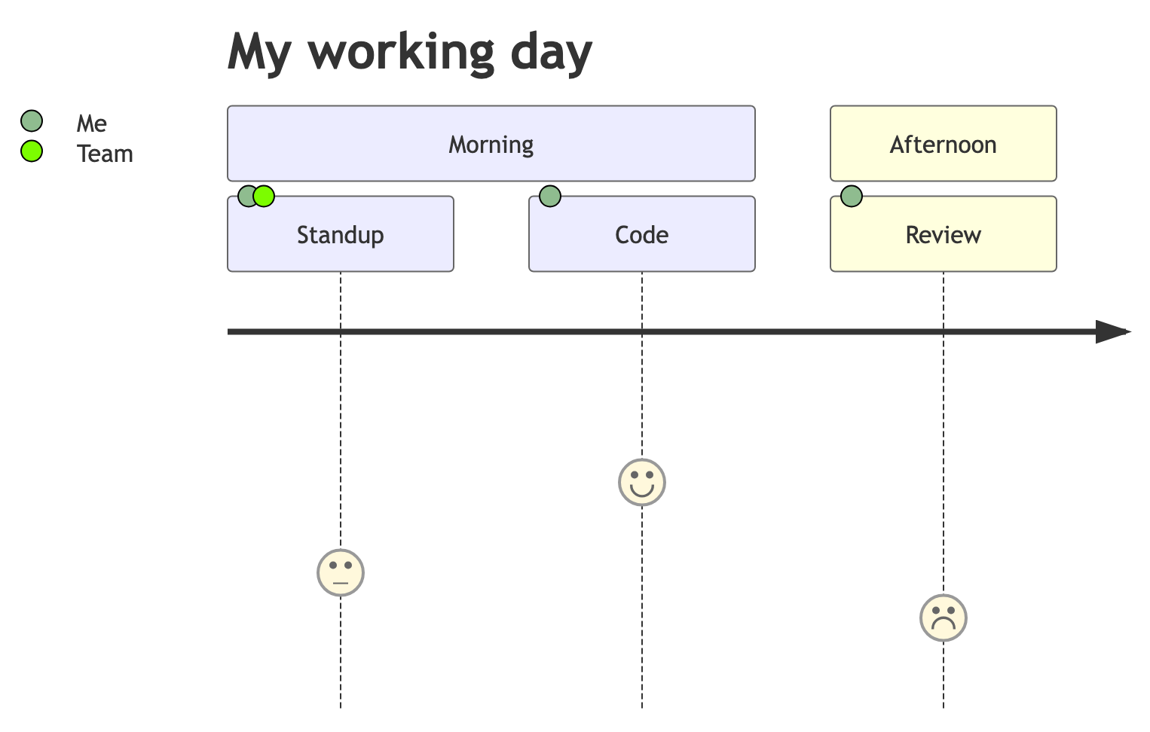
render=image — journey — user journey

Slide 11
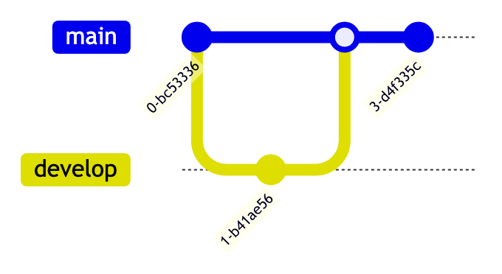
render=image — gitGraph — branch/merge

Slide 12
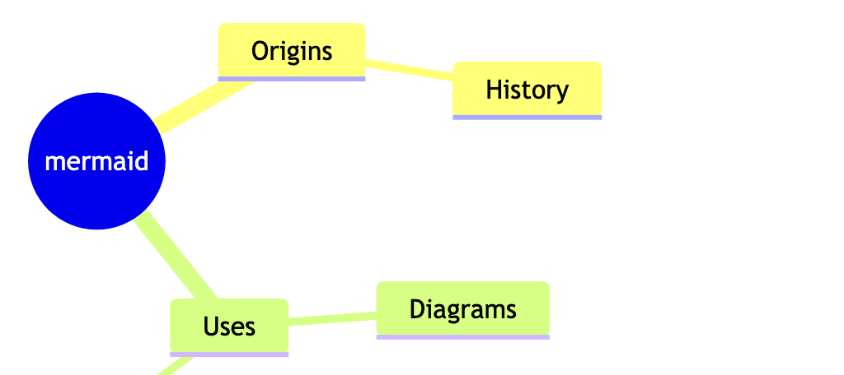
render=image — mindmap — hierarchy

Slide 13
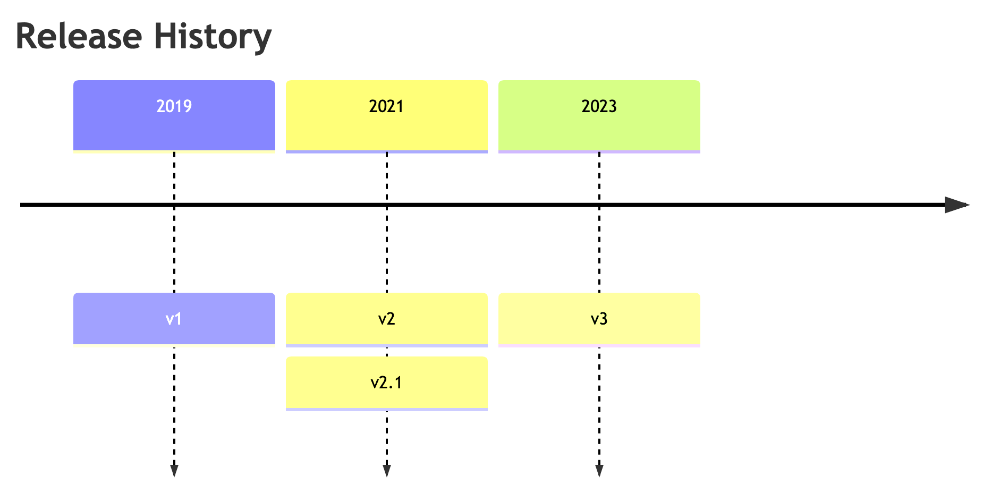
render=image — timeline — events

Slide 14
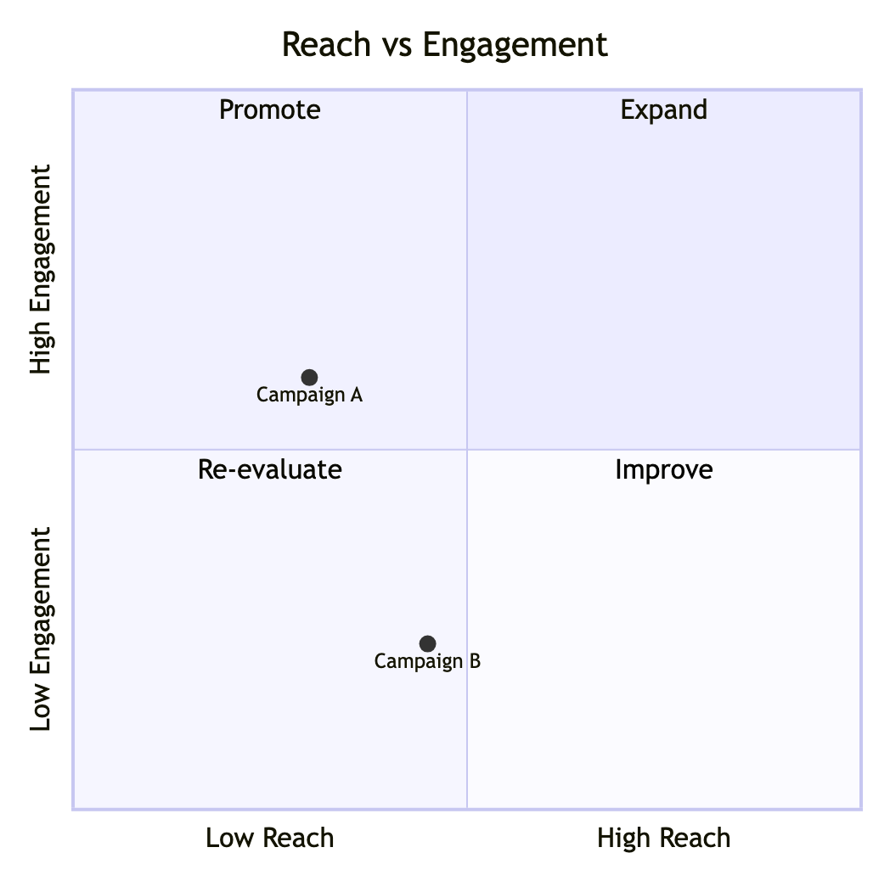
render=image — quadrantChart — 2x2 matrix

Slide 15
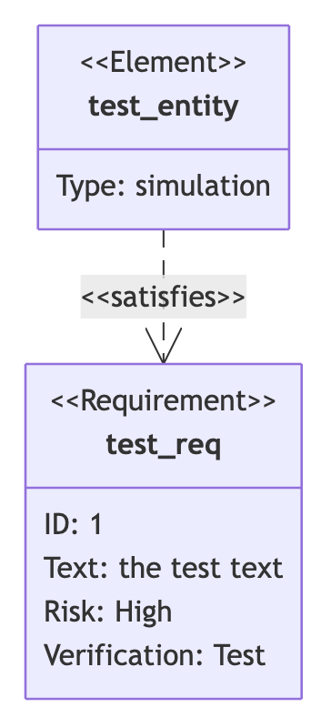
render=image — requirementDiagram — requirements

Slide 16
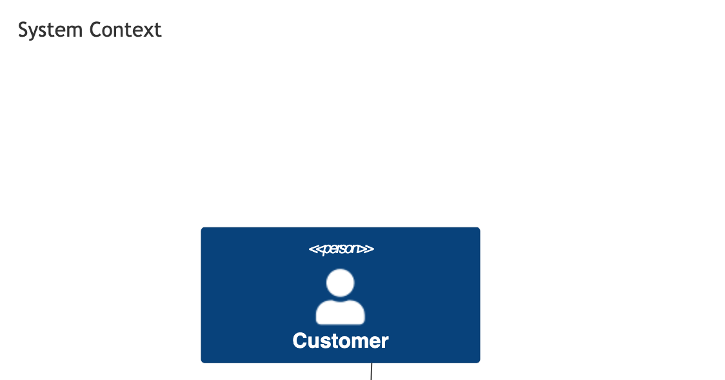
render=image — C4Context — system context

Slide 17
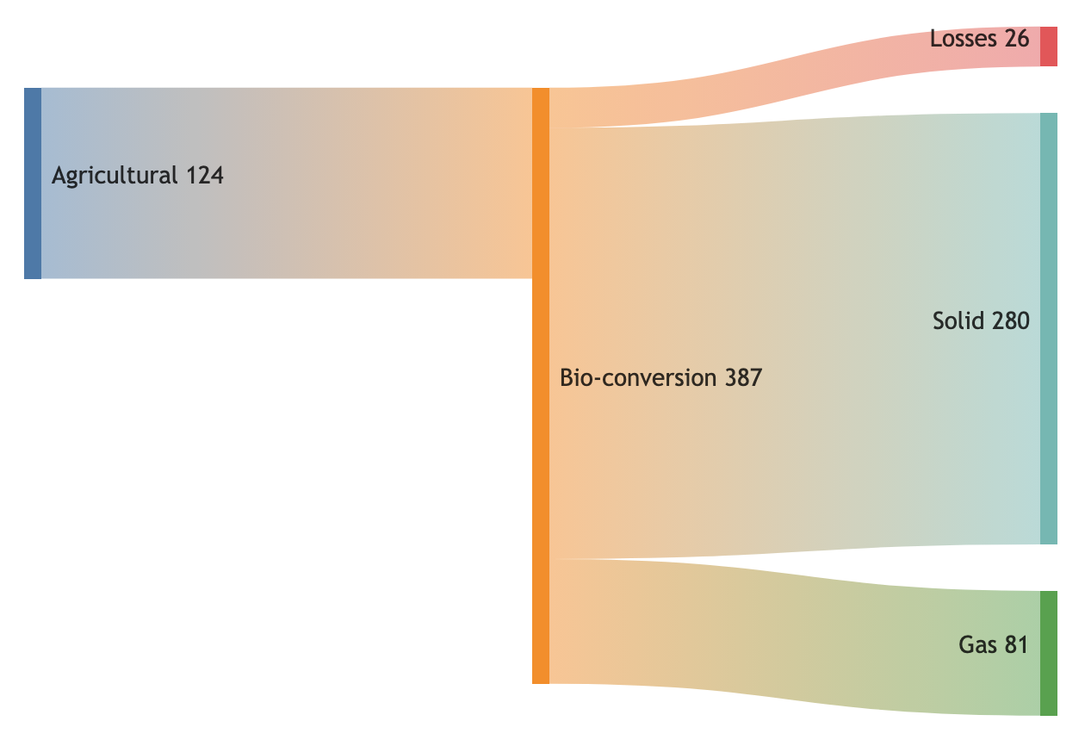
render=image — sankey-beta — flow volumes

Slide 18
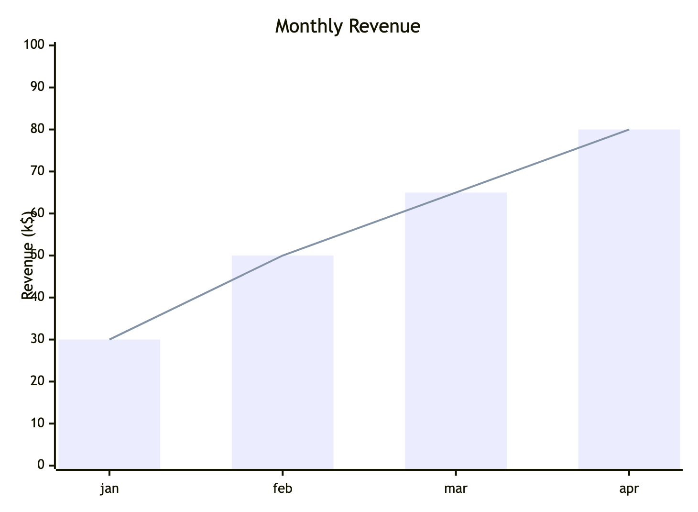
render=image — xychart-beta — bar/line

Slide 19
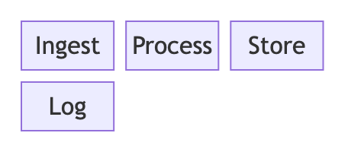
render=image — block-beta — block layout

Slide 20
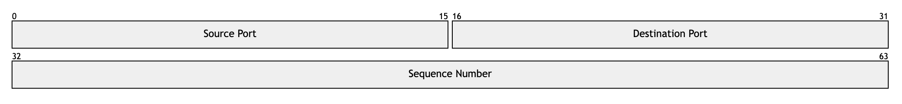
render=image — packet-beta — byte layout

Slide 21
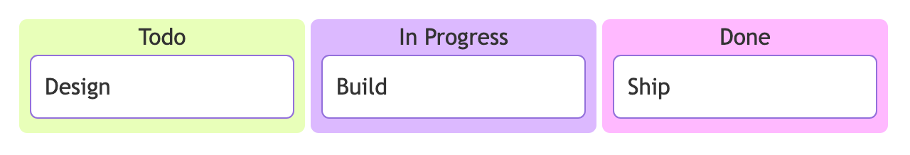
render=image — kanban — board

Slide 22
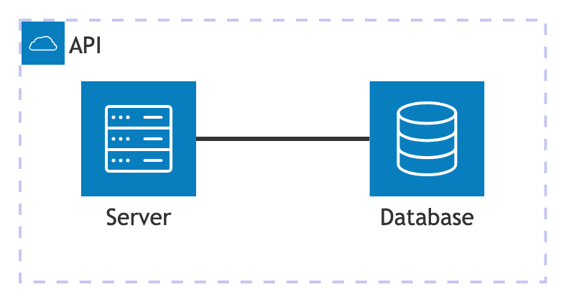
render=image — architecture-beta — cloud services

Slide 23
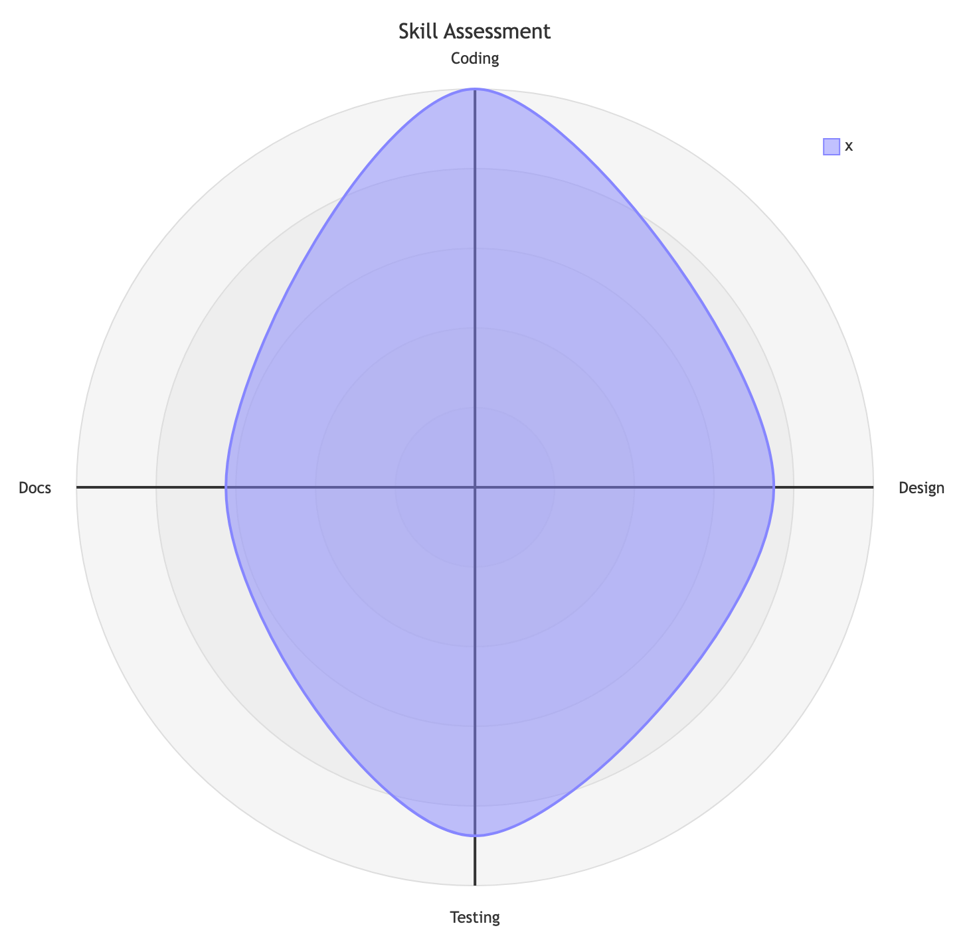
render=image — radar-beta — multi-axis scores

