Slide 1
Team Name : Agile India
Team bio : We are a team of passionate:
Data enthusiasts eager to harness the power of AI for real-world impact.
Technologists skilled in cloud platforms and cutting-edge AI tools.
Finance whizzes with a deep understanding of banking risk management challenges.
Our Mission:
We're on a mission to revolutionize risk management in banking by leveraging the power of generative AI.
Why We're Excited:
We believe our solution can significantly improve financial stability for banks and enhance customer trust. We're excited to collaborate, learn, and build something innovative at this hackathon!
Date : 30-06-2024

Slide 2

Problem Statement
The banking sector is increasingly vulnerable to diverse financial risks such as fraud, credit delinquencies, market volatility, and operational disruptions. Traditional risk management approaches often fail to predict and mitigate these risks proactively and effectively.
Even after the predicting risks, many risk management frameworks don’t suggest the solution for it. There is a high need of these features to properly manage the funds and thus retain the customers and their trust for better scalability of the company

Slide 3
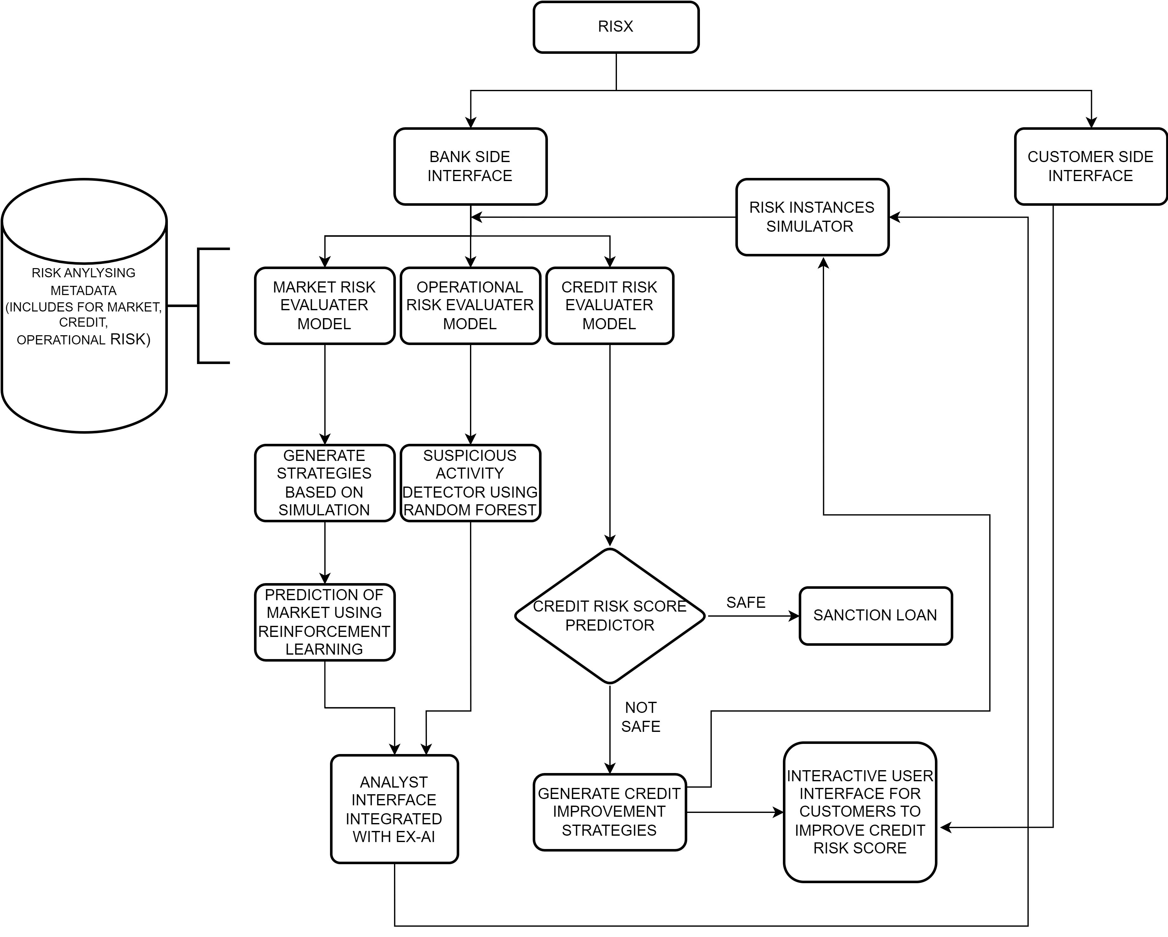
Solution
Our solution consists of a evaluating multiple different criteria creating a centralized solution
Market Risk evaluation: Use multiple criteria that include fundamental analysis of the market, sector wise analysis for portfolio divide, International and National news impact assessment.
Wealth distribution recommendation across midcap, small cap and large cap along with commodities.
Operational Risk evaluation: Detect suspicious activity in the company website/application and create a simulation for the same.
Vetting procedures for new analysts or recruits.
Credit risk evaluation: Credit liability predictor according to client's financial history along with credit improvement strategy for users.
Wealth assessment of bank comparing with client's needs to check if loans can be given or credit can be managed

Slide 4

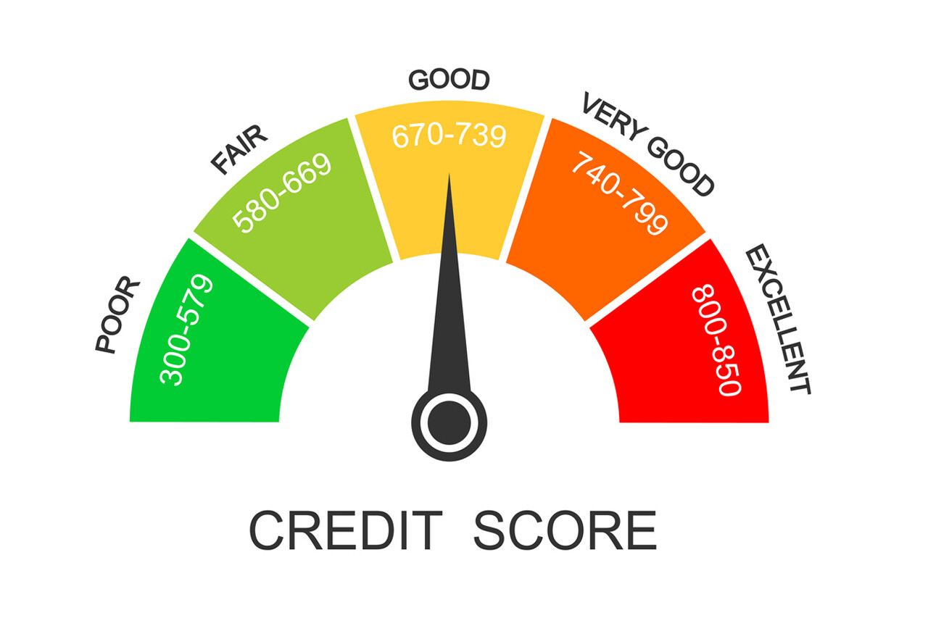
USP – Unique Selling Proposition
The focus on “Risk Instance Simulation using Gen AI” will help in improving the model and also assist the analysts in broadening the spectrum of Risk Strategies.
Usage of XAI (Explainable AI) is a key USP as it help in analysts coming to the conclusion of risk assessments much easily (less labour and effort) as the reason for the prediction will be generated.
A user friendly page of all the resources and measures to be taken by the user for betterment of the credit risk score will be available for the customer so that scalability of customers is handled.

Slide 5
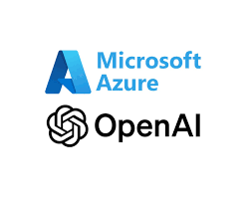
Use of Azure Open AI?
Azure OpenAI for Risk Management: Leverage Microsoft's cloud-based AI service and its large language models (LLMs) to empower your bank's risk management with Generative AI (GenAI).
Deep Data Analysis: LLMs excel at processing massive datasets, including structured transaction data, unstructured customer communications, and even external market news or social media sentiment. This allows for a holistic view of potential risks beyond what traditional methods can capture.
Advanced Anomaly Detection: Train these LLMs to identify unusual patterns and anomalies in the data. This can signal potential fraudulent activity, credit delinquencies, or operational disruptions, enabling early intervention before losses occur.
Scenario Modeling with Generative Power: Unlike traditional methods, Azure OpenAI can generate a wider range of plausible risk scenarios. This considers internal factors like system failures and external events like market crashes. This empowers you to stress-test existing mitigation strategies and proactively identify areas for improvement.

Slide 6


Business Potential and Relevance
Our product could be a tool that can be sold as a service to Institutional banks at a pay per use modal where small tasks are charged a smaller price while larger tasks and detail reports are more highly priced.
At the same time reduce operational costs with more efficient resource allocation through the model
The tool can be used to accelerate the step of risk management by providing financial advice to the analyst without adding any biases.
Offers modular services that can be tailored to the specific needs of each bank, from simple compliance checks to complex risk evaluations.
Learns to Seamlessly integrates with existing banking systems, ensuring minimal disruption and maximum efficiency.- Keeps banks aligned with the latest regulatory requirements, reducing the risk of non-compliance penalties.

Slide 7
Thank You
Team member names-
S BHUMIKA
S DANUSH TEJ YADAV
M HARSHITH
SUMUKHA K

