Slide 1
Export of GTP-U Information in IPFIX draft-voyersriram-opsawg-ipfix-gtpu-04
Enabling insights in GTP forwarding plane by adding GTP-U dimensions
daniel.voyer@bell.ca
sriragop@cisco.com
thomas.graf@swisscom.com
benoit.claise@huawei.com
vyasraj@juniper.net
5 March 2024

Slide 2
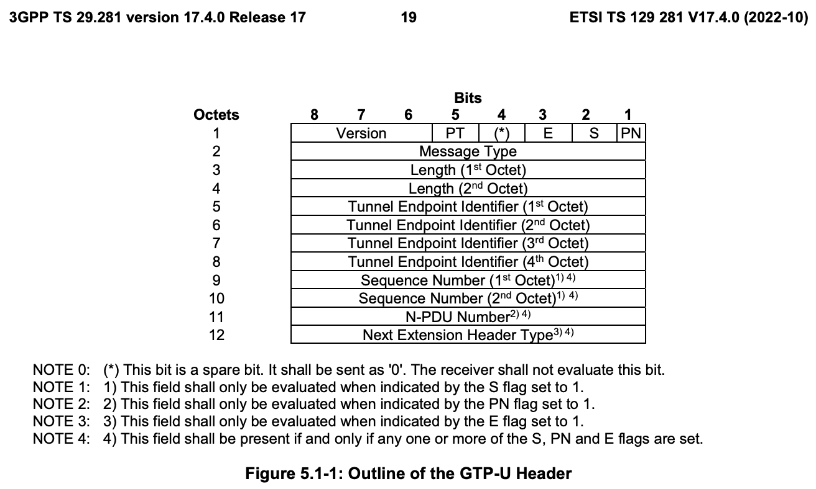
GTP-U @ IPFIX Data-Plane visibility is missing in GTP
GTP is already deployed by network operators
Data-Plane visibility is missing in GTP-U and so unable to identify the transport performance of PDU Sessions with specific QoS within a slice or within a group of slices hosted on the same User Plane Function.

Slide 3
GTP-U @ IPFIX IPFIX entities in context of the GTP-U (1)
gtpuFlags
8-bit flags field defined in the GTP-U which indicates the version of GTP-U protocol, protocol type and presence of extension header, sequence number and N-PDU number in the GTP-U header.
gtpuMsgType
8-bit message type field defined in the GTP-U which
indicates the type of GTP-U message.
gtpuTEid
32-bit tunnel endpoint identifier field defined in GTP-U which unambiguously identifies a tunnel endpoint in the receiving GTP-U protocol entity for a given UDP/IP endpoint..
gtpuSequenceNum
16-bit sequence number field defined in the GTP-U. This field is interpreted based on the corresponding flag value from gtpuFlags

Slide 4
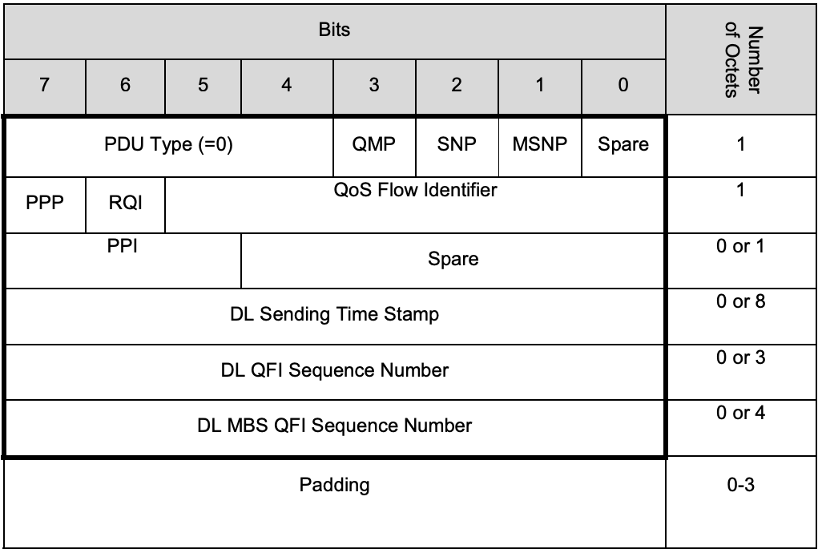
GTP-U @ IPFIX IPFIX entities in context of the GTP-U (2)
gtpuQFI
8-bit QoS flow identifier field defined in PDU Session Container extension header of GTP-U. This is defined in section 5.5.3 of PDU session spec [TS.38415]. This is used to determine the QoS flow and QoS profile which are associated with the received packet..
gtpuPduType
8-bit PDU type field defined in PDU Session Container extension header of GTP-U. This is defined in section 5.5.3 of PDU session spec [TS.38415]. This field indicates the structure of the PDU session UP frame..

Slide 5
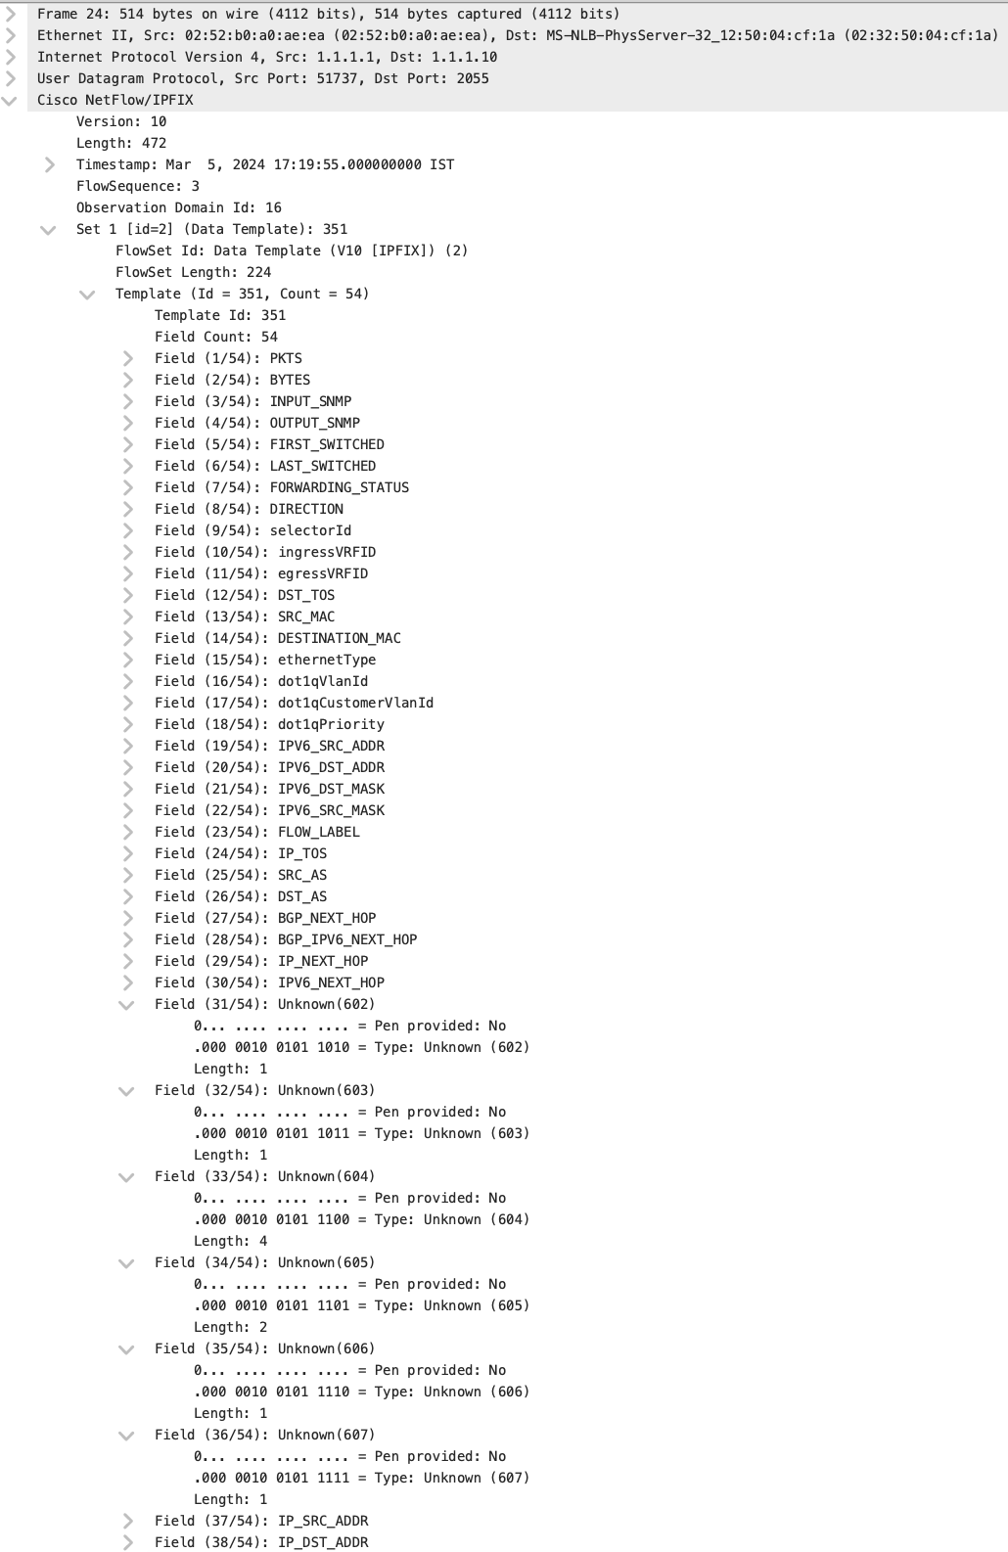
GTP-U @ IPFIX – Cisco IOX-XR Implementation status IPFIX Records exposed
1. gtpuFlags
8-bit flags field defined in the GTP-U which indicates the version of GTP-U protocol, protocol type and presence of extension header, sequence number and N-PDU number in the GTP-U header.
2. gtpuMsgType
8-bit message type field defined in the GTP-U which indicates the type of GTP-U message.
3. gtpuTEid
32-bit tunnel endpoint identifier field defined in GTP-U which unambiguously identifies a tunnel endpoint in the receiving GTP-U protocol entity for a given UDP/IP endpoint..
4. gtpuSequenceNum
16-bit sequence number field defined in the GTP-U. This field is interpreted based on the corresponding flag value from gtpuFlags
5. gtpuQFI
8-bit QoS flow identifier field defined in PDU Session Container extension header of GTP-U. This is defined in section 5.5.3 of PDU session spec [TS.38415]. This is used to determine the QoS flow and QoS profile which are associated with the received packet
6. gtpuPduType
8-bit PDU type field defined in PDU Session Container extension header of GTP-U. This is defined in section 5.5.3 of PDU session spec [TS.38415]. This field indicates the structure of the PDU session UP frame
1
2
3
4
5
6

Slide 6
GTP-U @ IPFIX Next Steps
Data-Plane visibility is missing in GTP.
Authors want to avoid private enterprise code points being used in GTP 5G deployments.
During the IETF week, we will be requesting for IPFIX IANA allocation.
This draft could progress to document the use cases and will be helpful for 3GPP references also.
Call for adoption at OPSAWG at IETF 119.

