Slide 1




OBJECT RECOGNITION
OBJECT DETECTIVE
See and recognise.
Notes:
Objekt-Detektiv — front (DE)
Background image: front_01.png (300 dpi, includes glow, scanlines, glitch bars, accent bar).
Kicker, title, tagline are editable text boxes. Accent #4ea8ff. Type: Helvetica Neue.

Slide 2
OBJECT DETECTIVE
EXPLORATION
Hold up objects. What does the AI recognise or miss?
Move the confidence slider all the way left. What happens?
Move it all the way right. What does the AI miss?
CHALLENGE
Find one object the AI recognises with over 80% confidence—and one it ignores.
REFLECTION
The AI knows exactly 80 things. Who chose them—and what does that mean for everything else?
aiwarenesslab.io
Notes:
Objekt-Detektiv — back (DE)
Everything here is native PowerPoint: text boxes, the accent bar and the background rectangle. Edit freely.

Slide 3

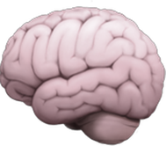
OBJECT RECOGNITION
TRAIN THE AI
You help shape it.
Notes:
Trainiere die KI — front (DE)
Background image: front_02.png (300 dpi, includes glow, scanlines, glitch bars, accent bar).
Kicker, title, tagline are editable text boxes. Accent #b57bff. Type: Helvetica Neue.

Slide 4
TRAIN THE AI
EXPLORATION
Choose two objects. Give them meaningful names on screen.
Record 8–10 examples of each from different angles.
Test: Does the AI recognise both reliably?
CHALLENGE
The bias experiment: train it badly on purpose—record one object only from the front and the other only from the back. Then turn both around. What happens, and what is this problem called in real AI systems?
REFLECTION
Here, you can delete all the data at the touch of a button. Where online would you like to be able to do that too?
aiwarenesslab.io
Notes:
Trainiere die KI — back (DE)
Everything here is native PowerPoint: text boxes, the accent bar and the background rectangle. Edit freely.

Slide 5


PRIVACY
PRIVACY SHIELD
Privacy by Design.
Notes:
Privatsphäre-Schild — front (DE)
Background image: front_03.png (300 dpi, includes glow, scanlines, glitch bars, accent bar).
Kicker, title, tagline are editable text boxes. Accent #3ddc97. Type: Helvetica Neue.

Slide 6
PRIVACY SHIELD
EXPLORATION
Look into the camera—your faces are blurred at once.
Try all three styles. Turn protection off briefly: how does the difference feel?
Test the limits: turn your head, cover half your face, or wear sunglasses.
CHALLENGE
Find two ways the protection fails. Why is that a problem for a promised safeguard?
REFLECTION
Face detection (“there is a face”) is not identification (“that is Ali from class 8B”). Why does this matter?
aiwarenesslab.io
Notes:
Privatsphäre-Schild — back (DE)
Everything here is native PowerPoint: text boxes, the accent bar and the background rectangle. Edit freely.

Slide 7

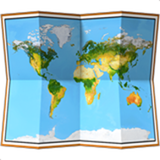
TRACKING
THE DATA TRAIL
Cameras and movement.
Notes:
Die Datenspur — front (DE)
Background image: front_04.png (300 dpi, includes glow, scanlines, glitch bars, accent bar).
Kicker, title, tagline are editable text boxes. Accent #ffb347. Type: Helvetica Neue.

Slide 8
THE DATA TRAIL
EXPLORATION
Open the station and look at the heatmap. This data was collected in the background while you were playing!
As a group, walk along a particular route—can you see your trail appear?
Press “Delete data trail”. Who should have this button in real life?
CHALLENGE
Name three things such a map could reveal about a room and the people in it—without showing any faces.
REFLECTION
“I have nothing to hide”—does that also apply to your routes, habits, and favourite corner?
aiwarenesslab.io
Notes:
Die Datenspur — back (DE)
Everything here is native PowerPoint: text boxes, the accent bar and the background rectangle. Edit freely.

Slide 9

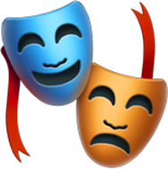
FACES AND GHOSTS
TRICK THE AI
Images and imagination.
Notes:
Täusche die KI — front (DE)
Background image: front_05.png (300 dpi, includes glow, scanlines, glitch bars, accent bar).
Kicker, title, tagline are editable text boxes. Accent #ff5d8f. Type: Helvetica Neue.

Slide 10
TRICK THE AI
EXPLORATION
The four challenges are displayed on screen.
Invisible 🥷 · Mix-up 🎩 · Bullseye 💯 · Ghosts 👻
CHALLENGE
Complete at least two challenges and record how you succeeded. Your tricks are the insight!
REFLECTION
You outsmarted an AI in just a few minutes. What does that mean for places where AI systems make decisions alone—border control, hiring, autonomous driving?
aiwarenesslab.io
Notes:
Täusche die KI — back (DE)
Everything here is native PowerPoint: text boxes, the accent bar and the background rectangle. Edit freely.

Slide 11

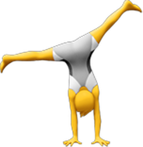
MOVEMENT
SKELETON MIRROR
Motion recognition.
Notes:
Skelett-Spiegel — front (DE)
Background image: front_06.png (300 dpi, includes glow, scanlines, glitch bars, accent bar).
Kicker, title, tagline are editable text boxes. Accent #2dd4bf. Type: Helvetica Neue.

Slide 12
SKELETON MIRROR
EXPLORATION
Stand before the camera—you become stick figures with 17 points.
Try the pose challenge: who can complete all four poses fastest?
Turn on ghost mode: no video, just skeletons. Can you still tell who is who?
CHALLENGE
In ghost mode, find three things you can learn about someone without seeing their face.
REFLECTION
Game consoles, care-home fall detectors and pool cameras that detect drowning all use skeleton tracking. When is it care, when surveillance—and who decides?
aiwarenesslab.io
Notes:
Skelett-Spiegel — back (DE)
Everything here is native PowerPoint: text boxes, the accent bar and the background rectangle. Edit freely.

Slide 13
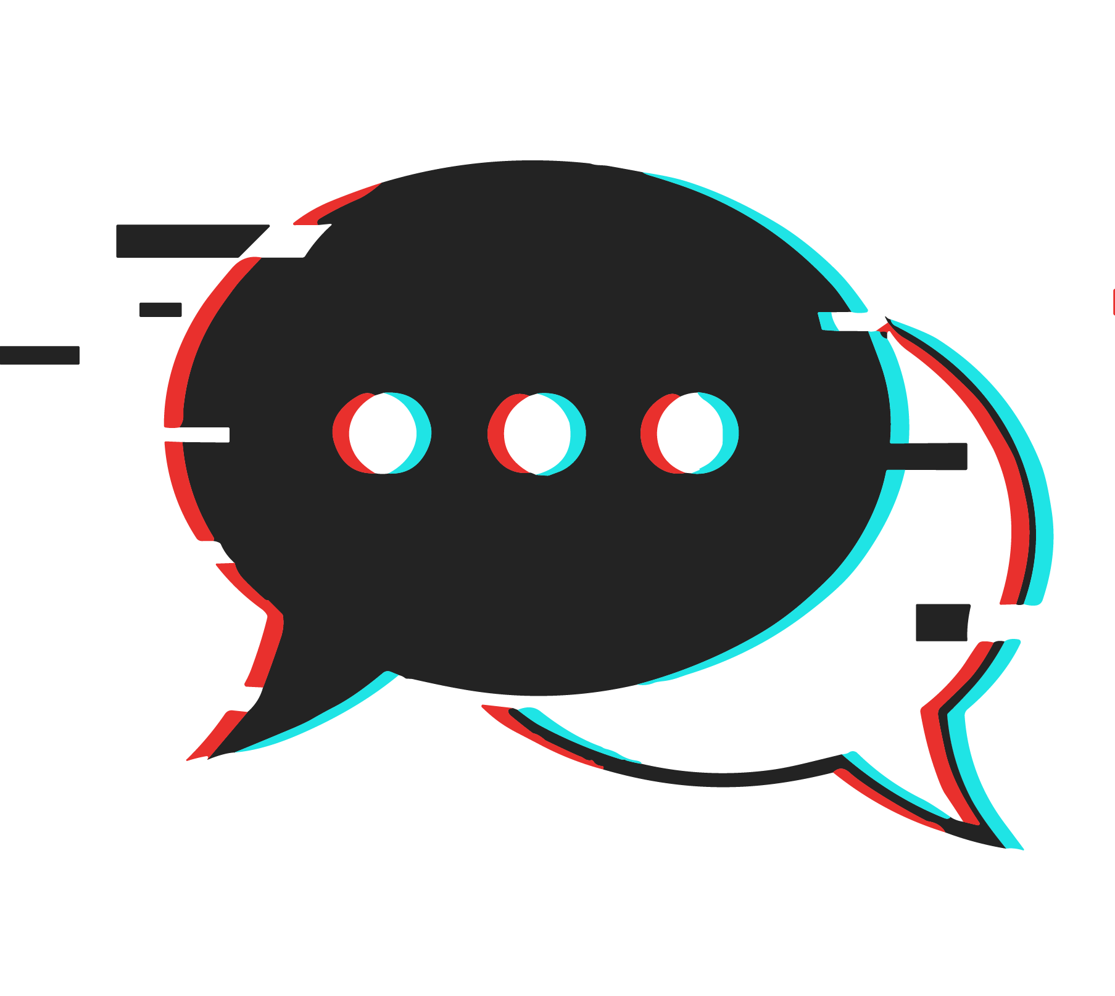

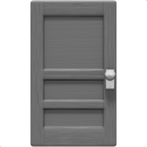
DISCUSSION CARD
THE SMART DOORBELL
Privacy & AI
Notes:
Die smarte Türklingel — front (DE)
Background image: front_07.png (300 dpi, includes glow, scanlines, glitch bars, accent bar).
Kicker, title, tagline are editable text boxes. Accent #8a4fd8. Type: Helvetica Neue.

Slide 14

THE SMART DOORBELL
The Yilmaz family has a video doorbell. It automatically records the pavement too—including neighbours, postal workers, and children playing. The recordings are sent to the manufacturer’s servers in the USA.
DISCUSS
Whose privacy matters here? What would you change if you could design the doorbell?
Hint: Today, you saw a camera that blurs faces before storing the footage.
aiwarenesslab.io
Notes:
Die smarte Türklingel — back (DE)
Everything here is native PowerPoint: text boxes, the accent bar and the background rectangle. Edit freely.

Slide 15

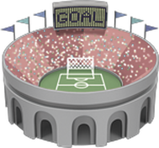
DISCUSSION CARD
THE STADIUM
Privacy & AI
Notes:
Das Stadion — front (DE)
Background image: front_08.png (300 dpi, includes glow, scanlines, glitch bars, accent bar).
Kicker, title, tagline are editable text boxes. Accent #c32683. Type: Helvetica Neue.

Slide 16
THE STADIUM
A football stadium wants facial recognition at the entrance: known violent offenders are to be identified automatically. To do this, the faces of all 50,000 visitors are scanned and compared with a database.
DISCUSS
49,990 uninvolved people are scanned to find 10. Is that fair? What if the AI is wrong—you now know it can be?
Hint:
Today, you also trained objects—and possibly faces—yourselves.
aiwarenesslab.io
Notes:
Die smarte Türklingel — back (DE)
Everything here is native PowerPoint: text boxes, the accent bar and the background rectangle. Edit freely.

Slide 17


DISCUSSION CARD
THE SCHOOL CAMERA
Privacy & AI
Notes:
Die Schulkamera — front (DE)
Background image: front_09.png (300 dpi, includes glow, scanlines, glitch bars, accent bar).
Kicker, title, tagline are editable text boxes. Accent #7c4dff. Type: Helvetica Neue.

Slide 18
THE SCHOOL CAMERA
Your school is considering AI cameras that flag “suspicious behaviour”—fights or vandalism. The school says nothing is stored; the system only raises an alert.
DISCUSS
Would you feel safer—or watched? Does a camera change how you behave, even if it “stores nothing”?
Hint:
Think back to the data trail station and how it worked.
aiwarenesslab.io
Notes:
Die smarte Türklingel — back (DE)
Everything here is native PowerPoint: text boxes, the accent bar and the background rectangle. Edit freely.

Slide 19


DISCUSSION CARD
THE FILTER
Privacy & AI
Notes:
Der Gratis-Filter — front (DE)
Background image: front_10.png (300 dpi, includes glow, scanlines, glitch bars, accent bar).
Kicker, title, tagline are editable text boxes. Accent #e0409f. Type: Helvetica Neue.

Slide 20
THE FILTER
A photo app offers fun AI filters—for free. The fine print says that all uploaded faces may be used to train new AI models.
DISCUSS
Today, you trained an AI yourselves—with data you could delete afterwards. Why do most apps not offer that? What would be a fair exchange for a free filter?
Hint:
Recall your experience of training the AI with objects.
aiwarenesslab.io
Notes:
Die smarte Türklingel — back (DE)
Everything here is native PowerPoint: text boxes, the accent bar and the background rectangle. Edit freely.

Slide 21
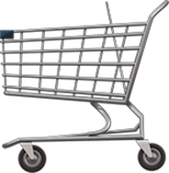
DISCUSSION CARD
THE SUPERMARKET
Privacy & AI
Notes:
Der Supermarkt — front (DE)
Background image: front_11.png (300 dpi, includes glow, scanlines, glitch bars, accent bar).
Kicker, title, tagline are editable text boxes. Accent #b57bff. Type: Helvetica Neue.

Slide 22
THE SUPERMARKET
A supermarket uses cameras to count anonymously where customers walk and stop—like our heatmap, without faces. The data is used to rearrange shelves and place price labels.
DISCUSS
Is that okay because no one is identifiable? Where do you draw the line between “anonymous statistics” and “manipulation”?
Hint:
Movement data can be collected in other places too.
aiwarenesslab.io
Notes:
Die smarte Türklingel — back (DE)
Everything here is native PowerPoint: text boxes, the accent bar and the background rectangle. Edit freely.

