Slide 1

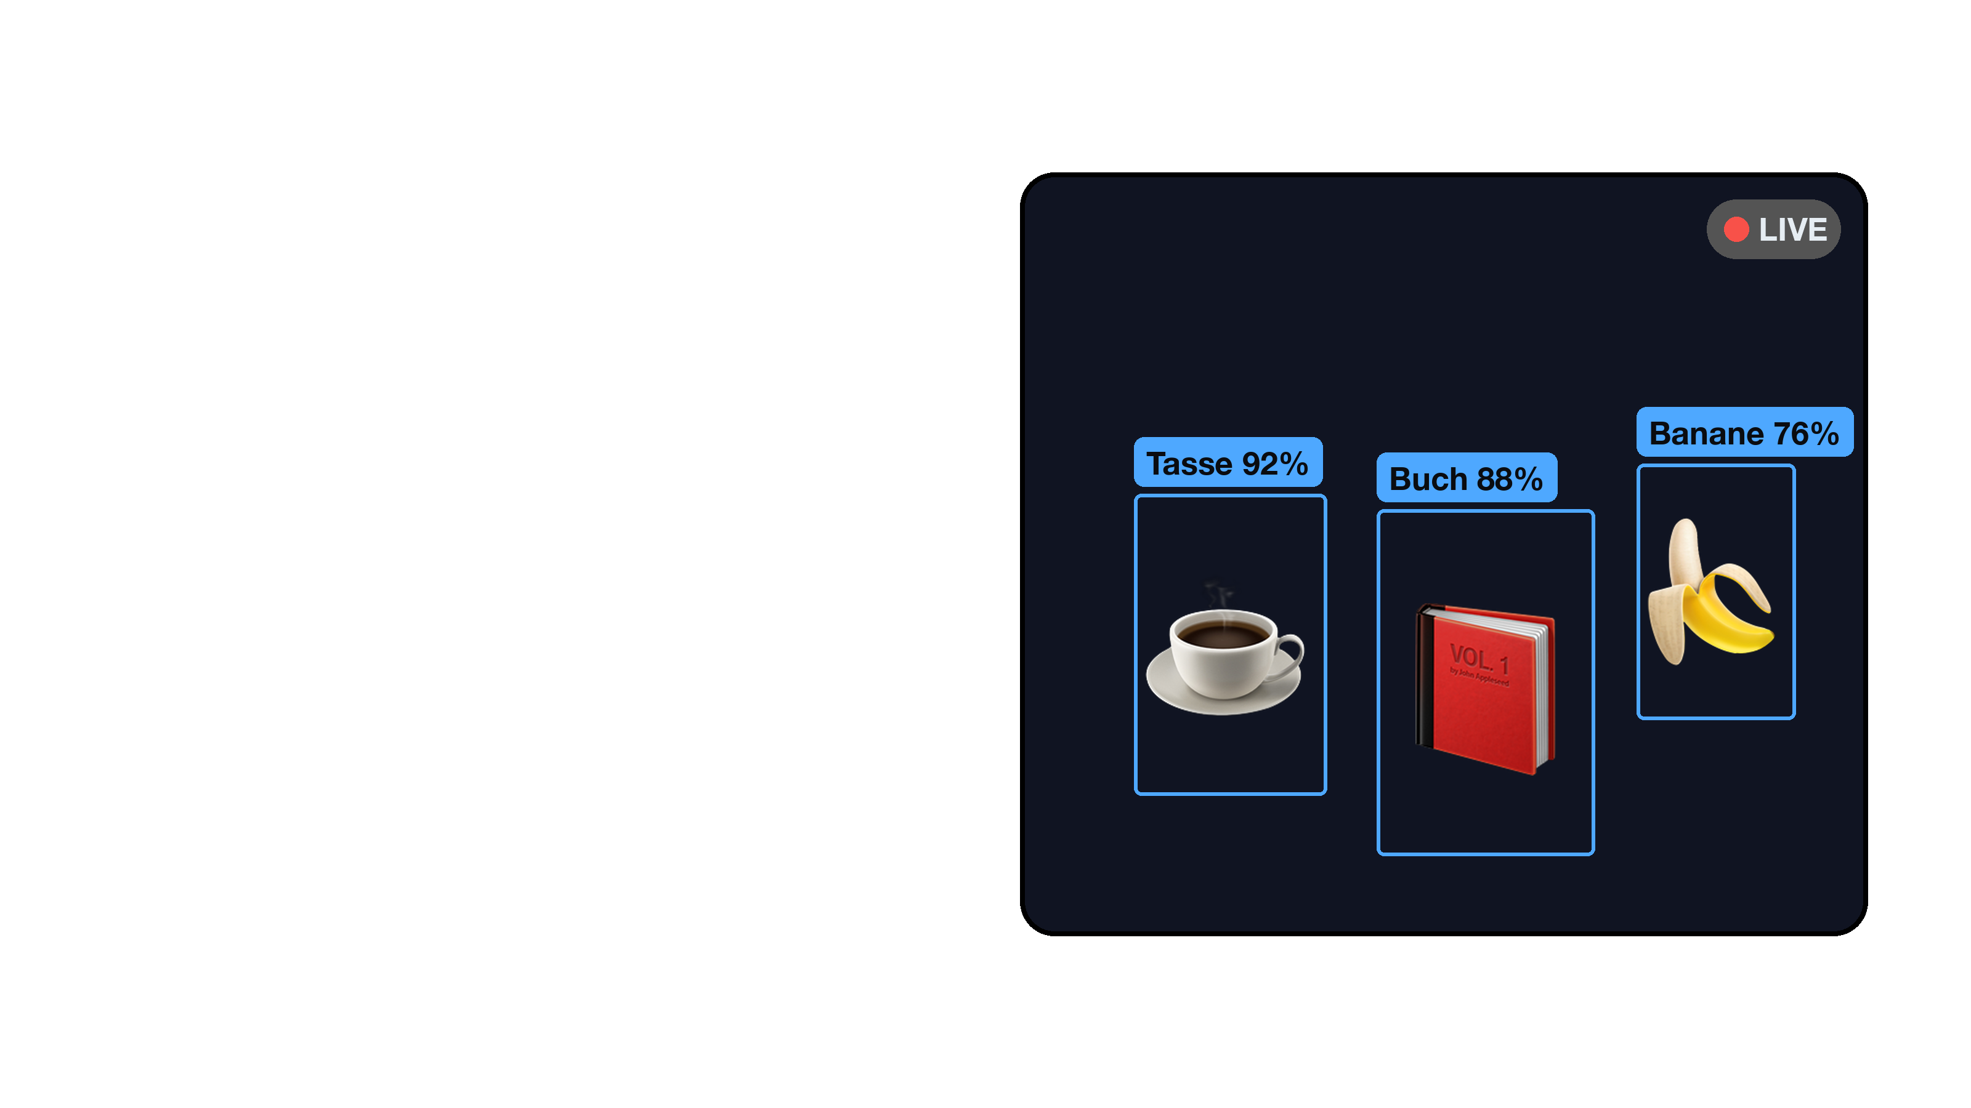



Objekt-Detektiv
Was sieht die KI?
Notes:
Objekt-Detektiv (Deutsch)
Layers: detektiv_de_bg.png · detektiv_de_screen.png · detektiv_icon.png
Accent #4EA8FF · type Helvetica Neue (Bold / Regular)
Title and tagline are real text boxes — edit them directly. Regenerate the layers with: python3 setup/make_station_cards.py --editable

Slide 2
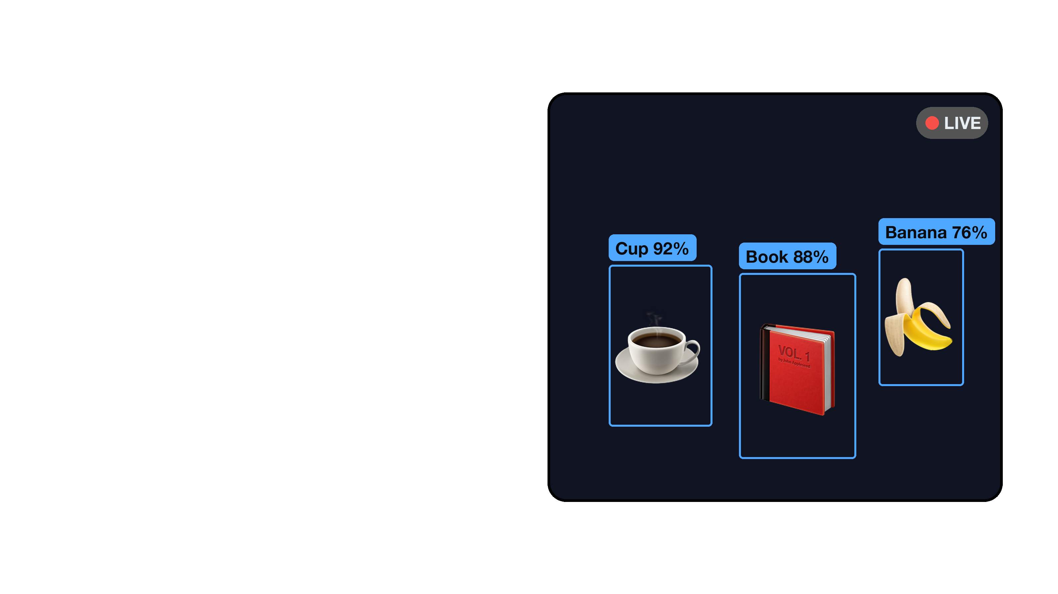
Object Detective
What does the AI see?
Notes:
Object Detective (English)
Layers: detektiv_en_bg.png · detektiv_en_screen.png · detektiv_icon.png
Accent #4EA8FF · type Helvetica Neue (Bold / Regular)
Title and tagline are real text boxes — edit them directly. Regenerate the layers with: python3 setup/make_station_cards.py --editable

Slide 3

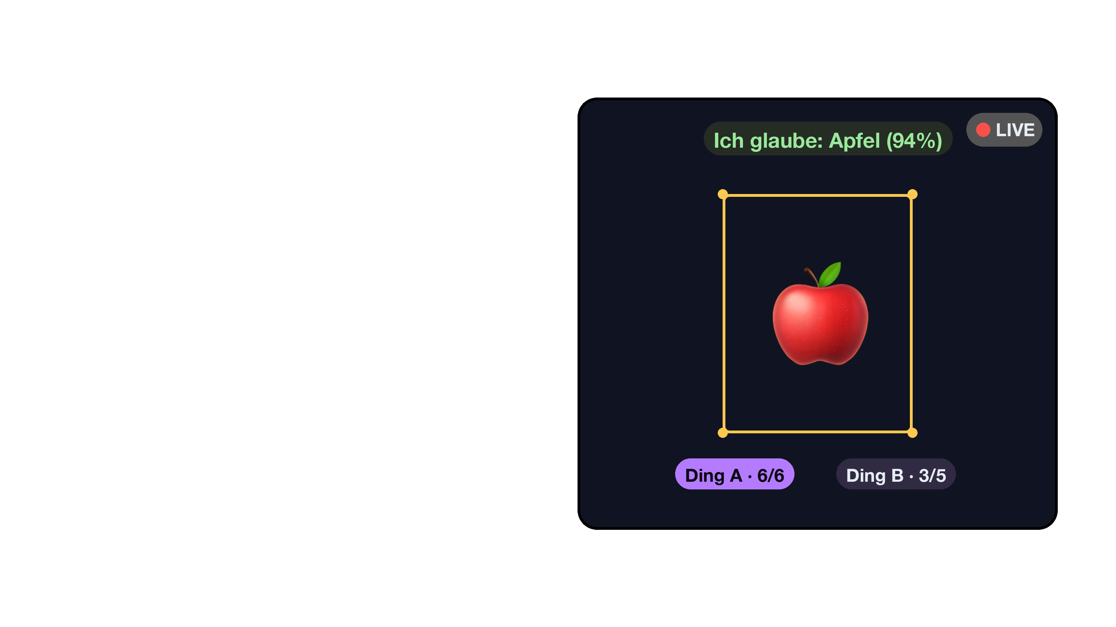

Trainiere die KI
Du bist der Coach
Notes:
Trainiere die KI (Deutsch)
Layers: trainer_de_bg.png · trainer_de_screen.png · trainer_icon.png
Accent #B57BFF · type Helvetica Neue (Bold / Regular)
Title and tagline are real text boxes — edit them directly. Regenerate the layers with: python3 setup/make_station_cards.py --editable

Slide 4
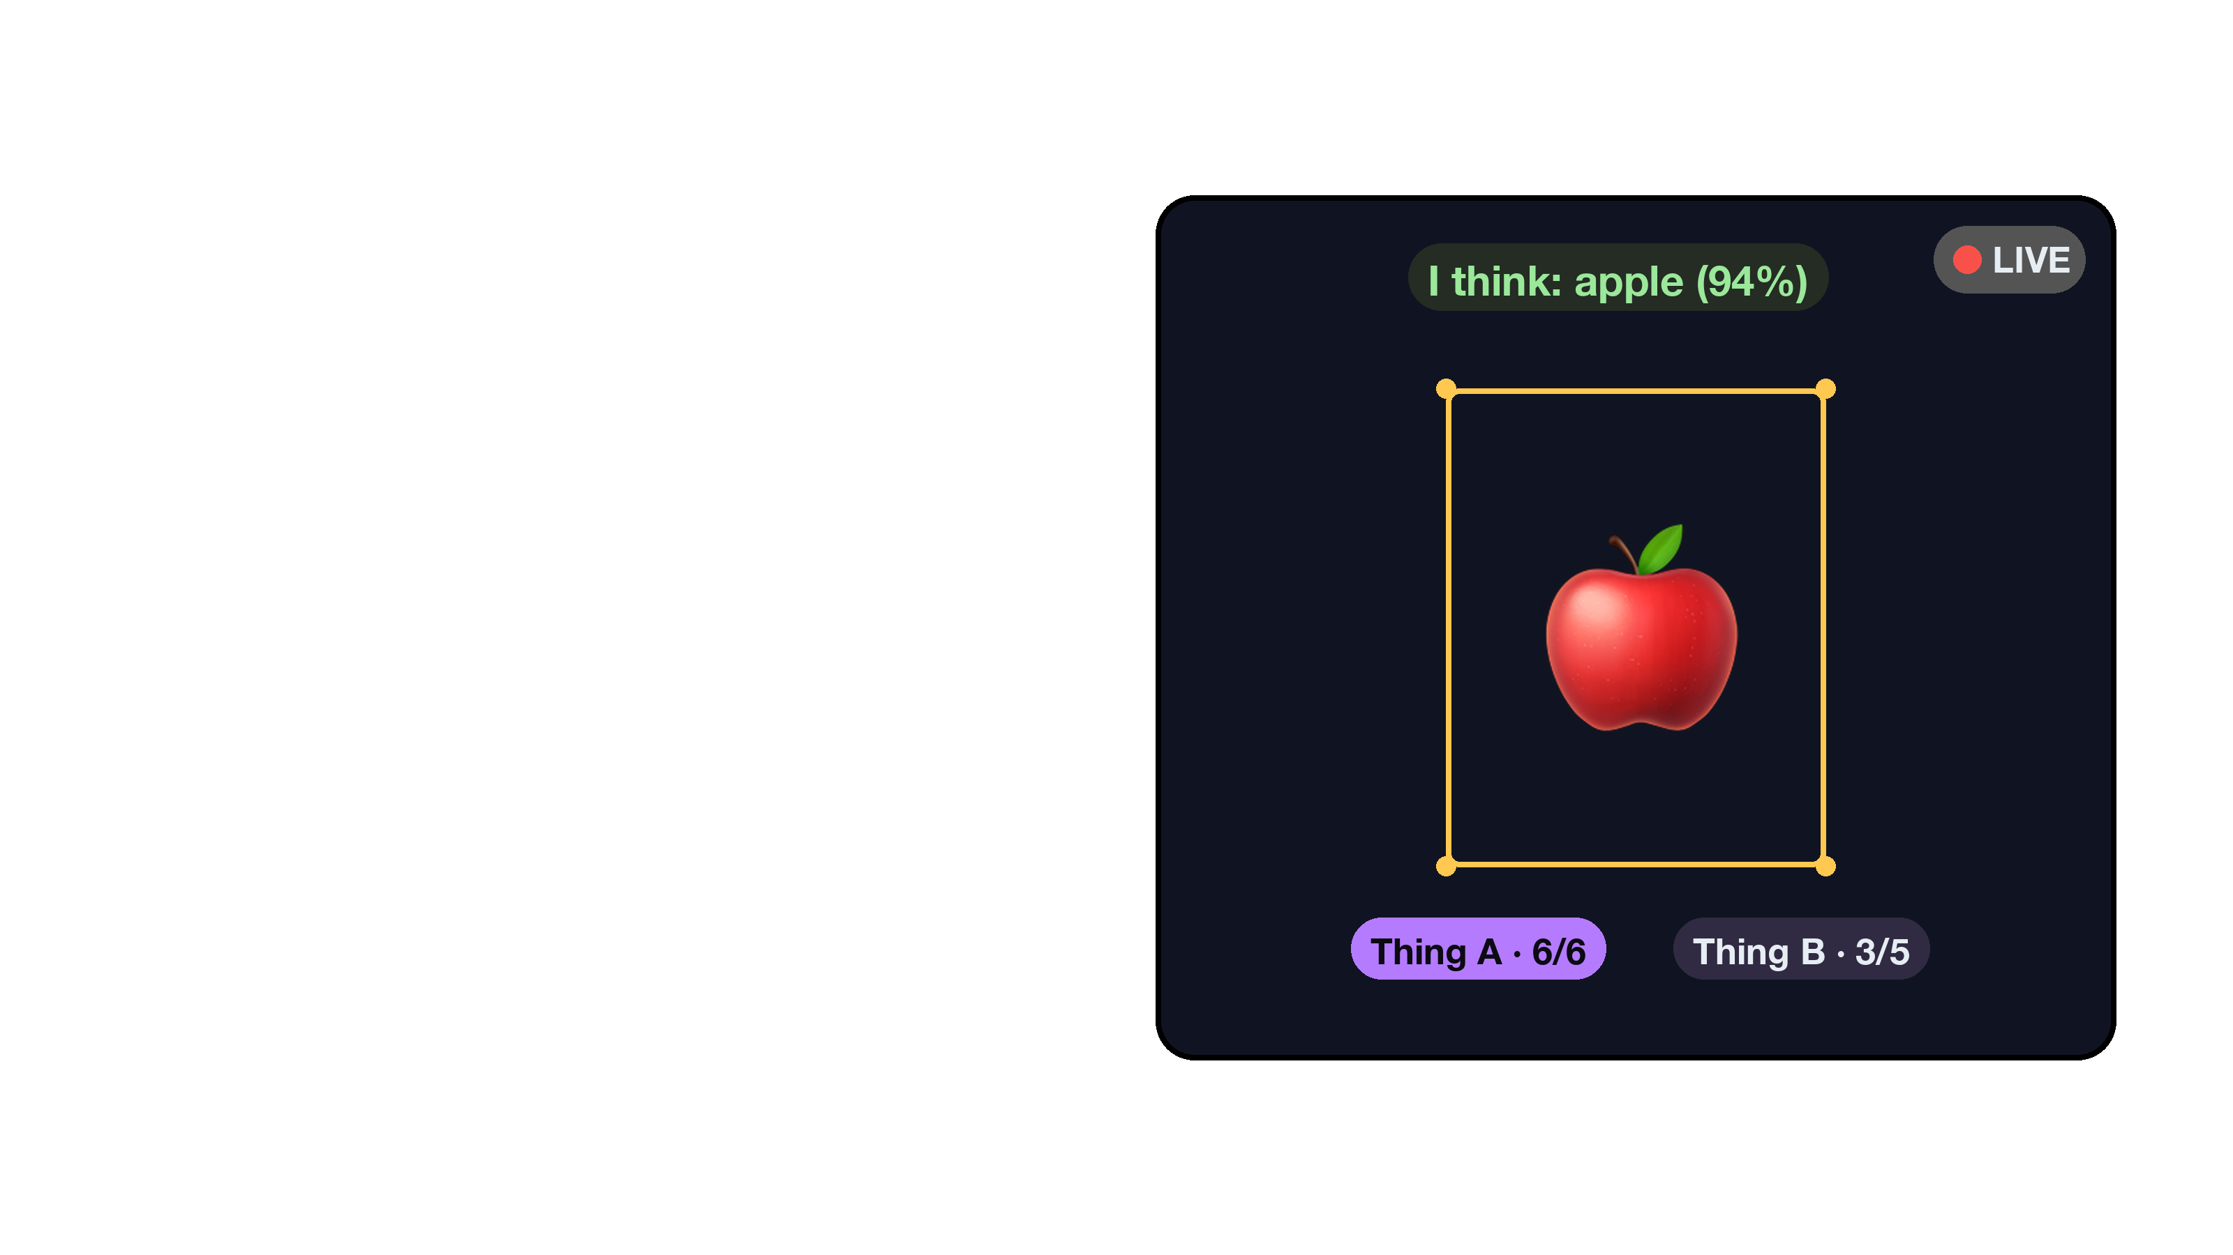
Train the AI
You are the coach
Notes:
Train the AI (English)
Layers: trainer_en_bg.png · trainer_en_screen.png · trainer_icon.png
Accent #B57BFF · type Helvetica Neue (Bold / Regular)
Title and tagline are real text boxes — edit them directly. Regenerate the layers with: python3 setup/make_station_cards.py --editable

Slide 5

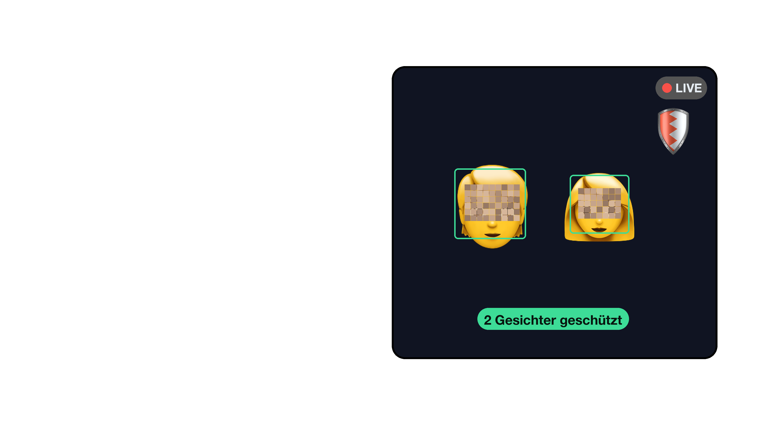

Privatsphäre-Schild
Schutz eingebaut
Notes:
Privatsphäre-Schild (Deutsch)
Layers: schild_de_bg.png · schild_de_screen.png · schild_icon.png
Accent #3DDC97 · type Helvetica Neue (Bold / Regular)
Title and tagline are real text boxes — edit them directly. Regenerate the layers with: python3 setup/make_station_cards.py --editable

Slide 6
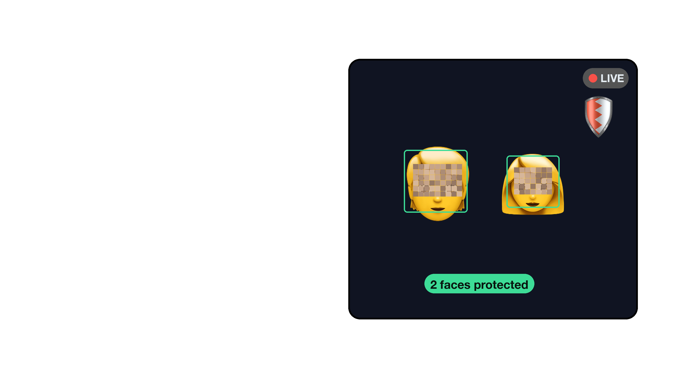
Privacy Shield
Protection built in
Notes:
Privacy Shield (English)
Layers: schild_en_bg.png · schild_en_screen.png · schild_icon.png
Accent #3DDC97 · type Helvetica Neue (Bold / Regular)
Title and tagline are real text boxes — edit them directly. Regenerate the layers with: python3 setup/make_station_cards.py --editable

Slide 7

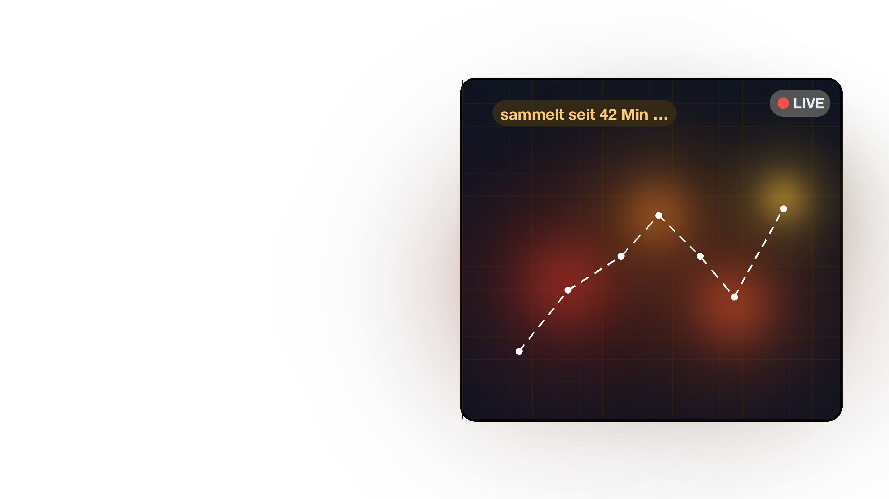

Die Datenspur
Was Kameras sammeln
Notes:
Die Datenspur (Deutsch)
Layers: spur_de_bg.png · spur_de_screen.png · spur_icon.png
Accent #FFB347 · type Helvetica Neue (Bold / Regular)
Title and tagline are real text boxes — edit them directly. Regenerate the layers with: python3 setup/make_station_cards.py --editable

Slide 8

The Data Trail
What cameras collect
Notes:
The Data Trail (English)
Layers: spur_en_bg.png · spur_en_screen.png · spur_icon.png
Accent #FFB347 · type Helvetica Neue (Bold / Regular)
Title and tagline are real text boxes — edit them directly. Regenerate the layers with: python3 setup/make_station_cards.py --editable

Slide 9

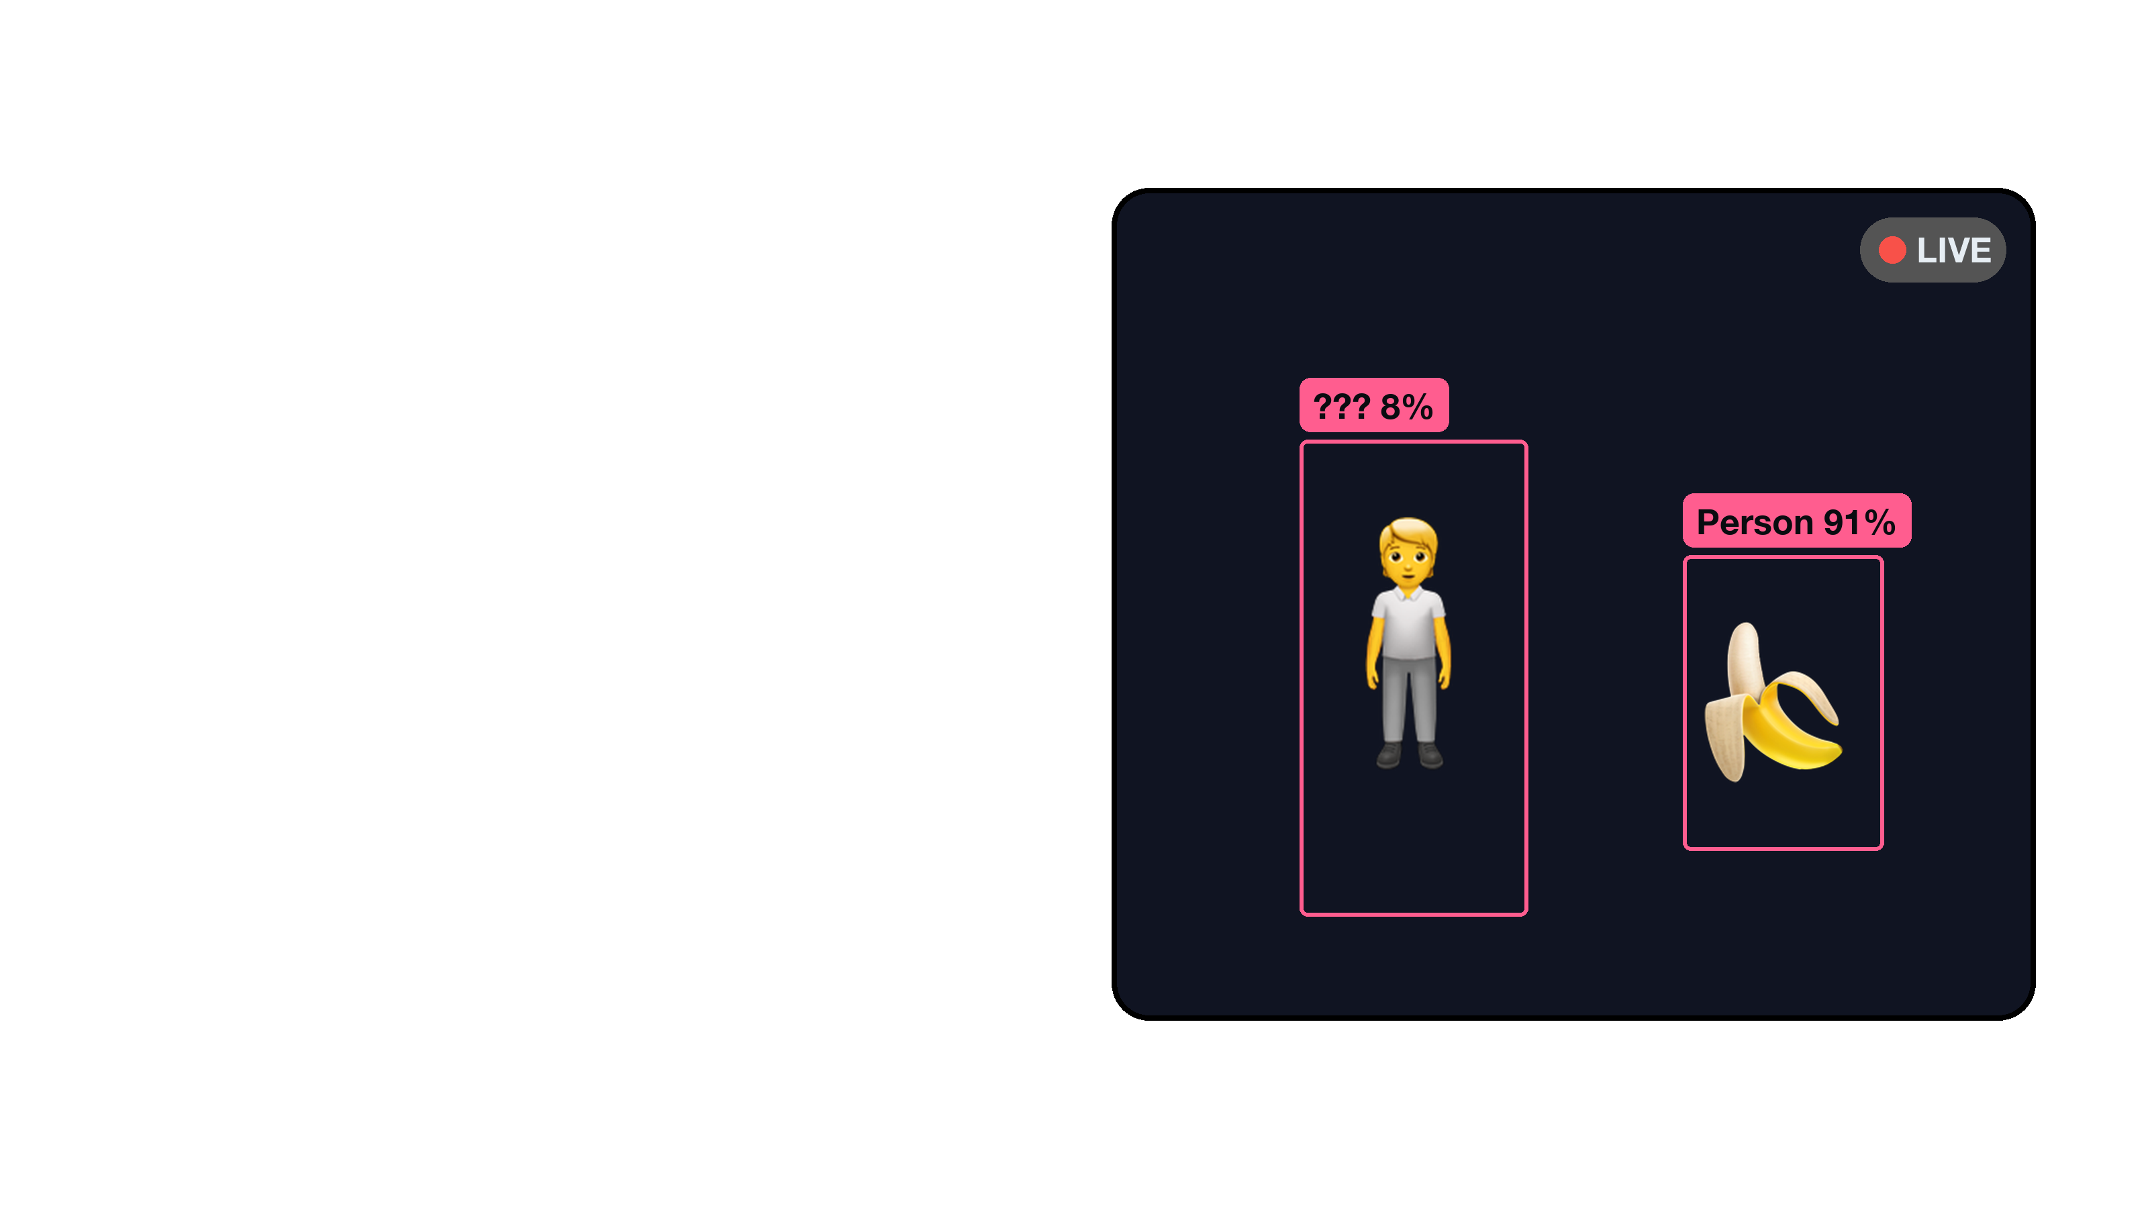

Täusche die KI
Finde ihre Grenzen
Notes:
Täusche die KI (Deutsch)
Layers: trick_de_bg.png · trick_de_screen.png · trick_icon.png
Accent #FF5D8F · type Helvetica Neue (Bold / Regular)
Title and tagline are real text boxes — edit them directly. Regenerate the layers with: python3 setup/make_station_cards.py --editable

Slide 10
Fool the AI
Find its limits
Notes:
Fool the AI (English)
Layers: trick_en_bg.png · trick_en_screen.png · trick_icon.png
Accent #FF5D8F · type Helvetica Neue (Bold / Regular)
Title and tagline are real text boxes — edit them directly. Regenerate the layers with: python3 setup/make_station_cards.py --editable

Slide 11

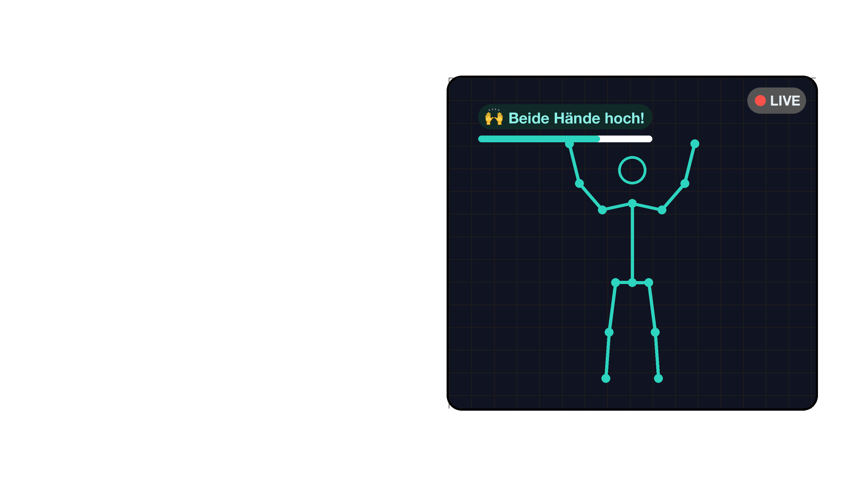

Skelett-Spiegel
Spiel ohne Bild
Notes:
Skelett-Spiegel (Deutsch)
Layers: pose_de_bg.png · pose_de_screen.png · pose_icon.png
Accent #2DD4BF · type Helvetica Neue (Bold / Regular)
Title and tagline are real text boxes — edit them directly. Regenerate the layers with: python3 setup/make_station_cards.py --editable

Slide 12
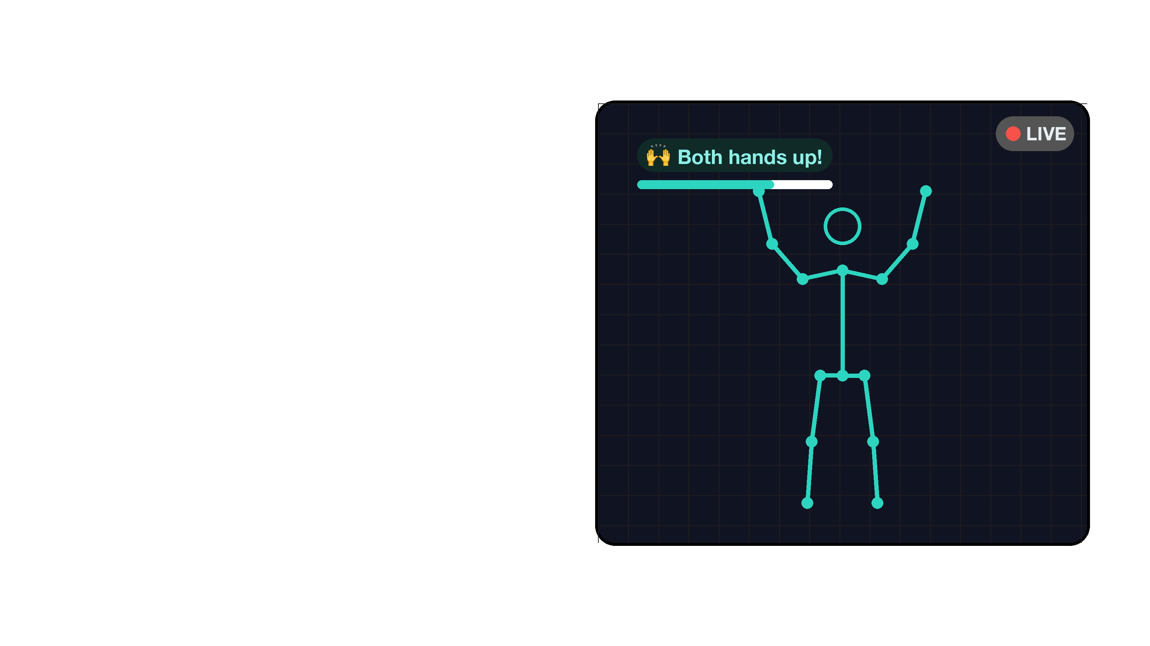
Skeleton Mirror
Play without pictures
Notes:
Skeleton Mirror (English)
Layers: pose_en_bg.png · pose_en_screen.png · pose_icon.png
Accent #2DD4BF · type Helvetica Neue (Bold / Regular)
Title and tagline are real text boxes — edit them directly. Regenerate the layers with: python3 setup/make_station_cards.py --editable

