Slide 1
One Decade of Commit Rights in DRM
Simona Vetter
LPC 2025, Tokyo
Notes:
meh

Slide 2
Commit Rights in DRM
https://blog.ffwll.ch/2016/09/commit-rights-in-the-linux-kernel.html
https://drm.pages.freedesktop.org/maintainer-tools/
This talk: the good, the bad & the ugly

Slide 3
Maintainers, Maintainers Everywhere!
missing steps in maintainer ladder fixed
no more «for life» maintainering
luxury of picking good teams

Slide 4
Review Market
tit for tat review market works ...
… with enough committers
no more maintainer pestering

Slide 5
The Good
maintainers everywhere
working review market
extremely relaxed subsystem maintainers

Slide 6
The Bad
committers are not fully trained maintainers
they screw up
sometimes really big
maintainer interference destroys the magic
tricky balance act

Slide 7
The Real Bad
just once in a decade
committers probably aggravating circumstance
people learned their lessons

Slide 8
The Ugly: Small Stuff
docs, scripts, checks: necessary but not sufficient
gitlab still mostly in waiting, CI is hard
more people, more cracks for patches to fall through

Slide 9
Tree Picking
committers default to one branch
$subsys-next always open
fewer topic branches
maintainers handle all topic branches/merges
more conflicts, merge resolution sharing is brittle
sometimes commit bad merge resolutions, oops

Slide 10
Tree Picking by Committers
flowchart that no one consistently gets right
occasionally hard-reset -fixes
still a pile of cherry-picks
no ongoing duties for maintainers

Slide 11
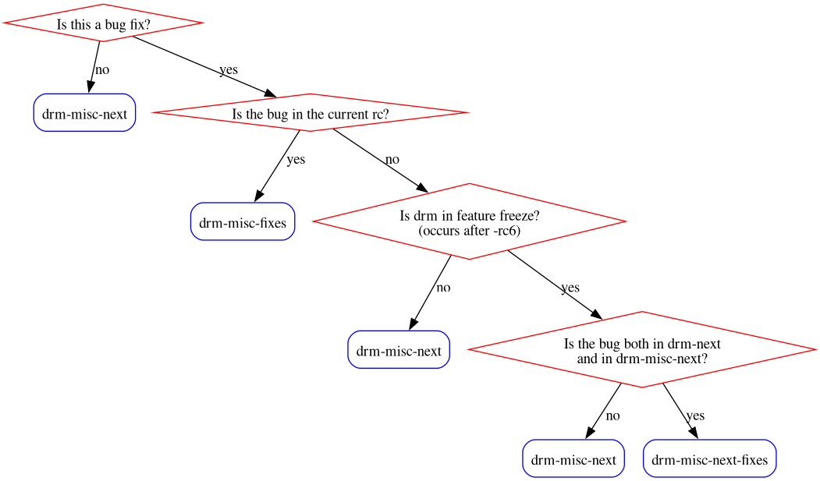
Tree Picking by Committers

Slide 12
Tree Picking by Maintainers
committers push to -next only
ongoing duty for maintainers
enormous piles of cherry-picks
https://lwn.net/Articles/1005222/
-stable tooling fixed since this year!!

Slide 13
Consensus Building
downside: more people, more voices, more conflict
upside: maintainers can focus on people&conflicts more

Slide 14
Summary/Questions
The Good: plenty of maintainers and review
The Bad: committers screw up, sometimes badly
The Ugly: cherry-picking, more chaos
overall much less control for maintainers

