Slide 1
Local Aircraft Analysis via Software Defined Radio
Daniel Morgan

Slide 2
Automatic Dependent Surveillance Broadcast
ADS-B is a surveillance technology that is used by aircraft to broadcast their position via satellite navigation or other sensors
The United States requires all commercial passenger carriers and aircraft flying in areas that require a transponder to be equipped
This information is broadcast on the 1090 MHz Frequency

Slide 3
Dump1090
Dump1090 is an opensource software that allows users to easily decode messages received on the 1090 frequency
https://github.com/antirez/dump1090
My set up consisted of a Raspberry Pi 3B+ and a Nooelec NESDR usb RTL-SDR antenna which constantly pumped data to a csv file stored on a hard drive
Aircraft send messages several times a second and could result in >2million data observations in a 24hour period
On week of reporting resulted in ~2GB of data

Slide 4
Data – test
A smaller test set was taken that contained 1569058 rows of 22 variables over the course of 15 hours on March 5th
Many of these variables were useless and were thus eliminated. The ones I paid attention to are the following:
Variables:
Transmission Type: Tells what type of message is being transmitted, different types send different variables
Aircraft Hex number: Aircraft identification number
DateTime: Date and Time a message was sent
Datetime Logged: Date and time a message was received
Call Sign: Flight identification Number
Altitude: Altitude in feet
Ground Speed: Horizontal speed in knots
Heading: Direction of aircraft
Latitude: Degrees north of the equator
Longitude: Degrees west of the prime meridian
Vertical Rate: Vertical velocity
Grounded: Indicates whether a aircraft has been grounded

Slide 5
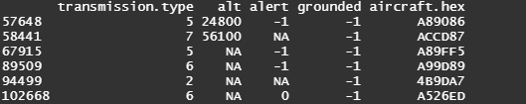
Model to predict grounded status
My initial plan was to build a model to predict planes that were to land at Lunken or CVG however there were inconsistencies in the data
Only .01% of the data ever indicated grounded and there was no proof that they had ever actually landed

Slide 6
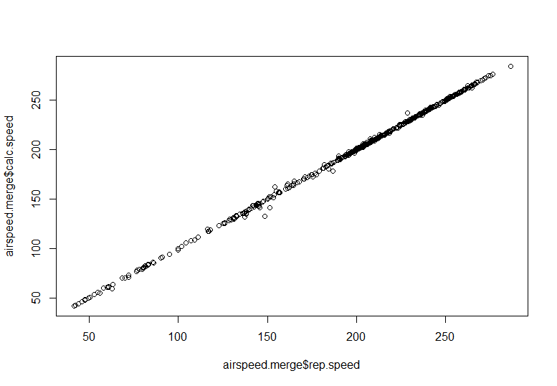
Speed Accuracy
Next, I sought to compare the reported speed to the theoretical speed calculated by geographical distance and time
Using a two sample t-test, I tested each theoretical mean speed against the reported mean speed of each aircraft and 6.5% reported a significant difference
Testing this proportion against 0, which is what we would expect the difference to be, also indicated a significant difference.
This leads me to question the accuracy of the reported ground speed

Slide 7
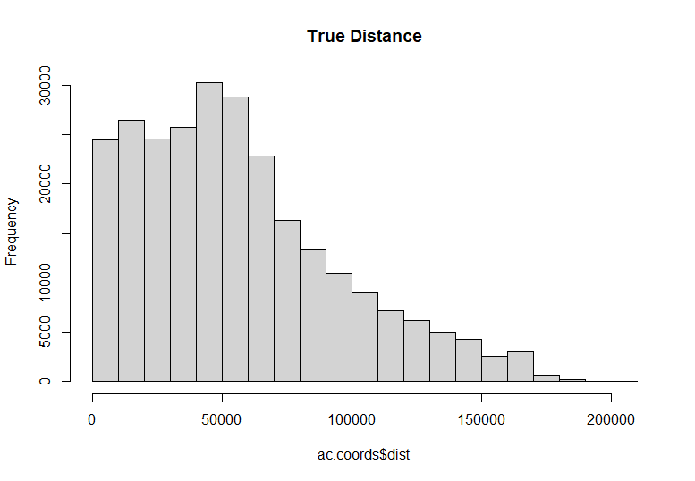
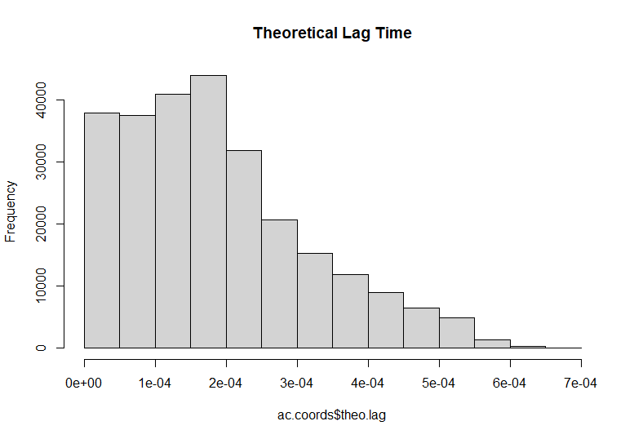
Lag Time and Distance
Another topic I wanted to explore was the lag time between when a message was sent and when it was received.
Since radio waves move at the speed of light, the lag time should be proportional to the distance even factoring in computational time

Slide 8
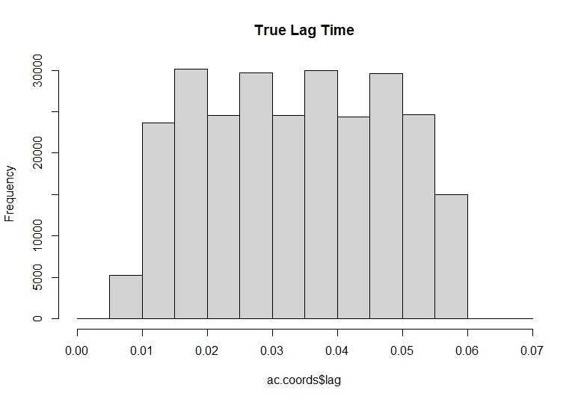
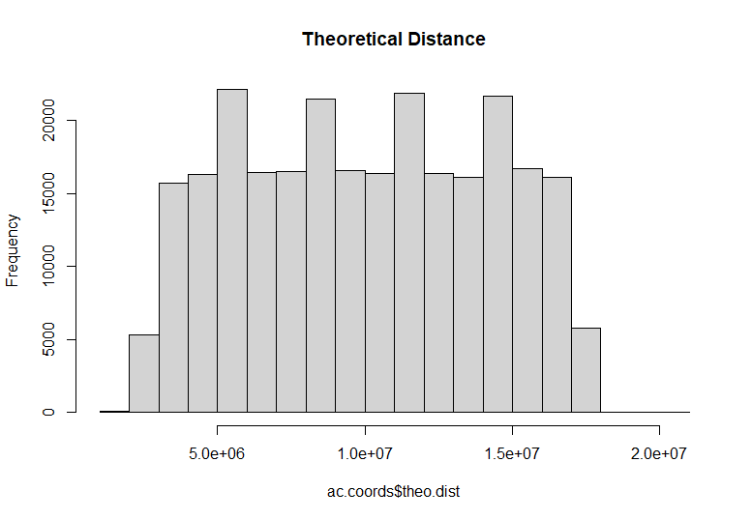
Lag Time and Distance
However, since the distance traveled was relatively small, the lag time seemed to be more influenced by the computational time
Without an accurate measure of the computational time or more significant digits in the lag time, it is very hard to accurately determine the distance

Slide 9
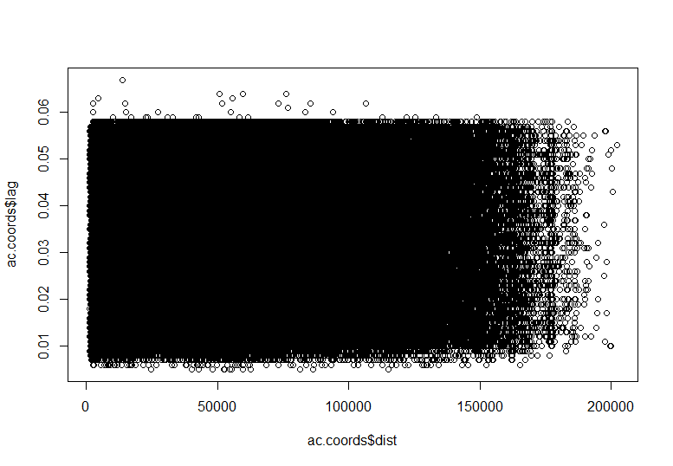
Lag time and Distance
There is not trend between the lag time and the distance.
Even when reducing the number of observations, the plot is basically white noise.

