Slide 1
Perspectives:
Can Host Authentication be Secure AND Cheap?
Demo + Software : http://www.cs.cmu.edu/~perspectives/
Dan Wendlandt - danwent@gmail.com
Carnegie Mellon University
Joint work with:
David G. Andersen and Adrian Perrig

Slide 2
Why should you care?
Using a traditional host PKI can be costly in $$ and admin time.
Perspectives used automated network probing to create a “lightweight PKI”:
  Makes SSH/self-signed HTTPS more secure + useable.
  Potential to offer cheap alternative to existing PKI solutions.
What I’m looking for:
  Your feedback / flames.
  If interested, your participation.

Slide 3


“Man in the Middle” (MitM) Attacks
secure channel
Alice needs Bob.com’s public key to establish a secure channel (e.g., SSL/SSH) to him.
Hello,Bob.com
K
Alice
Bob.com

Slide 4

“Man in the Middle” (MitM) Attacks
Is K really Bob.com’s key?
“secure” channel
Hello,Bob
Alice
K
Bob.com
Mallory
If Alice accepts K, Mallory can snoop and modify all traffic!

Slide 5
Do MitM Attacks Really Matter?
Recent trends increase MitM vulnerability
  Other hosts on a wifi LAN can spoof ARP/DNS.
    e.g., ARPIFrame worm
  Known vulnerabilities in home routers/APs.
  e.g., “Pharming” attacks
  Recent “Kaminsky” DNS attack vector.
Attacks are often automated & profit driven
Notes:
Most troubling of all, the ARPIFrame and pharming examples above are recent examples indicating a rise in MitM attacks that are both automated and profit driven. The most likely attacker is not a mallory tapping at a keyboard in a dark room, it is an automated worm written to hijack connections and still vast numbers of login credentials.

Slide 6
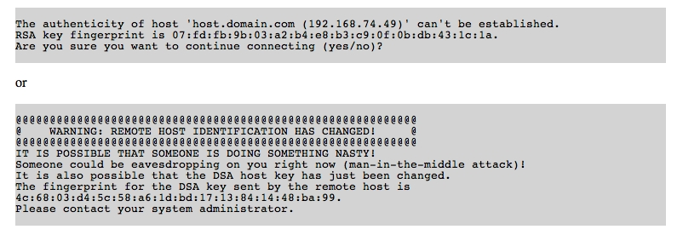
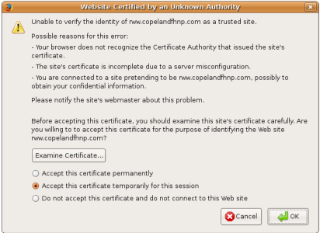
Authenticating Public Keys
  Two standard approaches to handling MitM attacks:
  Public Key Infrastructure (e.g., Verisign certs)
  Prayer (e.g., SSH and self-signed HTTPS)
Notes:
Its not exaggerating by much to say anyone who has typed “yes” or clicked OK on a menu like this has been entrusting the security of their data to a higher power.
It is possible to use SSH or self-signed certs securely, but that requires each user to essentially fulfill the role of a certificate authority themselves.
Our experience suggests that even people with a healthy understanding of Internet security tend to cross their fingers and continue in the face of such warnings.

Slide 7
Prayer (aka SSH-style Authentication)
Definition of SSH-style Authentication:
    Pray for no adversary on first connection, cache key.
    If key changes on a subsequent connection, panic!
    If you feel lucky, pray again and connect anyway.
Notes:
Anyone who has typed “yes” or clicked OK on a menu like this has been doing something resembling prayer.
Adding a server running SSH or self-signed SSL is simple. Just plug it in.
Note: blinding accepting changed keys offers zero security in the face of an active adversary, since an adversary can always cause a key change.

Slide 8
Why would anyone use prayer?
Unlike a PKI, it is cheap and simple to use.
A secure PKI traditionally requires:
  Costly (often manual) verification by a Certificate Authority
  Admin time to submit, install and replace certificates on each server.
SSH-style auth requires neither cost. It is “Plug-and-Play”
➔ SSH quickly + ubiquitously SSH replaced telnet.
Notes:
SSH Host Authentication is vulnerable to attack….

Slide 9
Our Approach: Strengthen the SSH Model
We design “Perspectives” to:
  Keep SSH-style “Plug-n-Play” simplicity + low-cost.
  Significantly improve attack resistance
Notes:
Want to emphasize: this talk is not saying that traditional PKIs and certificate authorities are useless. Far from it. For high-security and high-traffic websites, the additional cost and complexity is certainly warranted. But we think there is a significant portion of Internet communication that is not well-served by the traditional PKI model.

Slide 10
Perspectives Overview
N
Is K really Bob.com’s key?
K
Hello Bob.com
Bob.com’s Key?
N
K
K
Hello Bob.com
Bob.com’s Key?
K
Hello Bob.com
Alice
K
Bob.com
K
K
K,
K,
Bob.com’s Key?
K
Offered Key
Secure Notary Observations
N
K
Hello Bob.com
Client
Policy
Consistent
Accept Key, Continue
Inconsistent
Reject Key, Abort Connection
Notes:
* Notary response with key(s) they have seen bob using over the last month…

Slide 11
Perspectives: Attack Resistance Model
Spatial Resistance:
Multiple vantage points to circumvent localized attackers
N
N
N
N
Notes:
Show different picture on each one.
Adversary on one location
adversary on all links, but for a short time.

Slide 12
Perspectives: Attack Resistance Model
Temporal Resistance:
Key history raises alarm even if all paths are compromised.
K
K
N
N
K
N
N
K
Notes:
Show different picture on each one.
Adversary on one location
adversary on all links, but for a short time.

Slide 13
Perspectives: Attack Resistance Model
Temporal Resistance:
Key history raises alarm even if all paths are compromised.
K,K
K, K,
N
N
K, K
N
N
K ,K
Notes:
Show different picture on each one.
Adversary on one location
adversary on all links, but for a short time.

Slide 14
Perspectives: Attack Resistance Model
Temporal Resistance:
Key history raises alarm even if all paths are compromised.
K, K, K
K, K, K
N
N
K, K, K
N
N
Not bullet-proof, but significantly improves attack resistance.
K, K, K
Notes:
Show different picture on each one.
Adversary on one location
adversary on all links, but for a short time.

Slide 15
Perspectives Design
Who runs these network notaries?
How do notaries monitor keys/certificates?
How do clients securely retrieve notary data and decide to accept or reject a key?
Notes:
So now that you understand why we created Perspectives, let’s take a high-level look at the design of the system.

Slide 16
Who runs “network notary” servers?
Could be single player (e.g., Mozilla, Google, or EFF)
Or a “community deployment” with ISPs, universities, webhosts, etc. volunteering single nodes. Similar to:
  Public traceroute & looking-glass servers
  Academic network testbeds like PlanetLab and RON.
Our design + security analysis assumes that some notaries may be malicious/compromised at any time.
Notes:
Notary operators are well meaning, though not perfect.

Slide 17
Who runs “network notary” servers?
Currently targeting 10-30 global notary servers.
“master” public key shipped with client software.
Clients regularly fetch & verify a “notary list”:
  [notary ip, notary public key]
  [notary ip, notary public key]
  ……
  [notary ip, notary public key]
Notes:
Which is securely disseminated to clients.

Slide 18
How do notaries monitor keys?
Notary Server
Probing Modules
Protocol-specific probing modules mimic client behavior.
Notary regularly (e.g. daily) probes each service listed in database and updates its info.
HTTPS
SSH
Notary Database
HTTPS
www.shop.com:443
www.cs.cmu.edu:443
…..
www.secure.net:443
SSH
shell.foo.com:22
login.bar.net:22
…..
host1.cmu.edu:22
Notes:
Public key operation is on monitoring, rate controlled by

Slide 19
Notary Database Records
Service-id: www.shop.com:443, HTTPS
Key: 32:AC:21:5D:DE:43:73:E9:3A:EE:90:BC:17:C4:8F:36
Timespan: Start: Jan 9th, 2008 - 3:00 pm
End: Apr. 23rd, 2008 – 8:00 am
Key: F3:76:00:EC:D0:8E:DB:20:BC:2B:E0:06:60:24:C4:9F
Timespan: Start: Apr, 23th 2008 - 3:00 pm
End: Jun 27, 2008 – 8:00 am
HTTPS
www.shop.com:443
www.cs.cmu.edu:443
…..
www.secure.net:443
Signature
Created with Notary’s private key
Notes:
Signature is computed each time the service entry is updated. This entire chunk of data, including the signature, will be returned to the client that asks for information about SSH on shell.foo.com port 22.

Slide 20

How do clients receive notary data?
Firefox
Notary
HTTPS: www.shop.com
Port 443
key &
timespan
info
DB
Notary Client Code
signature
Verify using notary’s public key
Query & Response are UDP datagrams, like DNS.
Attacker cannot “spoof” notary reply.

Slide 21
Client Policies to accept/reject a key.
Test spatial and temporal “consistency”.
Many possible approaches to policies:
  Manual (power users)
      or
  Automatic (normal users)
Notes:
Note: unlike a PKI, the client does not simply verify a decision made by the notaries. Notaries reply with data, which the application can interpret with the users help, in the case of manual policies, or in the automatic case, with input based on the level of security desired by the client.

Slide 22
Manual Key Policies: Power Users
Give sophisticated users more detailed info:
  6/6 notaries have consistently seen the offered key from this service over the past 200 days.
  4/6 notaries currently see a different key!
  All notaries have seen the offered key for the past 8 hours, but previously all consistently saw key Y!
Power user would determine if offered key passes a “consistency threshold”.

Slide 23
Automated Key Policies: Normal Users
Automated “Consistency Thresholds” can be tailored to the individual client’s high-level security needs:
I really want to connect, just make sure I’m protected against simple (e.g., wifi) attacks.
If anything is fishy, be safe and don’t connect.
High Security
High Availability
100% of Notaries have seen offered key consistently for the past 3 days.
At least 50% of Notaries currently see offered key.
Our paper provides a detailed description and security analysis.

Slide 24
The Story so Far…
Traditional PKI model is costly and cumbersome.
Perspectives retains the low-cost and simplicity of SSH-style authentication while greatly improving attack resistance.
Not bullet-proof, but provides a security trade-off suitable for many non-critical websites.
Notes:
SSH was a pragmatic approach, validated by widespread deployment

Slide 25
Three Potential uses of Perspectives

Slide 26
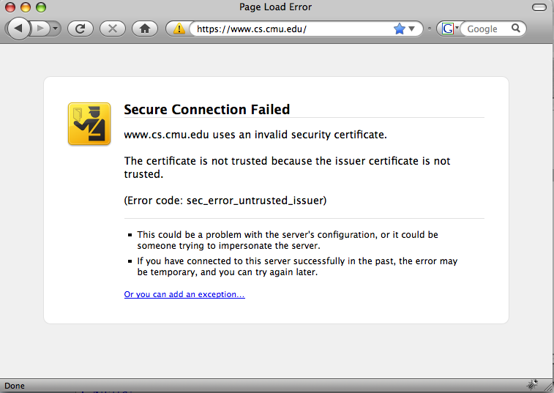
#1: Strengthen existing use of SSH and self-signed SSL
Recent changes to IE and Firefox make self-signed certs harder to use.
More than 10K people have downloaded and used our Firefox extension.

Slide 27
#2: Alternative for “low-end” CA-signed certs.
The HTTPS certificate market is splitting:
High-end certificates granted after manual verification of real-world identity.
(e.g., Extended Validation)
  Low-end certificates granted after automated email to WHOIS address.
  (e.g., Godaddy.com)
Secure but expensive
Cheap but less secure

Slide 28
#2: Alternative for “low-end” CA-signed certs.
Compared to current “low-end”, Perspectives:
Offers comparable security:
  A widespread attacker can likely spoof “verification” emails.
  This spoofing attack need not be long-lasting.
Is more convenient for server admins:
  No need to manually request/install a cert.
  Plays nicely with virtual hosting on a shared IP address.
Is based on freely available data:
  Server owners do not pay yearly “certificate tax”.
  Clients can make an individualized security trade-off.

Slide 29
#3: Provide an additional layer of security for root-signed SSL certificates
If an attacker can trick or compromise any one of the 30+ CAs, it can potentially spoof any website.
A client can detect that the attacker’s cert differs from the cert being seen by Notaries.
Also, website owners/third parties can monitor notary data to proactively detect attacks.

Slide 30
Publicly Available Notary Deployment
Currently running on the RON testbed.
Probes new services “on-demand”, adds them to DB.
Existing Notary Clients:
OpenSSH: “power user” policy if key is not cached.
Firefox 3: Automatically overrides security error page if notary data validates key.
Query via Web: If you can’t install software on the client.
Notes:
If you’ve been only half paying attention during this talk, this the slide I’d like you to perk up for.
Despite a somewhat naive implementation.

Slide 31
Notary Server Benchmarks
 | Probes / day | Queries / Sec
Modern Server: 4-core 2GHz, 8 GB RAM | 16.8 million | 25,000
3 year-old Workstation: 1-core 2.4GHz, 512MB RAM | 2.2 million | 21,000
Good News:
Current probing code is highly UNoptimized.
Operations are “trivially parallel” => easily scales with addition machines/cores.

Slide 32
Thanks!
Source and binaries available at:
http://www.cs.cmu.edu/~perspectives/
Interested in helping? danwent@gmail.com
Academic Paper:
http://www.cs.cmu.edu/perspectives_usenix08.pdf
Notes:
Currently no windows.

Slide 33
Back-up / Question Slides

Slide 34
Notary Bandwidth Requirements:
 | Upstream | Downstream
SSL | 0.5 KB | 2.0 KB
SSH | 1.5 KB | 2.3 KB
Single Probe:
 | Upstream | Downstream
SSL | 46 kbps | 185 kbps
SSH | 138 kbps | 213 kbps
Probe 1 million hosts / day
 | Upstream | Downstream
Single | 60 bytes | 315 bytes
@ 10 million / day | 55 kbps | 292 kbps
Client queries + responses.

Slide 35
What about DNSSEC?
Changing core protocols is painstaking work, adoption is uncertain.
Unclear how, if at all, DNSSEC verification of domain ownership will improve on the current “spoofable” model of email verification.
Still requires manual administration:
  Server admins must still request/install certs.
  Domain-owner must act as CA for all machines in the domain.

Slide 36
But SSL Certificates are Cheap!
Cheap certs use automated email verification.
Mimics notary probes, but makes less appealing trade-offs. Consider that:
Server owner must still manually generate, request, install cert.
An attacker powerful enough to fool Perspectives could often spoof an email response.
Only a single CA must be fooled, and the attack need only last long enough to request a cert.

Slide 37
Notaries and User Privacy
  Issue: A malicious notary might record (request src-IP, service-id) pairs to try and “track” users.
A legitimate concern, but not a deal-breaker:
  Source IP is an increasingly weak identifier of a human user (NAT/DHCP). Source ISP already sees all traffic.
  Clients need only query when key is not cached. This is relatively infrequent, and a trade-off used to mitigate risk
  Paper discusses possibility of DNS being used as a proxy to hide source IP.
  Long-term: servers act as intermediary to retrieve notary results, completely protecting client privacy.

Slide 38
Limitation: Clients directly contact Notaries
The Problem:
System vulnerable to widespread Notary failures or denial-of-service.
Privacy concerns. Notary query could expose (client IP, service-name) pairs.

Slide 39
Limitation: Clients directly contact Notaries
In the short-term:
Static notary replies are amenable to CDNs.
Querying via a proxy (e.g., using DNS) provides anonymity + caching benefits.
In the long-term:
A destination server could proactively fetch + cache notary results for its own name.
➔ Clients would not contact notaries at all.

Slide 40
Other Related Work
Portable SSH key cache [Ali & Smith]
  Centralized repository for all keys seen by a user
  Helps if user sees the same new key from different source machines.
  No help first time user connects or sees a new key.
SSH key fingerprints in DNS [RFC 4255]
  Requires DNSSEC, each DNS admin must act as Cert. Authority
Web Tripwires [Reis, et al]
  In-band Javascript detects modifications, but can be removed by an atacker.
Concurrent Work: On-demand HTTPS cert. verification [Stone-Gross, et al]
  HTTPS-only, no temporal history, simplified security model.
Notes:
Earlier in talk, just give confidns a shout out as having a similar intuition.
Backup slide: other approaches to securing SSH and SSL .
Many opinions on deployment of secure DNS.

Slide 41
Automated Key Policies: Normal Users
Quorum must be a fraction of the total number of queried notaries, not responses received.
Notary #1
Notary #2
Notary #3
Notary #4
Notary #5
K_{A}
K_{A}
K_{A}
K_{B}
K_{A}
  Adversary on client link can selectively drop notary replies.

Slide 42
Perspectives and ConfiDNS
They have a cooler name
Same intuition: spatial + temporal diversity
Different problems resulted in different design decisions:
  ConfiDNS focuses on bad local DNS resolver, we focus compromise of arbitrary network elements.
  DNS-to-name mappings legitimately differ more frequently than hostname to key mappings (e.g., locality based load balancing).

Slide 43
Security vs. Availability Trade-off
Legitimate key change is indistinguishable from an attack that is both widespread and long-lasting.
A client that sets a high quorum duration threshold to increase attack resistance would reject any new key for the same amount of time, even if it is legitimate.

Slide 44
Security vs. Availability Trade-off
In the short-term:
Clients can set QD based on individual needs.
No free lunch: services with stringent security & availability needs should use root-signed certs.
In the long-term:
A destination server could detect attacks and alert administrators by periodically querying notaries for its own name.
➔ Clients would not contact notaries at all.

Slide 45
How to Improve SSH-style Authentication?
SSH-style clients warn the user and ask her to make a security decision
The frequent “content free” warnings are usually ignored.
Perspectives provides additional data to distinguish between an attack and a spurious warning.
Notes:
No information => useless warnings that are ignored by users.

Slide 46
Automated Key Policies: Normal Users
quorum: a minimum threshold of notary agreement needed to consider a key valid.
Example: client configured with quorum of 75%
Notary #1
Notary #2
Notary #3
Notary #4
Notary #5
K_{A}
K_{A}
K_{A}
K_{B}
K_{A}
If offered key is K_{A}: 80% > 75% ➔ Accept

Slide 47
Automated Key Policies: Normal Users
Define “quorum duration” : given quorum threshold,
  the length of time a particular key has held quorum.
Notes:
Make time discrete. As if they monitor once a day.

Slide 48

Automated Key Policies: Normal Users
Define “quorum duration” : given quorum threshold,
  the length of time a particular key has held quorum.
Accept Key
Example Threshold: Quorum = 0.75 Duration = 2 days
Notary #1
Notary #2
Notary #3
Notary #4
Notary #5
3 days
K_{A}
K_{A}
K_{B}
K_{A}
2 days
K_{A}
K_{A}
K_{A}
K_{A}
1 day
K_{A}
K_{A}
K_{A}
K_{A}
Duration
Notes:
Make time discrete. As if they monitor once a day.

Slide 49
Key Policies: Normal Users
Define “quorum duration” : given quorum threshold,
  the length of time a particular key has held quorum.
Reject Key!
Example Threshold: Quorum = 0.75 Duration = 3 days
Notary #1
Notary #2
Notary #3
Notary #4
Notary #5
3 days
K_{A}
K_{A}
K_{B}
K_{A}
2 days
K_{A}
K_{A}
K_{A}
K_{A}
1 day
K_{A}
K_{A}
K_{A}
K_{A}
Duration

Slide 50
The Security vs. Availability Trade-off
Fundamental SSH-style authentication trade-off:
  Clients gain security at the cost of availability (i.e., rejecting a key and disconnecting).
Quorum duration flexibly encodes this trade-off:
  Higher quorum threshold is more secure:
  => but client is more likely to reject valid key due to notary compromise or failure.
  Higher quorum duration threshold is more secure:
  => but client rejects valid servers with new keys.
Notes:
Show example where 2/3 notary links see bad key, client rejects bad key.
Compromise or disable.
This should be rare, since an attack is in progress. Still it’s a fundamental trade-off.

