Slide 1
Perspectives:
Improving SSH-style Host Authentication or
How to Strengthen Tofu
Software download: http://www.cs.cmu.edu/~perspectives/
Dan Wendlandt - danwent@gmail.com - Carnegie Mellon
Joint work with:
David G. Andersen and Adrian Perrig

Slide 2


“Man in the Middle” (MitM) Attacks
secure channel
Alice needs Bob’s public key to establish a secure channel (e.g., SSL/SSH) to him.
Hello,Bob
K_{A}
Alice
Bob

Slide 3

“Man in the Middle” (MitM) Attacks
Is K_{B} really Bob’s key?
“secure” channel
Hello,Bob
Alice
K_{B}
Bob
Mallory
If Alice accepts K_{B} Mallory can snoop and modify all traffic!

Slide 4
Do MitM Attacks Really Matter?
Recent trends increase MitM vulnerability
  Other hosts on a wireless can spoof ARP/DNS.
    (e.g., ARPIFrame worm)
  Access points/home routers may be poorly administered or have known vulnerabilities.
    (e.g., “Pharming” attacks)
These attacks are automated & profit driven
Notes:
Most troubling of all, the ARPIFrame and pharming examples above are recent examples indicating a rise in MitM attacks that are both automated and profit driven. The most likely attacker is not a mallory tapping at a keyboard in a dark room, it is a worm worm written to hijack connections and still vast numbers of login credentials.

Slide 5
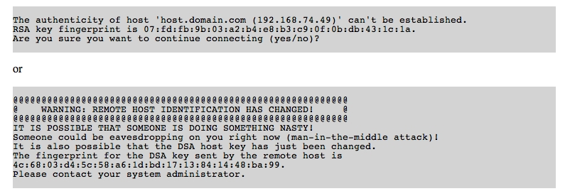
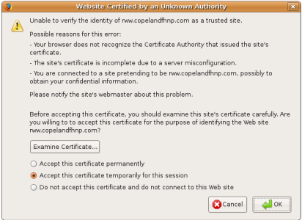
Obtaining Authentic Public Keys
  Two standard approaches to handling MitM attacks:
  Public Key Infrastructure (e.g., Verisign certs)
  Prayer
Notes:
Its not exaggerating by much to say anyone who has typed “yes” or clicked OK on a menu like this has been entrusting the security of their data to a higher power.
It is possible to use SSH or self-signed certs securely, but that requires each user to essentially fulfill the role of a certificate authority themselves.
Our experience suggests that even people with a healthy understanding of Internet security tend to cross their fingers and continue in the face of such warnings.

Slide 6
Trust-on-first-use Authentication
Why prayer? Isn’t that insecure?
  Yes, but unlike a PKI, it’s simple & cheap.
  No manual work when adding a server, just plug-and-play.
  Consider how quickly SSH replaced telnet
We call this: “Trust-on-first-use” (Tofu):
    Assume no adversary on first connection, cache key.
    If key changes, panic! Then (perhaps) pray.
SSH keys do change legitimately:
Consider recent key generation vulnerability in Debian.
Notes:
Anyone who has typed “yes” or clicked OK on a menu like this has been doing something resembling prayer.
Adding a server running SSH or self-signed SSL is simple. Just plug it in.
Note: blinding accepting changed keys offers zero security in the face of an active adversary, since an adversary can always cause a key change.

Slide 7
The goal of Perspectives
Our Goal: Strengthen Tofu
  Significantly improve attack resistance
  Keep simple SSH-style deployment model.
Can we find a better “middle-ground” between Tofu and a full blown PKI?

Slide 8
How to Improve on Tofu
With Tofu, clients face a security decision:
- When first connecting to a server.
- Any time a key mismatch is detected.
But Tofu gives little/no helpful information!
Notes:
I mean, have you ever looked at one of these SSH warning messages in detail? They basically say: something really bad may be happening, or things may be completely find. Would you like to continue?

Slide 9
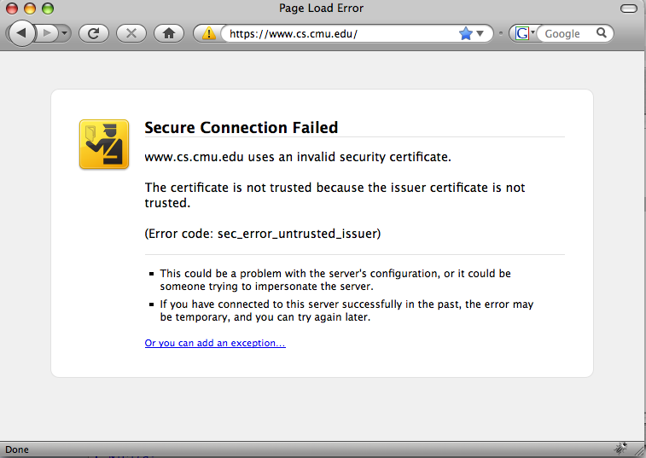
How to Improve on Tofu
With self-signed HTTPS:
Difficult for users to validate new/changed keys.
Frequent spurious warnings “train” users to ignore ALL warnings
Recent IE & Firefox treat self-signed as failure, not a warning.
Perspectives provides additional data to distinguish between an attack and a spurious warning.
Notes:
The difficult, and sometimes impossible if you are not in control of the remove

Slide 10
Perspectives Overview
K_{A}
N
Bob’s Key?
K_{A}
N
Bob’s Key?
Hello,Bob
Alice
K_{A}
Bob
K_{A}
Bob’s Key?
K_{A}
K_{A}
K_{A}
Offered Key
Observations
N
K_{A}
Client
Policy
Consistent
Accept Key, Continue
Inconsistent
Reject Key, Abort Connection
Notes:
* Notary response with key(s) they have seen bob using over the last month…

Slide 11
Perspectives: Attack Resistance Model
Spatial Resistance:
Multiple vantage points to circumvent localized attackers
N
N
N
N
Notes:
Show different picture on each one.
Adversary on one location
adversary on all links, but for a short time.

Slide 12
Perspectives: Attack Resistance Model
Temporal Resistance:
Key history raises alarm even if all paths are compromised.
K_{A}
K_{A}
N
N
K_{A}
N
N
K_{A}
Notes:
Show different picture on each one.
Adversary on one location
adversary on all links, but for a short time.

Slide 13
Perspectives: Attack Resistance Model
Temporal Resistance:
Key history raises alarm even if all paths are compromised.
K_{A},K_{A}
K_{A} K_{A},
N
N
K_{A}, K_{A}
N
N
K_{A} ,K_{A}
Notes:
Show different picture on each one.
Adversary on one location
adversary on all links, but for a short time.

Slide 14
Perspectives: Attack Resistance Model
Temporal Resistance:
Key history raises alarm even if all paths are compromised.
K_{A} K_{A}, K_{B}
K_{A} K_{A}, K_{B}
N
N
K_{A} K_{A}, K_{B}
N
N
Not bullet-proof, but significantly more attack resistant than Tofu.
K_{A} K_{A}, K_{B}
Notes:
Show different picture on each one.
Adversary on one location
adversary on all links, but for a short time.

Slide 15
Perspectives Design
Who runs these network notaries?
How do notaries probe servers?
How do clients use notary data to accept or reject a key?
Notes:
So now that you understand why we created Perspectives, let’s take a high-level look at the design of the system.

Slide 16
Who runs notary servers?
A “community deployment” with universities, ISPs, or hosting providers volunteering to host a single notary.
  Public traceroute & looking-glass servers
  Academic network testbeds like PlanetLab and RON.
Design assumes notaries are only “semi-trusted”.
Clients regularly download “notary list” to bootstrap.
  [notary ip, notary public key]
  [notary ip, notary public key]
  ……
  [notary ip, notary public key]
Notes:
Which is securely disseminated to clients.

Slide 17
How do notaries monitor keys?
Probing Modules
HTTPS
SSH
Probing modules mimic client.
Notary regularly (e.g. daily) probes each service listed in database and updates its info.
Notary Database
HTTPS
www.shop.com:443
www.cs.cmu.edu:443
…..
www.secure.net:443
SSH
shell.foo.com:22
login.bar.net:22
…..
host1.cmu.edu:22
Notes:
Public key operation is on monitoring, rate controlled by

Slide 18
Notary Database Records
Service-id: www.shop.com:443
Key: 32:AC:21:5D:DE:43:73:E9:3A:EE:90:BC:17:C4:8F:36
Timespan: Start: Jan 9th, 2008 - 3:00 pm
End: Apr. 23rd, 2008 – 8:00 am
Key: F3:76:00:EC:D0:8E:DB:20:BC:2B:E0:06:60:24:C4:9F
Timespan: Start: Apr, 23th 2008 - 3:00 pm
End: Jun 27, 2008 – 8:00 am
HTTPS
www.shop.com:443
www.cs.cmu.edu:443
…..
www.secure.net:443
Signature
Created with Notary’s private key
Notes:
Signature is computed each time the service entry is updated. This entire chunk of data, including the signature, will be returned to the client that asks for information about SSH on shell.foo.com port 22.

Slide 19

How do clients receive notary data?
Firefox
Notary
HTTPS: www.shop.com
Port 443
key &
timespan
info
DB
Notary Extension
signature
Verify using notary’s public key
Query & Response are UDP datagrams, like DNS.
Client rejects if signature is invalid.

Slide 20
Client Policies to accept/reject a key.
Test spatial and temporal “consistency”.
Many possible approaches to policies:
  Manual (power users)
      or
  Automatic (normal users)
Notes:
Note: unlike a PKI, the client does not simply verify a decision made by the notaries. Notaries reply with data, which the application can interpret with the users help, in the case of manual policies, or in the automatic case, with input based on the level of security desired by the client.

Slide 21
Manual Key Policies: Power Users
Give sophisticated users more detailed info than Tofu.
  6/6 notaries have consistently seen the offered key from this service over the past 200 days.
  4/6 notaries currently see a different key!
  All notaries have seen the offered key for the past 8 hours, but previously all consistently saw key Y!

Slide 22
Automated Key Policies: Normal Users
quorum: minimum notary agreement needed to consider a key valid.
Notary #1
Notary #2
Notary #3
Notary #4
Notary #5
K_{A}
K_{A}
K_{A}
K_{B}
K_{A}
If offered key is K_{A}:
if Q <= 80% then Accept
else then Reject

Slide 23
Automated Key Policies: Normal Users
Quorum must be a fraction of the total number of queried notaries, not responses received.
Notary #1
Notary #2
Notary #3
Notary #4
Notary #5
K_{A}
K_{A}
K_{A}
K_{B}
K_{A}
  Adversary on client link can selectively drop notary replies.

Slide 24
Automated Key Policies: Normal Users
Define “quorum duration” : given quorum threshold,
  the length of time a particular key has held quorum.
Notes:
Make time discrete. As if they monitor once a day.

Slide 25

Automated Key Policies: Normal Users
Define “quorum duration” : given quorum threshold,
  the length of time a particular key has held quorum.
Accept Key
Example Threshold: Quorum = 0.75 Duration = 2 days
Notary #1
Notary #2
Notary #3
Notary #4
Notary #5
3 days
K_{A}
K_{A}
K_{B}
K_{A}
2 days
K_{A}
K_{A}
K_{A}
K_{A}
1 day
K_{A}
K_{A}
K_{A}
K_{A}
Duration
Notes:
Make time discrete. As if they monitor once a day.

Slide 26
Key Policies: Normal Users
Define “quorum duration” : given quorum threshold,
  the length of time a particular key has held quorum.
Reject Key!
Example Threshold: Quorum = 0.75 Duration = 3 days
Notary #1
Notary #2
Notary #3
Notary #4
Notary #5
3 days
K_{A}
K_{A}
K_{B}
K_{A}
2 days
K_{A}
K_{A}
K_{A}
K_{A}
1 day
K_{A}
K_{A}
K_{A}
K_{A}
Duration
Notes:
Make time discrete. As if they monitor once a day.

Slide 27
Security vs. Availability
Fundamental network authentication trade-off:
  Clients gain security at the cost of availability (i.e., rejecting a key and disconnecting).
quorum/quorum duration” encode this trade-off:
  Higher quorum threshold is more secure:
  => but client is more likely to reject valid key due to notary compromise or failure.
  Higher quorum duration threshold is more secure:
  => but client rejects valid servers with new keys.
Notes:
Show example where 2/3 notary links see bad key, client rejects bad key.
Compromise or disable.
This should be rare, since an attack is in progress. Still it’s a fundamental trade-off.

Slide 28
Making a Flexible Trade-off
Perspectives allows each client to individually make a security vs. availability trade-off.
In contrast a traditional PKI applies a single criteria for all clients.

Slide 29
Summary
Operating a large host PKI is cumbersome.
Trust-on-first-use authentication is simple and cheap, but vulnerable to MitM attacks.
Perspectives improves Tofu attack resistance while preserving the “plug-and-play” simplicity of SSH-style authentication.
Notes:
SSH was a pragmatic approach, validated by widespread deployment

Slide 30
Publicly Available Notary Deployment http://www.cs.cmu.edu/~perspectives/
Currently running on the RON testbed.
Probes new services “on-demand”, adds them to DB
Benchmarks: well-equipped node can simultaneously:
Probe 8 million hosts in a day
Handle 10,000 requests/sec
To scale, probing and query handling can be distributed across several cooperating machines.
Notes:
If you’ve been only half paying attention during this talk, this the slide I’d like you to perk up for.
Despite a somewhat naive implementation.

Slide 31
OpenSSH & Firefox Notary Clients
OpenSSH: “power user” policy if key is not cached.
Firefox 3: Automatically overrides security error page if notary data validates key.
Query via Web: If you can’t install software on the client.
Source and binaries (Linux/OSX) available at:
http://www.cs.cmu.edu/~perspectives/
Interested in helping? danwent@gmail.com
Notes:
Currently no windows.

Slide 32
Notaries and User Privacy
  Issue: A malicious notary might record (request src-IP, service-id) pairs to try and “track” users.
A legitimate concern, but not a deal-breaker:
  Source IP is an increasingly weak identifier of a human user (NAT/DHCP). Source ISP already sees all traffic.
  Clients need only query when key is not cached. This is relatively infrequent, and a trade-off used to mitigate risk
  Paper discusses possibility of DNS being used as a proxy to hide source IP.

Slide 33
Perspectives and ConfiDNS
They have a cooler name
Same intuition: spatial + temporal diversity
Different problems resulted in different design decisions:
  ConfiDNS focuses on bad local DNS resolver, we focus compromise of arbitrary network elements.
  DNS-to-name mappings legitimately differ more frequently than hostname to key mappings (e.g., locality based load balancing).

Slide 34
Other Related Work
Portable SSH key cache [Ali & Smith]
  Helps when user sees the same new/changed key from different source machines.
  No help first time user connects or sees a new key.
SSH key fingerprints in DNS [RFC 4255]
  Requires DNSSEC, each DNS admin must act as Cert. Authority
Web Tripwires [Reis, et al]
  Lightweight Javascript detects modifications, but can be removed.
Concurrent Work: On-demand HTTPS probes [UCSB]
  HTTPS-only, no temporal history, simplified security model.
Notes:
Earlier in talk, just give confidns a shout out as having a similar intuition.
Backup slide: other approaches to securing SSH and SSL .
Many opinions on deployment of secure DNS.

