Slide 1
EduNext
An Adaptive Learning Platform Using On-Device Attention and Emotion Sensing
Sri Sivasubramaniya Nadar College of Engineering · Academic Year 2026–2027
Privacy-first · Personalised · Adaptive — all sensing on-device
Live: edunext-learn.vercel.app

Slide 2
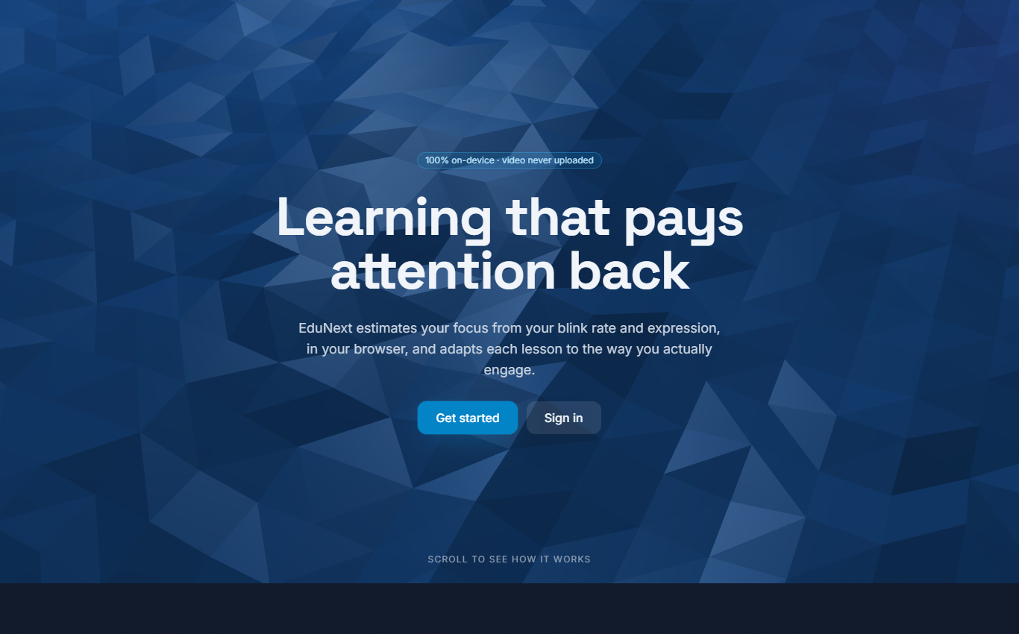
Introduction & Objectives
• Online learning lost a key feedback channel — it can't tell when a learner is engaged, confused, or tired.
• EduNext estimates focus from webcam blink rate + facial emotion (and quick feedback) and adapts the lesson.
• All sensing runs in the browser — no video ever leaves the device.
• Objectives:
  – Build a personal blink baseline per learner (calibration)
  – Estimate live engagement by fusing blink, emotion & feedback
  – Adapt lesson pace / replay / break / format in real time
  – Guarantee privacy (on-device) and ship a working app
EduNext landing page

Slide 3
Research Gap & Problem Statement
• Existing attention-aware tools fall into three gaps:
  – Privacy — they stream video / use the cloud (uncomfortable, esp. for minors)
  – Personalisation — fixed thresholds ignore that blink rate varies per person
  – Trust — attention is logged or used punitively, not to help the learner
• Problem statement:
  – Estimate engagement in real time from on-device webcam signals, personalise it via a short calibration, and use it to adapt lessons helpfully and transparently — with no image leaving the browser.

Slide 4
Literature Survey
• Blink & attention: Nakano et al. (blink timing ↔ attention); Ranti et al. (blink rate ↔ cognitive load).
• Emotion & affect: Maffei & Angrilli (blink ↔ emotional state); Ekman & Friesen (facial expressions).
• Engagement: Csikszentmihalyi — Flow theory (sustained engagement, adapting difficulty).
• Tooling: MediaPipe FaceMesh (landmarks → Eye Aspect Ratio); face-api.js (in-browser expressions).
• Patent/product scan: commercial tools stream video or need special hardware — no single privacy-first, personalised, non-punitive offering; only permissive open-source used.

Slide 5
Novelty / Innovation
• Fully on-device sensing — only derived numbers stored; enforced by an automated privacy test.
• Personalised blink baseline — attention zones rescaled to each learner (defaults as fallback).
• Multi-signal fusion — blink (0.45) + emotion (0.35) + feedback (0.20), re-weighted & smoothed.
• Transparent, non-punitive adaptation — breaks / replay / pace / format, each with a plain reason.
• Learning-style detection + honest 'estimates, not diagnoses' framing throughout.

Slide 6
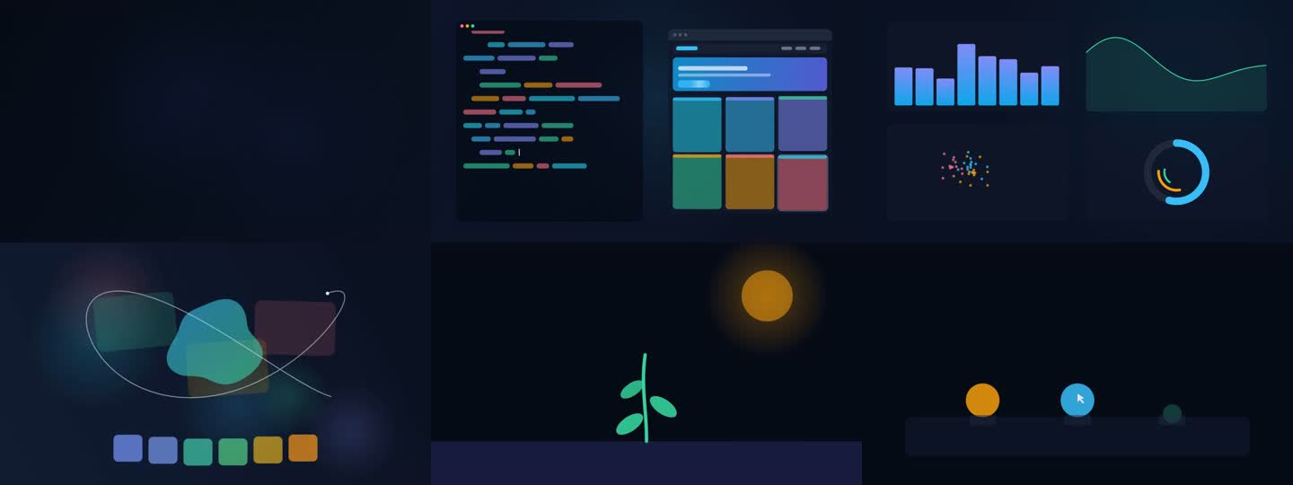
Methodology — Architecture & Sensing
• Monorepo: shared formulas (one source of truth) · Express/SQLite backend · React frontend.
• On-device pipeline (per frame):
  – MediaPipe FaceMesh → Eye Aspect Ratio → blink state machine → blinks/minute
  – face-api.js ~1 Hz → 7 expression classes; presence check; no pixels retained
• Blink-rate warm-up: no BPM until 20 s of observed face time (avoids false early reads).
• Calibration: text-free clips measure engaged vs. neutral blink rate → personalised zones.
The six on-device, text-free calibration clips

Slide 7
Methodology — Engagement & Adaptation
• Every 5 s → an engagement score (0–100): weighted mean, re-normalised if a signal is missing, EMA-smoothed.
  – Weights: blink 0.45 · emotion 0.35 · feedback 0.20
  – Blink → 5 zones (hyperfocused → sleepy); emotion grouped (engaged/confused/bored…)
• Adaptive curation — a deterministic, priority-ordered engine:
  – Break › replay › switch variant › slow down › speed up — with warm-up & cooldown gates
  – Every suggestion is the learner's choice, shown with an honest reason

Slide 8
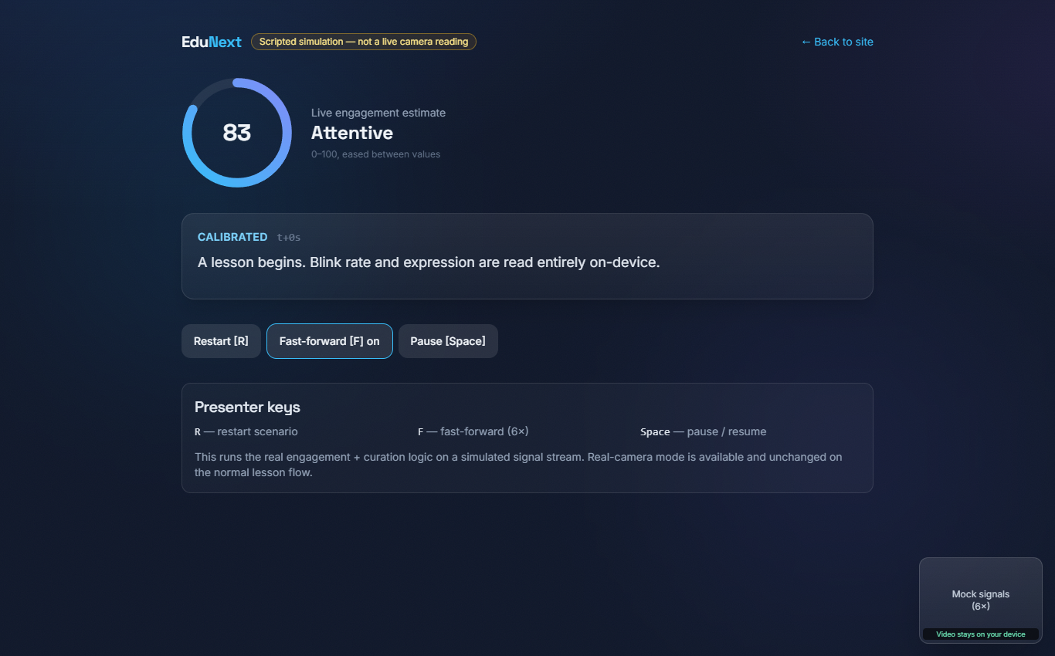
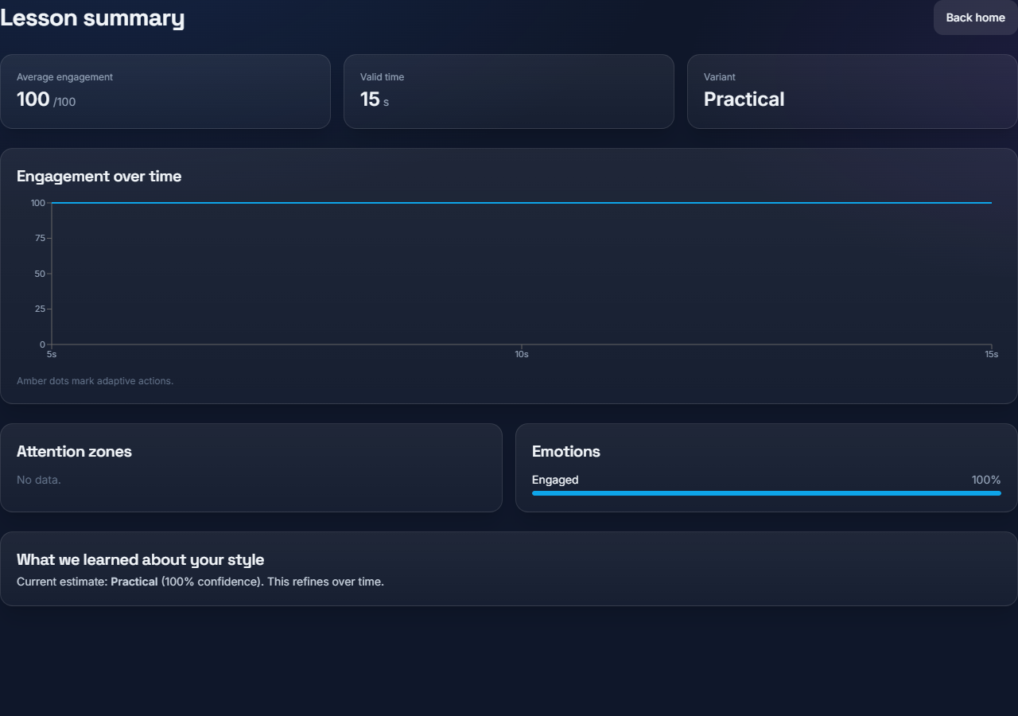
The Product — Live Engagement & Summary
Left: live engagement score ring reacting to the signal. Right: post-lesson summary — engagement over time, attention zones & emotions.

Slide 9
Market Value & Unique Selling Point
• Large, growing EdTech market with a persistent engagement problem and rising privacy scrutiny.
• Segments: self-learners · schools/universities (no surveillance) · e-learning platforms (B2B) · corporate training.
• Low marginal cost — on-device, webcam-only, no video storage. Models: freemium, per-seat, API/SDK.
• USP:
  – Privacy-first by construction · Personalised, not averaged
  – Helpful, not punitive · No special hardware · Honest & transparent

Slide 10
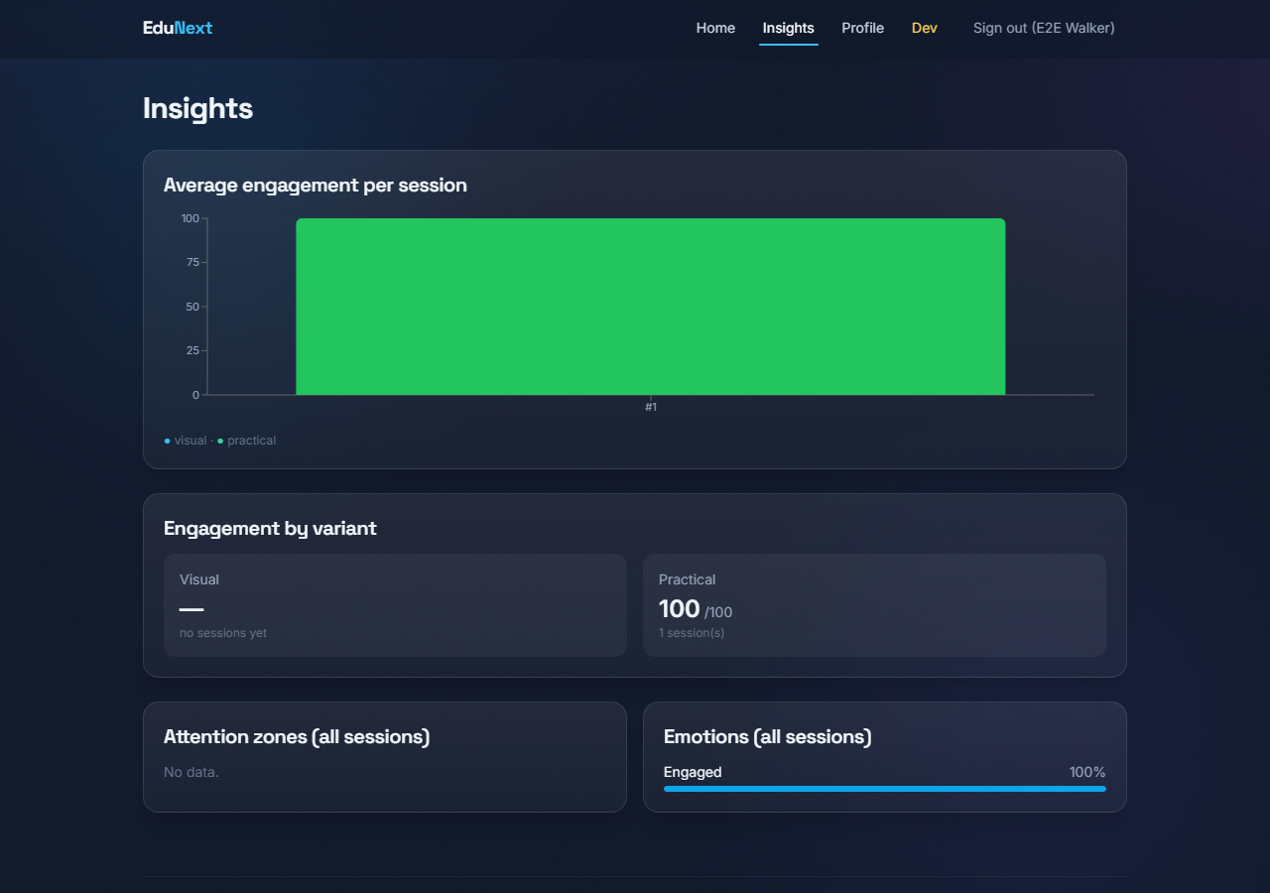
Results & Discussion
• Complete, working prototype built & publicly deployed (Vercel + Render).
• Full flow works: register → calibrate → learn (live HUD) → adapt → summary → insights.
• Validated: engagement estimate & curation respond correctly to changing signals (scripted demo).
• Personalisation produces individual blink zones (clear fallback when reads are too close).
• Privacy enforced by an automated test — no image/video data in the upload.
• Smooth production performance; tracker runs only where needed.
Insights across sessions

Slide 11
Limitations & Future Work
• Engagement is an estimate — blink rate is affected by lighting, screens, dry eyes, caffeine.
• Calibration 'interest' clips are placeholders — only a rough proxy for genuine interest.
• No formal user study yet — accuracy vs. ground truth and learning-outcome impact are future work.
• Future: richer real content, accuracy validation, mobile support, teacher dashboards.

Slide 12
Conclusion
EduNext shows that attention-aware, adaptive learning can be private, personalised and helpful —
using only a webcam, with no video ever leaving the browser.
Live: edunext-learn.vercel.app
Thank you.

