Slide 1
Efficient UDP Haptic Device
Communication
Daniel Wilhelm
Advisor: Prof. Hong Tan, Graduate Student: Ryan Traylor
Dr. Dov Adelstein (NASA Ames)
Haptic Interface Research Laboratory
Undergraduate Research Assistant
(dwilhelm@purdue.edu)
SURI Symposium 2004. August 6, 2004.

Slide 2
overview
Haptic Device Constraints
  Human Eye: 30 Hz (33 ms/frame)
  Human Skin: 1000 Hz (1 ms/frame)
  What must meet this constraint?
    Computer
    Haptic Device
    Network

Slide 3
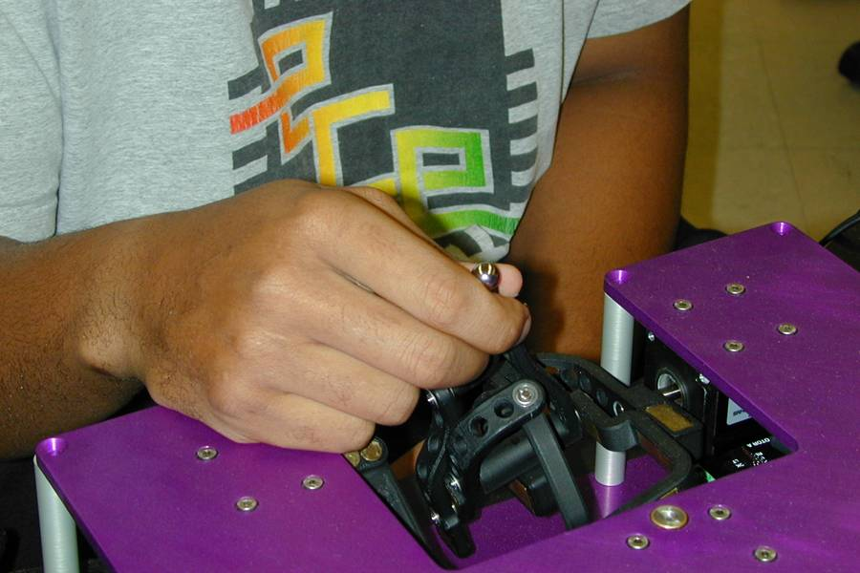
overview
MiniStick
In-production HIRL haptic device:
High-precision motors and encoders
3 Degrees of freedom
Passive mass balancing
LAN Ethernet control

Slide 4
overview
UDP Advantages
User Datagram Protocol Advantages:
  Small overhead
  Control from any computer(s) on LAN
  Broadcast to many computers without slowdown
  Send and forget

Slide 5
overview
UDP Disadvantages
User Datagram Protocol Disadvantages:
  Reception not guaranteed (dropped datagrams)
  Order not guaranteed (out-of-order datagrams)
  Duplicate datagrams

Slide 6
networking
UDP Transmission Speed
Speed/Efficiency must be maximized in order to:
  Ensure smooth haptic perception
  Allow transmission over congested networks
  Enable time-intensive calculations/graphics

Slide 7
networking
Round Trip Frequency (RTF)
  Host computer sends a 64-byte UDP packet to the MiniStick.
  MiniStick receives the packet, processes it, then sends a 64-byte UDP reply.
  The host computer receives the reply.

Slide 8
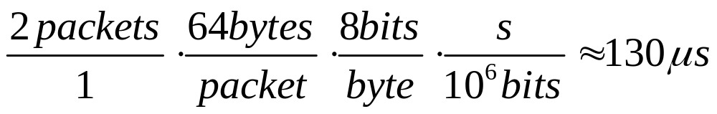
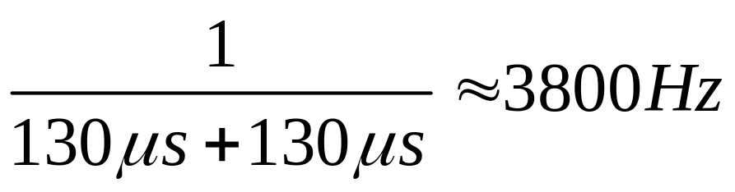
networking
Theoretical RTF
  Internally, the MiniStick takes approximately the same amount of time to process a packet. Thus,

Slide 9
procedure
Software Development
Software was developed:
  Precise timing mechanisms (µs)
  Averaged across groups of packets
  Automated packet validity testing
  Automated testing

Slide 10
procedure
Software Development
Initial Software versions:
  Linux version (ran on Knoppix and Red Hat)
  Serial I/O
  Overlapped I/O
  Send/Receive multi-threading

Slide 11
results
Initial Empirical RTF
LabView: ~3200 Hz then stabilizes at ~1800 Hz
C: ~3800 Hz then stabilizes at ~2000 Hz
Why the drop in RTF? Is the higher RTF desirable?
LabView is slower due to extraneous debugging code.

Slide 12
results
Networking Modes
Real-Time – 2000 Hz
Buffered – 3800 Hz
Distributed – theoretical maximum

Slide 13
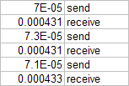
results
Real-Time (2000 Hz)
Receives data slowly after waiting for it.
Note that receive times are more than the predicted 230 µs.
(in seconds)

Slide 14
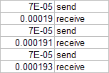
results
Buffered (3800 Hz)
Receives last-frame data quickly from buffer.
  Note that receive times are less than the predicted 230 µs.
(in seconds)

Slide 15
results
Distributed (Max Hz)
Multiple computers used to alternately send packets.
The idea is to force the MiniStick to be the bottleneck – the past two methods indicate the computer currently is.

Slide 16
Distributed Dilemma
results
force
F_{app}
force
F_{app}
time
time
2000 Hz, Non-Distributed
4000 Hz, Distributed
How does this affect stability and perceptual smoothness?

Slide 17
Possible Variables
results
Internet vs. Direct-Connect
Windows vs. Linux vs. RTLinux
Berkeley Sockets vs. Windows Sockets
Firewall?
Buffered?
Blocking?
High/Low Priority Process?

Slide 18
Empirical Results
results
Experiment
Buffered
Firewall
High Priority
Low Priority
Average Hz
3800
2025
2099
2074

Slide 19
future work
MiniStick SDK
MiniStick
Position Packet
Host Computer
Receive Pipeline
Angles_To_Cartesian
Encoder_To_Angles
Encoder_String_To_Number
Networking Code
-Converts angles to Cartesian coordinates
-Converts motor tick values to angles
-Reads packet
-Overflow checks
-Receives and decodes packet
Application Requests Forces
Jacobian
Command_Commutation_Signal
Networking Code
Send Pipeline
-Desired force vector sent to API
-Computes J^{T} of J^{T}*F=T and torque values
-Computes required motor voltage values
-Generates and sends packet
MiniStick
Force Packet
Host Computer
Uses DLLs like the popular Delta and PHANToM SDKs
Code and Implementer's Manual mostly written
Debugging necessary when the MiniStick is ready for use

