Slide 1
Real Time Sensor Readings
on a Raspberry Pi
Dan Wagner
Hunter Goddard
11 May 2018

Slide 2
Outline
Background
Objectives
Hardware
Software
Applications
Conclusions

Slide 3

Background
Raspberry Pi OS not real-time
  Debian Linux derivative
Microkernel or RTOS needed
  Enables real-time programming

Slide 4
Background
Xenomai 3
  RTOS installed on top of existing Linux system

Slide 5
Objectives
Read sensors in real time on Pi
Obtain sensor data within timing constraints
    Encoder: 5ms
    Humidity & temperature: 100ms

Slide 6
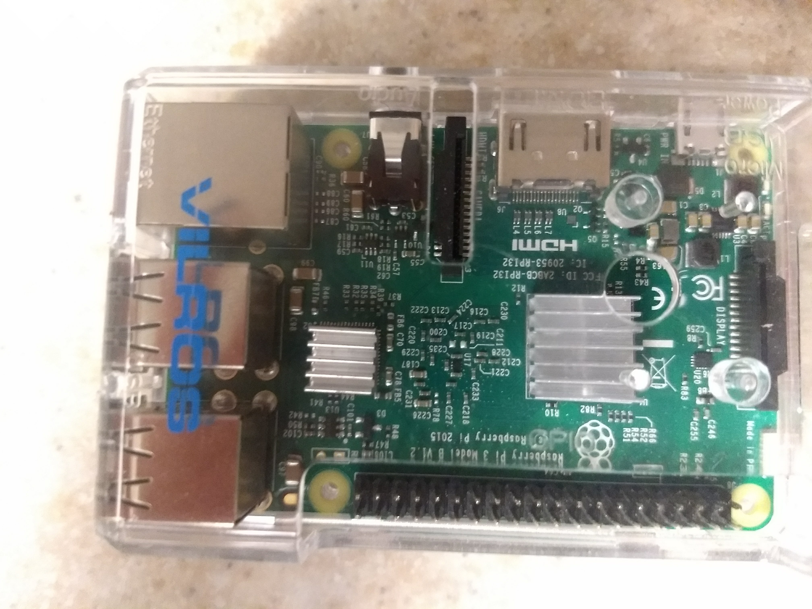
Hardware
Raspberry Pi
Rotary Encoder
DHT11 Sensor

Slide 7
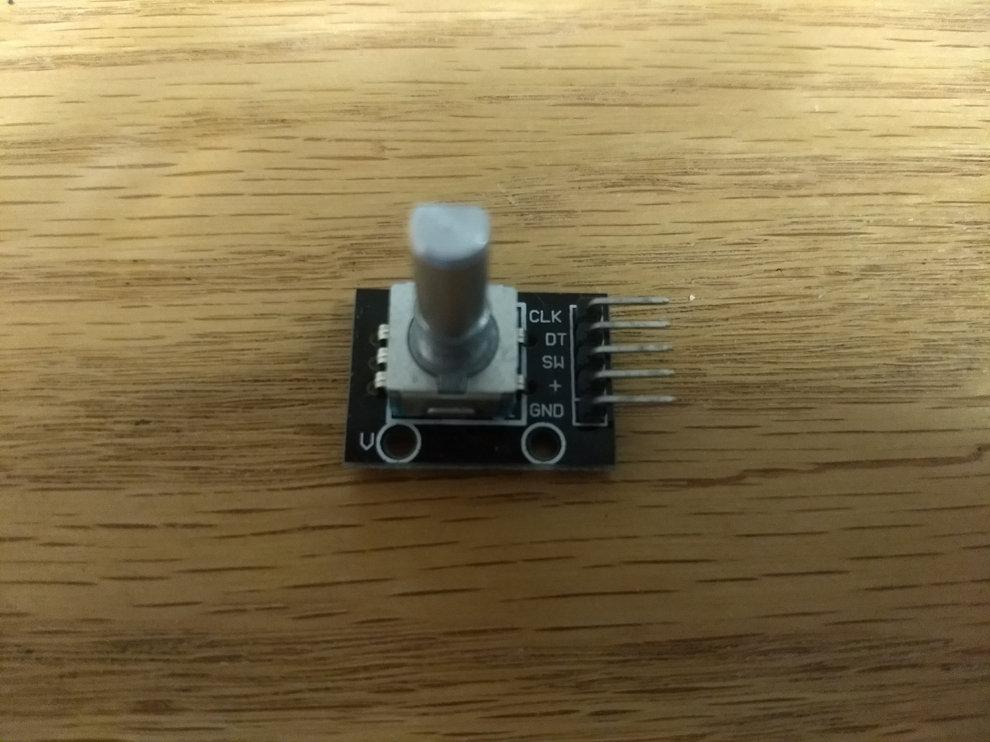
Hardware: Rotary Encoder
Twenty pulses per cycle
Four pins
    5V Rail
    Ground
    Switch
    Data

Slide 8
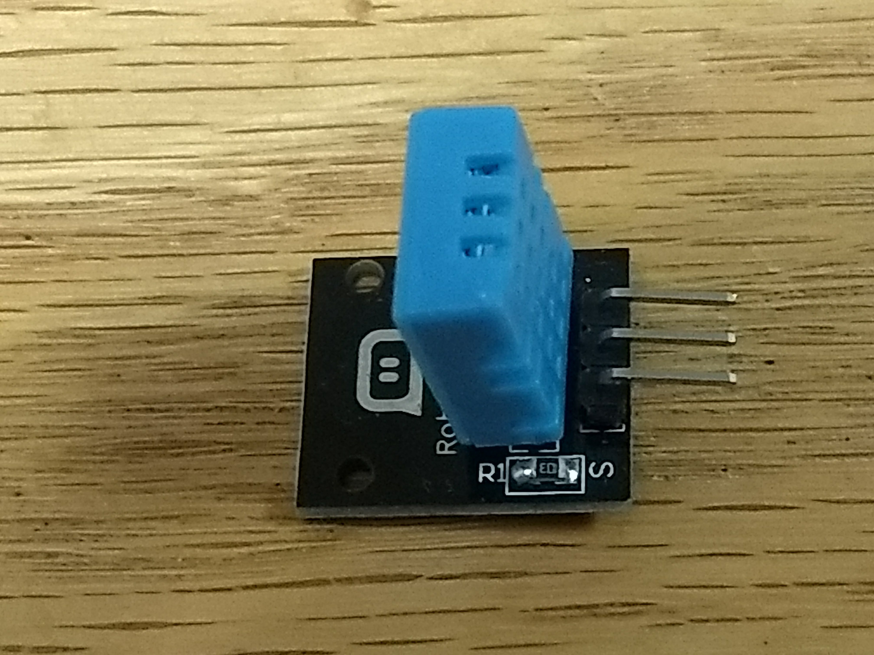
Hardware: DHT11 sensor
Records temperature and humidity
Checksum to validate data
Three pins
    5V rail
    Ground
    Data

Slide 9
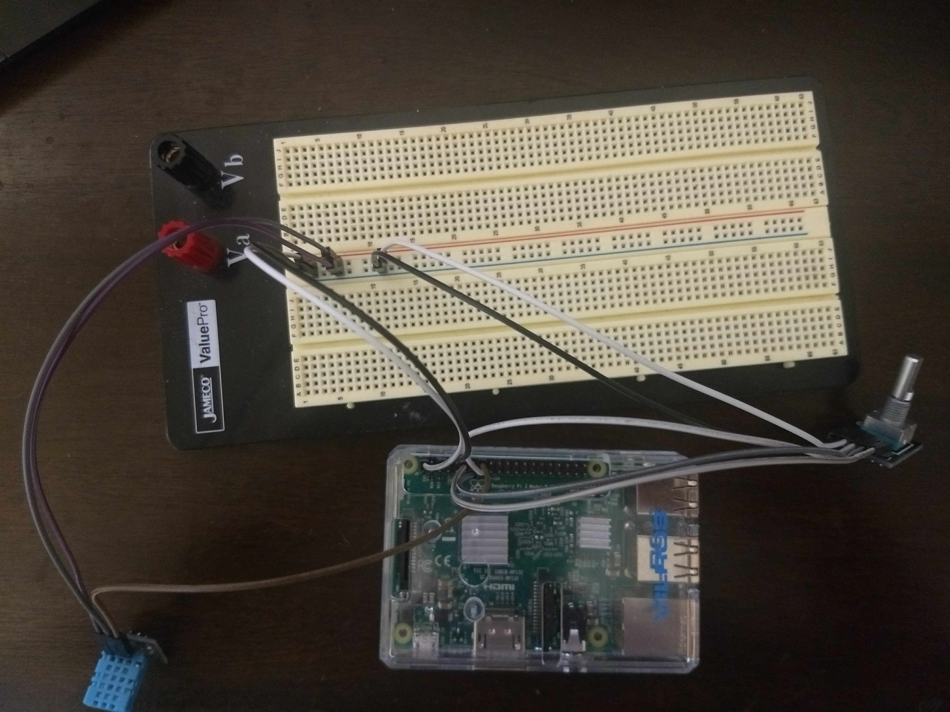
Hardware

Slide 10
Software
UPPAAL Model
  Xenomai Functions

Slide 11
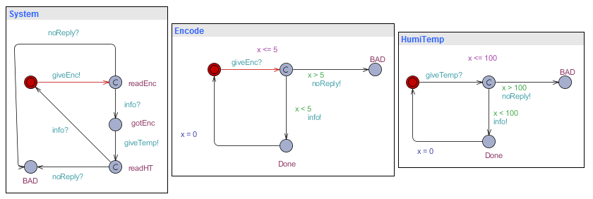
UPPAAL Model

Slide 12

UPPAAL Verification
Neither the system nor either sensor enter a bad state

Slide 13
Xenomai Functions
Initialization
  rt_task_create()
  rt_task_start()
Scheduling
  rt_task_set_periodic()
  rt_task_wait_period()
Deletion
  rt_task_suspend()
  rt_task_delete()

Slide 14
Applications
Extensibility
Greenhouse Atmospheric Control
Hospital Air Quality Monitor
Hiking/Climbing Safety Monitor

Slide 15
Questions

