Slide 1
NahuaHi
Eliminating Social Exclusion One Barrier at a Time!
Claudia Leung, Estella Chen, Georges Belanger, Dany Stefan

Slide 2
52%
Decline in the number of people who have an indigenous language as their mother tongue since 1996
UNESCO, 2008

Slide 3
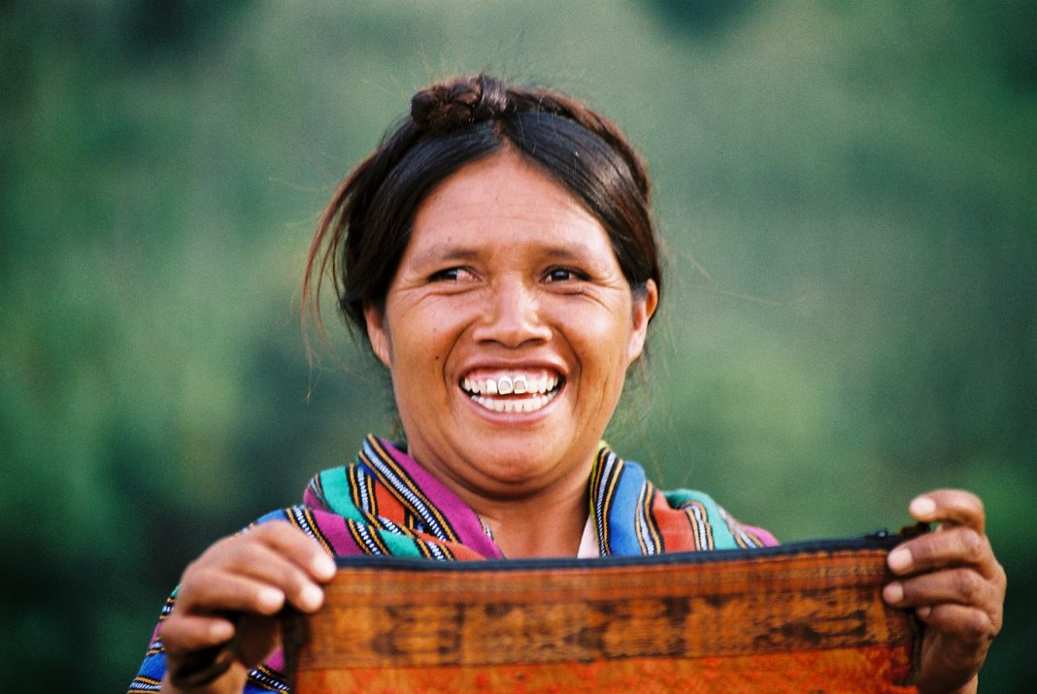
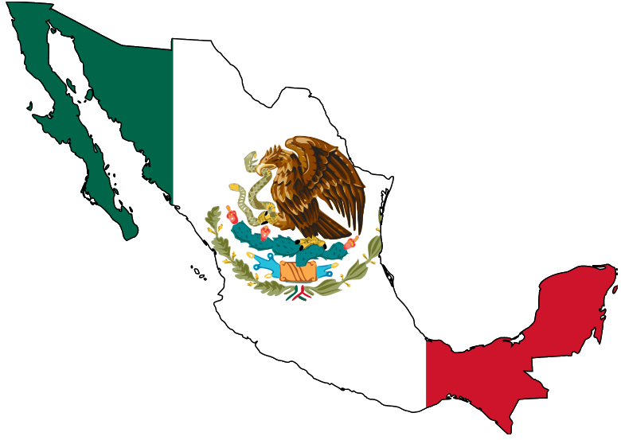
Juana speaks Nahuatl, but not Spanish

Slide 4
The Mission
Promote:
Inclusion
Empowerment
Communication
Union
Belonging

Slide 5
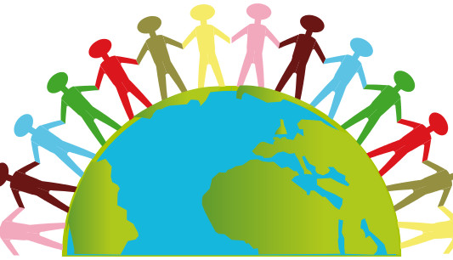
The Vision
A connected world
Preservation of culture
Elimination of disparities

Slide 6
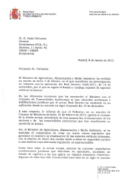
Juana’s dream app would be an image to speech translation system
Nahuatl Speech

Slide 7
In this Hackathon, we focused on the text to text translation problem
Spanish
Nahuatl
Se refería, se decía que así hubo ya antes cuatro vidas, y que ésta era la quinta edad
Moteneua mitoa, ka yu nautlamantli mochiu nemilistli ipan iya makuili edad

Slide 8
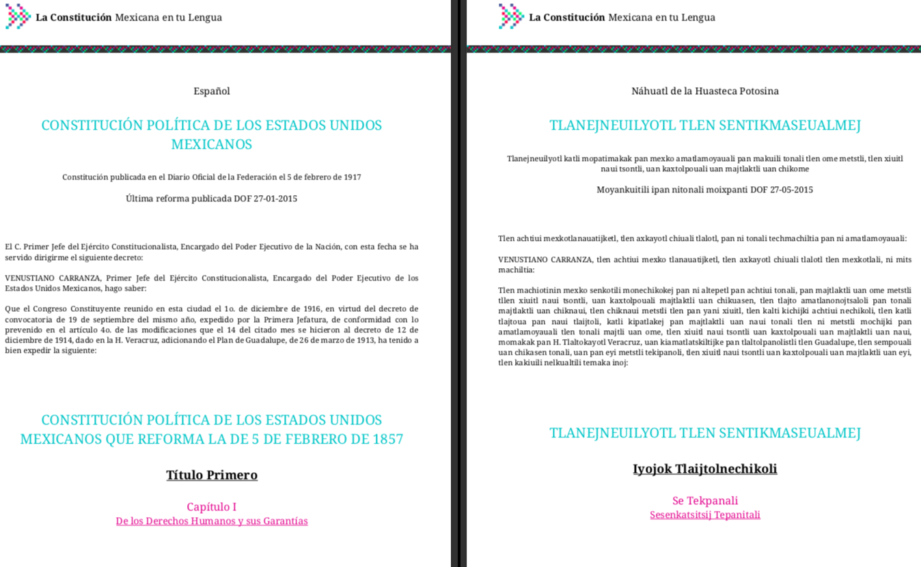
We tried to do the neural machine translation by ourselves by collecting our own data

Slide 9
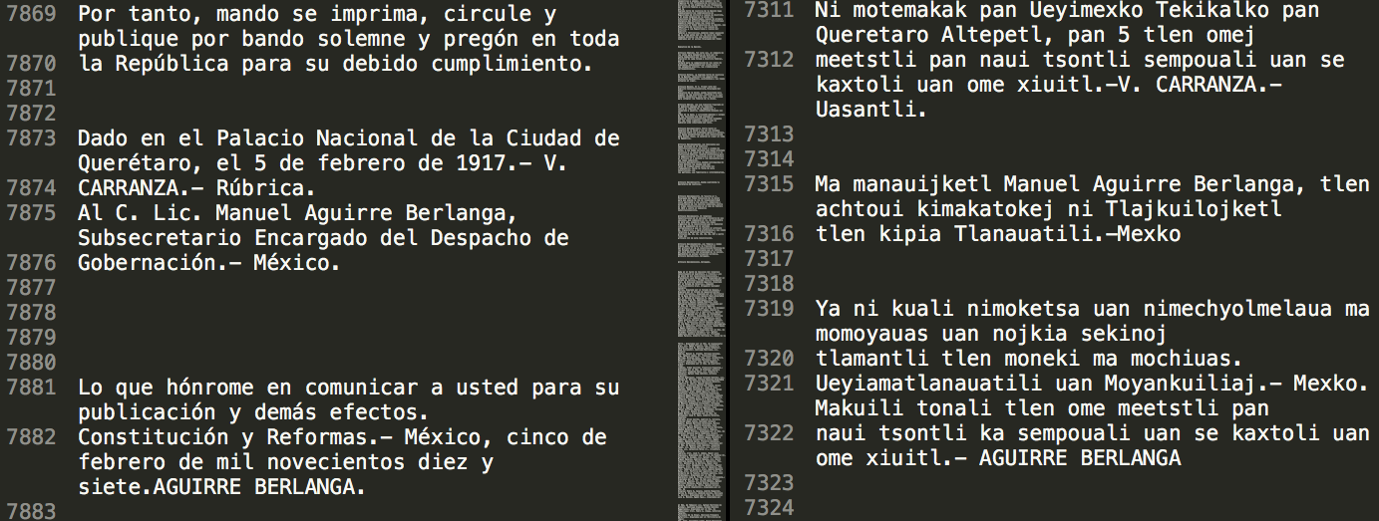
Data for neural machine translation needs to be paired: online data needs a lot of preprocessing

Slide 10
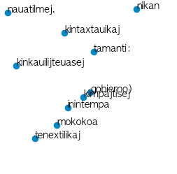
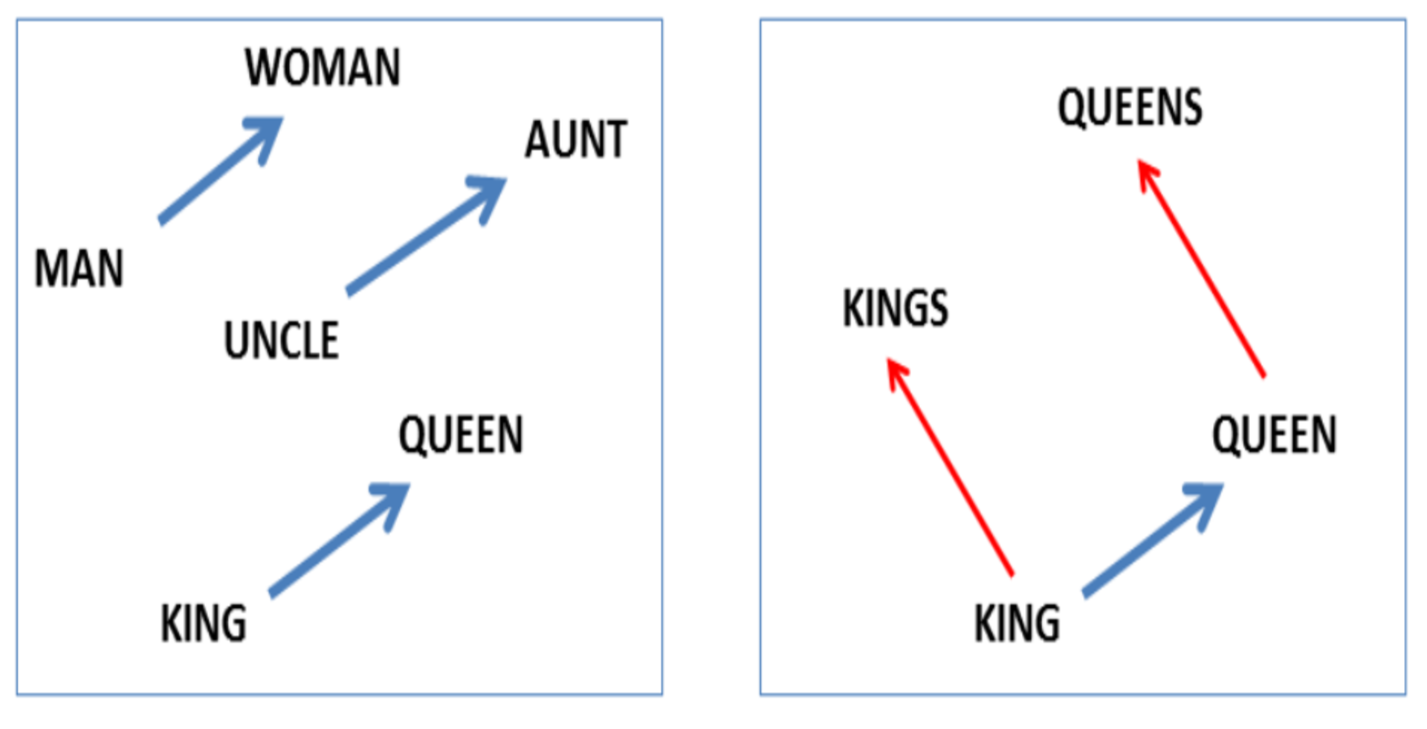
Word embeddings don’t need paired data and it’s a first step towards the translation algorithm

Slide 11
The Product
Data Collection
Form
Chatbot

Slide 12
Technologies
Translator
(training)
Data Collection
(paired data)
Firebase

Slide 13
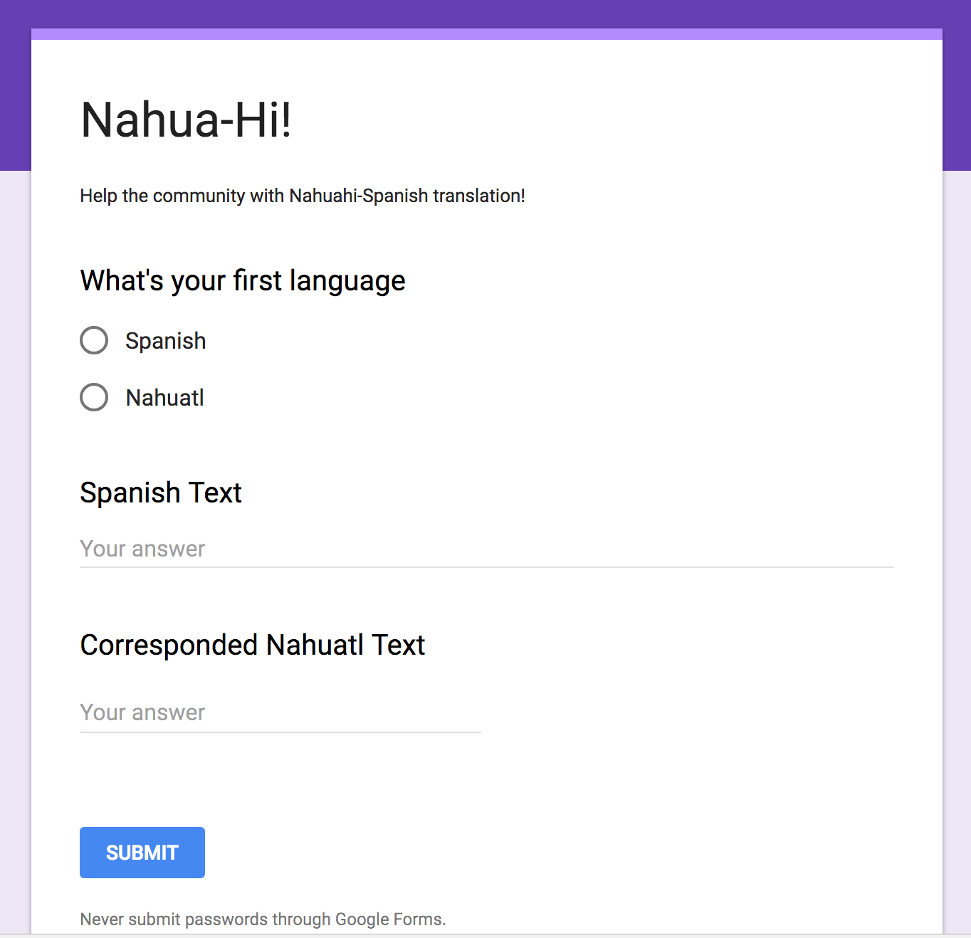
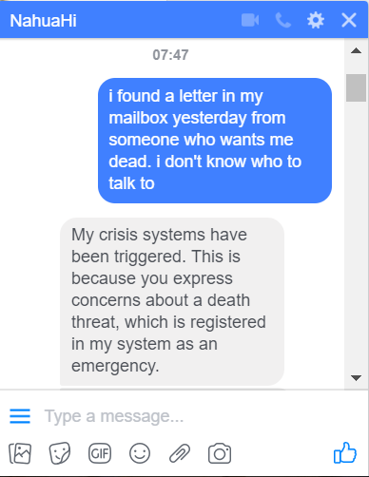
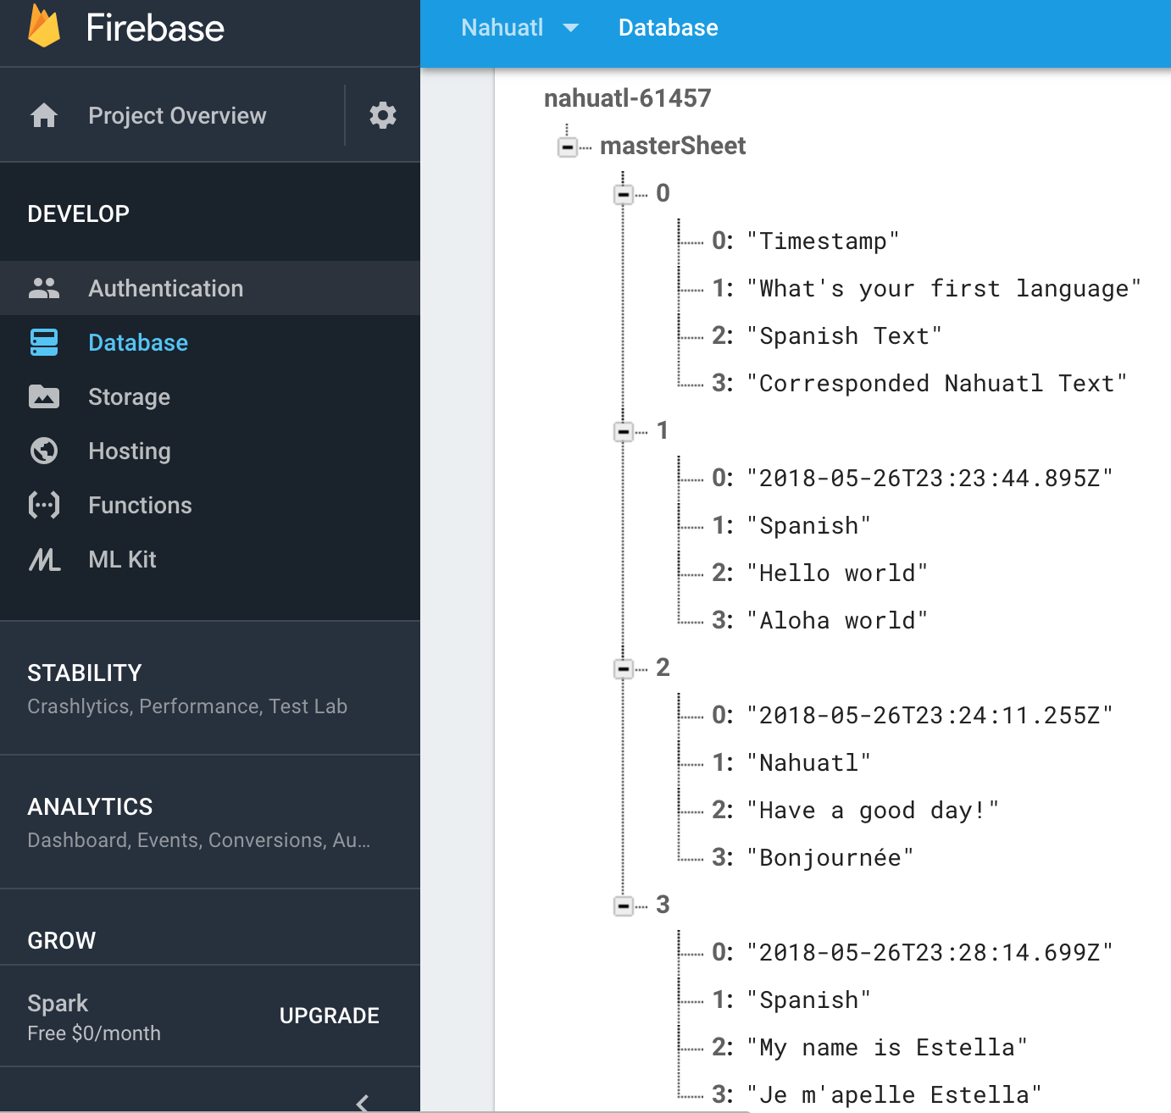
Chatbot, Form and Real-time Database

Slide 14
The Impact Evaluation
Social
Health
Bottom-up process

Slide 15
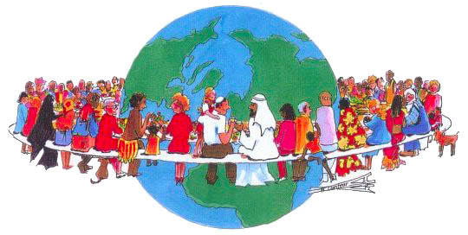
Let’s help Juana and enjoy a world where we can all understand each other!

