Slide 1
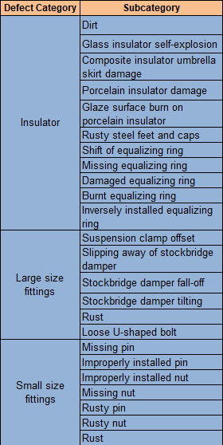
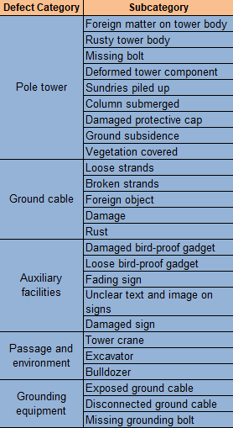
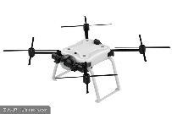
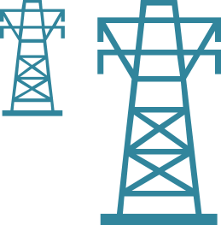
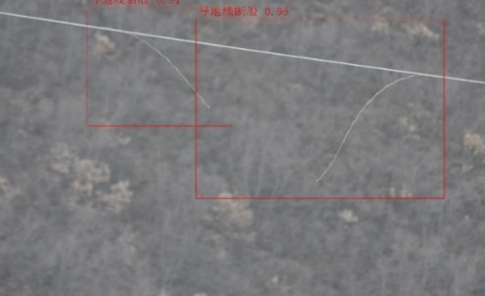
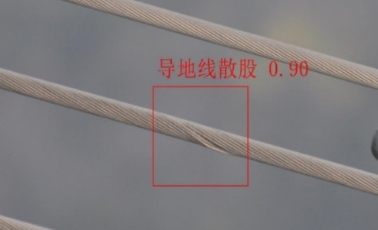
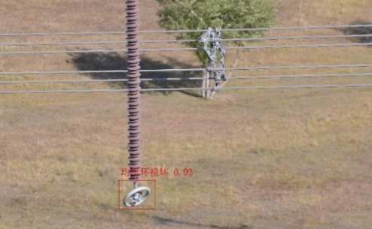
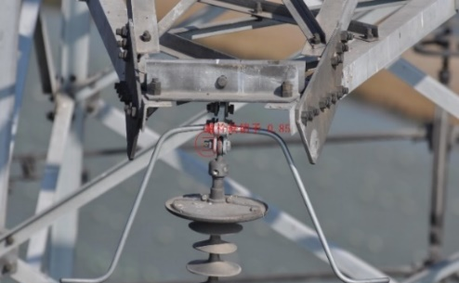
Intelligent Power Line Inspection Using Drones
Background: Power line inspection is an important yet difficult task. In mountainous areas, inspecting each tower takes 6 hours, and climbing each tower alone takes 0.5 hour. Plus, walking through the mountains is laborious and sometimes dangerous, and inspecting the power lines at a great height is also dangerous.
Solution: Images are captured by drones, and then recognized by the Pangu CV model. The recognition results are classified into 9 categories and 49 sub-categories as defined by China Electric Power Research Institute.
AS IS
1. A large number of useless images, many repetitive tasks for experts, ~1,000 images collected for 5 to 8 towers in a couple of hours
2. Low efficiency of manual analysis in the background, no real-time analysis and diagnosis
3. Drones may need to be sent back to take pictures again in order to confirm a potential problem.
Broken strands in ground cable
Loose strands in ground cable
Disengaged or missing pin
TO BE
Damaged equalizing ring
1. Fewer models used:
20+ small models → 1 Pangu model
2. Accuracy: 65.1% > 83%+
Notes:
输电线路一旦发生故障影响大，需要定期巡检和维护。一般高压架空线路巡检周期1次/月；电网人工定期巡检需要耗费大量的人力物力，福建电网采用无人机输电线路进行巡检，也面临为了提高福建电网可靠运行水平，缓解日益增长人力矛盾压力，智能巡检已经成为电力行业应用趋势。
输电线路由线路杆塔、导线、绝缘子、线路金具、拉线、杆塔基础、接地装置等构成，架设在地面之上。输电线路巡检工作目标是有效消除可能的隐患或损失，保障电网运行安全，进而降低成本、提高工作绩效的高效管理。

Slide 2
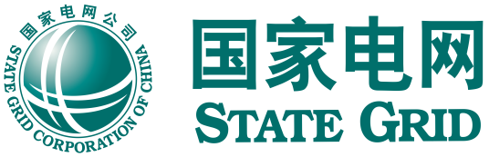
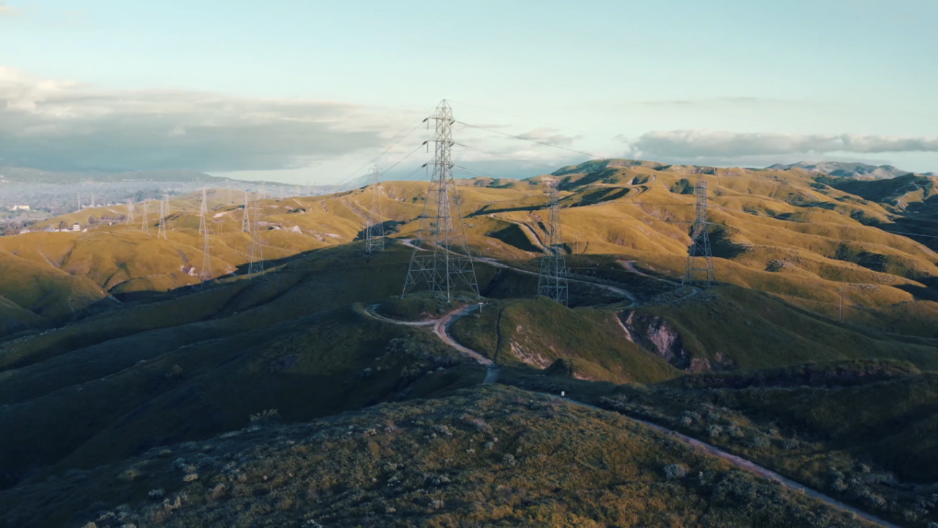
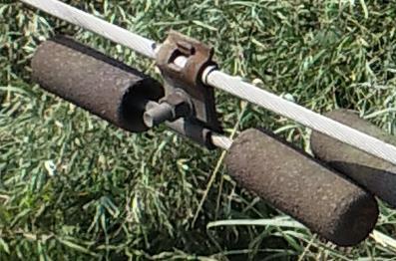

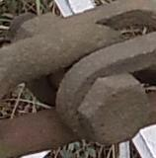
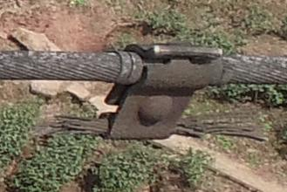
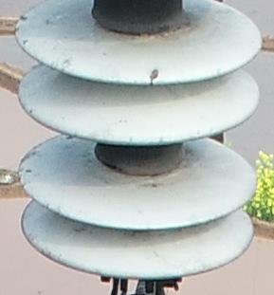
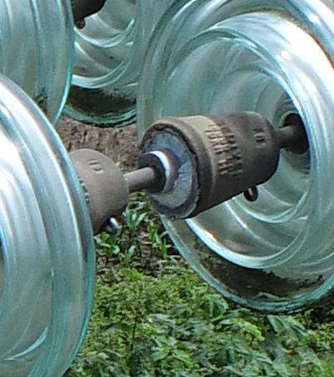
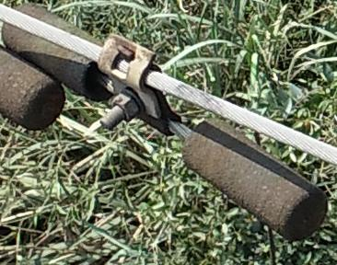
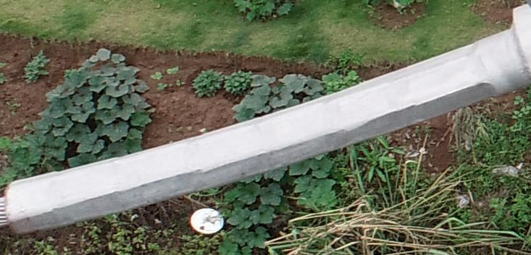
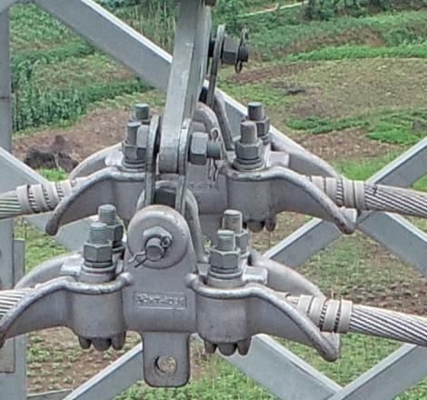
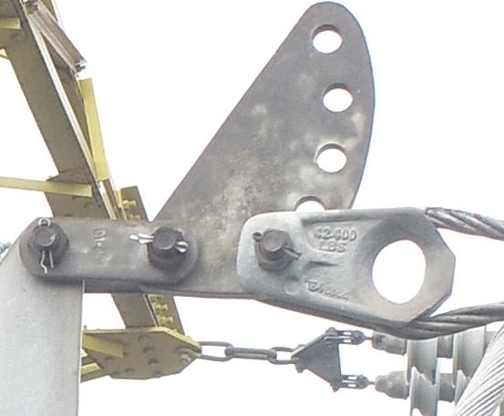

SGCC Chongqing: Pangu Electric Power Model Ensures Accurate Power Line Inspection
Challenges
Manual labeling of massive data is costly.
Many different types of defects, not enough samples for some defects.
Multiple models used, slow and difficult iteration.
Many
Rusty stockbridge damper
Pin missing
Samples
Rusty nut
Stockbridge damper fall-off
Insulator surface burn
Glass insulator damage
Stockbridge damper tilting
Deformed crimp sleeve
Dislocated hull
Incorrect adjustment plate installation
Few
Long-tail distribution of defect samples
Intelligent power line inspection using drones
Sample screening efficiency
Recognition accuracy
Models used
Development efficiency
30x
18.4%
20
1
10x
Huawei algorithms won 1st place in five categories and 2nd place in one category in the nationwide tests organized by CEPRI.

