Slide 1




City
Signals
What 311 Service Requests Reveal About Community Needs
Danya Jones
MATH 014: Introduction to Data Science
April 28th, 2026
DATASET SIZE
GOAL
440,600
Patterns
311 requests analyzed
request type, location, time, status, response
01

Slide 2

ROADMAP
Presentation Roadmap
The structure follows the required presentation module: dataset, methods, analysis, and findings.
01
02
03
04
Dataset
Methods
Analysis
Findings
→
→
→
What I studied
How I cleaned it
What the visuals show
What it means
The purpose of this project is to analyze 311 service request data to identify patterns in community needs and city service response. By examining request type, ward, time, status, and response time, this project demonstrates how resident concerns can be translated into clear data insights.
02

Slide 3

DATASET
Dataset Snapshot
311 City Service Requests from DC Open Data
ROWS
ORIGINAL COLUMNS
AFTER CLEANING
WARDS
440,600
33
39
8
Each row represents one 311 request
Columns from the raw dataset
New time and response fields created
All DC wards are represented
Key fields I used
• SERVICECODE and SERVICECODEDESCRIPTION: request type
• SERVICEORDERSTATUS: closed, open, duplicate, canceled, or in progress
• WARD: location comparison
• ADDDATE and RESOLUTIONDATE: time and response calculations
• response_time_days: new calculated column
03

Slide 4
OBJECTIVE
Objective and Research Questions
The analysis was built around questions that the data could actually answer.
Objective
Research questions
Analyze 311 service request patterns by request type, location, time, status, and response time.
• What request types are most common?
• Which wards have the most requests?
• When are requests most often submitted?
• How long do requests take to close?
• Which request types take longest to resolve?
These questions connect directly to the required notebook cycle: load, clean, analyze, visualize, and interpret.
04

Slide 5
METHODS
Cleaning and Code Problem Solving
One key issue was that my first column finder returned None for the date column.
What I learned
# The issue: date_col was None, so df[date_col] caused a KeyError.
df.columns.tolist()
# I saw the real date columns were adddate and resolutiondate.
date_col = 'adddate'
closed_col = 'resolutiondate'
df[date_col] = pd.to_datetime(df[date_col], errors='coerce')
df[closed_col] = pd.to_datetime(df[closed_col], errors='coerce')
• The error happened because Python was trying to use df[None].
• I checked the real column names instead of guessing.
• The correct date fields were adddate and resolutiondate.
• After converting them to datetime, I could create month, day, hour, and response time.
This shows the debugging process, not just the final answer.
05

Slide 6
METHODS
Feature Engineering
I created new columns so the dataset could answer the research questions.
Why it mattered
df['year'] = df[date_col].dt.year
df['month'] = df[date_col].dt.month
df['month_name'] = df[date_col].dt.month_name()
df['day_of_week'] = df[date_col].dt.day_name()
df['hour'] = df[date_col].dt.hour
df['response_time_days'] = (
df[closed_col] - df[date_col]
).dt.total_seconds() / 86400
df.loc[df['response_time_days'] < 0, 'response_time_days'] = np.nan
• month_name helped show seasonal patterns.
• day_of_week showed weekday versus weekend behavior.
• hour showed what time residents submitted requests.
• response_time_days measured how long requests took to close.
• Negative response times were removed because they did not make sense logically.
06

Slide 7
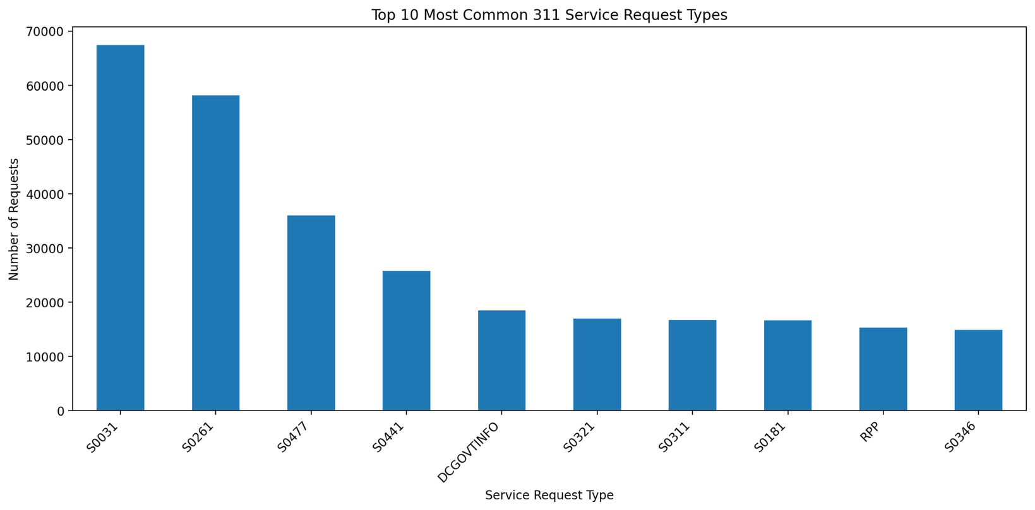
ANALYSIS
Top 10 Most Common Request Types
The real notebook graph uses service codes, so I translated the main codes into meaning.
Code translation
• S0031 = Bulk Collection, 67,414
• S0261 = Parking Enforcement, 58,149
• S0477 = Scheduled Yard Waste, 36,011
• S0441 = Trash Collection Missed, 25,722
• DCGOVTINFO = DC Government Information
Finding: the most common requests were practical neighborhood service needs.
07

Slide 8
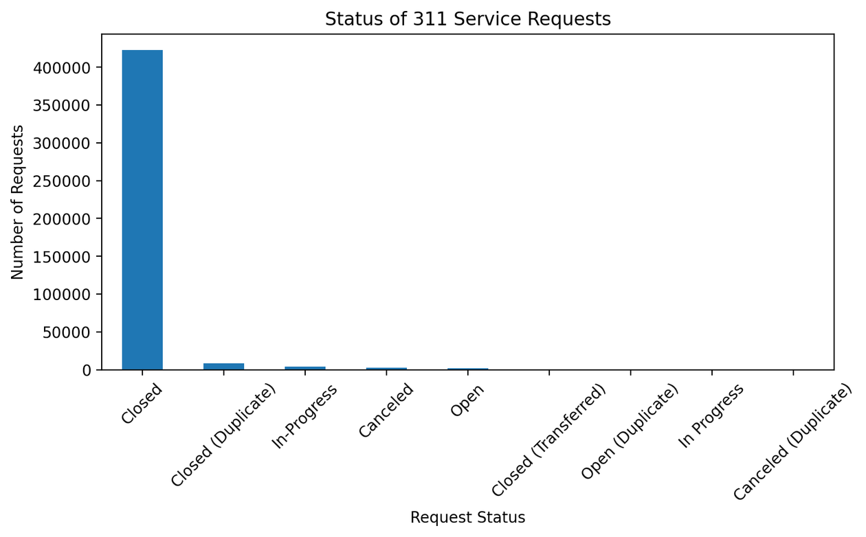
ANALYSIS
Status of 311 Service Requests
Most requests were closed, but some were duplicates, open, canceled, or in progress.
CLOSED
422,406
Most records reached completed status
DUPLICATE
8,764
Closed duplicate records
Interpretation: status adds context because it shows what happened after residents submitted requests.
08

Slide 9
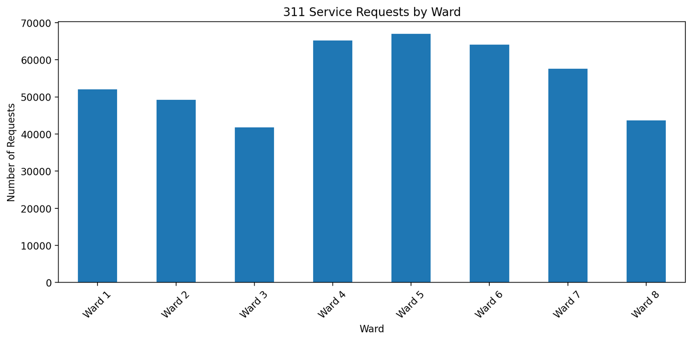
ANALYSIS
311 Service Requests by Ward
Request volume was not evenly distributed across the city.
HIGHEST WARD
Ward 5
66,950 requests
OTHER HIGH WARDS
4 and 6
Ward 4: 65,170 | Ward 6: 64,108
Caution: more requests can reflect population, infrastructure needs, or higher reporting behavior.
09

Slide 10
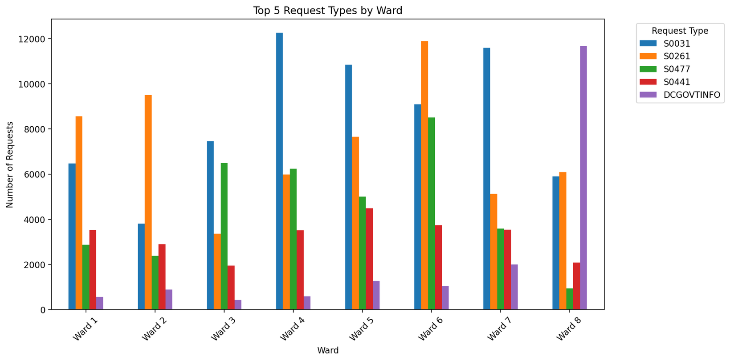
ANALYSIS
Top 5 Request Types by Ward
This additional analysis combines location with request type.
What this adds
• Instead of only asking which ward has the most requests, this asks what types of requests appear in each ward.
• S0031 and S0261 appear strongly across several wards.
• The graph helps show that community needs are not exactly the same in every area.
10

Slide 11
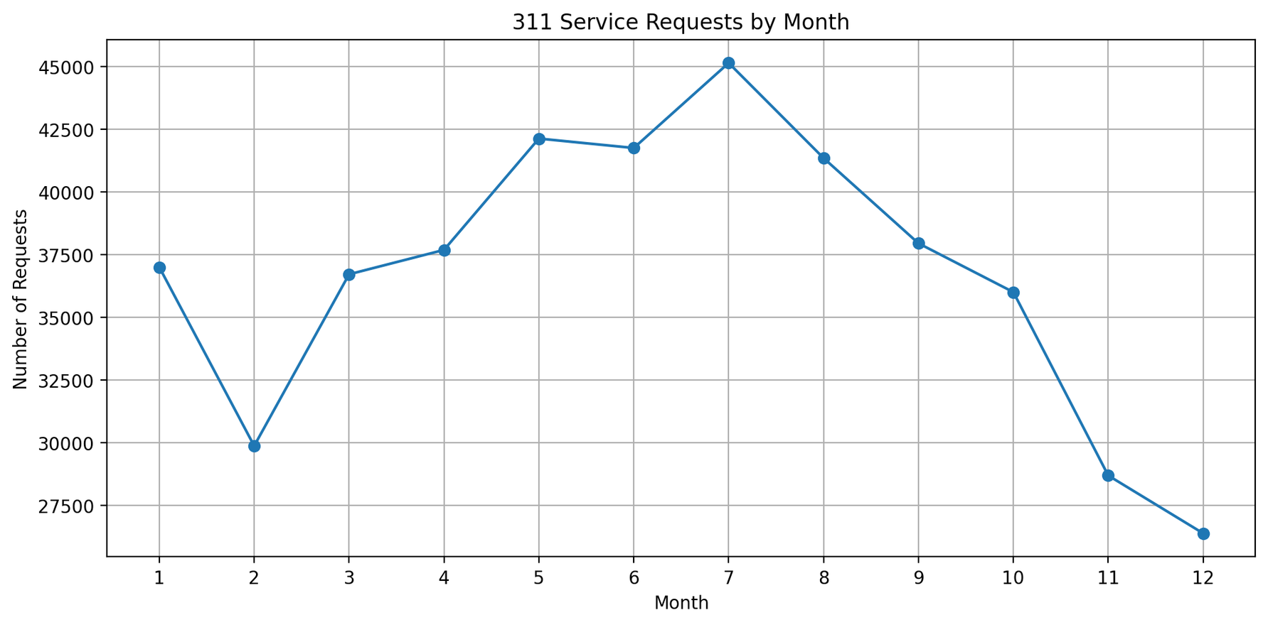
ANALYSIS
311 Service Requests by Month
Requests peaked in July and dropped toward the end of the year.
PEAK MONTH
July
45,137 requests
LOWEST MONTH
December
26,378 requests
Possible reason: warmer months can make outdoor issues, yard waste, sanitation, and public space problems more visible.
11

Slide 12
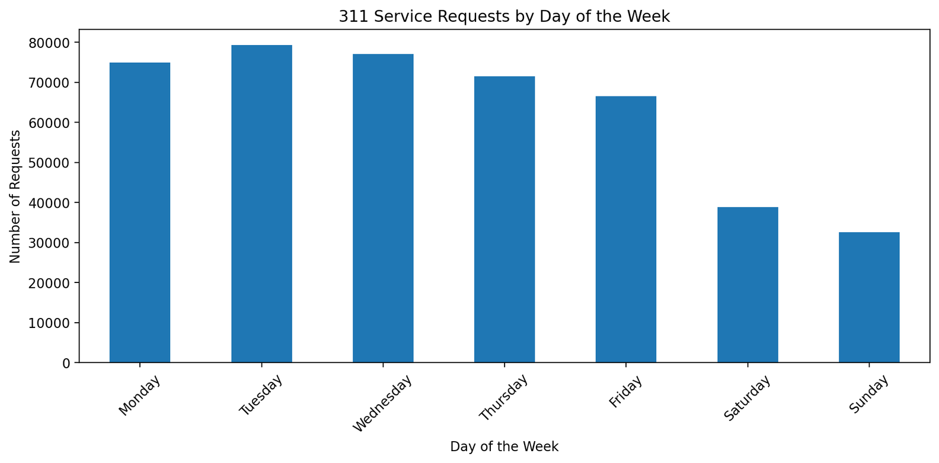
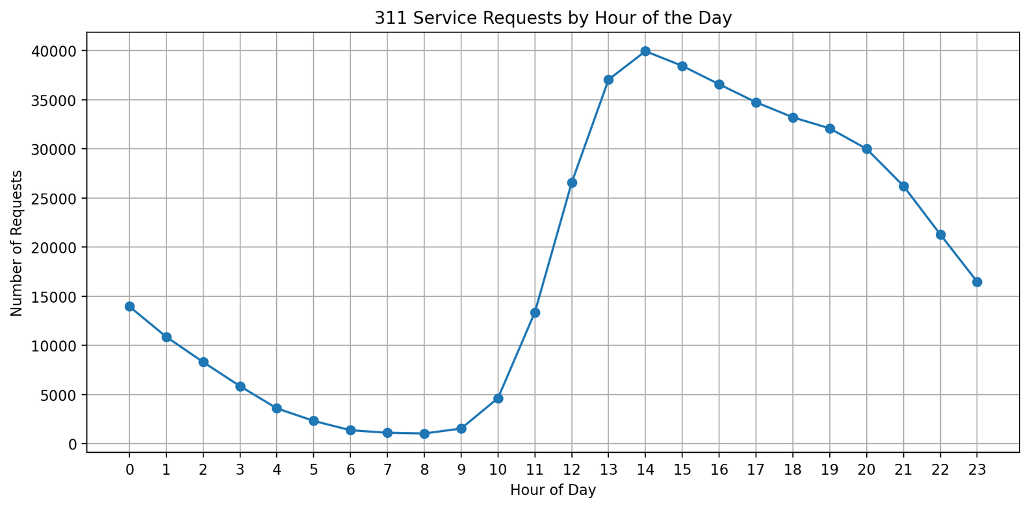
ANALYSIS
When Residents Submitted Requests
Day of week and hour of day show the timing pattern.
BUSIEST DAY
BUSIEST HOUR
The timing pattern points toward weekday and daytime reporting behavior.
Tuesday
2 PM
79,260 requests
39,933 requests
12

Slide 13
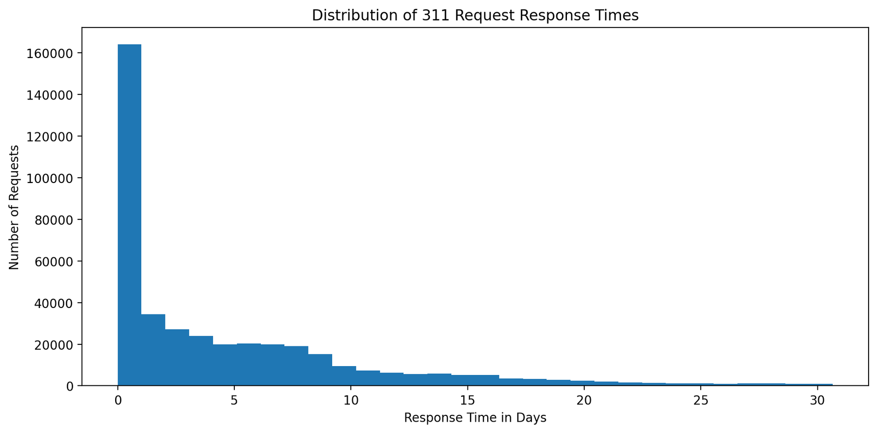
ANALYSIS
Distribution of Response Times
Most requests closed quickly, but some took much longer.
AVERAGE
9.32 days
Pulled upward by long cases
MEDIAN
2.88 days
Better picture of the typical request
This right skew means most requests closed faster than the average alone suggests.
13

Slide 14
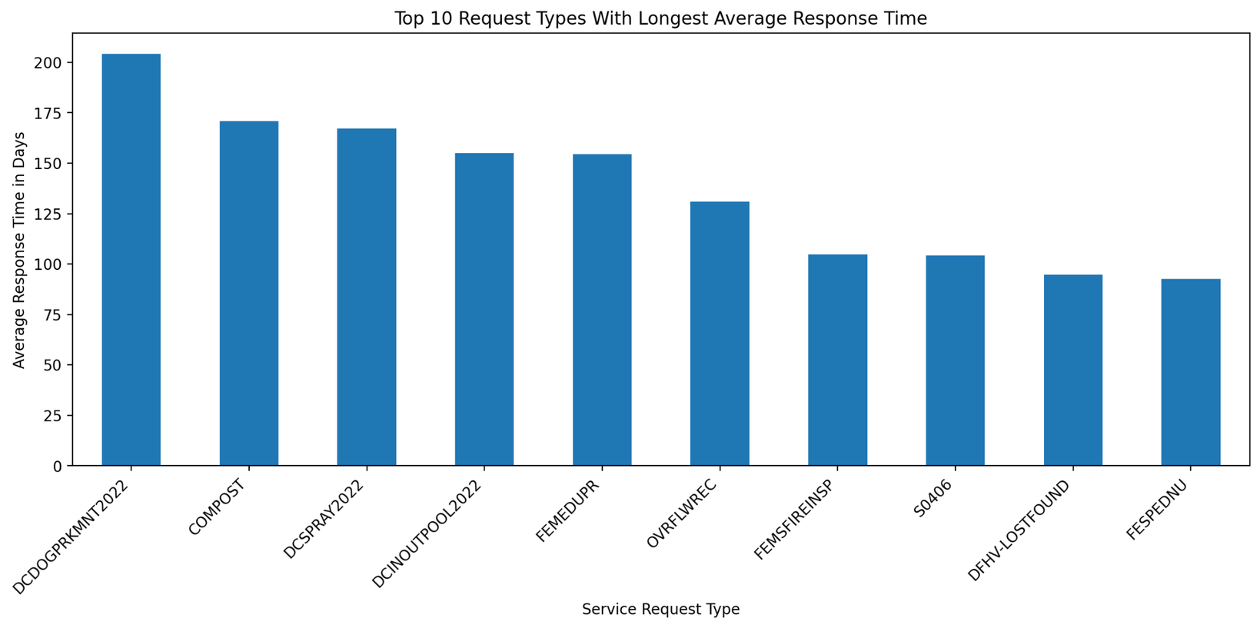
ANALYSIS
Longest Average Response Times
The slowest categories were not the same as the most common categories.
Code translation
• DCDOGPRKMNT2022 = DC Dog Park Maintenance
• COMPOST = compost bin or curbside composting issue
• DCSPRAY2022 = DC Spray Parks
• DCINOUTPOOL2022 = DC pool maintenance
• S0406 = Roadway Repair
Finding: long response times indicate service complexity, not just request volume.
14

Slide 15
FINDINGS
Key Findings and Takeaway
The data turned resident concerns into measurable service patterns.
Main findings
Final takeaway
• Bulk Collection was the most common request type.
• Most requests were closed.
• Ward 5 had the highest number of requests.
• July, Tuesday, and 2 PM were the busiest time patterns.
• Response time varied strongly by request type.
311 data is more than a list of complaints. It is a public record of how residents experience the city and how services respond over time.
Code helped move from raw records to a clear story: load → clean → create features → visualize → interpret.
15

