Slide 1




Upsample or Upweight?
Balanced Training on Heavily Imbalanced Datasets
Tianjian Li, Haoran Xu, Weiting Tan, Kenton Murray, Daniel Khashabi
NAACL 2025
Notes:
Hi, my name is Tianjian. I am very happy to present our work “Upsample or Upweight, Balanced Training on Heavily Imbalanced Datasets”, which is published at NAACL 2025. I am thankful to my wonderful colleagues Haoran and Weiting, and my wonderful advisors Kenton and Daniel. Let’s get started!

Slide 2
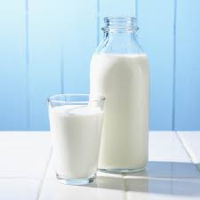
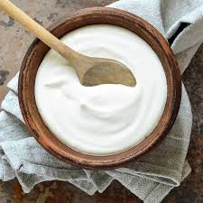
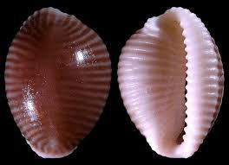
In our language model’s pre-training data…
There exists very common knowledge:
You can get calcium from dairy products like milk, yogurt and cheese, canned fish with soft bones (sardines, anchovies and salmon; bones must be consumed to get the benefit of calcium), dark-green leafy vegetables (such as kale, mustard greens and turnip greens) and even tofu (if it's processed with calcium sulfate).
But there also exists very niche topics:
Trivia mediterranea is a species of small sea snail, a marine gastropod mollusc in the family Triviidae, the false cowries or trivias.
Notes:
We first take a look at our LMs pre-training data: in our pre-training corpus, there exists very common knowledge such as where to get calcium. There also exist very rare knowledge such as a species of small sea snail. All the text here, by the way, are from a very commonly used pre-training corpus (red pajama).

Slide 3
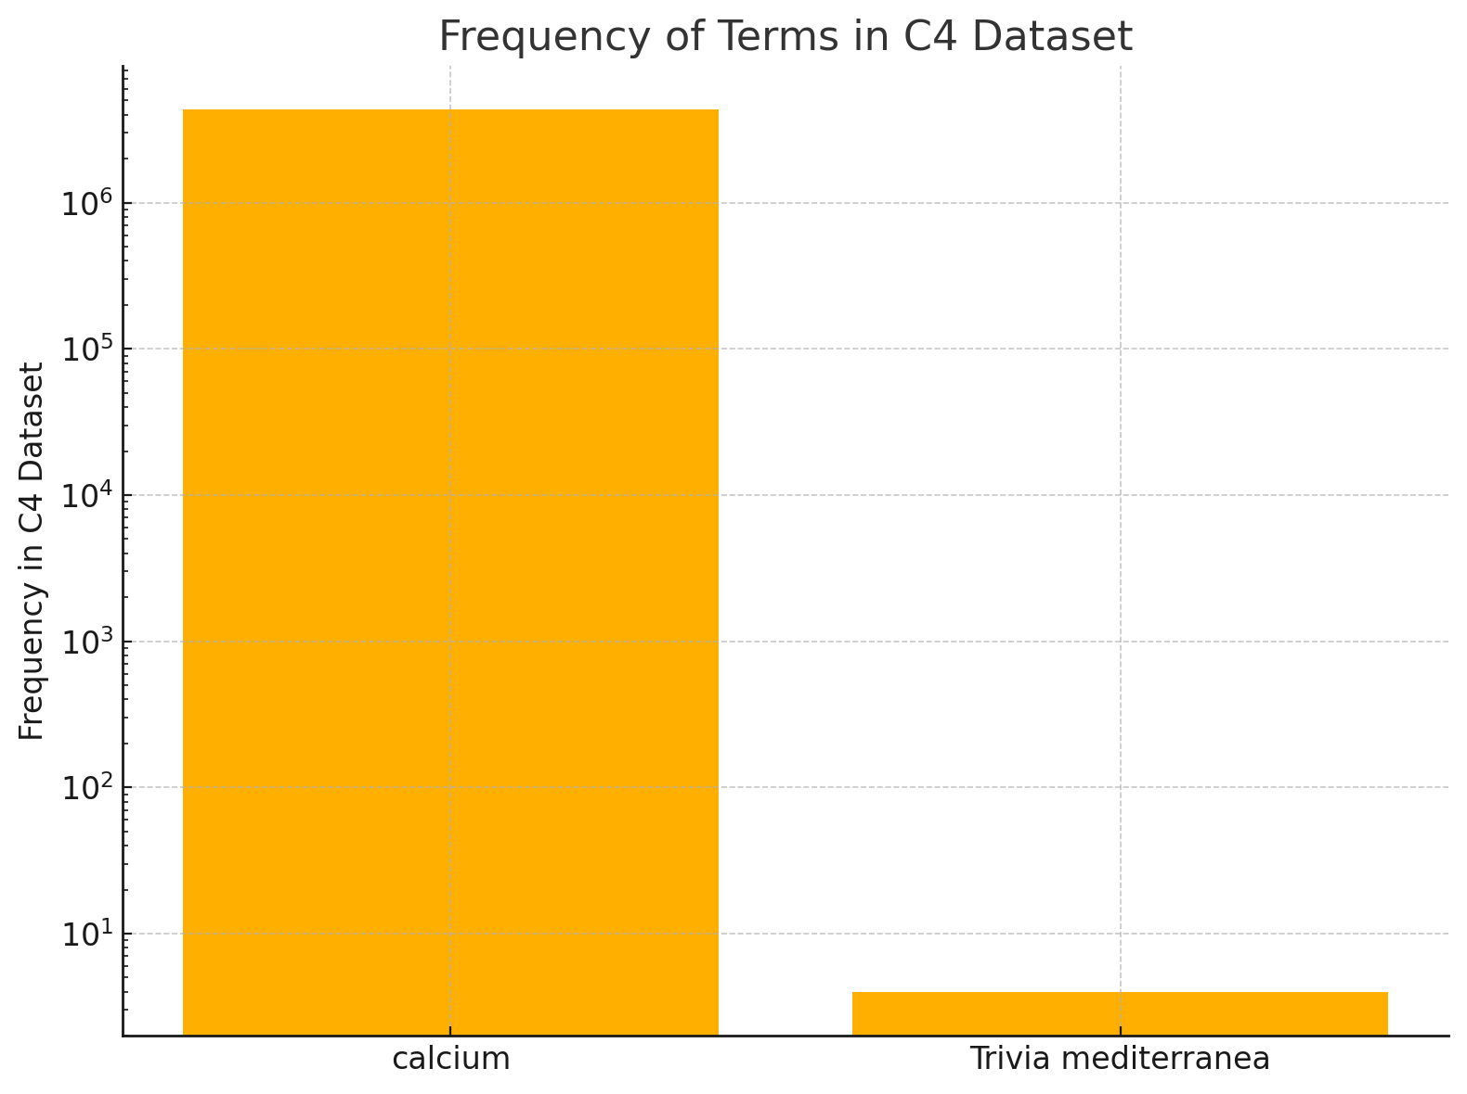
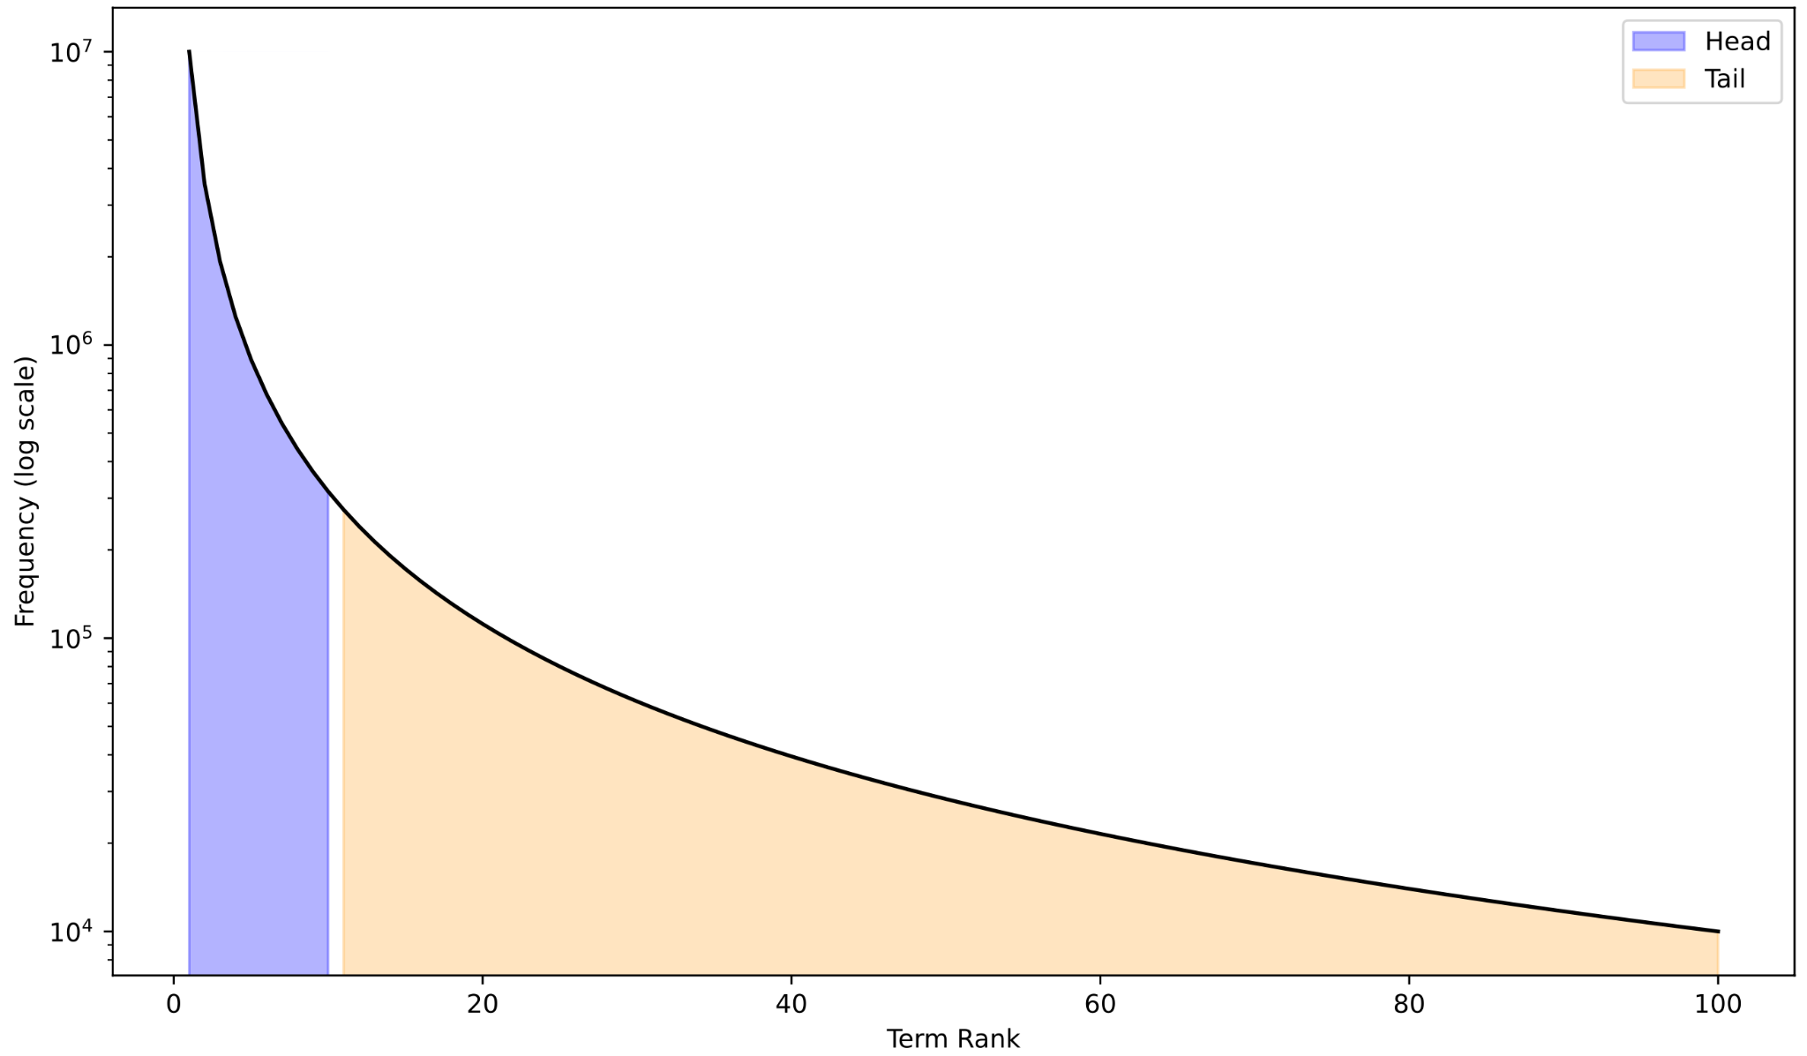
The “long-tailedness” of knowledge
In the entire C4 dataset, trivia mediterranea only appears 4 times.
calcium
Trivia mediterranea
Notes:
We search in the entire C4 dataset and we found that while calcium appears over 4 million times, trivia mediterranea only appears 4 times. This reveals that knowledge in pre-training data exhibits a long-tail phenomenon, where common terms / knowledge such as calcium can appear million of times more than rare knowledge such as this little sea snail.

Slide 4
The “long-tailedness” of knowledge
In the entire C4 dataset, trivia mediterranea only appears 4 times.
calcium
How to train a model on this skewed dataset,
so that the model does not overlook the long-tail?
Trivia mediterranea
Notes:
We search in the entire C4 dataset and we found that while calcium appears over 4 million times, trivia mediterranea only appears 4 times. This reveals that knowledge in pre-training data exhibits a long-tail phenomenon, where common terms / knowledge such as calcium can appear million of times more than rare knowledge such as this little sea snail.
Our question: how to train a model on this skewed dataset, so that the model doesn't overlook the long tail

Slide 5
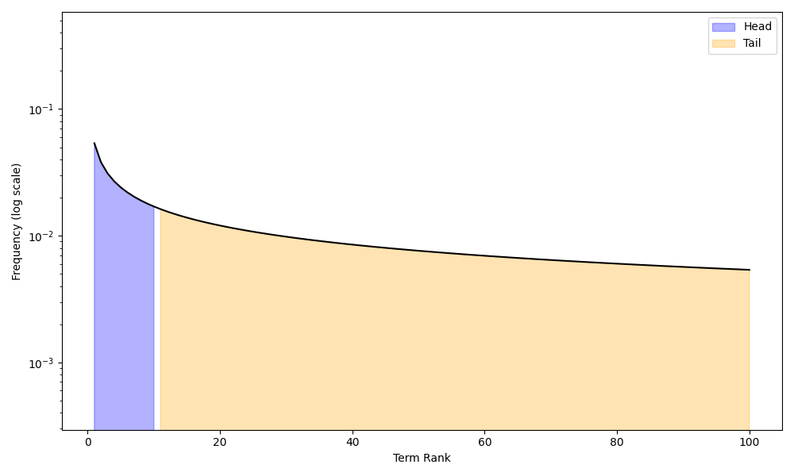
To solve the long-tailed problem, we can…
Solution 1: (Temperature Sampling) We heavily oversample infrequent domains —— Effectively duplicating the data multiple times.
Temp = 1
Temp = 3
Notes:
In order to solve this long-tailed problem, we can use temperature sampling, which oversamples the infrequent domains. Here is an illustration of what temperature sampling accomplishes, it effectively “smooths” the distribution to a more uniform one. The higher the temperature, the more uniform the distribution is. Here we plot the transition of temperature sampling from temp=1 to temp=3, effectively making the distribution smoother.

Slide 6
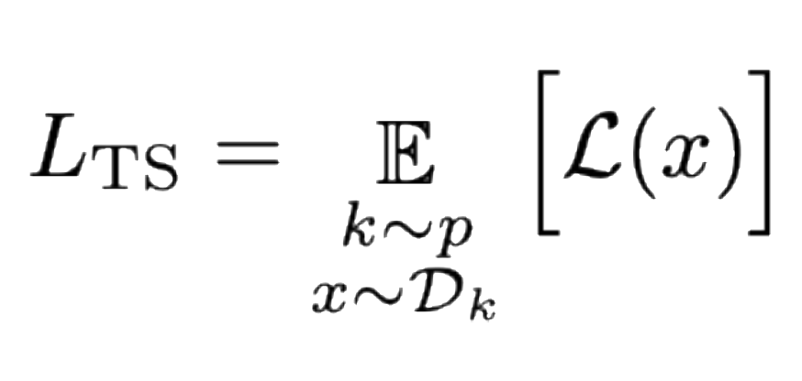
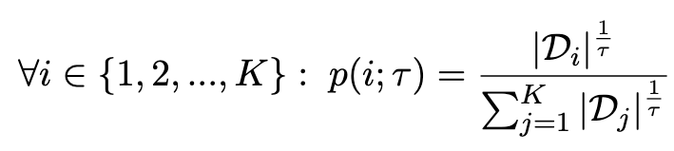
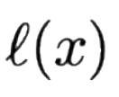
To solve the long-tailed problem, we can…
Solution 1: (Temperature Sampling) We heavily oversample infrequent domains —— Effectively duplicating the data multiple times.
Temperature
Notes:
Here is the mathematical notation of temperature sampling —— it simply powers up the domain sizes by one over the sampling temperature to form domain weights.

Slide 7
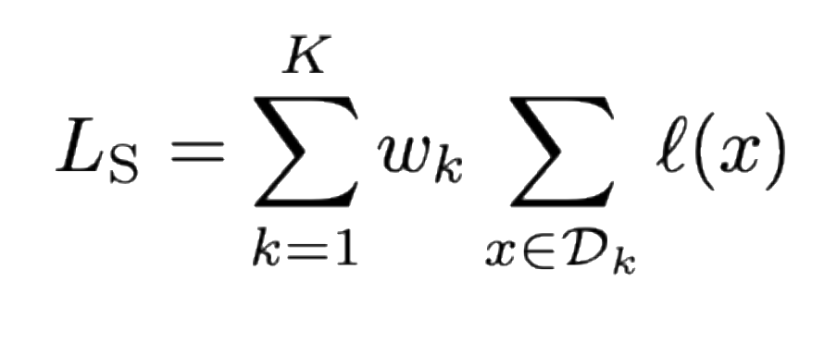
To solve the long-tailed problem, we can also…
Solution 2: (Scalarization)
We assign a much higher weight to the loss of infrequent domains.
Solution 1: (Temperature Sampling) We heavily oversample infrequent domains —— Effectively duplicating the data multiple times.
Notes:
Another solution is scalarization —— this is to assign a weight to every domain, and we can assign much higher weight to the loss of infrequent domains to overcome the long-tailed problems. (click) Here is the weight w_k that is assigned to each domain d_k. We compare this with Temperature scaling, show that the difference is that Scalarization applies a multiplier to the loss while TS applies a mutiplier to the sampling probabiltiies.
The two solutions — scalarization and temperature sampling, are two of the most commonly used methods to overcome long-tailedness.

Slide 8
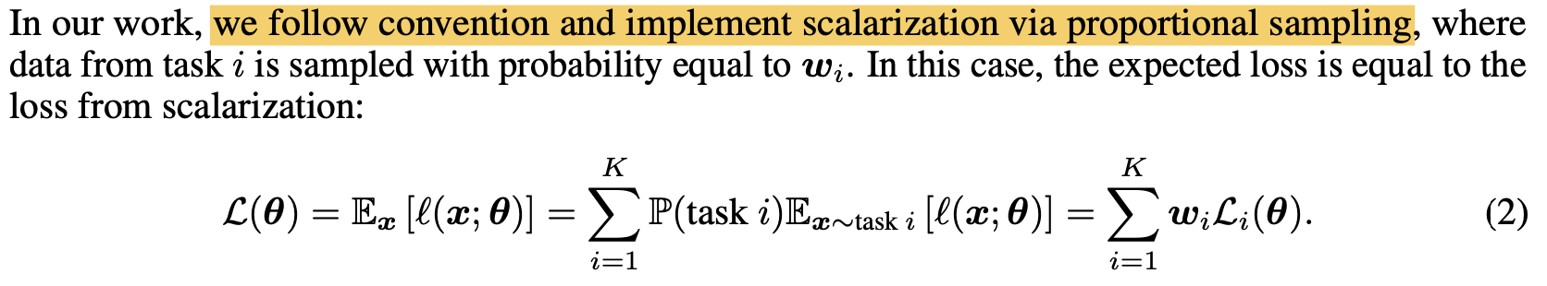
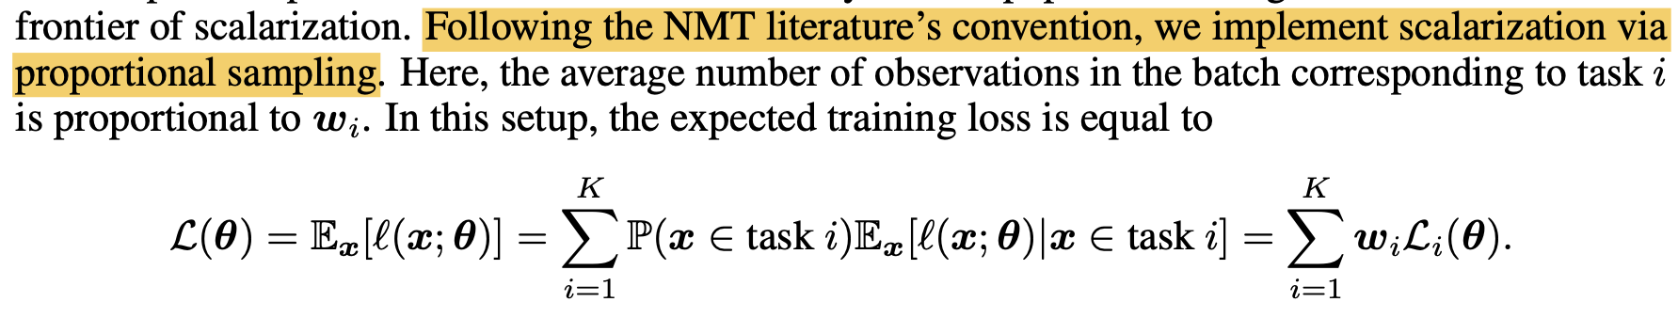
Temperature Sampling often assumed to be equivalent to Scalarization
Order Matters in the Presence of Dataset Imbalance for Multilingual Learning (Choi et al., NeurIPS 2024)
Do Current Multi-Task Optimization Methods Even Help? (Xin et al., NeurIPS 2022)
Notes:
We look into the literature —— which often assumes that the two are equivalent and we can use them interchangeably. We highlight certain quotes in previous work “we implement scalarization via proportional sampling”.

Slide 9
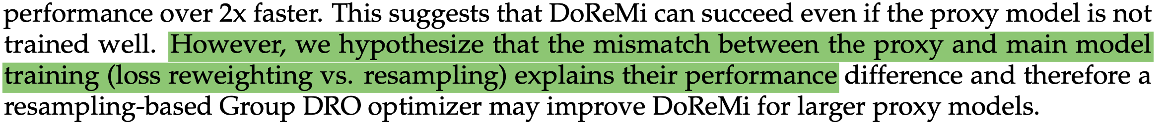
Temperature Sampling often assumed to be equivalent to Scalarization
The reason why they differ is often overlooked
DoReMi: Optimizing Data Mixtures Speeds Up Language Model Pretraining (Xie et al., NeurIPS 2023)
Author Rebuttal of Order Matters in the Presence of Dataset Imbalance for Multilingual Learning
Notes:
Although they are works that acknowledge the differences empirialy, they fail to provide an detailed explanation on why they differ. In this case, the author ackowledges the differences but fails to provide an explanation.
In this author rebuttal, the author mentions that the advantage of temperature sampling is just “simple and intuitive”, again failing to provide a theoretical comparision. The lack of understanding prompts our investigation on the differences between both methods.

Slide 10
Scalarization (S) = Temperature Sampling (TS)
This is True! under *full* Gradient Descent (GD)
Theorem 1: For any sampling temperature, there exists a set of weights that makes S loss = TS loss (on the whole data)
Notes:
First, it is well established that under full GD, the two are equivalent. As you can simply set the weights to be the ratio between by the sampling probabilities w/ and w/o the temperature, making the two loss equivalent.

Slide 11
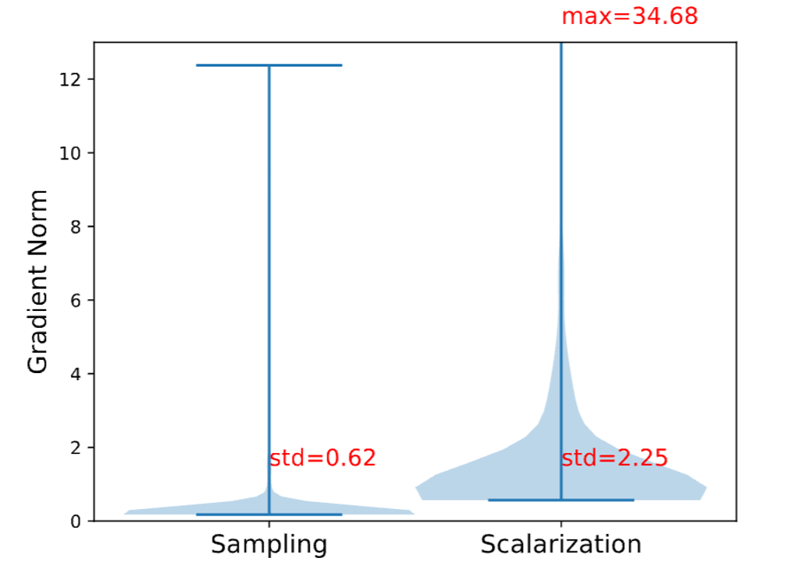
Scalarization (S) = Temperature Sampling (TS)
They are not! Under *Stochastic* Gradient Descent (SGD)
Theorem 2: Temperature Sampling induces a larger variance between gradients compared to Scalarization in SGD.
Notes:
However, under stochastic gradient descent, the two are not equivalent. Specifically, we prove the following theorems: Temperature Sampling induces a larger variance between gradients compared to scalarization in SGD. We empirically verifiy our hypothesis ansd shouw that Sampling, on the left violinplot, does have lower variance then scalarization.

Slide 12
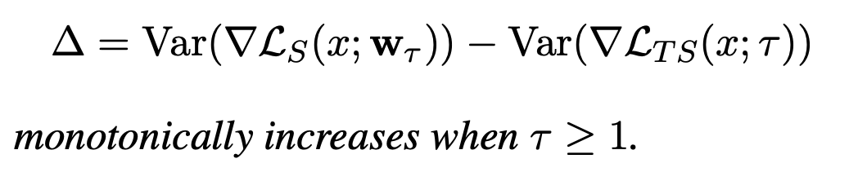
Scalarization (S) = Temperature Sampling (TS)
They are not! Under *Stochastic* Gradient Descent (SGD)
Theorem 2: Temperature Sampling induces a larger variance between gradients compared to Scalarization in SGD.
Theorem 3: larger temperature induces a larger variance gap!
Notes:
Here is the mathematical notation. Then we further prove that as we increase the temperature, the variance also gets higher.

Slide 13
So far
Theorem 2: Temperature Sampling induces a larger variance between gradients compared to Scalarization in SGD.
Theorem 3: larger temperature induces a larger variance gap!
What does the theory tell us about model training?
Notes:
So far, we have shown that TS induces larger var, and as we increase temperature, the variance also gets higher.

Slide 14
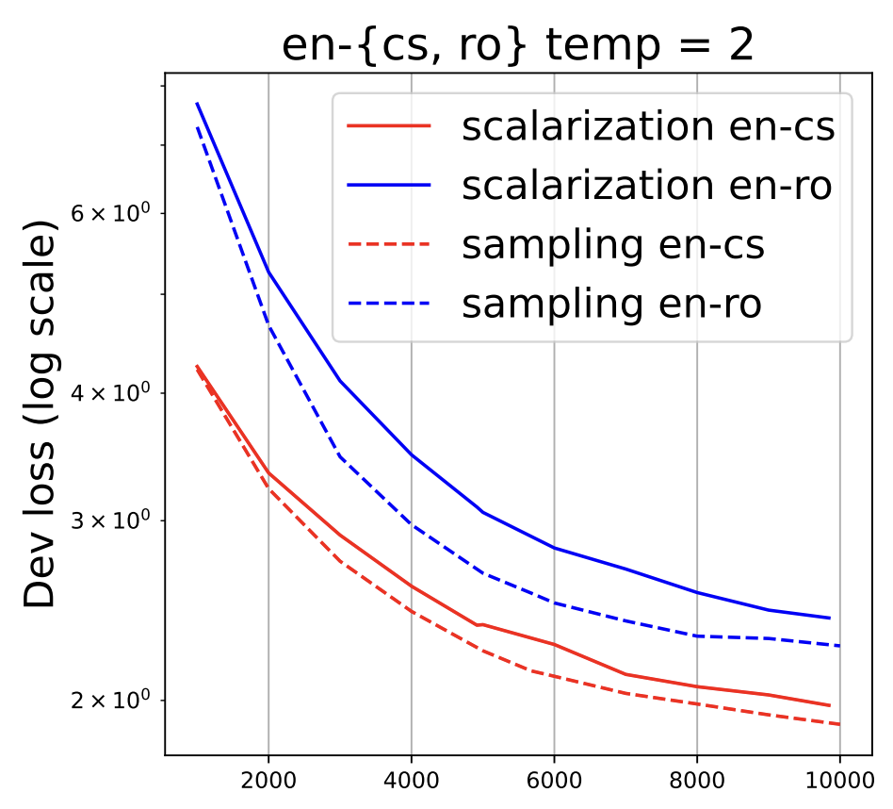
Theorem 2: Temperature Sampling induces a larger variance between gradients compared to Scalarization in SGD.
It is well-known that variance-reduction accelerates the convergences of SGD. (Sutskever et al., 2013; Kingma and Ba, 2015)
Temperature Sampling induces less variance, therefore it should converge faster!
Temperature Sampling (Dashed) converges faster than Scalarization (Solid)!
Notes:
We connect our findings to the literature on variance reduction techniques that accelerates convergence of SGD, and thus we make the hypothesis that due to temperature sampling induces less variance, it should converge faster than scalarization. Specifically, we train a machine translation model on English to both czech and romainian, where Czech is the high resource direction and romainian is the low-resource one. (Click) we observe that the dash line, which is temperature sampling, always outperform the solid line (scalarization). Confirming our theorem 2. So we train a machine translation model to validate our hypothesis — we train with two directions english - czech (high resource in the head) and english - romanian (low resource in the tail). We found that temperature sampling (dashed) do converge faster than scalarization (solid).

Slide 15
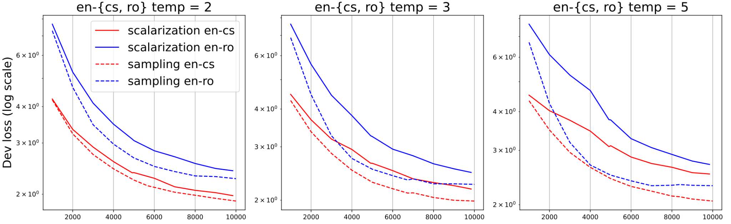
Theorem 3: larger temperature induces a larger variance gap!
Theorem 3 implies:
Increasing temperature (2 to 5) makes the convergence even faster, but easy to overfit
Notes:
Moving further (click), we found that increasing the temperature from 2 to 5 does accelerates the convergence even more, which confirms our theory. (Click) However there is a drawback: due to the heavy oversampling of low-resource languages, in this case romanian, it makes the model easily overfit this domain at higher temperatures.

Slide 16
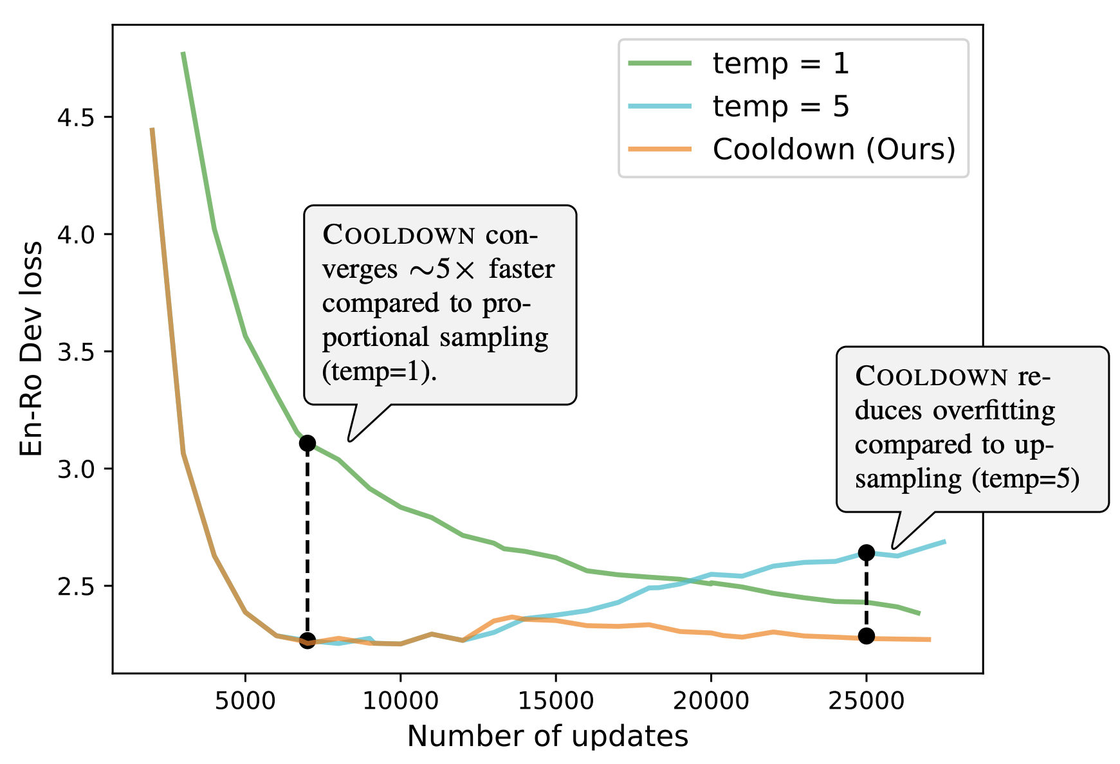
Cooldown: Initially use large temp, then use small temperature
Notes:
We compare our method with just using a static temp=1 (green line) and temp=5 (blue line) on the same setting. We found that the green line, which is temp=1 conveges slower, while the blue line temp=4 converges faster, it is easy to overfit. We thus propose cooldown —— to first use a large temperature at the beginning and then reduce the temperature. Our method achieve the best-of-both-worlds, accelerating the convergence while also not overfitting the low-resource domain Show one by one - green, then blue, then cooldown, then stage

Slide 17
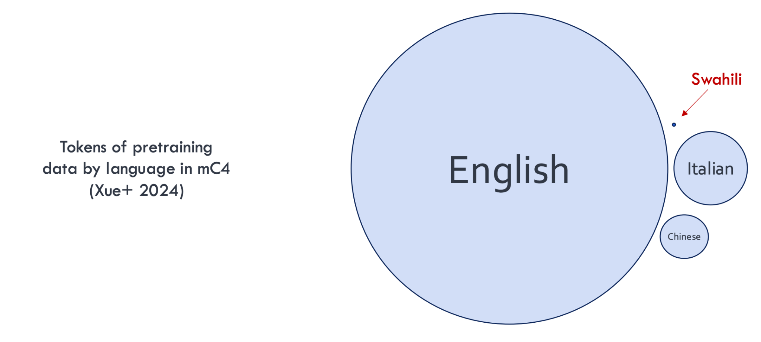
We used different languages as a case study:
Notes:
We use language as a case study as data skew. We use a natural division of domains — different languages in the world, which has a super heavy domain mismatch. Here is an illustration of how much data is in the mC4 Corpus, where the size of the circle is proportional to dataset size.

Slide 18
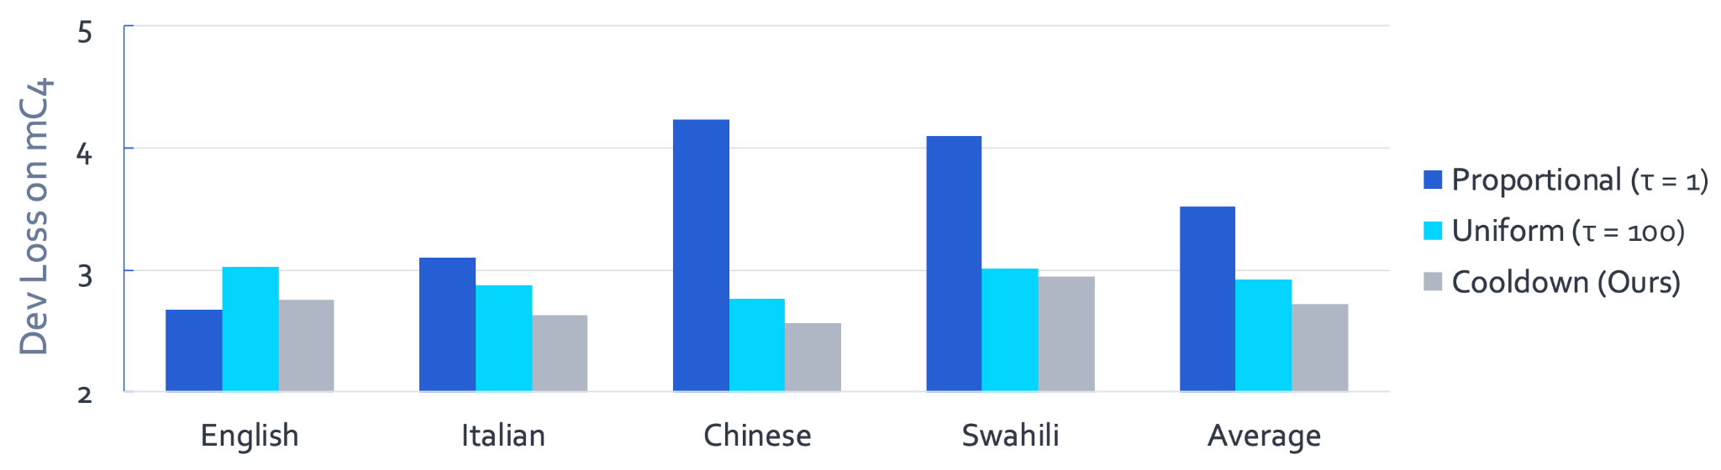
Cooldown: Dev Loss on mC4 (lower is better)
Cooldown outperforms fixed temperature sampling!
Notes:
We then validate our findings on more realistic tasks — in this case we pre-train a 280M language model on 4 languages selected from mC4. Recall that English is significantly more than other languages. We found that our method outperformed using a static temperature.

Slide 19
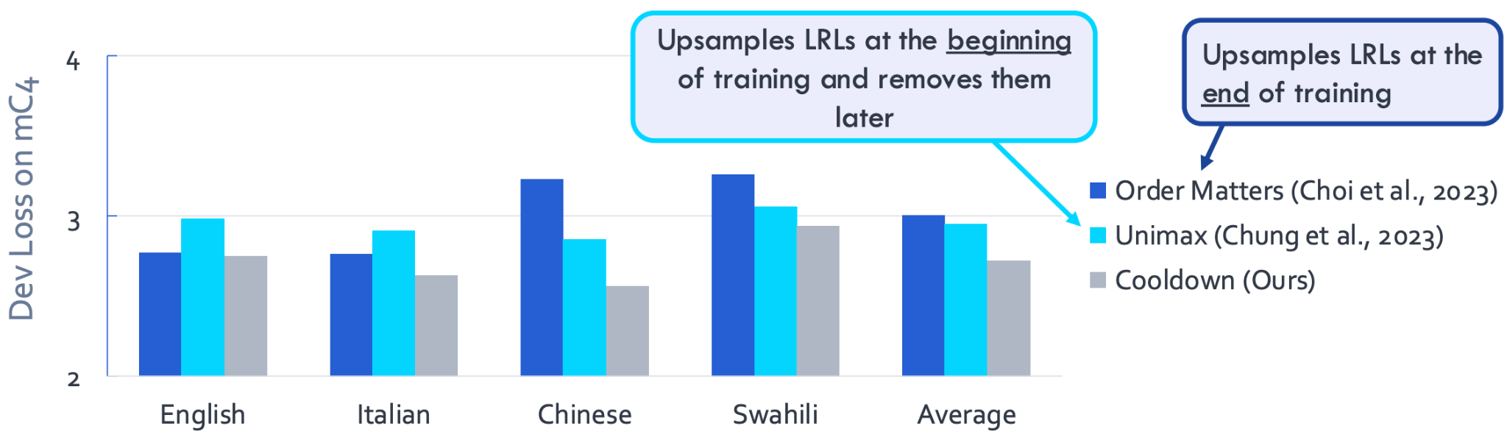
Cooldown: Dev Loss on mC4 (lower is better)
Cooldown outperforms existing work that dynamically adjusts the sampling temperature!
Notes:
We also compare our work with other existing work that dynamically adjusts the sampling temperature with two different trends: Order Matters that upsampling LRLs at the end of training (which is the opposite of cooldown) and Unimax that upsamples LRLs at the beginning of of training and removes them entirely. Our work differs in that instead of completely removing them, we remove the upsample and just sample proportionally. Again, we found that our method outperformed the two baselines.

Slide 20
Summary
Two common approaches for dealing with imbalanced data:
Temperature Sampling: Resampling of domains
Scalarization: Reweighting of per-domain losses
Despite common perception, these two are not equivalent
Temperature Sampling leads to lower variance in gradient estimates
...and faster convergence
We propose ❄️ COOLDOWN ❄️
A suggested recipe for imbalanced (pre-) training

Slide 21
For more results:
https://arxiv.org/pdf/2410.04579
Notes:
For more theoretical and empirical results, please check out our paper! Thank you.

