Slide 1

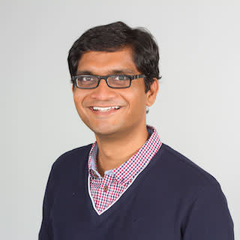





Text Modular Networks: Learning to Decompose Tasks in the Language of Existing Models
Tushar Khot, Daniel Khashabi, Kyle Richardson, Peter Clark & Ashish Sabharwal
Notes:
Hello today I will talk about …
My name is .. And this is joint work with …

Slide 2


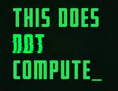
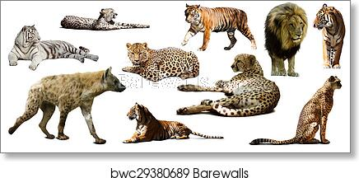
Motivation
Let’s say you are researcher studying Feliformia
Hey VizBot, Find me all images containing a Feliformia
…
Feliformia
Notes:
Before going into the details of the paper, lets consider this scenario. Say you are researcher studying Feliformia and you are interested in finding images containing species of this sub-order. So you go to your favorite visual QA bot, VizBot and ask it to find you all images containing Feliformia. Unfortunately VizBot does not understand what Feliformia means and does not know how to answer your question.

Slide 3
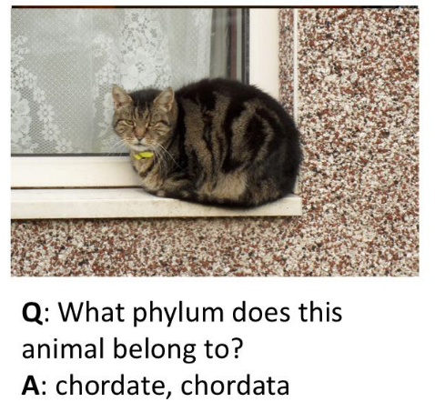
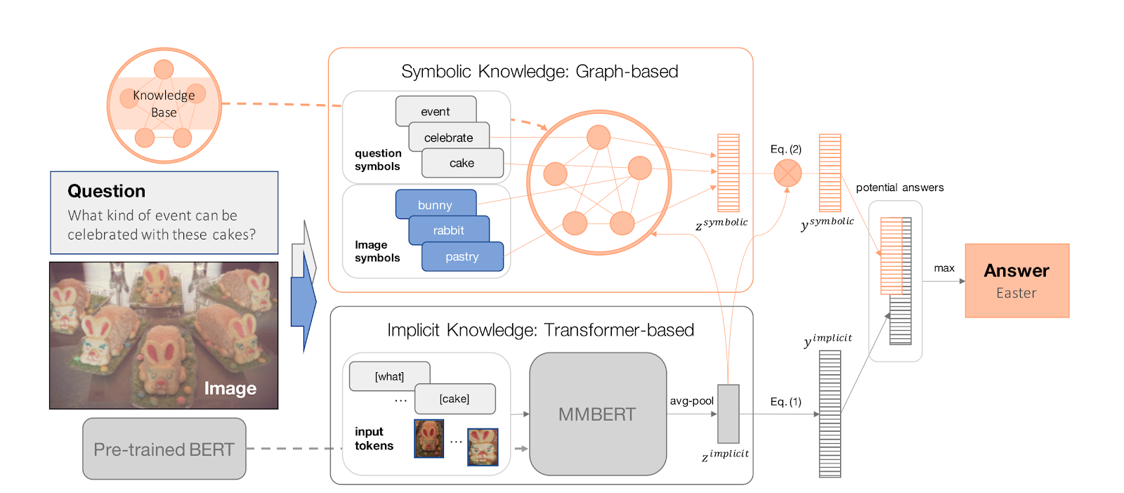
Motivation
Let’s build a dataset
Hey that’s an interesting unsolved problem. Let’s build a dataset
<x, y>
Marino et al’ 19
Hey that’s an interesting unsolved dataset. Let’s build a novel model for it
x
y
Marino et al’ 20
Notes:
So at this point, as a ML researcher, you might think: “hey this is an interesting unsolved problem. Lets build a dataset to focus on this problem.” And some researchers have done that. And you could now take this dataset and try to solve it with a novel model that combines text transformers with symbolic kbs and visual features.

Slide 4

Motivation
Can we reuse existing models (stand on the shoulder of giants) to solve new tasks?
New Problem => New Dataset => New Model
<x, y>
<x, y>
<x, y>
<x, y>
Develop and train new (and often large) models for each task from scratch each time
Notes:
And this is generally how things progress, we identify a new unsolved problem, build a dataset for it and develop and train novel models to solve these problems.
Unfortunately this means we need to train these new, and often very large, models from scratch each time for each task.
So the question we ask in this work: can we instead re-use existing models i.e. stand on the shoulder of these giants, to solve these new complex tasks?

Slide 5






Motivation
Hey MBot, Find me all images containing a Feliformia
Hey TextBot, What are Feliformia?
Feliformia is a suborder … consisting of cats, hyenas, mongooses, and viverrids
Hey VizBot, which images contain cats?
…
Notes:
What would that look like? Lets take at our current example of finding images containing feliformia.
Our system should recognize that Vizbot model does not understand the Feliformia category, and so instead uses TextBot, a text QA model, to find out “What are Feliformia”. It gets back the answer that Feliformia consists of cats..
Now it knows that Vizbot can find images of cats and so it asks Vizbot to return images of cats. And this can be repeated for the other species.
Basically, instead of building a new model, the system decomposed the complex tasks into sub-tasks that are solvable by current models.

Slide 6

Our Contribution
Research Question:
Can we learn to decompose complex tasks into sub-tasks solvable by existing models?
Text Modular Networks (TMNs): A general framework that can leverage existing simpler models -- neural and symbolic -- as blackboxes for answering complex questions.
ModularQA: An implementation of this framework that learns to decompose multi-hop and discrete reasoning questions.
A model that is more robust, versatile, sample-efficient and interpretable
Notes:
That is exactly the research question we ask in this work: Is it possible to decompose complex QA tasks into simpler sub-tasks solvable by existing models. We find that it is possible. We propose a general framework, Text Modular Networks that can leverage… to answer complex questions. We implement a system in this framework that we call ModularQA that can answer multi-hop and discrete reasoning questions. Finally the resulting model is shown to be more robust, …
Before going to the details of the framework, let me first set up the scope of our study

Slide 7

Setup
Research Question:
Can we learn to decompose the complex tasks into sub-tasks solvable by the existing models?
Sub-Tasks & Models:
Task: Reading Comprehension
Model: RoBERTa model trained on SQuAD
Task: Basic Math Calculation
Model: Symbolic Python function
Complex Tasks: Multi-hop + discrete reasoning
HotpotQA (Yang et al’ 18)
DROP Subset (Dua et al’ 19)
P: ...The sector decreased by 7.8 percent in 2002 ...
Q: When did the services sector start to decrease?
A: 2002
Q: diff(August 1922, 30 March 1922, months)
A: 5
SBot
CBot
HotpotQA Question: Little Big Girl was a Simpsons episode directed by the animator and artist of what nationality? (answer: American)
DROP Question: How many years did it take for the services sector to rebound? (answer: 1)
Notes:
To explore our research question, we considered two sub-tasks and models. We considered the reading-comprehension question-answering task and used a RoBERTa model trained on the Squad dataset as the sub-model. We refer to this as Sbot. We also consider a basic math calculator model implemented as a symbolic Python function. We refer to this as Cbot. You can see the input questions to these models to the right. The key thing to note here is that Sbot answers simple natural language questions whereas Cbot answers arithmetic questions in this specific functional form.
Given these two sub-models, we focus on multi-hop and discrete reasoning questions solvable by the composition of these two models. Specifically we look at HotpotQA and a subset of DROP questions in this work. We have couple of example questions from this dataset. Lets look at the question from the DROP dataset more closely and see how we could use Sbot and Cbot to answer it.

Slide 8



Text Modular Networks
P: ...The sector decreased by 7.8 percent in 2002, before rebounding in 2003 with a 1.6 percent growth rate...
How many years did it take for the services sector to rebound?
Hey Sbot, In what year did the services sector rebound?
Question Decomposition (Talmor and Berant, 2018; Min et al., 2019; Perez et al., 2020): Often need annotations; decompositions independent of the sub-model, target one dataset + sub-model
Neural Module Networks(Andreas et al., 2016; Jiang and Bansal, 2019; Gupta et al., 2020): Modules need to be trained on end-task, vector-based communication
NextGen
2003
Hey SBot, When did the services sector start to take a dip?
NextGen
2002
Hey Cbot, diff(2003, 2002)=?
NextGen
1
Done!
x
y
NextGen
Notes:
So the question states: How many years... To answer this question we would need to find the difference between the years when the service sector went down and when it rebounded. And we can do that by first asking Sbot our reading comprehension system “In what year…” We need to then ask Sbot when the sector started to take a dip. Note that complex question does not explicitly mention this dip but is implied from the question. Finally we can use Cbot to find the difference between these years using its functional format and return that as the answer. This is basically our proposed Text Modular Network framework, where we train the NextGen model to generate sub-questions for appropriate sub-models in their language. We use NextGen to iteratively generate the next question and the appropriate sub-model to answer it till it finds the final answer.
While Question decomposition has been explored before, they are dataset-specific, often need additional annotations and generate sub-model independent decompositions. Neural Module Networks are modular architectures often used in QA but do not have this natural textual communication and do not re-use existing models.

Slide 9
Text Modular Networks
P: ...The sector decreased by 7.8 percent in 2002, before rebounding in 2003 with a 1.6 percent growth rate...
How many years did it take for the services sector to rebound?
Hey Sbot, In what year did the services sector rebound?
Big Question:
How do we train to ask the right questions to the appropriate models in the model’s language?
NextGen
2003
Hey SBot, When did the services sector start to take a dip?
NextGen
2002
Hey Cbot, diff(2003, 2002)=?
NextGen
1
Done!
NextGen
Notes:
So the big question in our work is: how do we train this nextgen model to ask the right questions to the appropriate sub-models in their language?

Slide 10
Training Text Modular Networks (TMNs)
Learn the language of the sub-models
Decompose complex tasks into questions in this language
Train NextGen to generate the decomposition
Notes:
That is the key technical issue that we try to solve in this work. Our solution can be broken down into 3 steps:
We first learn the language of the sub-model. We then decompose complex questions into sub-questions in this language. Finally we train nextgen on these generated decompositions.

Slide 11

Learning the language of models
Informally, language of a model: “What kind of questions can we ask this model?”
Learn this language: Use the model’s original training data
P: ...The sector decreased by 7.8 percent in 2002, before rebounding in 2003 with a 1.6 percent growth rate...
A: 2002
V: “services”, “sector”, “start”
Q: When did the services sector start to decrease?
P: ...The sector decreased by 7.8 percent in 2002, before rebounding in 2003 with a 1.6 percent growth rate...
A: 2002
Q: When did the services sector start to decrease?
Notes:
First what do I even mean by language of models. Informally it is what kind of .. And expect a reasonable answer.
And to learn this language we basically rely on the model’s original training data.
Lets take our Sbot here. It was trained on the squad dataset where given a passage and question as input, it finds an answer span in the input passage. So to model the language of its questions, we learn an inverse sbot model that generates a squad-like question given the passage and answer as input. Note that the input does not have to be limited to just passage and answer, we can also provide vocabulary hints. But for the purposes of this talk, I will assume that these inverse functions are trained to generate the questions given just passage and answer.

Slide 12

Decomposing Complex Tasks
How many years did it take for the services sector to rebound?
P: ...The sector decreased by 7.8 percent in 2002, before rebounding in 2003 with a 1.6 percent growth rate...
Hey SBot, In what year did the services sector rebound?
A: 2003
Hey SBot, When did the services sector start to take a dip?
A: 2002
Hey CBot, diff(2003, 2002)=?
A: 1
Answer: 1
Notes:
Now to decompose the complex tasks, we rely on distant supervision hints often used in such complex tasks. Specifically given the final answer, we can identify potential intermediate answers that a model would have to “hop” through to arrive at the final answer. e.g., In this question, we can look for dates and numbers in the context which after a simple arithmetic operation results in the final answer. In this case, we can subtract 2002 from 2003 to get the final answer 1.
Given these intermediate answers, we can now use our inverse models to generate the questions for appropriate models at each reasoning step. E.g., In the first step, we can use the inverse sbot model to generate a squad-like question given the input passage and 2003 as the answer. In this case, it generates the question “In what year…”. Similarly it generates “When did the .. “ for the second step. Given these previous answers, the inverse cbot can now generate the question to find the difference between these two numbers; in the functional form as expected by cbot
In this way, we can generate the decompositions for complex questions in the language of these sub-models using only distant supervision hints.

Slide 13

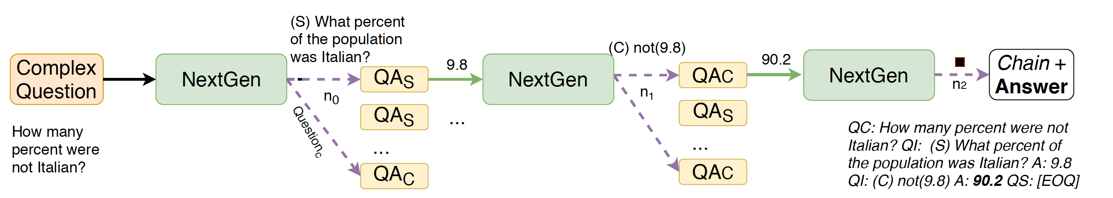
Training & Inference
Train on these decompositions to generate the next question
Inference: Use to ask questions and the sub-models to answer them
How many years did it take for the services sector to rebound?
Hey Sbot, In what year did the services sector rebound?
Hey SBot, When did the services sector start to take a dip?
2003
No need for answer hints!
Notes:
Training next gen is just a matter of training a seq2seq model that generates the next question and the sub-model name given the previous conversation history.
During inference, as we showed earlier, we use nextgen to ask the questions and the sub-modesl to answer them. There is an underlying search procedure that I won’t go into now but the key thing I want to highlight here is that: we do not need any answer hints once the nextgen model is trained.

Slide 14
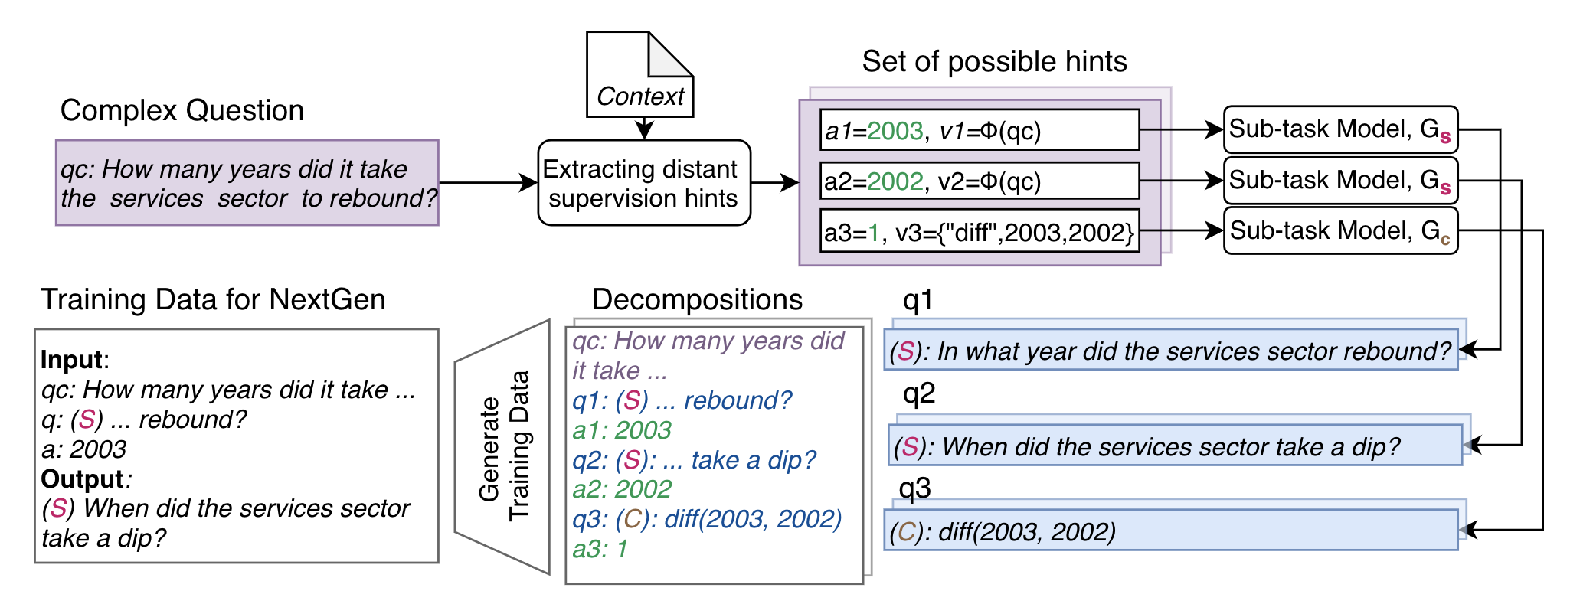
ModularQA: An implementation of TMNs
Checkout demo at:
https://modularqa-demo.apps.allenai.org/
Notes:
Using the TMN framework as the blueprint, we implemented a QA system for HotpotQA and DROP called ModularQA. I don’t have the time to go into the details of the system right now, but we have a demo of the modularqa system at this url that you can try.

Slide 15
Results
Notes:
Next we evaluate the modularqa system on hotpot and drop datasets

Slide 16
Sample Decompositions
No decomposition annotations needed!
12 Years a Slave starred what British actor born 10 July 1977) Q: Who stars in 12 Years a Slave? A: Chiwetel Ejiofor Q: Who is the British actor born 10 July 1977? A: Chiwetel Umeadi Ejiofor
How many children’s books has the writer of the sitcom Maid Marian and her Merry Men written ? Q: What writer was on Maid Marian and her Merry Men? A: Tony Robinson Q: How many children’s books has Tony Robinson written? A: sixteen
Did Holland’s Magazine and Moondance both begin in 1996? Q: When did Holland’s Magazine begin? A:1876 Q: When did Moondance begin? A:1996 Q: if_then(1876=1996, no, yes) A: no
Notes:
First, qualitatively, here are few sample decompositions generated by the ModularQA system. Lets look at the second multi-hop example from hotpotqa :…The system first finds the writer of the sitcom using Sbot and then uses Sbot to find the number of childrens books.
One key thing to highlight here is that the model generates these decompositions in this natural language without needing any decomposition supervision.

Slide 17
Results
More versatile
More robust
Contrast Test | DROP EM | DROP F1
ModularQA | 55.7 | 63.3
NumNet+V2 | 45.2 | 56.2
 | DROP F1 | HotpotQA
ModularQA | 87.9 | 61.8
NMN-D | 79.1*
SNMN |  | 63.1
Modular
Sample Efficient
Training Set % | 100% | 60% | 20%
ModularQA | 87.8 | 89.3 | 87.0
NumNet+V2 | 91.6 | 88.3 | 85.4
 | DROP F1 | HotpotQA
ModularQA | 87.9 | 61.8
NumNet+V2 | 91.6
Quark |  | 75.5
Interpretable
Black-box
Human Eval | Trust | Understand | Prefer
ModularQA | 67% | 78% | 68%
DecompRC | 33% | 22% | 32%
* Evaluated on an overlapping test set
Notes:
Quantitiavely, we compare modularqa to dataset-specific models on both the datasets. Unlike previous models, ModularQA is more versatile where this single system works across both these datasets. While being applicable to multiple datasets, it is even competitive with the dataset-specific modular approaches. Compared to black-box models, our system lags behind but gains on other aspects. First, we show that modularqa is more robust by evaluating on the contrast test set. These contrast sets are meant to evaluate the models ability to learn the task, and not the dataset . We show that our system outperforms NumNet+V2, a state-of-the-art model for DROP on this set. We also show that we can train a more effective QA system with fewer examples than this black-box model. Finally we show our models explanations are more interpretable compared to the previous decomposition –based approach developed for HotpotQA, DecompRC. In a human evaluation, crowdworkers trusted understood and preferred our explanations over DecompRc.

Slide 18
Conclusion & Future Work
We propose Text Modular Networks, a framework to compose existing models – symbolic or neural – to solve more complex tasks
We develop ModularQA, an implementation of TMNs that can answer multi-hop and numeric reasoning questions
Resulting model is more robust, versatile, sample-efficient and interpretable
Future Work
Dealing with many spurious decompositions (due to distant supervision) e.g., “Q: How many FGs were scored? A:3”
Dealing with sub-optimal models due to unexplored sub-tasks
https://github.com/allenai/modularqa
{tushark, danielk, kyler, peterc, ashishs} @allenai.org
Notes:
In conclusion, we presented text modular netowkrs, a new framework to compose existing models neural or symbolic to solve more complex tasks. We presented an implementation of this framework modularqa that decomposes multi-hop and discrete reasoning questions into the language of text qa model and calculator. Apart from the model re-use, the resulting model is shown to have multiple advantages over prior work,
There are various avenues for future work. Certain question classes can have many spurious distant supervision hints that lead to noise in the question decompositions. Additionally some complex tasks require sub-models for relatively unexplored sub-tasks. As a result these sub-models are not as accurate and this leads to noisy answers in each reasoning step.
We have released the data, code and models at the url below. If you have any quesitons, please feel free to contact us
Thank you for your time!

Slide 19
Thanks

