Slide 1



Upsample or Upweight?
Balanced Training on Heavily Imbalanced Datasets
Tianjian Li, Haoran Xu, Weiting Tan, Kenton Murray, Daniel Khashabi
NAACL 2025
Notes:
Hi, my name is Tianjian. I am very happy to present our work “Upsample or Upweight, Balanced Training on Heavily Imbalanced Datasets”, which is published at NAACL 2025. I am thankful to my wonderful colleagues Haoran and Weiting, and my wonderful advisors Kenton and Daniel. Let’s get started!

Slide 2
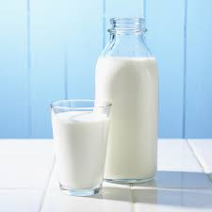
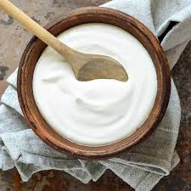
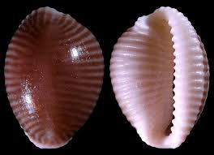
In our language model’s pre-training data…
There exists very common knowledge:
You can get calcium from dairy products like milk, yogurt and cheese, canned fish with soft bones (sardines, anchovies and salmon; bones must be consumed to get the benefit of calcium), dark-green leafy vegetables (such as kale, mustard greens and turnip greens) and even tofu (if it's processed with calcium sulfate).
But there also exists very niche topics:
Trivia mediterranea is a species of small sea snail, a marine gastropod mollusc in the family Triviidae, the false cowries or trivias.
Notes:
We first take a look at our LMs pre-training data: in our pre-training corpus, there exists very common knowledge such as where to get calcium. There also exist very rare knowledge such as a species of small sea snail. All the text here, by the way, are from a very commonly used pre-training corpus (red pajama).

Slide 3
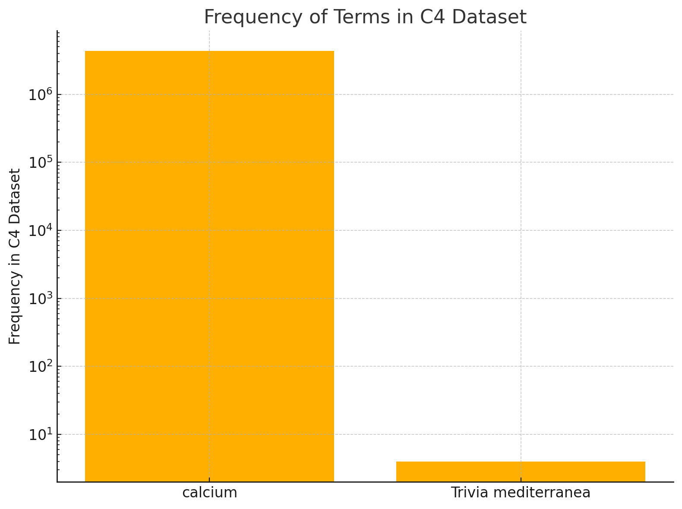
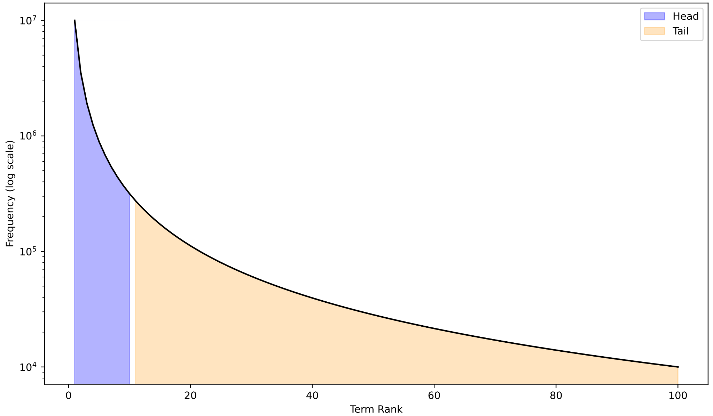
The “long-tailedness” of knowledge
In the entire C4 dataset, trivia mediterranea only appears 4 times.
calcium
Trivia mediterranea
Notes:
We search in the entire C4 dataset and we found that while calcium appears over 4 million times, trivia mediterranea only appears 4 times. This reveals that knowledge in pre-training data exhibits a long-tail phenomenon, where common terms / knowledge such as calcium can appear million of times more than rare knowledge such as this little sea snail.

Slide 4
How to train on the long-tailed data
calcium
How to train a model on this skewed dataset, so that the model does not overlook the long-tail?
Trivia mediterranea
Notes:
The question we want to ask is simple: how can we deal with this super heavy long-tailed problem? First, we want to come up with a way to split the dataset, not just by terms because there can be too many.

Slide 5
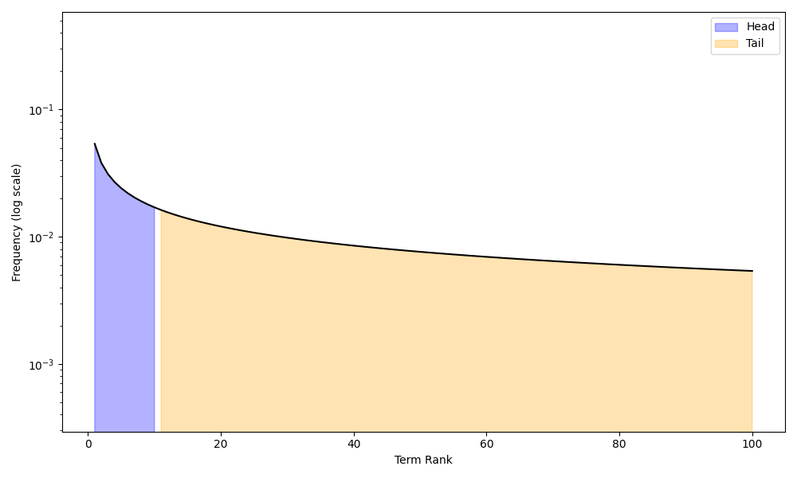
To solve the long-tailed problem, we can…
Solution 1: (Temperature Sampling) We heavily oversample infrequent domains —— Effectively duplicating the data multiple times.
Temp = 1
Temp = 3
Notes:
In order to solve this long-tailed problem, we can use temperature sampling, which oversamples the infrequent domains. Here is an illustration of what temperature sampling accomplishes, it effectively “smooths” the distribution to a more uniform one. The higher the temperature, the more uniform the distribution is.

Slide 6
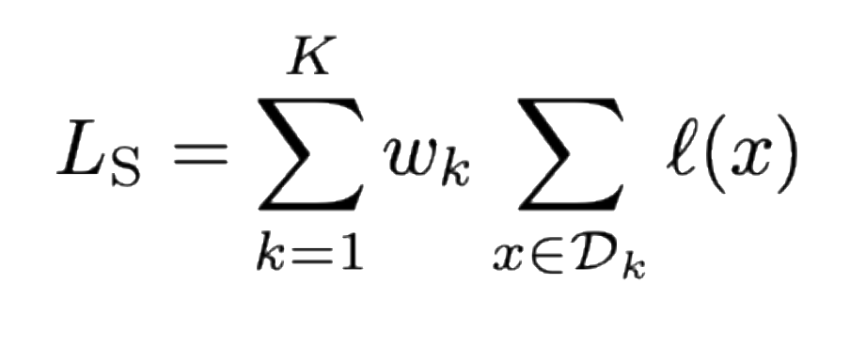
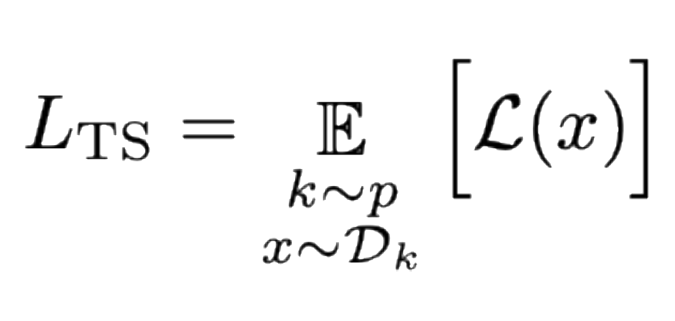
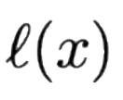
To solve the long-tailed problem, we can also…
Solution 2: (Scalarization)
We assign a much higher weight to the loss of infrequent domains.
Solution 1: (Temperature Sampling) We heavily oversample infrequent domains —— Effectively duplicating the data multiple times.
Notes:
Another solution is scalarization —— this is to assign a weight to every domain, and we can assign much higher weight to the loss of infrequent domains to overcome the long-tailed problems. The two solutions — scalarization and temperature sampling, are two of the most commonly used methods to overcome long-tailedness.

Slide 7
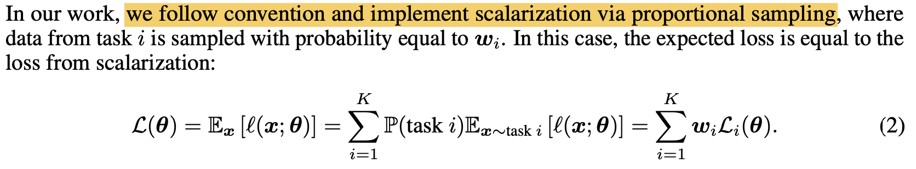
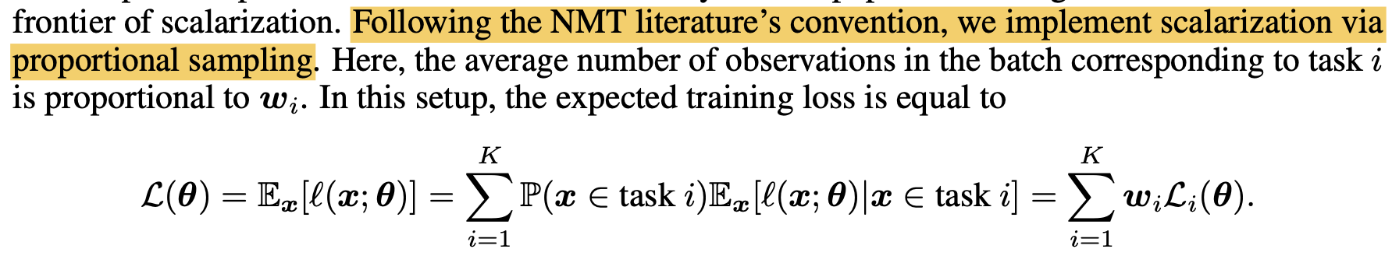
Temperature Sampling often assumed to be equivalent to Scalarization
Order Matters in the Presence of Dataset Imbalance for Multilingual Learning (Choi et al., NeurIPS 2024)
Do Current Multi-Task Optimization Methods Even Help? (Xin et al., NeurIPS 2022)
Notes:
We look into the literature —— which often assumes that the two are equivalent and we can use them interchangeably. We highlight certain quotes in previous work “we implement scalarization via proportional sampling”.

Slide 8
DoReMi paper case study

Slide 9
Equivalency Under (Full) Gradient Descent

Slide 10
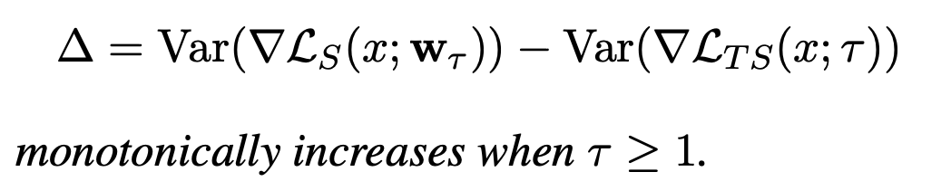
Scalarization often assumed to be equivalent to Temperature Sampling
But in fact, they are not!
Theorem: Temperature Sampling induces a larger variance between gradients compared to Scalarization in SGD.
Theorem: larger temperature induces a larger variance gap!
Notes:
(Start with In our work, we reveal they are not. Specifically, we prove the following theorems: Temperature Sampling induces a larger variance between gradients compared to scalarization in SGD. Then we prove that as we increase the temperature, the gap between both methods becomes larger. But what does this tell us about model training? What are the implications?

Slide 11
Scalarization often assumed to be equivalent to Temperature Sampling
But in fact, they are not!
Theorem: Temperature Sampling induces a larger variance between gradients compared to Scalarization in SGD.
Theorem: larger temperature induces a larger variance gap!
Notes:
Fixed batchsize, empirical verification of the variance.

Slide 12
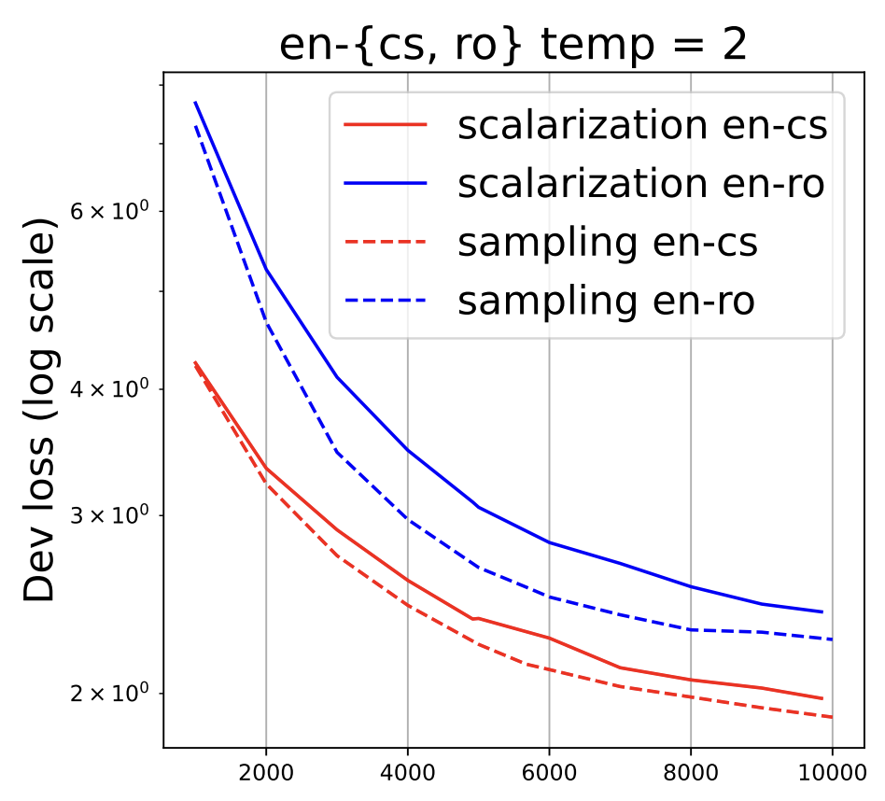
It is well-known that variance-reduction accelerates the convergences of SGD (Sutskever et al., 2013; Kingma and Ba, 2015)
Hypothesis: Temperature Sampling induces less variance, therefore it should converge faster!
Temperature Sampling (Dashed) Converges faster than Scalarization (Solid)!
Notes:
We connect our findings to the literature on variance reduction techniques that accelerates convergence of SGD, and thus we make the hypothesis that due to temperature sampling induces less variance, it should converge faster than scalarization. Show blue one then show red one. So we train a machine translation model to validate our hypothesis — we train with two directions english - czech (high resource in the head) and english - romanian (low resource in the tail). We found that temperature sampling (dashed) do converge faster than scalarization (solid).

Slide 13
Scalarization often assumed to be equivalent to Temperature Sampling
But in fact, they are not!
Theorem: Temperature Sampling induces a larger variance between gradients compared to Scalarization in SGD.
Theorem: larger temperature induces a larger variance gap!
Notes:
Fixed batchsize, empirical verification of the variance.

Slide 14
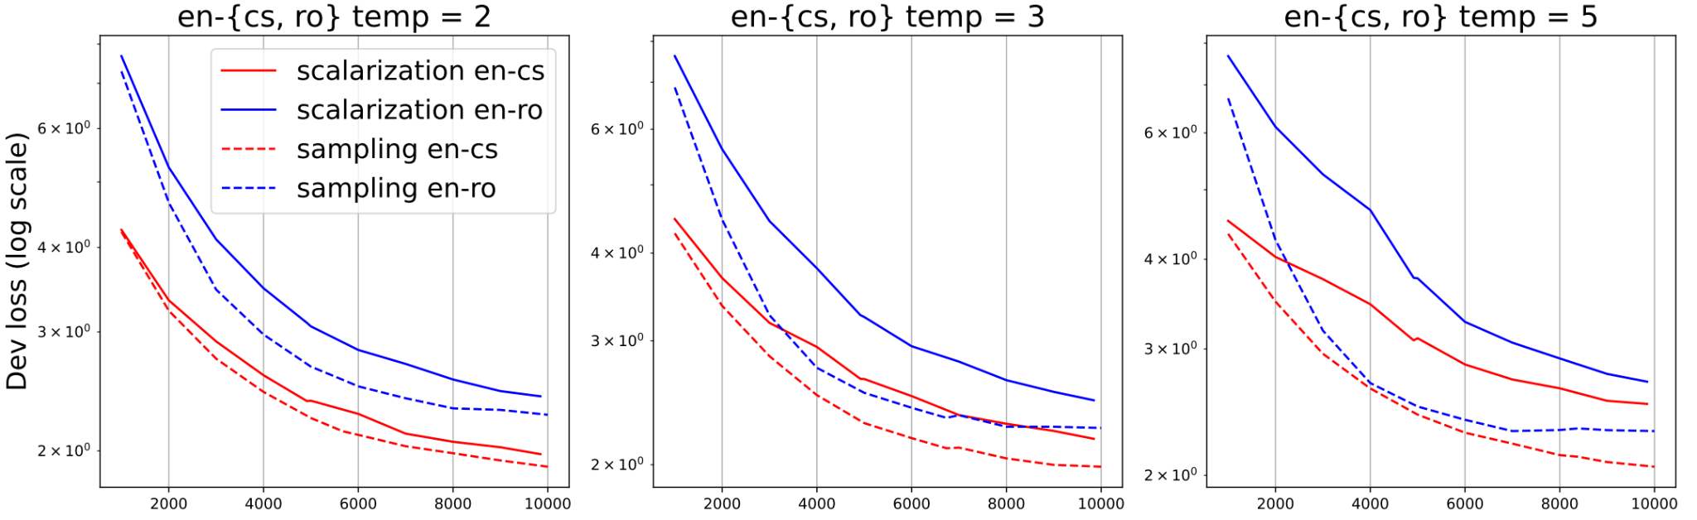
Hypothesis: Temperature Sampling induces less variance, therefore it should converge faster!
Increasing temperature (2 to 5) makes the convergence even faster, but easy to overfit
Notes:
Moving further, we found that increasing the temperature from 2 to 5 does accelerates the convergence even more, which confirms our theory. However there is a drawback: due to the heavy oversampling of low-resource languages, in this case romanian, it makes the model easily overfit this domain at higher temperatures.

Slide 15

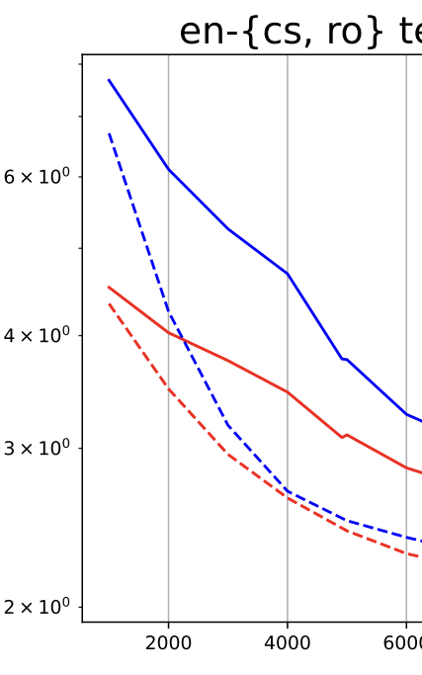
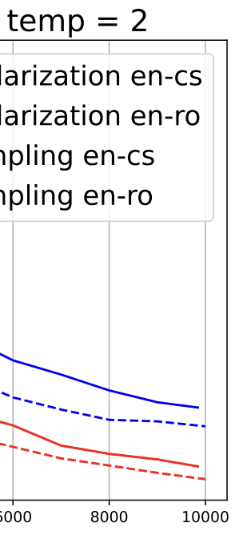
Cooldown: Initially use large temp, then use small temperature
+
Notes:
So, what if we can interpolate this: to first use a large temperature at the beginning, then use a smaller temperature in the end. This would make the model first converge faster, then mitigate the overfitting problem. So this is our proposed method: cooldown: to use a large temperature at the beginning, then use a smaller temperature in the end.

Slide 16
Summary thus far

Slide 17
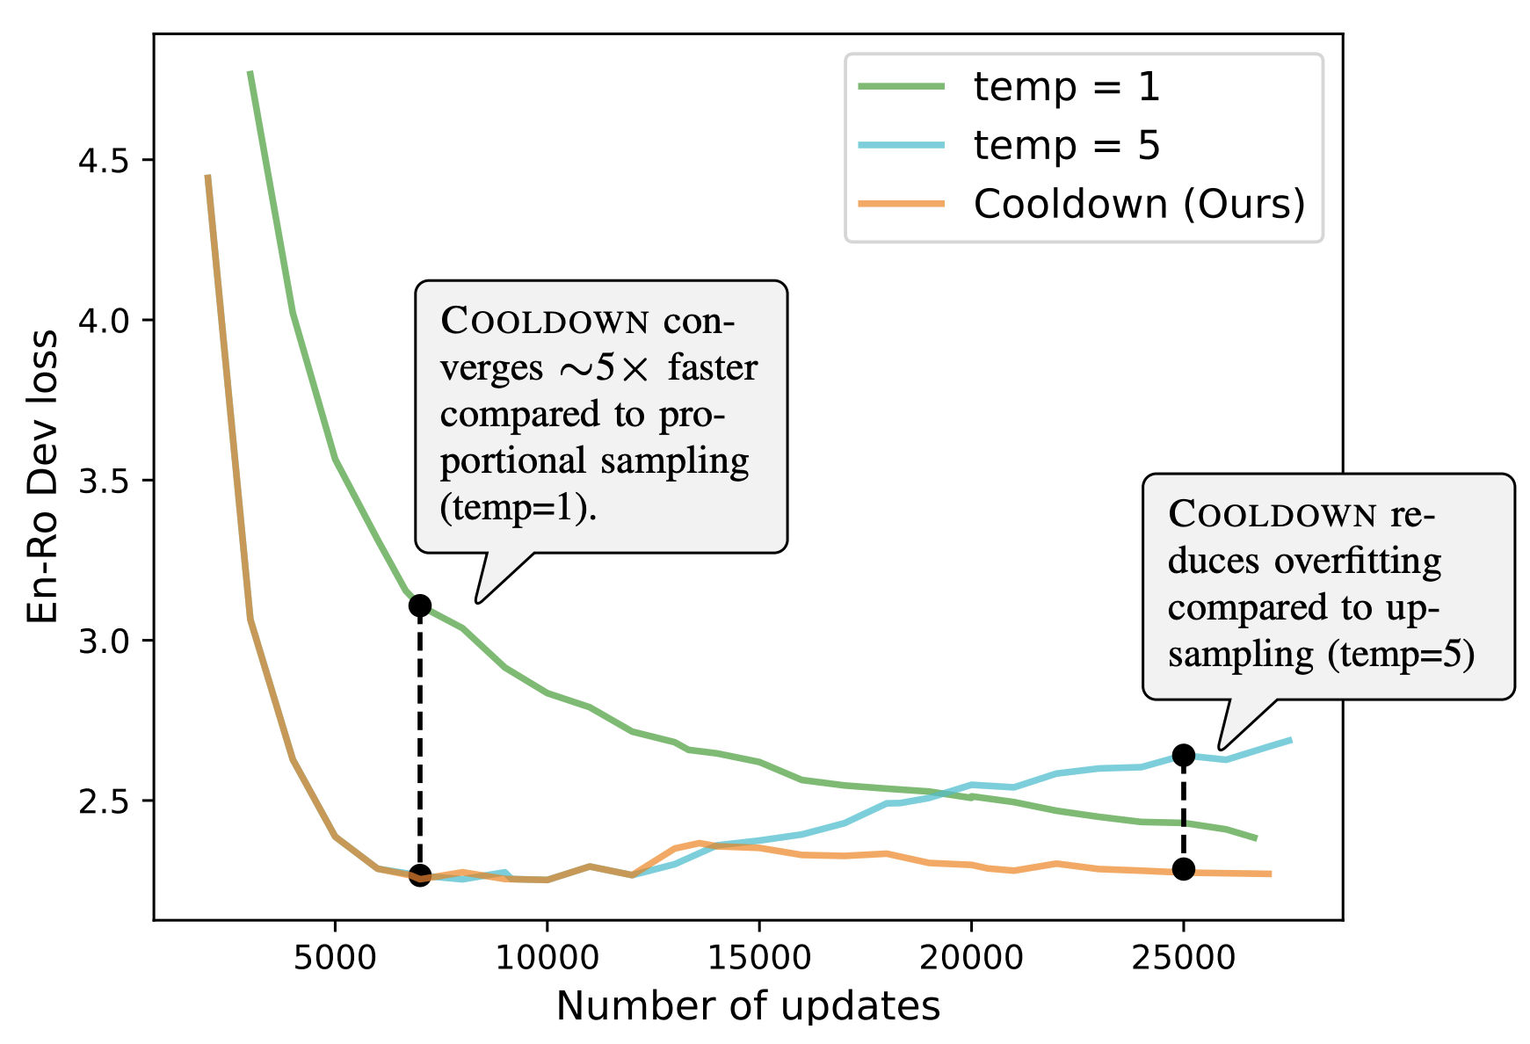
Cooldown: Initially use large temp, then use small temperature
Notes:
We compare our method with just using a static temp=1 and temp=5 on the same setting. Our method achieve the best-of-both-worlds, accelerating the convergence while also not overfitting the low-resource domain Show one by one - green, then blue, then cooldown, then stage

Slide 18
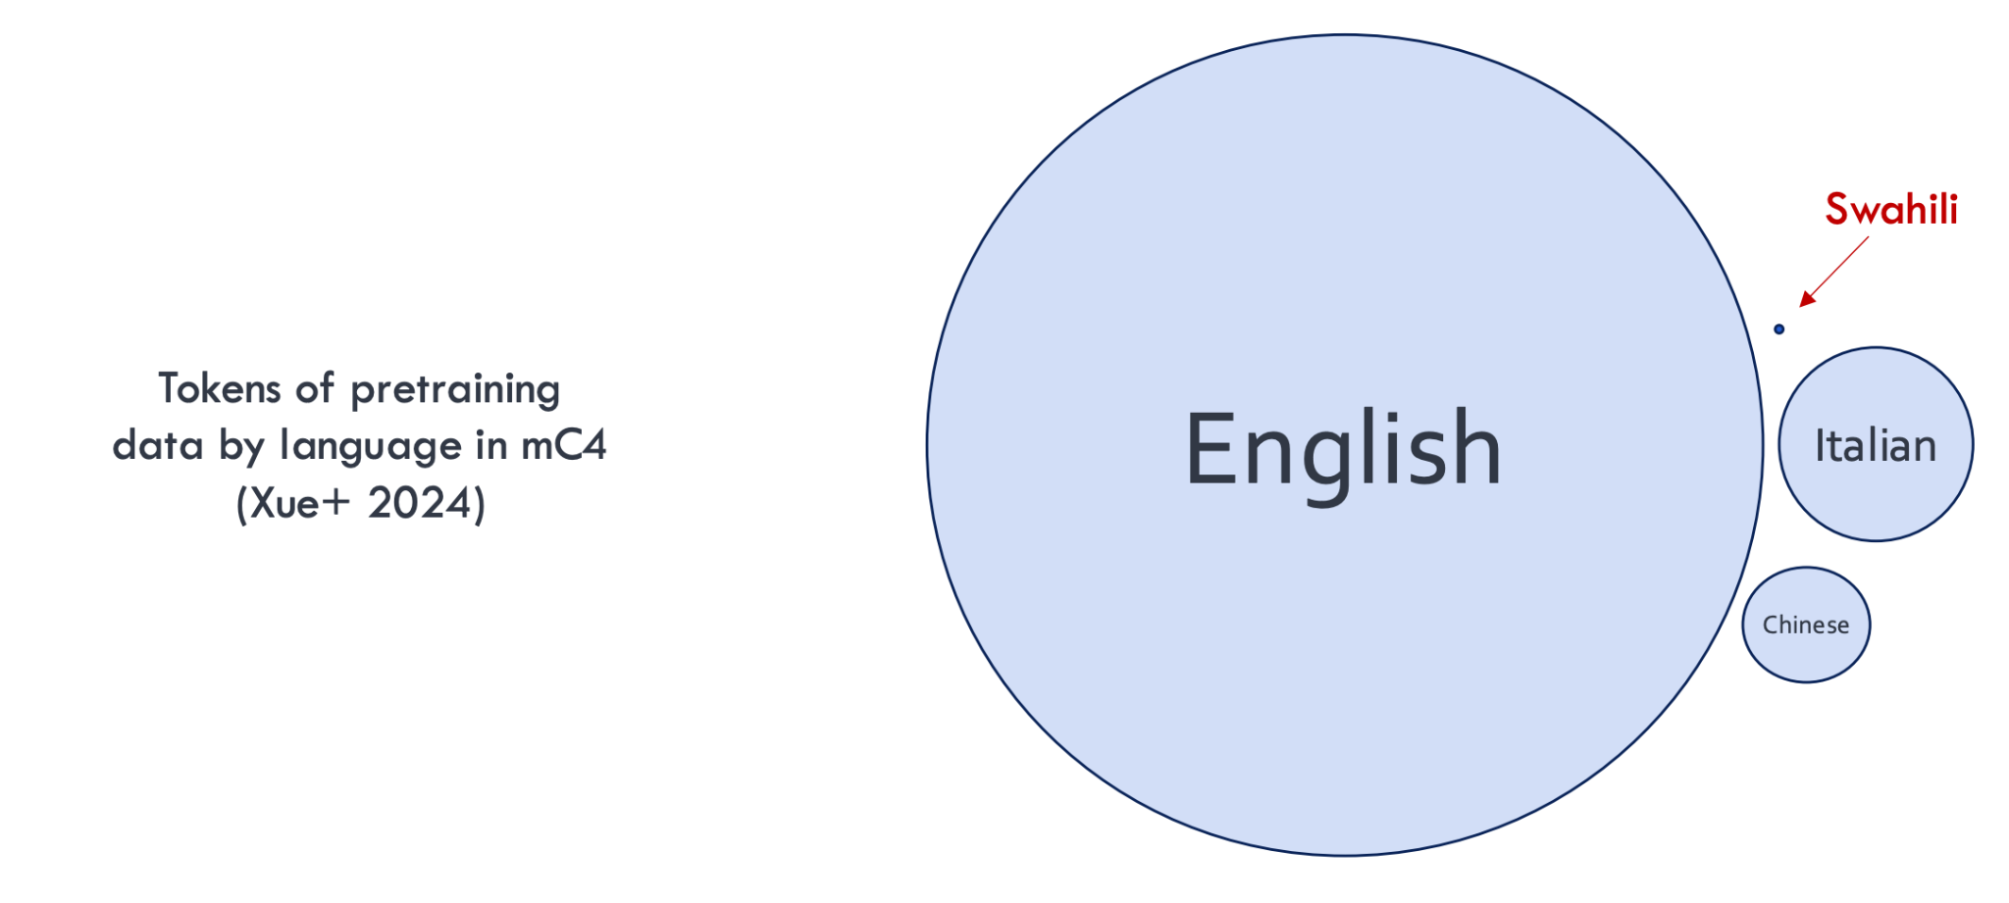
A Natural Definition of “Domains” —— language
Notes:
We use language as a case study as data skew. We use a natural division of domains — different languages in the world, which has a super heavy domain mismatch. Here is an illustration of how much data is in the mC4 Corpus, where the size of the circle is proportional to dataset size.

Slide 19
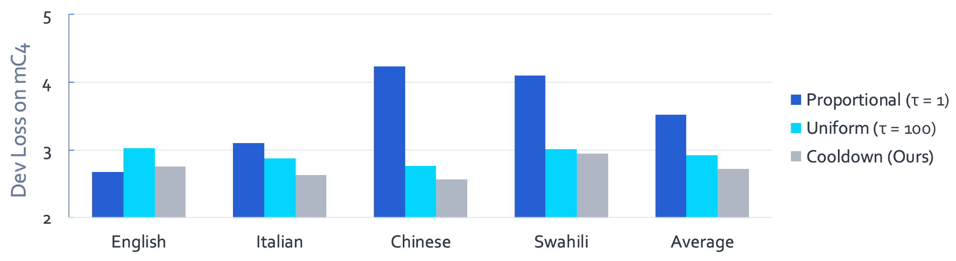
Cooldown: Dev Loss on mC4 (lower is better)
Cooldown outperforms fixed temperature sampling!
Notes:
We then validate our findings on more realistic tasks — in this case we pre-train a 280M language model on 4 languages selected from mC4. Recall that English is significantly more than other languages. We found that our method outperformed using a static temperature.

Slide 20
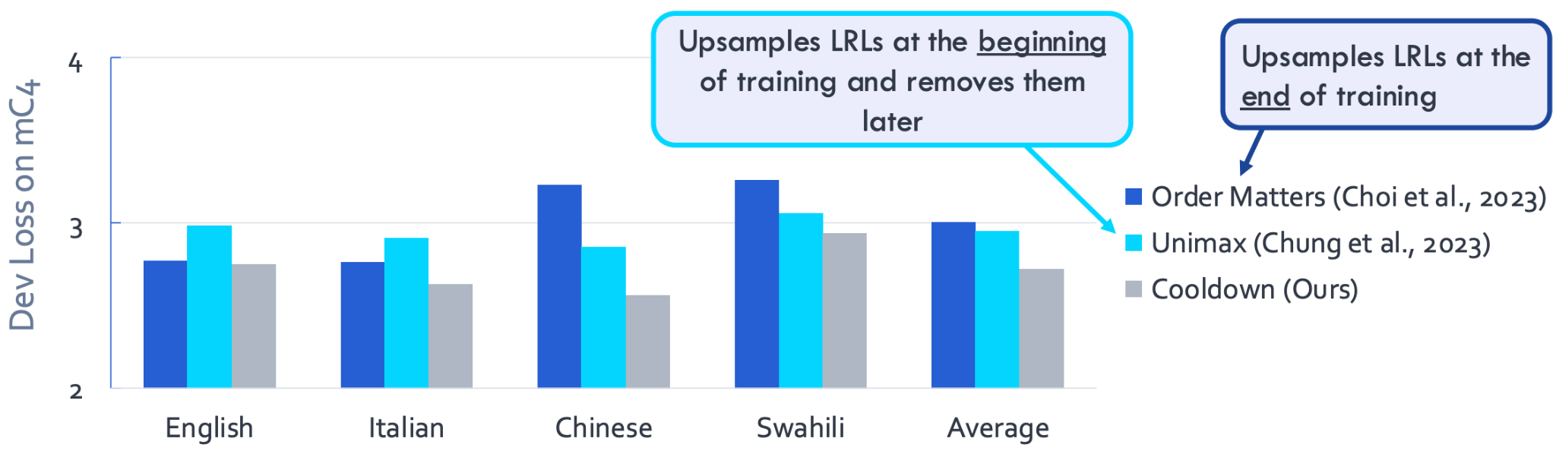
Cooldown: Dev Loss on mC4 (lower is better)
Cooldown outperforms existing work that dynamically adjusts the sampling temperature!
Notes:
We also compare our work with other existing work that dynamically adjusts the sampling temperature with two different trends: Order Matters that upsampling LRLs at the end of training (which is the opposite of cooldown) and Unimax that upsamples LRLs at the beginning of of training and removes them entirely. Our work differs in that instead of completely removing them, we remove the upsample and just sample proportionally. Again, we found that our method outperformed the two baselines.

Slide 21
Summary
-

Slide 22
For more results:
https://arxiv.org/pdf/2410.04579
Notes:
For more theoretical and empirical results, please check out our paper! Thank you.

