Slide 1

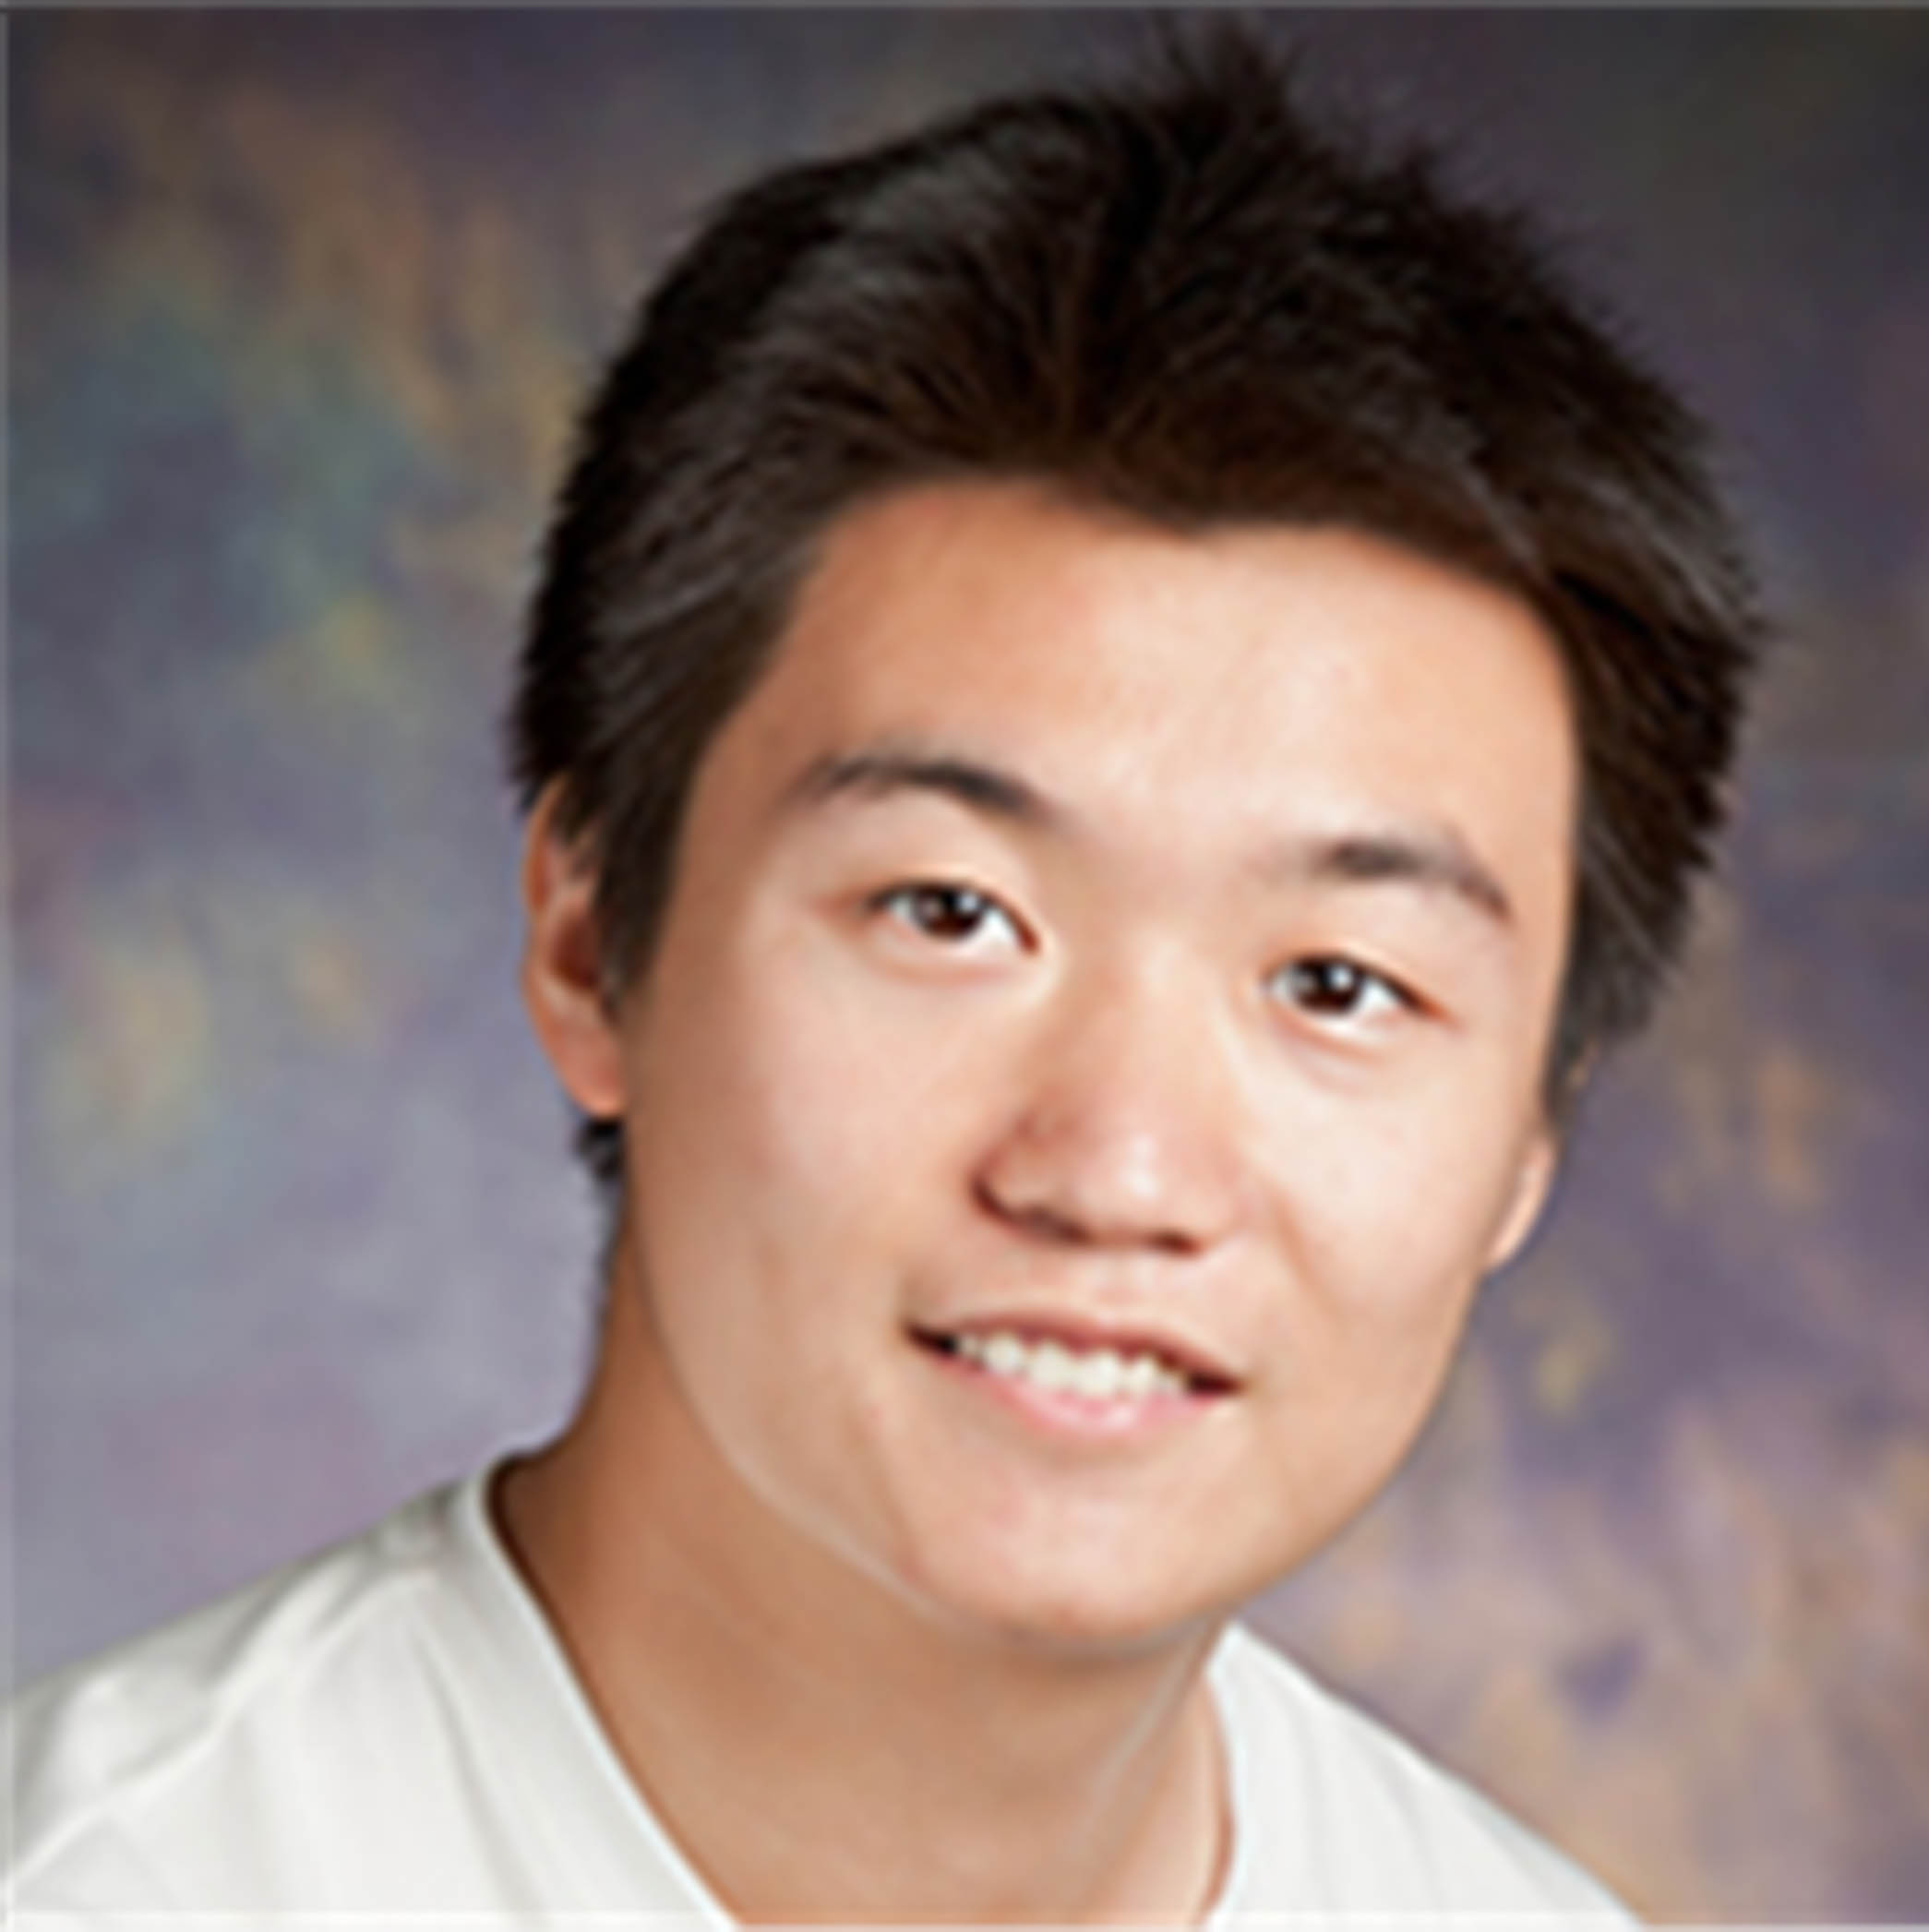
“Going on a vacation” takes longer than “Going for a walk”: A Study of Temporal Commonsense Understanding
Ben Zhou Daniel Khashabi* Qiang Ning* Dan Roth
*Currently affiliated with AI2

Slide 2
Temporal Common Sense
Humans assume information when reading
Not explicitly mentioned
Related to time
Happens all the time
To better understand the storyline and beyond
Notes:
Let me first start with the what and why question.
Temporal Commonsense is the information that we are capable to assume during reading that is not explicitly mentioned in the text, and also related to time.
We generate this kind of knowledge all the time to help us better understand the storyline and reason beyond.

Slide 3
Temporal Common Sense
My friend Bill went to Duke University in North Carolina. With a degree in CS, he joined Google MTV as a software engineer. As a huge basketball fan, he has attended all 3 NBA finals since then. He also plans to visit Duke regularly as an alumnus to attend their home games.
Notes:
Let me use this short story to demonstrate some of the temporal commonsense people derive during reading.

Slide 4
Temporal Common Sense
My friend Bill went to Duke University in North Carolina. With a degree in CS, he joined Google MTV as a software engineer. As a huge basketball fan, he has attended all 3 NBA finals since then. He also plans to visit Duke regularly as an alumnus to attend their home games.
College: about 4 years, start at the age of 18
Duration
Typical Time
Bill in North Carolina: about 4 years
Duration
Stationarity
Duke in North Carolina: always (expected)
Stationarity
Notes:
When we are reading the first sentence, my friend bill went to duke university, we already know some implicit information about time: for example, college …
However, we know that Duke is always in North Carolina, whereas a person may only be at a place for a limited time. We call this ability to distinguish between these two Stationarity.

Slide 5
Temporal Common Sense
My friend Bill went to Duke University in North Carolina. With a degree in CS, he joined Google MTV as a software engineer. As a huge basketball fan, he has attended all 3 NBA finals since then. He also plans to visit Duke regularly as an alumnus to attend their home games.
College: about 4 years, start at the age of 18
Duration
Typical Time
Bill in North Carolina: about 4 years
Duration
Stationarity
Duke in North Carolina: always (expected)
Stationarity
Join Google: after college graduation
Ordering
Notes:
Moving on, …

Slide 6
Temporal Common Sense
My friend Bill went to Duke University in North Carolina. With a degree in CS, he joined Google MTV as a software engineer. As a huge basketball fan, he has attended all 3 NBA finals since then. He also plans to visit Duke regularly as an alumnus to attend their home games.
College: about 4 years, start at the age of 18
Duration
Typical Time
Bill in North Carolina: about 4 years
Duration
Stationarity
Duke in North Carolina: always (expected)
Stationarity
Join Google: after college graduation
Ordering
NBA Finals: every year
Frequency
Notes:
As a huge basketball fan ...

Slide 7
Temporal Common Sense
My friend Bill went to Duke University in North Carolina. With a degree in CS, he joined Google MTV as a software engineer. As a huge basketball fan, he has attended all 3 NBA finals since then. He also plans to visit Duke regularly as an alumnus to attend their home games.
College: about 4 years, start at the age of 18
Duration
Typical Time
Bill in North Carolina: about 4 years
Duration
Stationarity
Duke in North Carolina: always (expected)
Stationarity
Join Google: after college graduation
Ordering
NBA Finals: every year
Frequency
Visit Alma Mater: 0-2 times per year, 0-2 days each time
Frequency
Duration
Attend basketball games: a few hours
Duration
Notes:
The last sentence is ...
Here we know visit college after graduation typically has a low frequency, and a relatively short duration each time.

Slide 8
Temporal Commonsense
My friend Bill went to Duke University in North Carolina. With a degree in CS, he joined Google MTV as a software engineer. As a huge basketball fan, he has attended all 3 NBA finals since then. He also plans to visit Duke regularly as an alumnus to attend their home games.
Q: How old is Bill?
A: Around 25.
R: 3 + 4 + 18
Q: How long will take Bill to fly to Duke?
A: A few (1-5) hours.
R: Duke is always in NC, Bill is now in CA
Q: How often would he visit Duke in the future?
A: A few (<5) times a year.
Q: Which one happened first, went or joined?
A: Went.
* Human infer temporal common sense that helps them to better understand the story.
Notes:
With temporal commonsense, humans are able to answer questions regarding stories to demonstrate their true understandings, and some of the questions are hard for systems.
For example...
We can also answer the question how long... We know that Bill is now in California, and duke is always in North Carolina. with a little background knowledge, we should be able ...
We are also able to answer more straghtforward questions about time, ...
As a good portion of all written texts requires us to implicitly construct the storylines and reason with time related information, temporal commonsense is important and ubiquitous, yet there had been limited attention

Slide 9
Our Contribution
MC-TACO 🌮 (multiple choice temporal common-sense) :
A dataset that focuses on temporal commonsense
Input:
Task: Decide whether each answer is plausible.
Metrics:
Exact Match: the percentage of question of which all candidates are predicted correctly
F1: The F1 score of “plausible”
Statistics:
1,893 questions
13,225 question-answer pairs
Conclusion: current systems are not enough to solve this.
Gold
Prediction
He went to Duke University.
How long did it take him to graduate?
4 years
✔
He went to Duke University.
How long did it take him to graduate?
10 days
✔
3.5 years
✗
16 hours
✔
Reading Comprehension: able to answer any questions regarding a piece of text
1 century
✔
Exact Match: able to label all candidate answers of a question
F1: 66.7
Exact Match: 0.0
Notes:
In order to encourage research on how to make machines capable of answering such questions, we propose...
The input is composed with a sentence that provides contexts, a question asking about some temporal information related to the context, and a candidate answer. We also provide gold labels indicating whether the answer is "plausible" with respect to the question. Here green indicates 4 years is plausible for the given question.
A question is paired with more than one candidate answers, among them zero or many may be plausible.
The metrics we employ are ... To give a better explanation of the metrics, consider this question with the following candidate answers, and a set of predictions. The judgement of each individual labeling is shown on the right. It has a accuracy of 0.8, however, according...
We believe exact match is the most appropriate metric for this task. We borrow the argument true reading comprehension is demonstrated through answering any questions regarding... Similarly, we argue that through exact match, we evaluate if a system truly understands the question.

Slide 10
MC-TACO: Construction
Step 0: Source Sentence Generation
Randomly samples sentences
Step 1: Question Generation
Ask people to write questions
A) temporal
B) non-extractive
To require commonsense
Ask for one “plausible” answer
He joined Google as a software engineer after graduating from college.
How long did he stay in college?
Will he work at Google for the rest of his life?
Duration
Duration
Stationarity
4 years
No
Notes:
Next I will discuss a few details on the dataset construction.

Slide 11
MC-TACO: Construction
Step 2: Question Verification
2 additional verifications on each question
100% agreement
We also ask for
1 “plausible” answer
1 “implausible” answer
He joined Google as a software engineer after graduating from college.
How long did he stay in college?
What did he do after college?
Temporal?
Yes
Yes
Non-extractive?
Yes
No

Slide 12
MC-TACO: Construction
Step 3: Candidate Answer Expansion
Seed answers from step 1+2
Expand candidates automatically
Perturbations
Information Retrieval
He joined Google as a software engineer after graduating from college.
How long did he stay in college?
What happened after he started working?
4 years
He started making money.
6 years
He started a factory.
11 days
He contributed to public services.
…
…

Slide 13
MC-TACO: Construction
Step 4: Answer Labeling
Each answer is labeled by 4 different annotators
Either “likely” or “unlikely”
Enforce 100% agreement
Eliminate marginal answers with “intermediate” probability
He joined Google as a software engineer after graduating from college.
How long did he stay in college?
What happened after he started working?
or
4 years
He started making money.
6 years
He started a factory.
11 days
He contributed to public services.
…
…

Slide 14
Results
13% drop
3 weeks -> 0.75 months
40% drop
ESIM: Enhanced LSTM for Natural Language Inference (Chen et al., 2016)
GloVe: Global Vectors for Word Representation (Pennington et al., 2014)
ELMo: Deep contextualized word representations (Peters et al., 2018)
BERT: BERT: Pre-training of Deep Bidirectional Transformers for Language Understanding (Devlin et al., 2019)
RoBERTa: A Robustly Optimized BERT Pretraining Approach (Liu et al., 2019)
26% improvement over +GloVe
Surface Association
Notes:
We conducted experiments involving a few baseline systems. Here the top blue and orange bar indicates the human f1 and exact match scores respectively.
A naive approach that guesses according to priors is shown here, and a ESIM model with GloVe initialzation does slightly better. If we replace the initialization with ELMo, we see a 26% relative improvement in EM over the GloVe initialization, which shows the effectiveness of external knowledge via pretraining. With more pretraining, we see a much higher improvement in the BERT baseline.
One issue we noticed during the BERT experiment is that some temporal expressions in the candidate answers do not have the most appropriate unites. We then employ a normalization process that converts expressions such as 3 weeks to 0.75 months, and we see improvements from BERT. This shows that the model relies a lot on surface association or word matching.
Finally, we compare with Roberta as well, which achieved the best exact match scores. However, notice that there is a 40% relative drop in the absolute numbers from F1 to exact match. Although the numbers are not directly comparable, this shows that the model is able to label most of the candidate answers in one question correctly, but rarely all of them. That’s why we see only a 13% drop in human scores.

Slide 15


Summary
Define 5 temporal commonsense phenomena
Present MC-TACO, a QA dataset focused on temporal commonsense
Show that existing systems are not enough to solve it
Encourage further research
Thanks!
Leaderboard
https://leaderboard.allenai.org/mctaco/
GitHub (data, baseline, evaluator)
https://github.com/CogComp/MCTACO
Notes:
In summary,

