Slide 1
POORIA PANAHIFAR
Mechanical Engineering
Instructor: Dr. B. TAHERI
The only thing that you have to do in order to understand what I’m saying is just sit relax, read and listen carefully. Please ask any question that you may have.

Slide 2
Arrays & Structures
In General

Slide 3
Overview
An overall view to C++ Data Types
Three major types of data exist in C++
1) Simple 2) Structured 3) Addresses
Understanding Structures and Arrays

Slide 4
C++ Data Types
simple
structured
integral enum
floating
array struct union class
char int bool string
address
float double long double
Pointer (*) reference (&)

Slide 5
Structured Data Type
A structured data type is a type that
  stores a collection of individual components under a SINGLE variable name
    Each component can be accessed sperately
  Arrays
    Indexed components (bracket notation)
    Uniform type
  Structures
    Named components (dot notation)
    Can have different types

Slide 6
One-Dimensional Array Definition
An array is a structured collection of components
  same data type
  given a single name
  stored in adjacent(divar be divar) memory locations

Slide 7
One-Dimensional Array Definition
One bothering thing is that the number of its components should be defined as a constant variable.
Const int NC = n; // (n belongs to natural numbers)
StudnetID[NC];
=> Array StudentID is a sequence like : StudentID = {a₀,a₁,a₂,a₃,…,a_{n-1}}
The individual components are accessed by using the array name together with an integral valued index in square brackets:
StudentID[5]
The index indicates the position of the component within the collection.

Slide 8
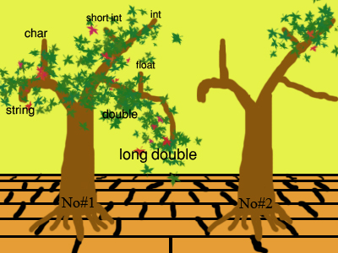
Understanding
STRUCTURES
What is a structure?
Up to now we have been using simple variables - integers, floating points, unsigned longs etc. The most complicated variables that we have been using have been arrays. Structures offer a way of joining these simple variables together to form complex structures.

Slide 9
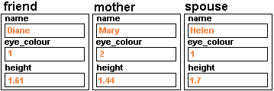
Understanding
STRUCTURES
Let's suppose that we want to store data about people inside the computer. Each person has a name, an address, a height, eye colour - you can think of dozens of pieces of information that you may want to store about them. It is always possible to store these as a series of simple variables - a string for the name, an integer for the eye colour (1 could be brown, 2 blue etc.) It is even possible to store all the pieces of information as an array (with each element being a different piece of information) or as a single string (with all the data strung together). However, it would be nice if we could encapsulate all that information in an easy-to-read form inside one data structure. This is where structures come in.
struct person {
string name;
int eye_colour;
float height; };
person friend,mother,spouse; friend.name = "Diane"; friend.eye_colour = 1; friend.height = 1.61; mother.name = "Mary"; mother.eye_colour = 2; mother.height = 1.44; spouse.name = "Helen"; spouse.eye_colour = 1; spouse.height = 1.7;

Slide 10
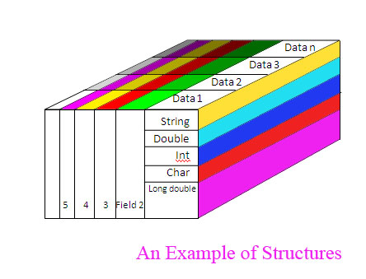
Another Illustration
The difference between the colors on the right represents that each field is completely separated from the other one.
2) The brightness difference shows that datas in a field are like each other in construction but different in what they contain.
3) The lines means that we can access each of these informations separately.

Slide 11
Another Example
struct Student
{// string name;
char *name;
int section;
float grade;
};
struct Student
Dan = {"Smith, Dan", 210, 79.8},
Jan = {"Brown, Jan", 201, 89.3};
Struct property syntax is used to refer to various data
cout << "Dan's full name is: " << Dan.name << "\n";
Making the suitable body for our struct.
Declaration and initialization of real instances of two structs

Slide 12
Extra
strcpy(Jan.name,"Smith, Jan");
struct Student Temp = Jan;
all[i].FirstName
myClass[i].name[j] = 97 + rand()%26;
(char name[maxNameLength];)
const int maxNameLength = 10;

Slide 13
Comparing Arrays and Structures
Arrays are just sequence of the same type variables but structures are a combination of these sequences.
Arrays’ lengths are not changeable while there is no specific limit for a sequence of a structure.
We can declare arrays in structures, even structures in structures.
We can transform structures into CLASSES and convey their information to CLASSES without any changes.

Slide 14
References
THE “C” PROGRAMMING LANGUAGE by: BRIAN W. KERNIGHAN
HOW TO PROGRAM “C” Forth Edition by: DEITEL & DEITEL
Introduction to Computers and Programming using C++ and MATLAB by: Alex F Bielajew (Dr. TAHERI’s handout)
http://richardbowles.tripod.com Richard Bowles
http://www.daniweb.com Jwenting
http://www.oracle.com Berkeley
http://www.mactech.com Dan Weston
http://www.wikipedia.org A Free Online Encyclopedia
http://www.csci.csusb.edu California State University – San Bernardino
http://web.cs.wpi.edu

Slide 15
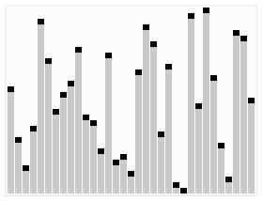
THE END
Let’s have a break

