Slide 1
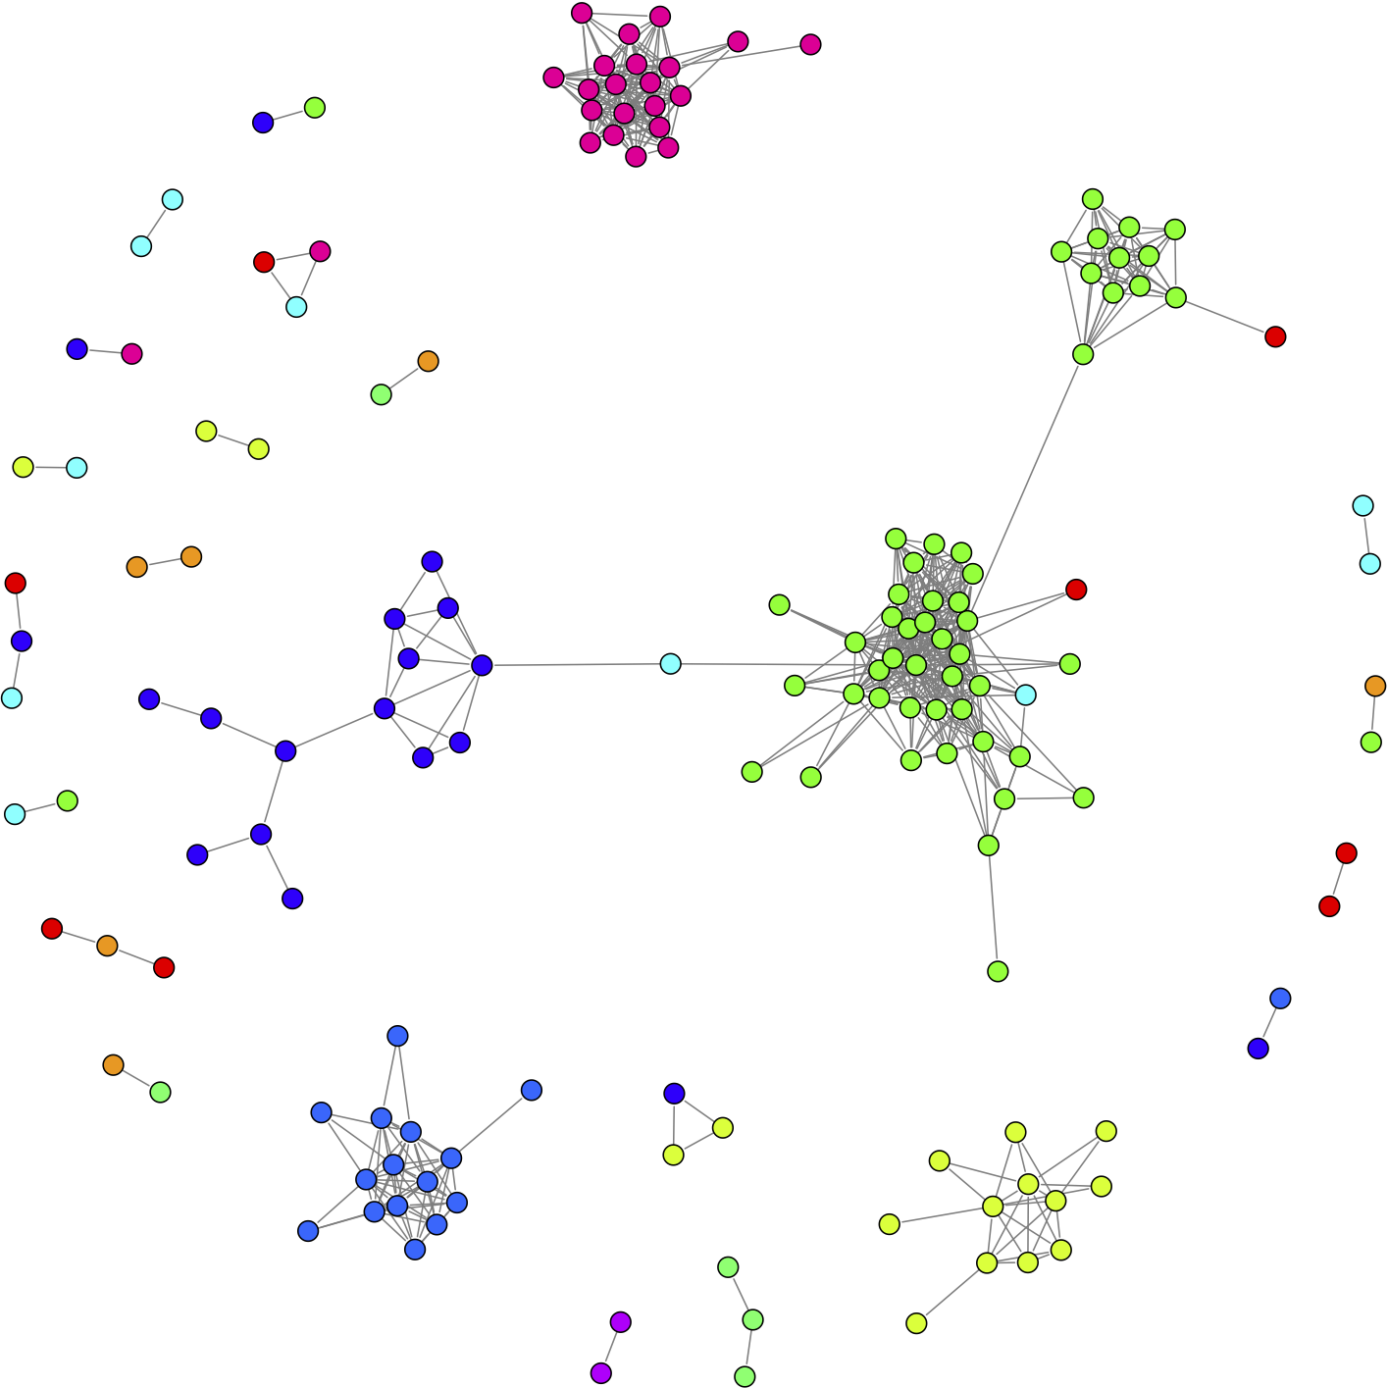
Qual Presentation
Daniel Khashabi

Slide 2
Outline
My own line of research
Papers:
Fast Dropout training, ICML, 2013
Distributional Semantics Beyond Words: Supervised Learning of Analogy and Paraphrase, TACL, 2013.

Slide 3
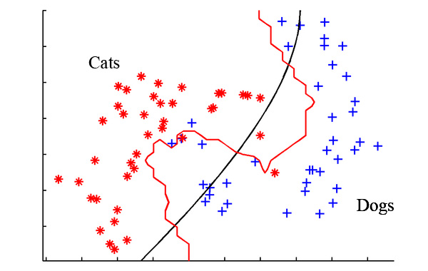
Current Line of Research
Conventional approach to a classification problem:
Problems:
Never use the label information
Lose the structure in the output
Limited to the classes in the training set
Hard to leverage unsupervised data

Slide 4
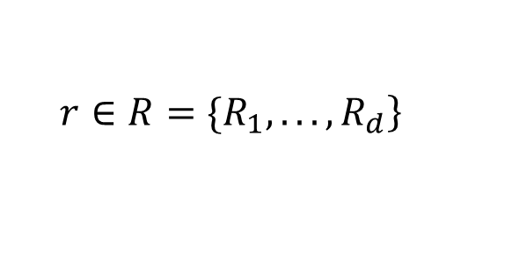

Current Line of Research
For example take the relation extraction problem:
Conventional Approach:
Given sentence s and mentions e1 and e2, find their relation:
Output:
“Bill Gates, CEO of Microsoft ….”
Manager
$$\left.r∈R=\{R_{1},...,R_{d}\right\}$$
$$\left\{s,e1,e2\}→r\right.$$

Slide 5
Current Line of Research
Let’s change the problem a little:
Create a claim about the relation:
“Bill Gates, CEO of Microsoft ….”
R = Manager
Text=“Bill Gates, CEO of Microsoft ….”
True
Claim=“Bill Gates is manager of Microsoft”

Slide 6
Current Line of Research
Creating data is very easy!
What we do:
Use knowledge bases to find entities that are related
Find sentences that contain these entities
Create claims about the relation inside the original sentence
Ask Turker’s to label it
Much easier than extracting labels and labelling

Slide 7
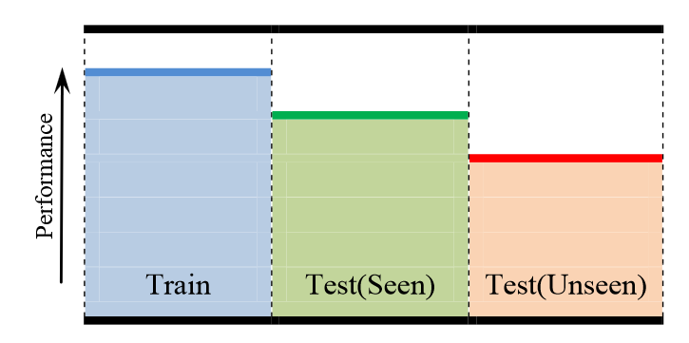
Current Line of Research
This formulation makes use of the information inherent in the label
This helps us to generalize over the relations that are not seen in the training data

Slide 8
Outline
My own line of research
Papers:
Fast Dropout training, ICML, 2013
Distributional Semantics Beyond Words: Supervised Learning of Analogy and Paraphrase, TACL, 2013.

Slide 9
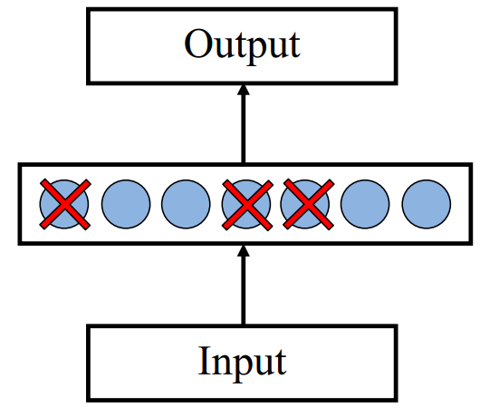
Dropout training
Proposed by (Hinton et al, 2012)
Each time decide whether to delete one hidden unit with some probability p

Slide 10
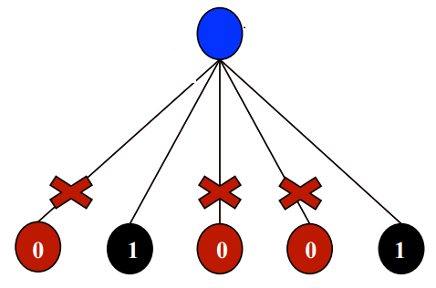
Dropout training
Model averaging effect
Among models, with shared parameters
Only a few get trained
Much stronger than the known regularizer
What about the input space?
Do the same thing!

Slide 11
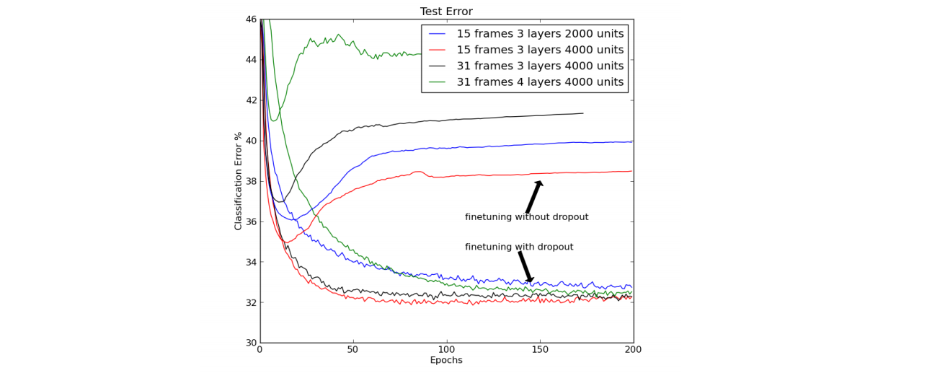
Dropout training
Model averaging effect
Among models, with shared parameters
Only a few get trained
Much stronger than the known regularizer
What about the input space?
Do the same thing!
Dropout of 50% of the hidden units and 20% of the input units (Hinton et al, 2012)

Slide 12

Outline
Can we explicitly show that dropout acts as a regularizer?
Very easy to show for linear regression
What about others?
Dropout needs sampling
Can be slow!
Can we convert the sampling based update into a deterministic form?
Find expected form of updates

Slide 13
Linear Regression
Reminder:
Consider the standard linear regression
With regularization:
Closed form solution:

Slide 14
Dropout Linear Regression
Consider the standard linear regression
LR with dropout:
How to find the parameter?

Slide 15
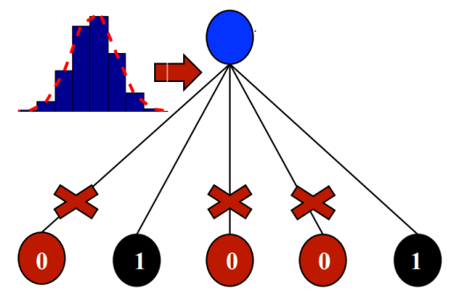
Fast Dropout for Linear Regression
We had:
Instead of sampling, minimize the expected loss
Fixed x and y:

Slide 16
Fast Dropout for Linear Regression
We had:
Instead of sampling minimize the expected loss:
Expected loss:

Slide 17
Fast Dropout for Linear Regression
Expected loss:
Data-dependent regulizer
Closed form could be found:

Slide 18
Some definitions
Dropout each input dimension randomly:
Probit:
Logistic function / sigmoid :

Slide 19
Some definitions useful equalities
Useful equalities
We can find the following expectation in closed form:

Slide 20
Logistic Regression
Consider the standard LR
The standard gradient update rule is
For the parameter vector

Slide 21
Dropout on a Logistic Regression
Dropout each input dimension randomly:
For the parameter vector
Notation:

Slide 22
Fast Dropout training
Instead of using we use its expectation:

Slide 23

Fast Dropout training
Approx:
By knowing:
How to approximate?
Option 1:
Option 2:
Have closed forms but poor approximations

Slide 24
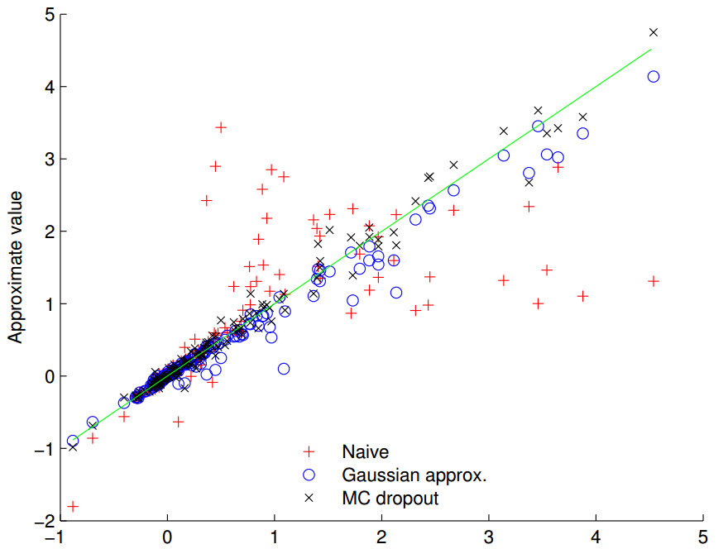
Experiment: evaluating the approximation
The quality of approximation for

Slide 25
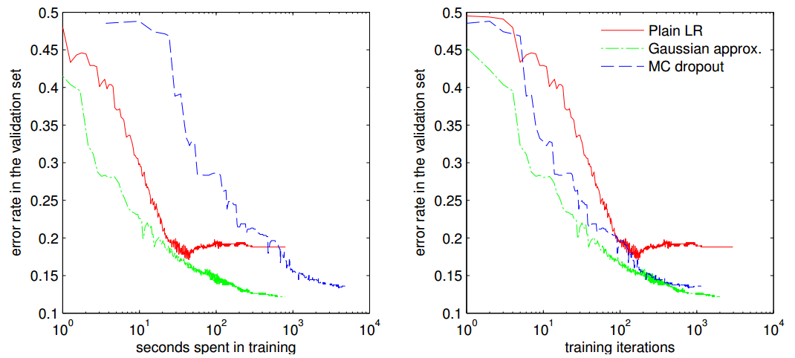
Experiment: Document Classification
20-newsgroup subtask alt.atheism vs. religion.misc

Slide 26
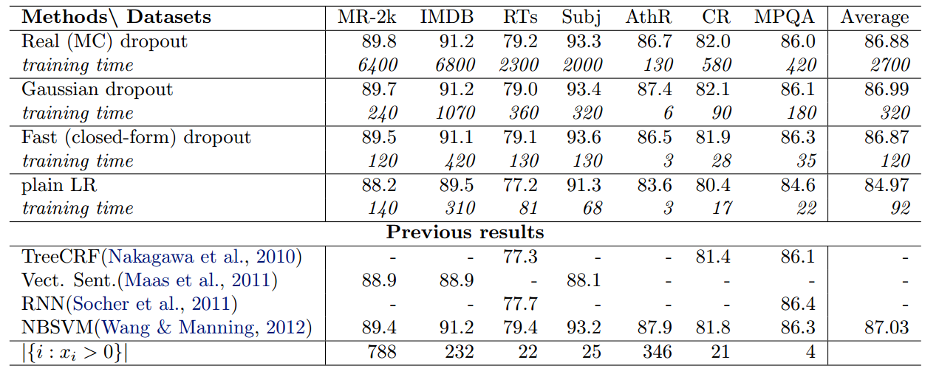
Experiment: Document Classification(2)

Slide 27
Fast Dropout training
Approx:
By knowing:

Slide 28
Fast Dropout training
We want to:
Previously:
which could be found in closed form.

Slide 29
Fast Dropout training
We want to:
Previously:
deviates (approximately) from with and
Has closed form!

