Slide 1
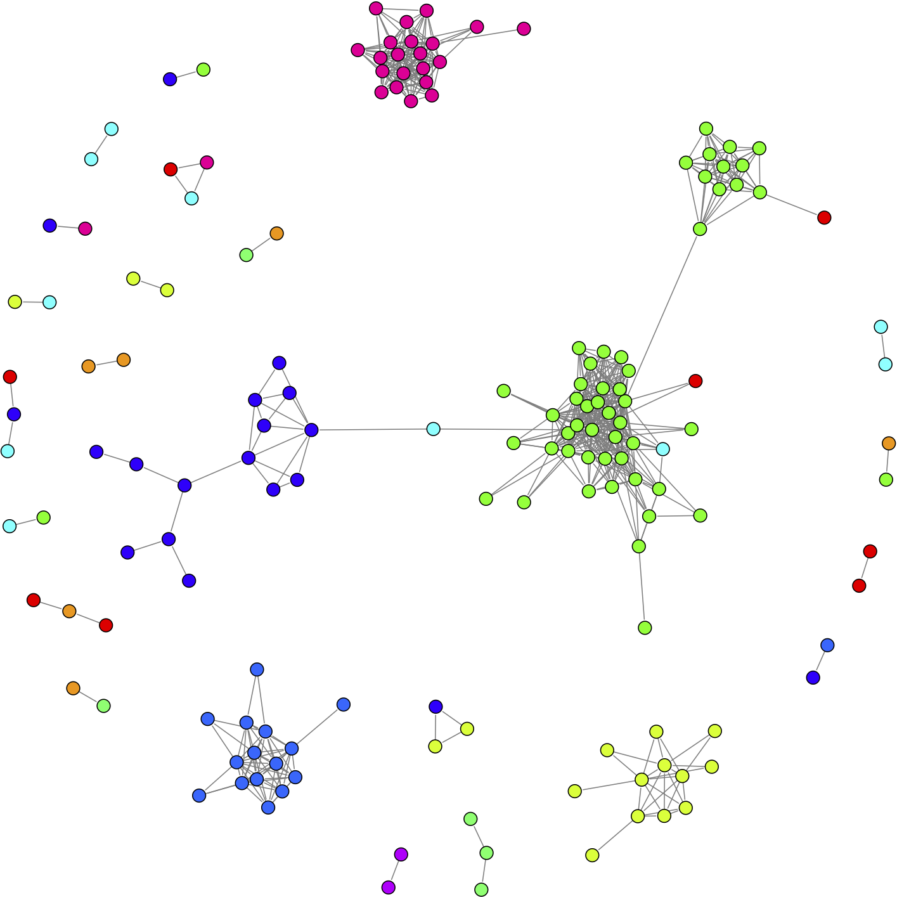
Qual Presentation
Daniel Khashabi

Slide 2
Outline
My own line of research
Papers:
Fast Dropout training, ICML, 2013
Distributional Semantics Beyond Words: Supervised Learning of Analogy and Paraphrase, TACL, 2013.

Slide 3


Motivation
Developing tools for word-similarity
Useful in many applications
For example paraphrase detection:
The Iraqi foreign minister warned of disastrous consequences if Turkey launched an invasion.
Iraq has warned that a Turkish incursion would have disastrous results.
I can be there on time.
I can’t be there on time.

Slide 4
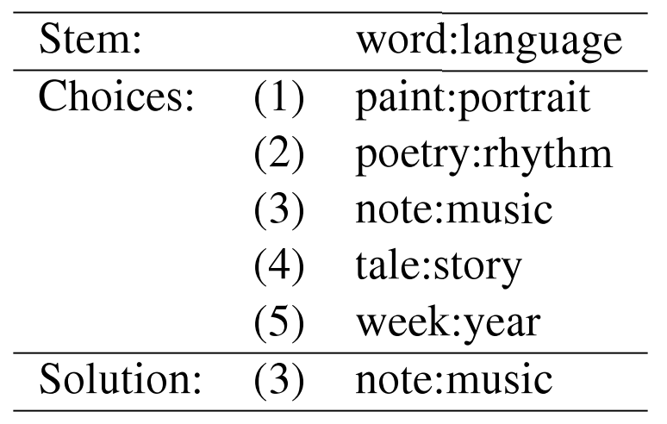
Motivation (2)
Developing tools for word-similarity
We need to solve easier problem
For example, SAT test:
Very important for understanding hierarchies of word semantics

Slide 5

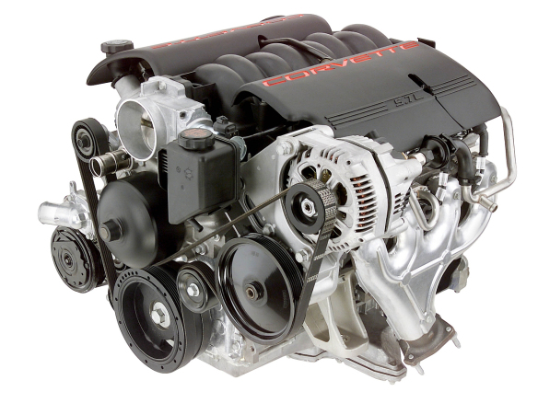

Motivation (3)
Developing tools for word-similarity
We need to solve easier problem
Compositional behavior of the word semantics
Search
Engine
Search Engine

Slide 6
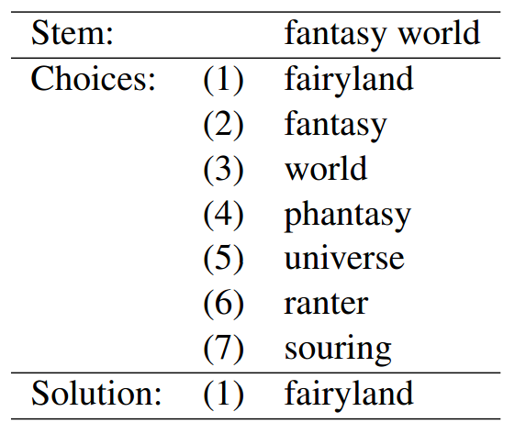
Motivation (4)
Developing tools for word-similarity
We need to solve easier problem
Compositional behavior of the word semantics
For example: understanding noun-modifier questions

Slide 7
Designing semantic features
Feature engineering
An important step in semantic modeling of words
The rest is just learning the task in a fully supervised fashion
Type of the features:
Log-Frequency
PPMI (Positive Pointwise Mutual Information)
Semantic Similarity
Functional Similarity

Slide 8
Feature generation
Features
Log-Frequency
PPMI (Positive Pointwise Mutual Information)
Semantic Similarity
Functional Similarity
All features are generated on a collection of documents
Of size words
Definition
Word-Context:
Three word-context matrices
Rows correspond to words/phrases
in Wordnet
(Left) Context
Word
(Right) Context
context
Words
And Phrases

Slide 9
Pointwise Mutual Information
PMI (Pointwise Mutual Information):
PPMI(Positive PPMI)
One useful definition for probabilities
The ratio of the times a context appears with a words

Slide 10
Pointwise Mutual Information (2)
Only the words or phrases that exist in the Wordnet
And appear with frequency more than 100 in the corpus
Find words to the left and right of the word (context) in phrases:
Create word-context frequency matrix F:
is the number of times appear in context .
Table shows forty paradigm words
context
F
words

Slide 11
Pointwise Mutual Information (3)
Create word-context frequency matrix F:
Create PPMI matrix:
context
F
words
context
X
words

Slide 12
Pointwise Mutual Information (4)
context
Given PPMI matrix:
Word in the i-th row
Word in the j-th column
For an n-tuple one can generate PPMI features
X
words

Slide 13
A vector space for domain similarity
Designed to capture the topic of a word.
Construct a frequency matrix:
Rows: correspond to words in Wordnet
Columns: Nearby nouns
Given a term search the corpus for it
Choose a “noun” closest to the right/left of
And increment by one.
Nearby nouns
D
words

Slide 14
A vector space for functional similarity
Exactly the same as the domain similarity measures
Except that it is made using the “verbal” context
Construct a frequency matrix:
Rows: correspond to terms in Wordnet
Columns: Nearby verbs
Given a term search the corpus for it
Choose a “verbs” closest to the right/left of
And increment by one.
Nearby verbs
S
words

Slide 15
Using semantic and functional similarity
Nearby verbs
Given the frequency matrix:
Keep the lower-dimensional representation
Keep the values corresponding to the k biggest eigenvalues
Given word , is the corresponding vector
is used to tune sensitivity with respect to eigenvalues
Given and to find:
find corresponding vectors
find cosine distance between the vectors
words

Slide 16


5-choice SAT tests
374 ﬁve-choice SAT questions
Could be converted into 5 4-tuples:
Each positive 4-tuple could be converted to:

Slide 17
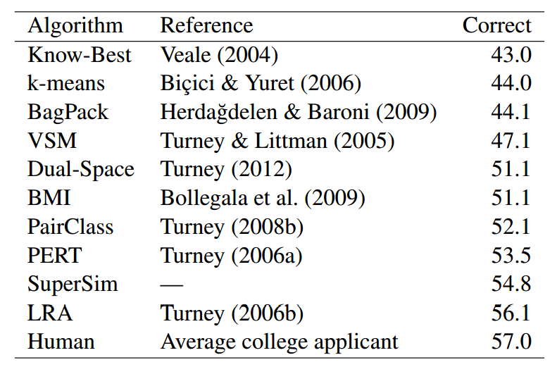
Results on 5-choice SAT
The top ten results with the SAT analogy questions.
SuperSim answers the SAT questions in a few minutes
LRA requires nine days
not significantly different according to Fisher’s exact test at the 95% confidence level

Slide 18


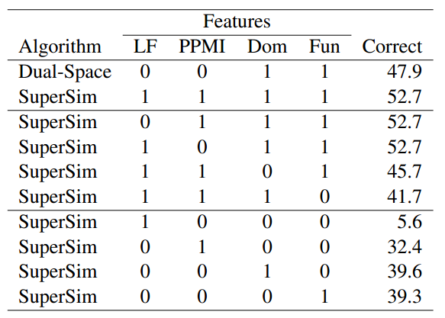
SAT with 10 choices
Adding more negative instances
In general if is positive is negative
For example: Positive:
Negative:
This generates 5 more negative instances

Slide 19
SemEval-2012 Task 2
Class and subclasses labels + examples
Gather using Mechanical Turk:
75 subcategories
Average of 41 word-pairs per subcategories
CLASS-INCLUSION,Taxonomic
50.0 "weapon:spear"
...
34.7 "vegetable:carrot"
...
-1.9 "mammal:porpoise"
...
-29.8 "pen:ballpoint"
...
-55.1 "wheat:bread"

Slide 20
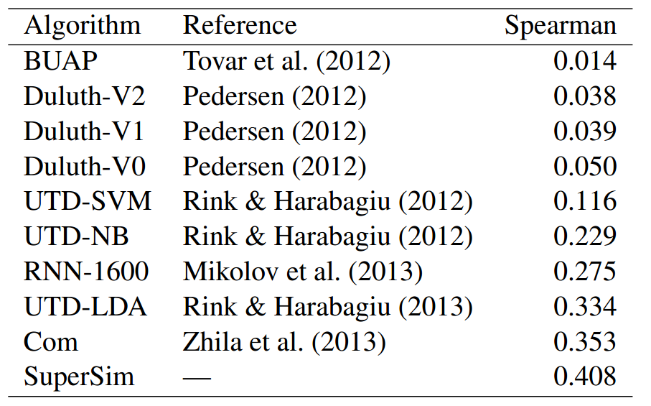
SemEval-2012 Task 2
SuperSim Trained on 5-choice SAT and tested on SemEval data
It gives the best correlation coefficient

Slide 21


Compositional similarity: the data
Noun-modifier question based on WordNet
Create tuples of the form:
Example:
Any question gives one positive instance and six negative instance

Slide 22
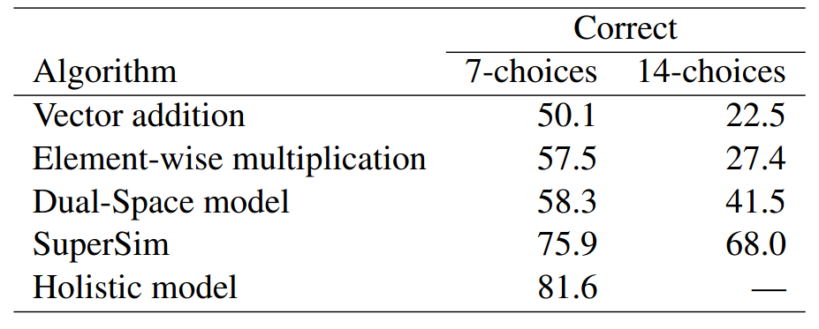
Compositional similarity: 7-choices questions
680 questions for training
1,500 questions for testing
Any question gives one positive instance and six negative instance
And train a classifier given the tuple for probabilities
The holistic approach is noncompositional.
The stem bigram is represented by a single context vector
As if it were a unigram.
Total of 2,180 questions

Slide 23

Compositional similarity:14-choices questions
Any question gives one positive instance and six negative instance
Positive instance:
Negative instance: e.g. word fantasy wonderland
This gives 7 more negative instances (14-choices)

Slide 24
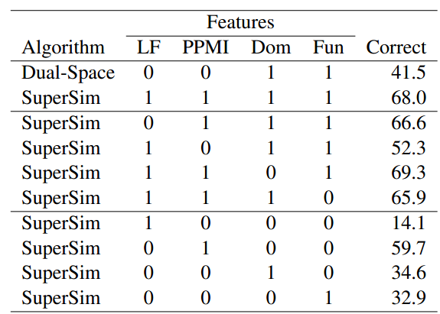
Compositional similarity: ablation experiment
Analyzing effect of each feature type on the 14-choice test
PPMI features are the most important

Slide 25


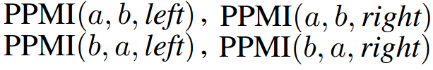
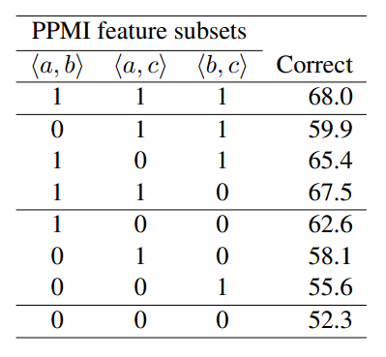
Compositional similarity: closer look at PPMI
PPMI features for into three subsets:
For example for :
subset are more important.

Slide 26
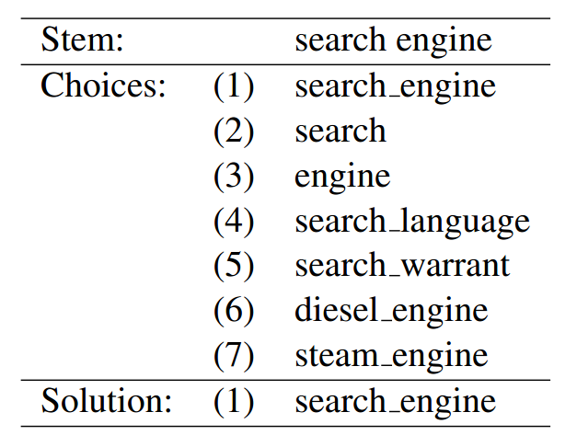

Compositional similarity: holistic training
A holistic training data
Extract noun-modifier pairs from WordNet
Call a pseudo-unigram
and treat it as unigram
Use the components as
distracters

Slide 27
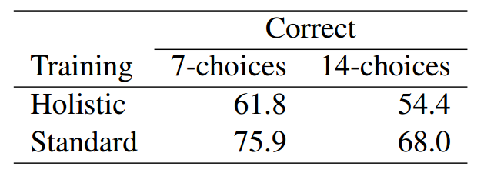
Compositional similarity: holistic training(2)
Training on the holistic questions: “Holistic”
Compared with the standard training
Test is the standard testing
There is a drop when training with the holistic samples
Not very clear, but seems to be because of the nature of the

Slide 28
References
Some figures from: http://nlp.cs.berkeley.edu/tutorials/variational-tutorial-slides.pdf
Hinton, Geoffrey E., et al. "Improving neural networks by preventing co-adaptation of feature detectors." arXiv preprint arXiv:1207.0580 (2012).

Slide 29
Past research
My own line of research
Intersection of: Machine Learning, NLP, Vision.
Past:
Multi-agent systems (Robocup 2009)
Object tracking (2009; internship)
Neural Networks (SMC-2011)
Recursive Neural Networks for NLP (2013)
Gaussian Processes (2013)
Regression Tree Fields for Joint Denoising and Demosaicing (2013; internship)

Slide 30
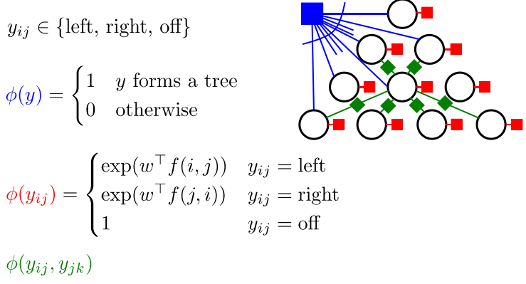
Current Line of Research
Many models in natural language use hard constrains:
Example: Dependency Parsing

Slide 31
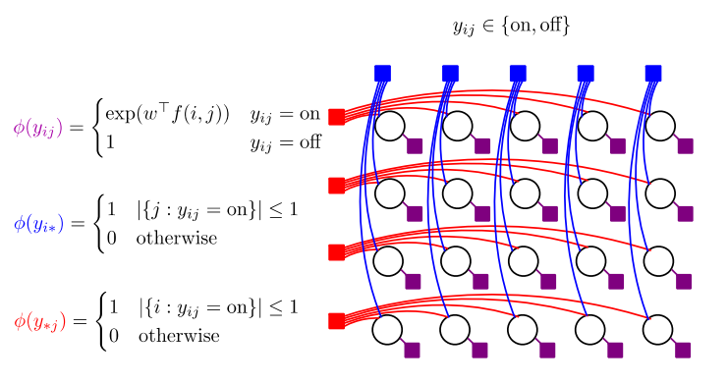
Current Line of Research
Many models in natural language use hard constrains:
Example: Sentence Alignment (Burkett & Klein, 2012)

Slide 32
Current Line of Research
Many models in natural language use hard constrains:
Example: Sentence Alignment (Burkett & Klein, 2012)
Hard constraints are big challenges, since they create large combinatorial problems
Instead we can separate the inference on hard constraints and soft constraints
Soft inference: Expectation Propagation
Hard inference: Projection with respect to hard constraints
EP projection Constrained projection
Complicated Distribution Known distribution Constrained distribution

Slide 33
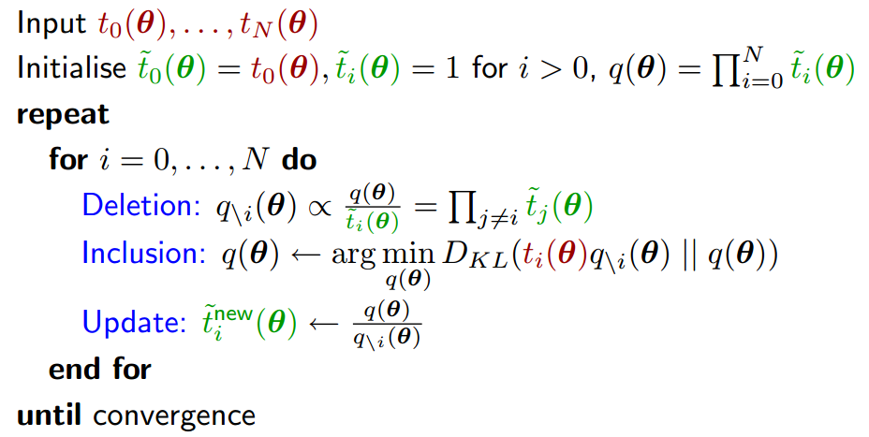
Current Line of Research
Expectation Propagation:
A method to perform Bayesian inference in graphical models
Works based on projection of the expectations
EP soft-projection

Slide 34
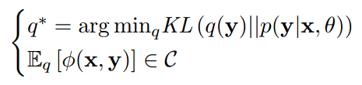
Current Line of Research
Expectation Propagation:
A method to perform Bayesian inference in graphical models
Works based on projection of the expectations
EP projection .
Constrained projection:

Slide 35
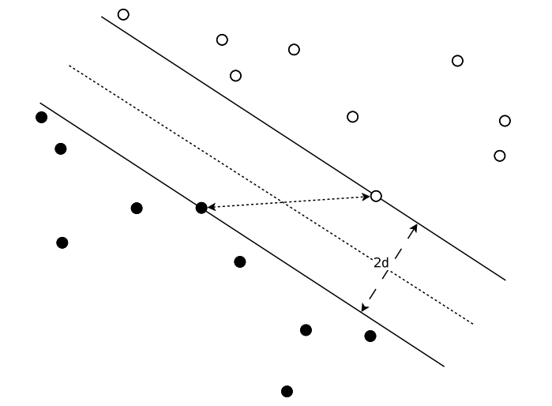
SVM
Primal form:
Relaxed form:
Dual form:

Slide 36
Proof:

Slide 37
Proof:

Slide 38
Proof: Hinge regression closed form
Suppose we want to minimize:

Slide 39
Proof: Hinge regression closed form
Proof:

Slide 40
Proof: Hinge regression closed form
Proof:

Slide 41
Fisher’s test ?
Statistical significance test

