Slide 1

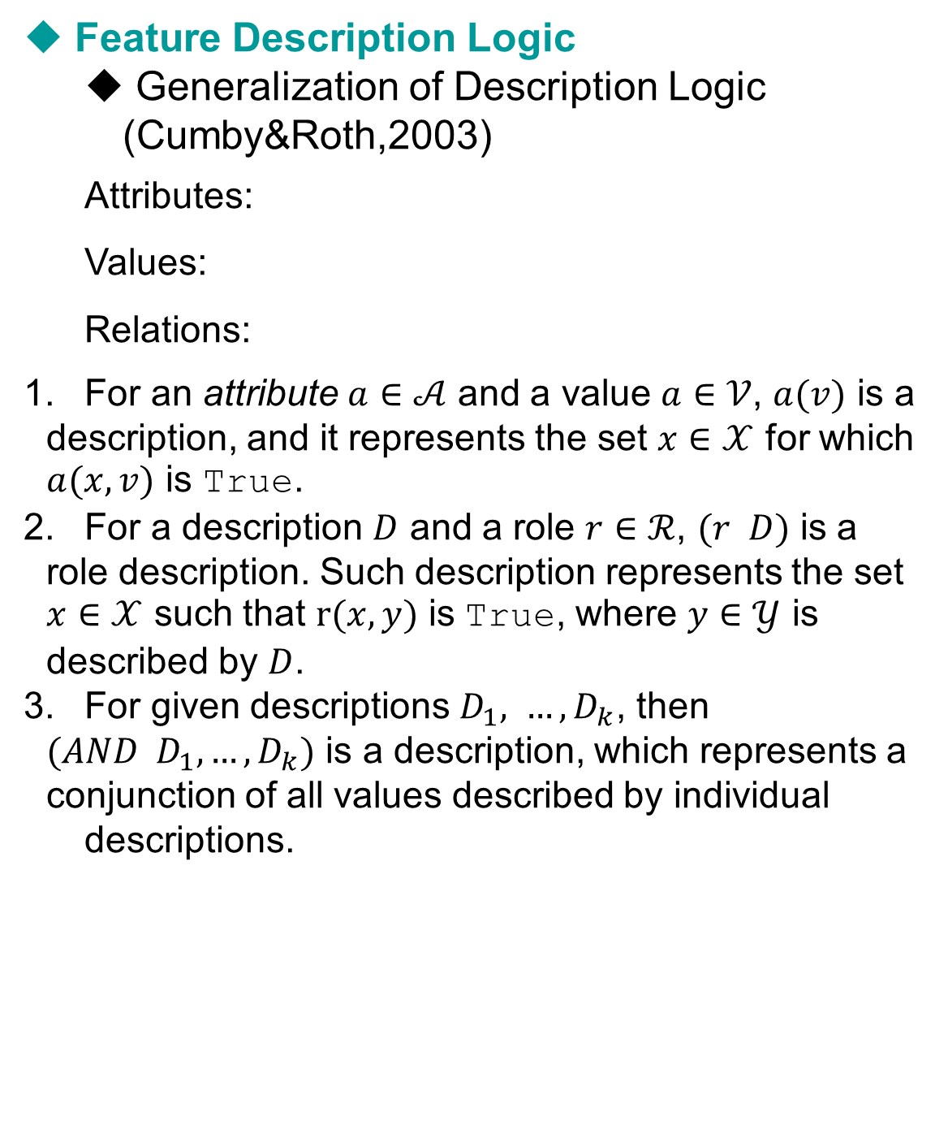

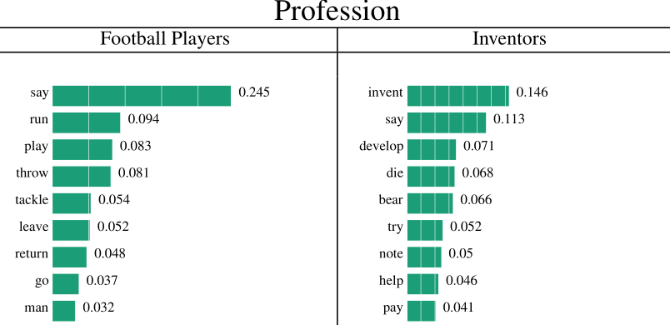

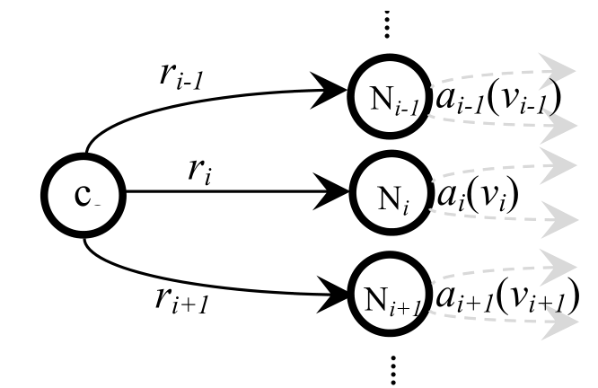

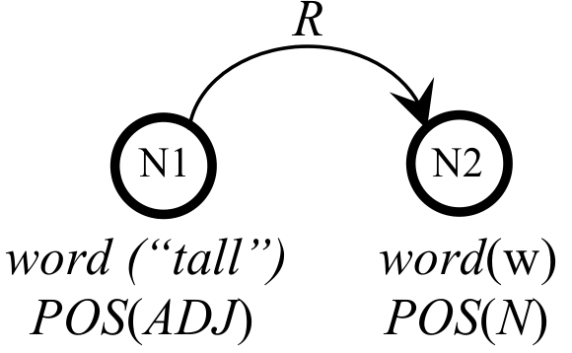
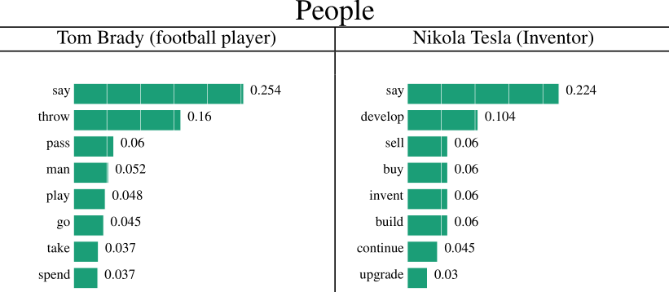
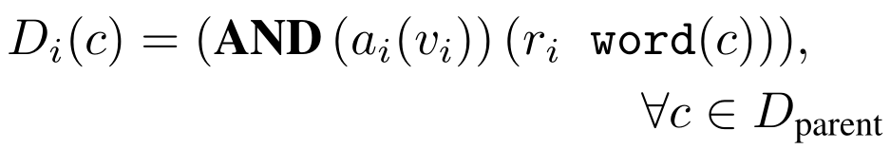
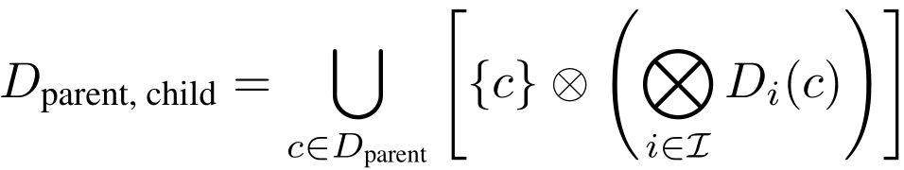
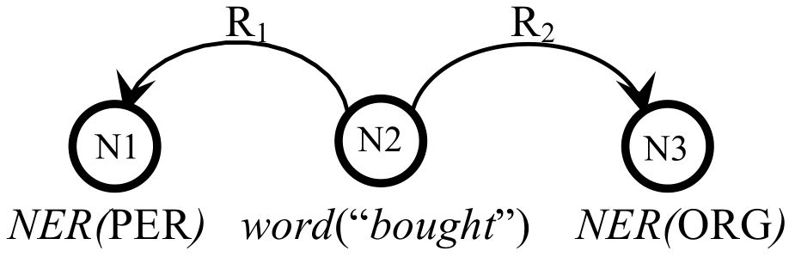
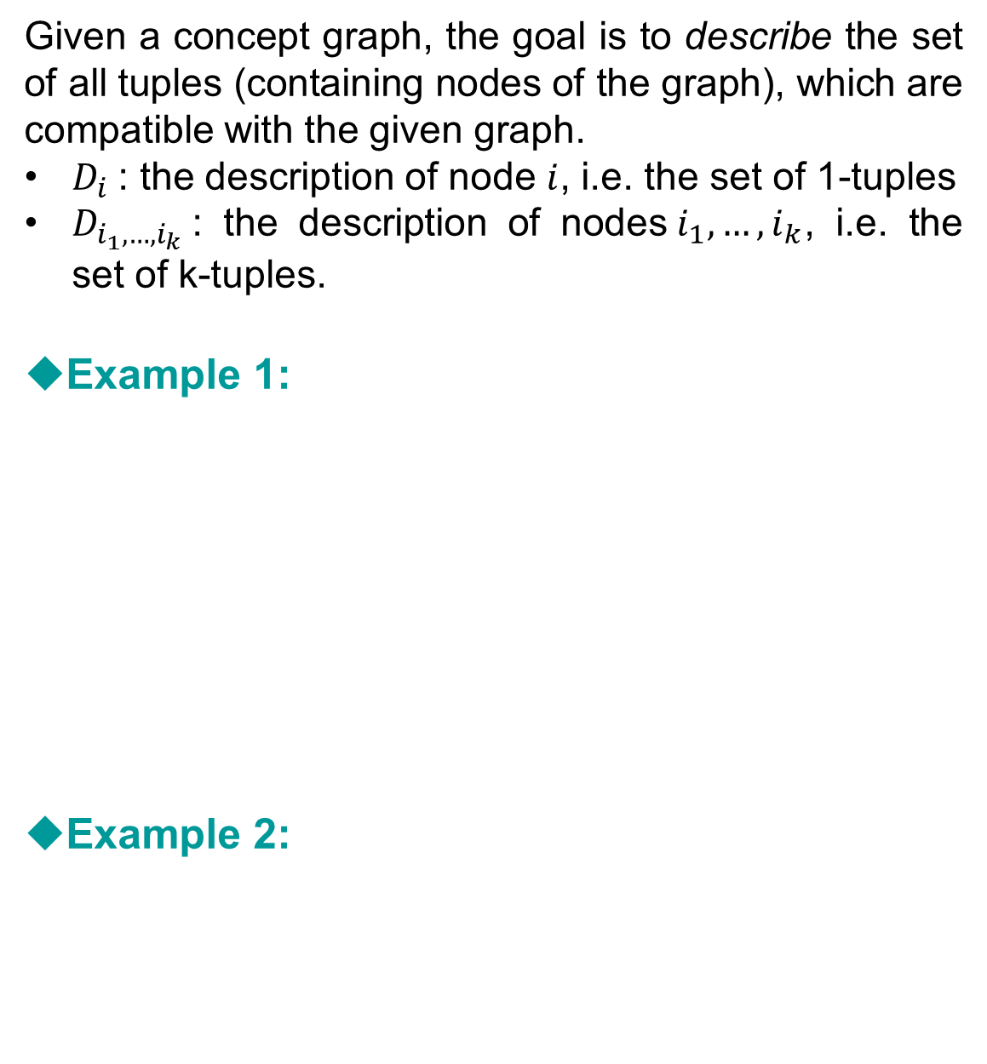
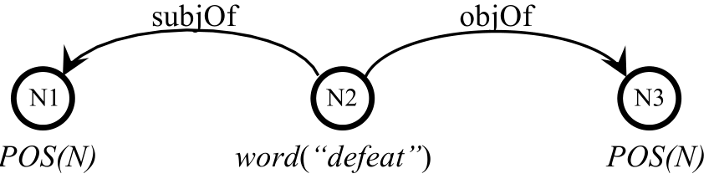
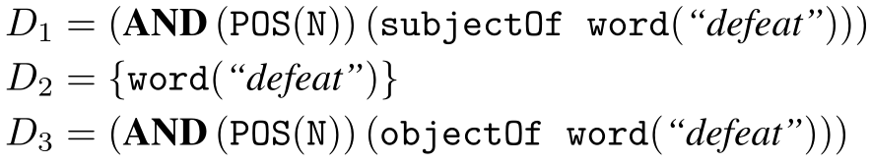
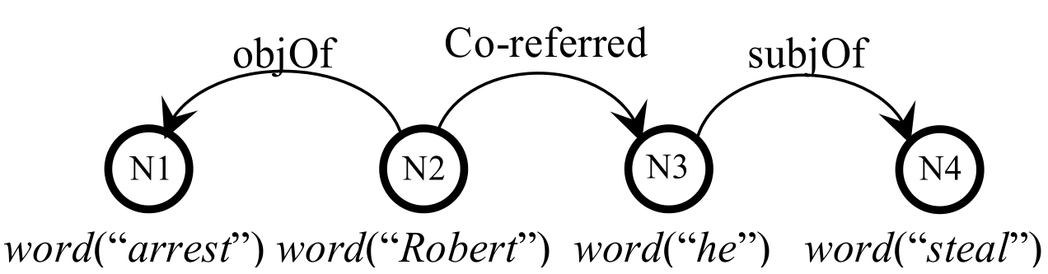
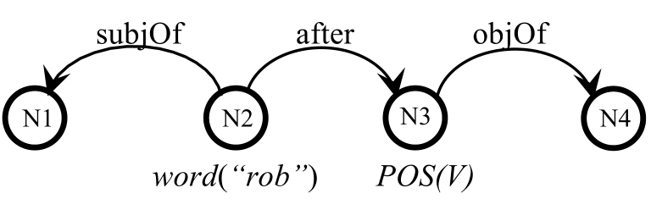
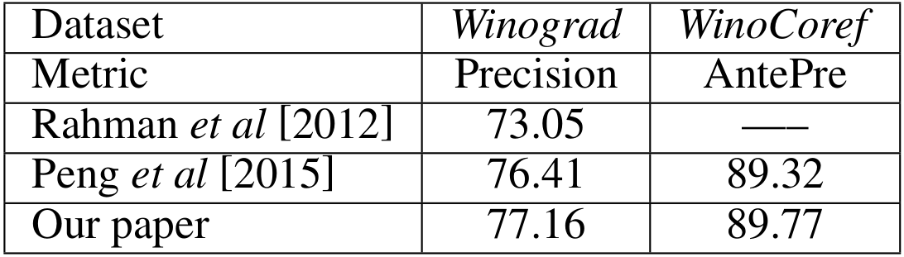
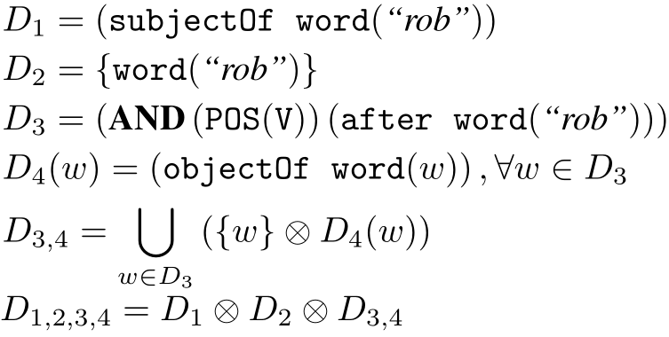
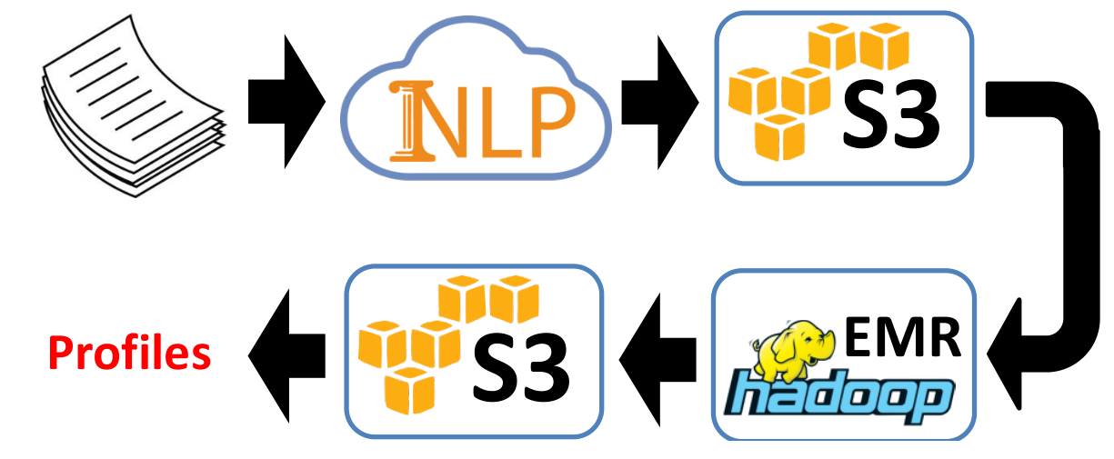
Profiler: Knowledge Schemas at Scale
Cognitive Computation Group, University of Illinois
Goal and Description
Knowledge Schemas
A General Description
of Knowledge Schemas
Experiments
Issue
Textual Inference needs additional knowledge.
Therefore there is a need to induce external knowledge in NLP tasks.
Examples
  Co-reference resolution:
  Named Entity resolution:
  More intricate co-reference resolution:
Goal
Creating a knowledge base with
  Knowledge schemas with different patterns
  Extracted automatically and efficiently
  Patterns contain multiple abstraction levels
  Easily extendible to new knowledge patterns
  Visualizing sample schemas
“Verb After” schema
  Detaless Classification of Professions-People
We create a labeled dataset of people-professions, using Wikipedia, such that for any entity its professions is labeled.
For a given entity, we create a feature for it, based on a select set of schemas.
For each profession, we average the feature vectors of a bunch of entities.
Now given the feature vectors of professions, for an unseen entity, decide the profession of an unseen entity based on its profiler feature vector.
Result: In 72.1% of the test cases, the correct answer is among the top-5 prediction.
Winograd Challenge
We follow the setting in Peng et al [2015].
We add extract information based on their setting from our schemas and add them as both constraints and features.
Ex.1 The [ball] e1 hit the [window] e2 and Bill repaired [it] pro.
Ex.2 The [ball] e1 hit the [window] e2 and Bill caught [it] pro.
References
Cumby, Chad M., and Dan Roth. "Learning with feature description logics.“ILP. Springer, 2003. 32-47.
Peng, Haoruo, Daniel Khashabi, and Dan Roth. "Solving Hard Coreference Problems." Urbana 51: 61801.
Given a concept graph, the goal is to give a general description of the elements that accord to the description of the graph.
Description of each based on its parent node:
Chaining description:
Process data with IllinoisCurator deployed on IllinoisCloudNLP
Store the data on S3, Amazon’s scalable storage
Process the data using MapReduce on Amazon EC2
Store the result on Amazon S3
Import the results to MongoDB, a scalable dababase supporting flexible indexing
Annotated 4,019,936 Wikipedia documents with 1,455 GB size with 200 mid-end EC2 nodes in 3 hours, at a cost of $420.
The result has size 198 GB and it contains 3,636,263 profiles for Wikipedia entities and 313,156 profiles for Verbsense entities.
“I chopped down [the tree] with my [axe] because [it] was tall.”
“[Larry Robbins], founder of Glenview Capital Management,
bought shares of [Endo International Plc] ...”
Describing Knowledge Schema
Acquisition Procedure
“[Jimbo] attacked [Bobbert] because [he] stole an elephant
from the zoo.”

