Slide 1

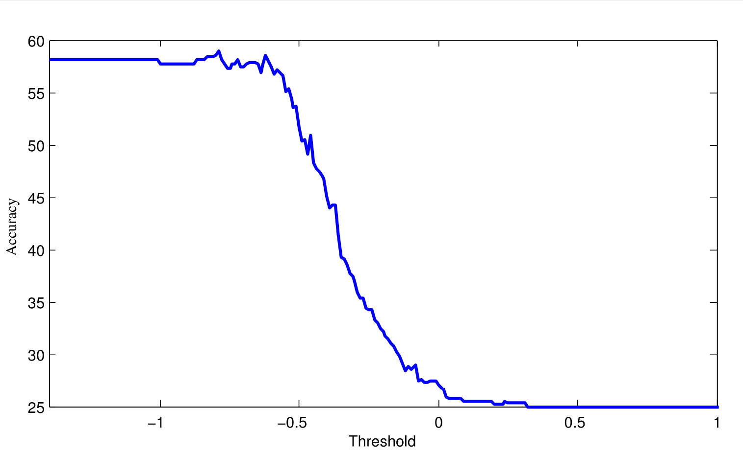
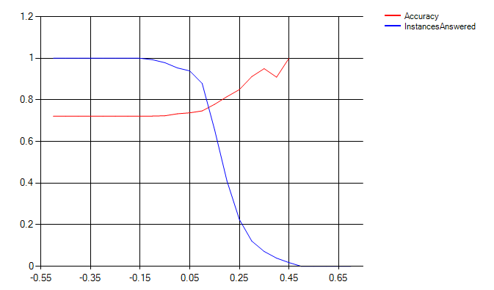
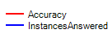
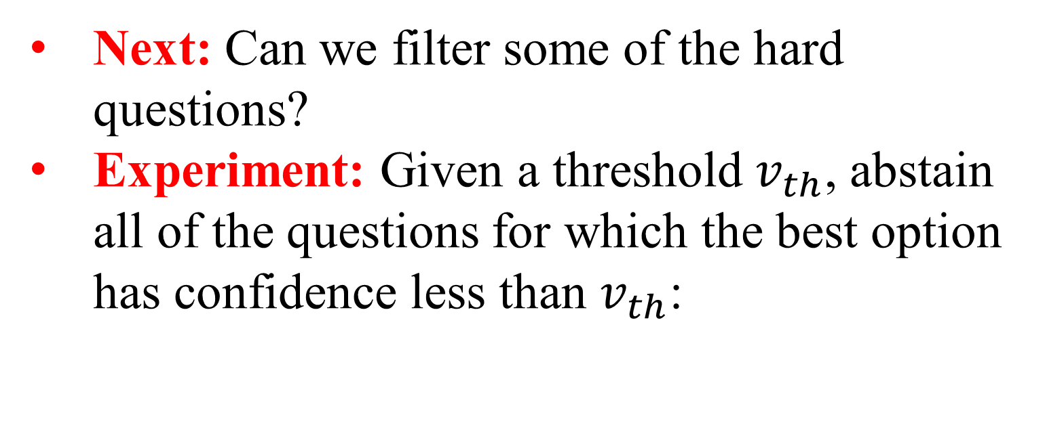
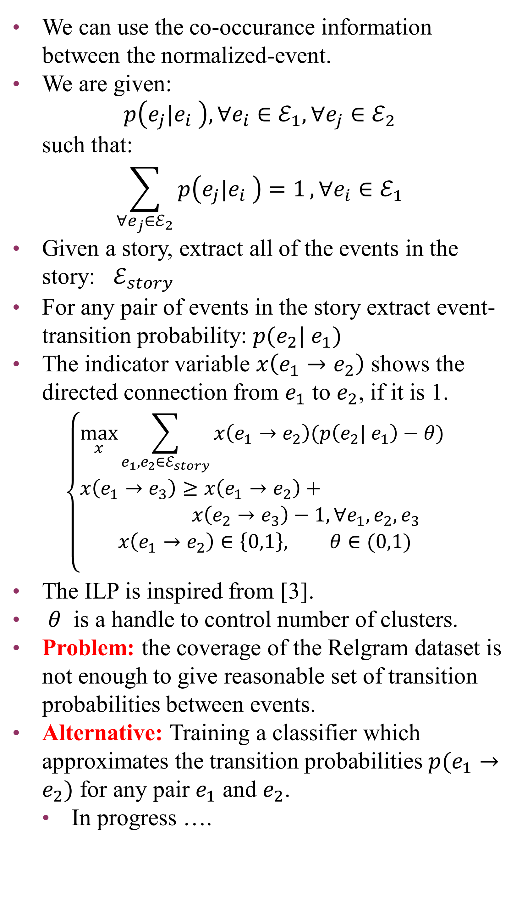
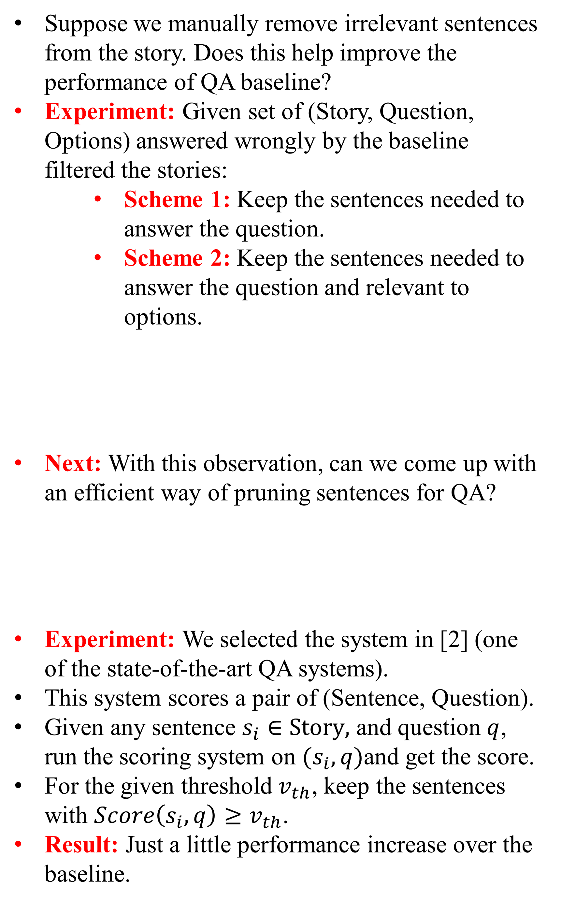
Flow of Semantics in Narratives
Daniel Khashabi, Chris J.C. Burges
Introduction
Accuracy vs Threshold
Coreference for creating timeline
Creating timeline with event probabilities
MCTest-160 [1] contains pairs of narratives and multiple choice questions.
An example of narrative QA:
Story: “Sally had a very exciting summer vacation. She went to summer camp for the first time. She made friends with a girl named Tina. They shared a bunk bed in their cabin. Sally's favorite activity was walking in the woods because she enjoyed nature. Tina liked arts and crafts. Together, they made some art using leaves they found in the woods. Even after she fell in the water, Sally still enjoyed canoeing. … ” Q: Who went to the beach with Sally?
1) her sisters
2) Tina
3) her brothers, mother, and father
4) herself
Suppose we are given coreference chains of a given story. Can we create a coherent set of event chains, for each animate entity?
Experiment:
Extract coreference chains for each story
Separate chains into plural and singular chains, and find connection between them.
And create timeline of singular chains, with plural chains attached to them.
An example is shown below. The output can be much noisier.
Next: Can we use this timeline to improve QA?
Experiment: Given question, find its main character, and choose the subset of sentences, related to this character, using the timeline.
Result:
On average the reduced size of the stories is 83.2% (no. of words) of the original stories.
But the performance almost doesn’t change.
Promising point: although no improvement yet, but reduced text
Define an event to be:
( Subject; Relation; Object )
Ex.:
( Abramoff; was indicted in; Florida )
Normalize the arguments:
(Person; be indicted in; State)
In [4] the authors have gathered co-occurance information for the normalized events, for 1.8 M words, gathering about 11M pair of events.
We can use the co-occurance information between the normalized-event.
We are given: $p\left(e_{j}|e_{i} \right), ∀e_{i}∈ℰ_{1}, ∀e_{j}∈ℰ_{2}$
such that:
$$\sum_{∀e_{j}∈ℰ_{2}}{p\left(e_{j}|e_{i} \right)=1}, ∀e_{i}∈ℰ_{1}$$
Given a story, extract all of the events in the story: $ℰ_{story}$
For any pair of events in the story extract event-transition probability: $p({e_{2}| e}_{1})$
The indicator variable $x\left(e_{1}→e_{2}\right)$ shows the directed connection from $e_{1}$ to $e_{2}$, if it is 1.
$$\left\{\begin{aligned}\max_{x}{\sum_{e_{1},e_{2}∈ℰ_{story}}{x\left(e_{1}→e_{2}\right)(p\left({e_{2}| e}_{1}\right)−θ) }} \\ x\left(e_{1}→e_{3}\right)≥x\left(e_{1}→e_{2}\right)+ \\ x\left(e_{2}→e_{3}\right)−1, ∀e_{1},e_{2},e_{3} \\ x\left(e_{1}→e_{2}\right)∈\left\{0,1\right\}, θ∈(0,1) \\ \end{aligned} \right.$$
The ILP is inspired from [3].
$θ$ is a handle to control number of clusters.
Problem: the coverage of the Relgram dataset is not enough to give reasonable set of transition probabilities between events.
Alternative: Training a classifier which approximates the transition probabilities $p(e_{1}→e_{2})$ for any pair $e_{1}$ and $e_{2}$.
In progress ….
Decreasing story size
Next: Can we filter some of the hard questions?
Experiment: Given a threshold $v_{th}$, abstain all of the questions for which the best option has confidence less than $v_{th}$:
An early observation: pruning stories helps!
Suppose we manually remove irrelevant sentences from the story. Does this help improve the performance of QA baseline?
Experiment: Given set of (Story, Question, Options) answered wrongly by the baseline filtered the stories:
Scheme 1: Keep the sentences needed to answer the question.
Scheme 2: Keep the sentences needed to answer the question and relevant to options.
Next: With this observation, can we come up with an efficient way of pruning sentences for QA?
Experiment: We selected the system in [2] (one of the state-of-the-art QA systems).
This system scores a pair of (Sentence, Question).
Given any sentence $s_{i}∈Story,$ and question $q$, run the scoring system on $(s_{i}, q)$and get the score.
For the given threshold $v_{th}$, keep the sentences with $Score\left(s_{i}, q\right)≥v_{th}$.
Result: Just a little performance increase over the baseline.
Scores normalized with respect to question length:
Relgrams
Accuracies on baseline error
No pruning | Schema 1 | Schema 2
0.0 % | 38.77 % | 14.13 %
threshold
Result: Increased performance comes at the cost of losing substantial coverage!
Next: Can we chunk events, based on their animate characters?
Future work
Using the timeline information for improving coreference
QA on the subset chosen by event timeline
Neural models for transition between events
SRL-gram
System1: Finding the Right Sentence(s)
System2: Answering the question, given the selected sentence(s)
Acknowledgment
Scott Yih, Erin Renshaw, Andrzej Pastusiak, Matt Richardson, and Chris Meek
References
[1] Richardson, Matthew, et al "MCTest: A Challenge Dataset for the Open-Domain Machine Comprehension of Text." EMNLP. 2013.
[2] Chang, Wen-tau Yih Ming-Wei, and Christopher Meek Andrzej Pastusiak. "Question answering using enhanced lexical semantic models." (2013).
[3] Chang, Kai-Wei, et al. "Inference protocols for coreference resolution." CoNLL: Shared Task, 2011.
[4] Balasubramanian, Niranjan, et al. "Generating Coherent Event Schemas at Scale." EMNLP. 2013.
Mistake in timeline; should have belonged to the red chain.
Mistake in timeline; wrong subject.

