Slide 1
Blinded Bandits
Ofer Dekel, Elad Hazan, Tomer Koren
NIPS 2014 (Yesterday)

Slide 2
Overview
Online Learning setting with Bandit feedback
No feedback when we switch action
“Blinded” Multi-Armed Bandit

Slide 3
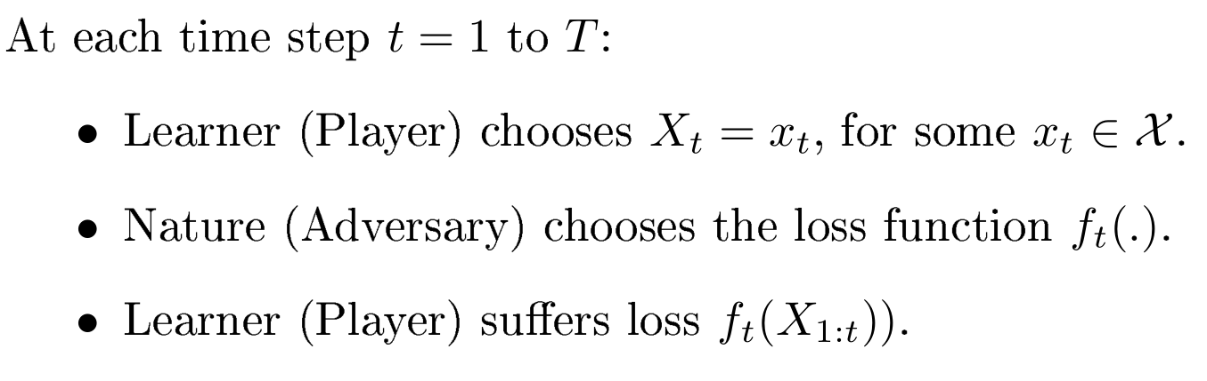
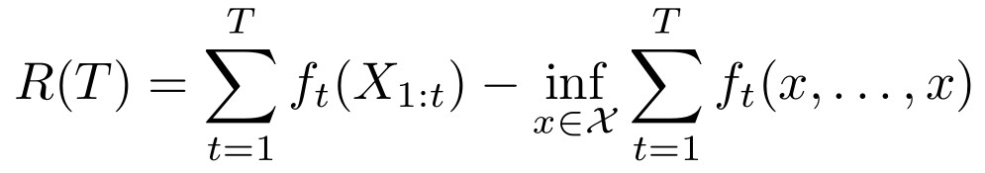
Online Learning
Regret:

Slide 4

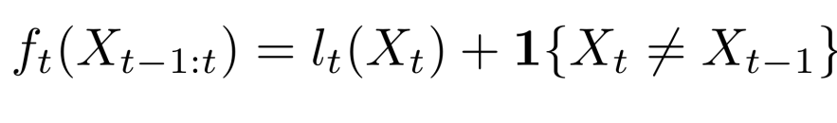

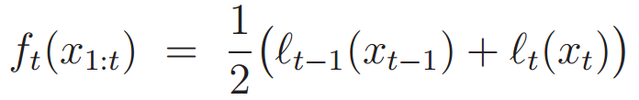
Oblivious vs. non-oblivious (adaptive)
Oblivious:
Simple non-oblivious cost:
Switching :
m-memory:
Max:
Average:

Slide 5
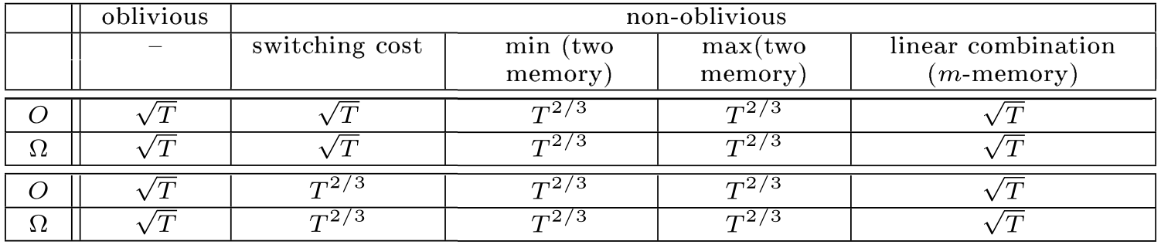
Review on works discussed at class
[1] Weighted-Majority: Littlestone and K Warmuth. The weighted majority algorithm, 1994.
[2] Follow-The-Perturbed-Leader: Kalai and Vempala. Effcient algorithms for online decision problems. 2005.
[3] EXP3: Auer et al. The nonstochastic multiarmed bandit problem, 2002.
[4] Switching Cost: Dekel et al. Bandits with switching costs: T^{2/3} regret, 2013.
[5] Linear Composite Costs: Dekel et al. Online learning with composite loss functions, 2014.
Full-Information
Bandit

Slide 6
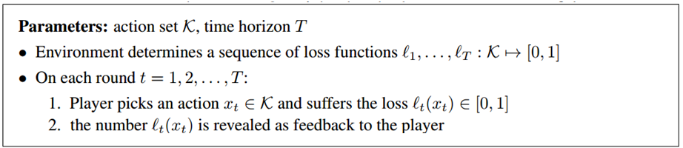
Reminder: A Bandit Game
EXP3 algorithm, 2002
EXP3: Auer et al. The nonstochastic multiarmed bandit problem, 2002.

Slide 7
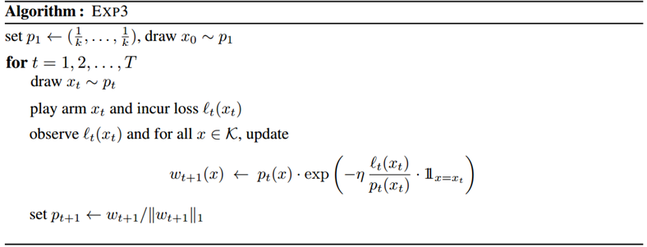
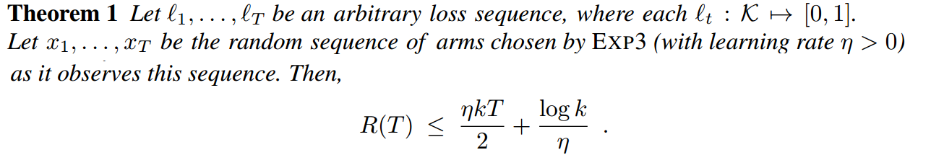
EXP3: Auer et al. The nonstochastic multiarmed bandit problem, 2002.

Slide 8

Blinded Bandit
if $x_{t}=x_{t−1}$we get feedback $l_{t}(x_{t})$
Otherwise, no feedback!
We still suffer the loss $l_{t}(x_{t})$

Slide 9
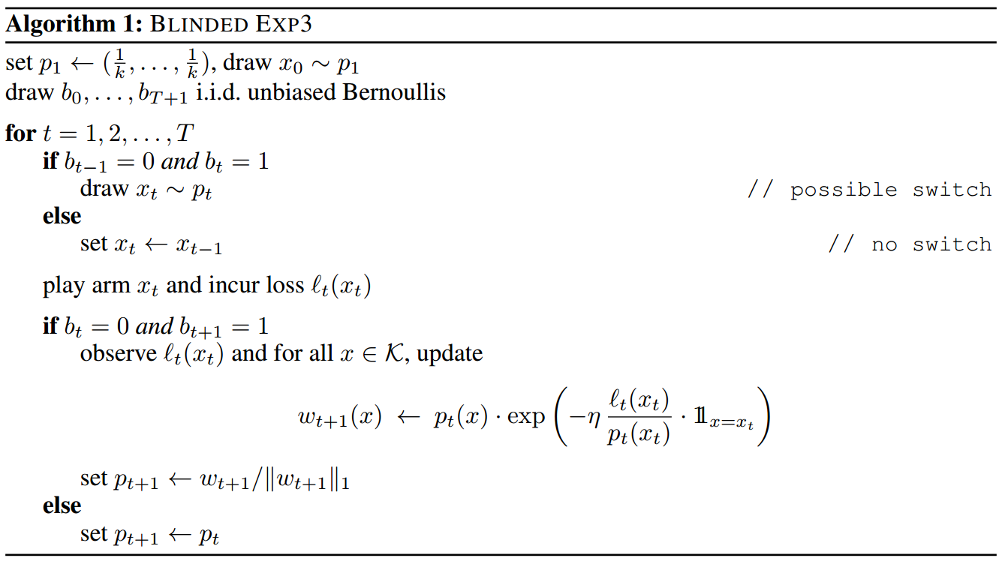

Slide 10
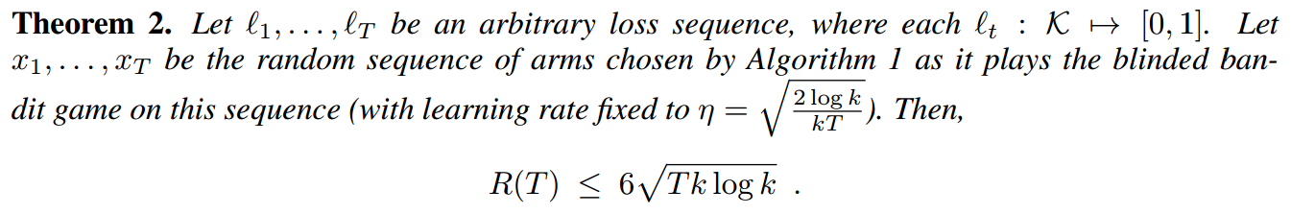
(Proof on the board)

Slide 11
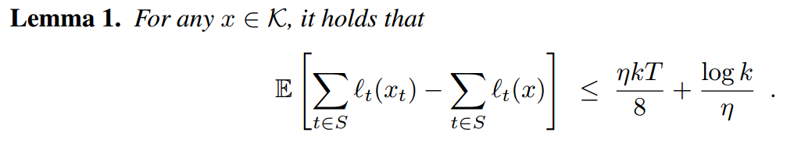
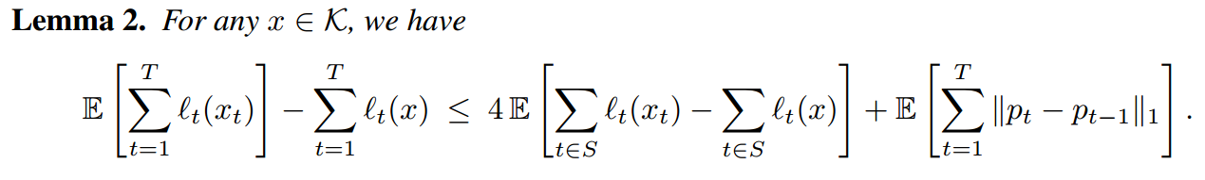
Blinded EXP3: The guarantee
Proofs on the board!

