Slide 1
Memoized Online Variational Inference for Dirichlet Process Mixture Models
NIPS 2013
Michael C. Hughes and Erik B. Sudderth

Slide 2
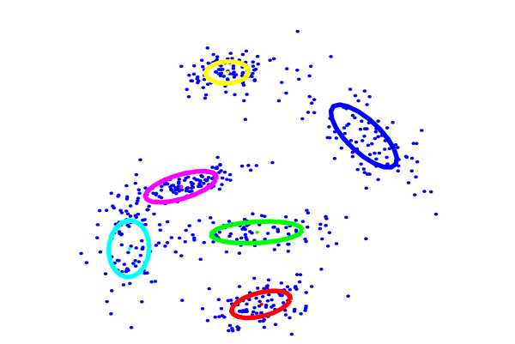
Motivation
Notes:
Consider a set of points
- One way to get an understanding of how the points are related to each other, is clustering “similar” points.
“Similar” might completely depend on the metric space that we are using. So, “similarity” is subjective, but for now let’s not worry about that.
Clustering is very important in many ML applications. Say we have tons of images, and we want to find an internal structure for the points in our feature space.

Slide 3
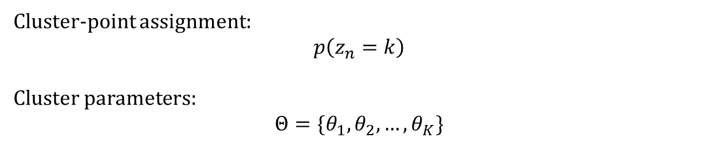
k=6
k=1 k=2 k=3
Clusters:
Points:
n=1 n=2 n=3 n=4
k=5
k=1
k=2
k=4
k=3
Cluster-point assignment:
$$p\left(z_{n}=k\right)$$
Cluster parameters:
$$Θ=\{θ_{1},θ_{2},…,θ_{K}\}$$
Notes:
Examples from k-means

Slide 4
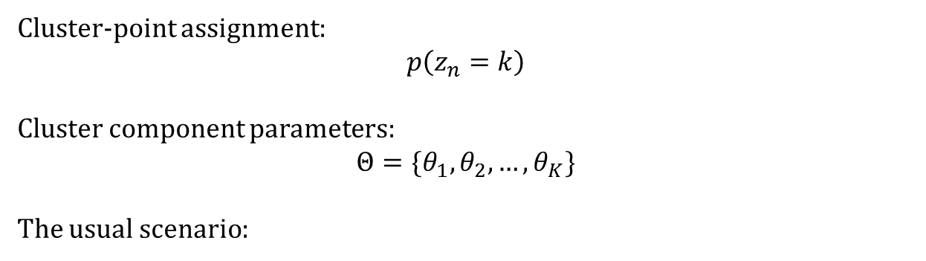



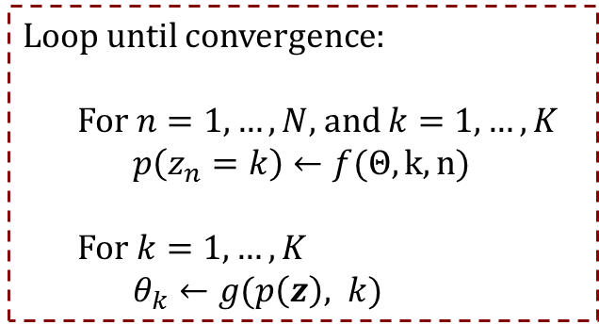
k=1 k=2 k=3
Clusters:
Points:
n=1 n=2 n=3 n=4
Cluster-point assignment:
$$p\left(z_{n}=k\right)$$
Cluster component parameters:
$$Θ=\{θ_{1},θ_{2},…,θ_{K}\}$$
The usual scenario:
$$N≫K$$
Loop until convergence:
For $n=1, …, N$, and $k=1, …, K$
$p\left(z_{n}=k\right)←f(Θ, k, n)$
For $k=1, …, K$
$θ_{k}←g(p\left(z\right), k)$
$$K×N$$
Clustering Assignment Estimation
Component Parameter Estimation
$$K$$

Slide 5
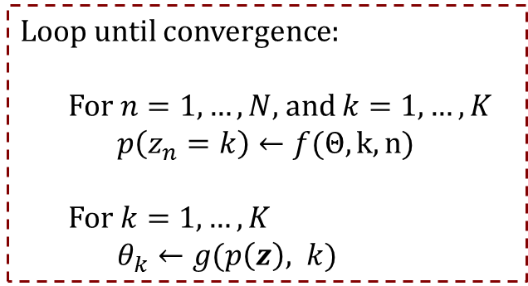




Loop until convergence:
For $n=1, …, N$, and $k=1, …, K$
$p\left(z_{n}=k\right)←f(Θ, k, n)$
For $k=1, …, K$
$θ_{k}←g(p\left(z\right), k)$
$$K×N$$
Clustering Assignment Estimation
Component Parameter Estimation
$$K$$
How to keep track of convergence?
A simple rule for k-means
Alternatively keep track of the k-means global objective:
Dirichlet Processs Mixture with Variational Inference
Lower bound on the marginal likelihood
When the assignments don’t change.
$$L(Θ)=\sum_{n}{\sum_{k}{{\left|\left|x_{n}−θ_{z_{n}}\right|\right|}^{2}}}$$
$ℒ =h(Θ, p(z))$
Notes:
At this point we should probably ask ourselves how good it is to use lower bound on marginal likelihood, as measure of performance?
Even, how good is it to use likelihood as a measure of performance?

Slide 6
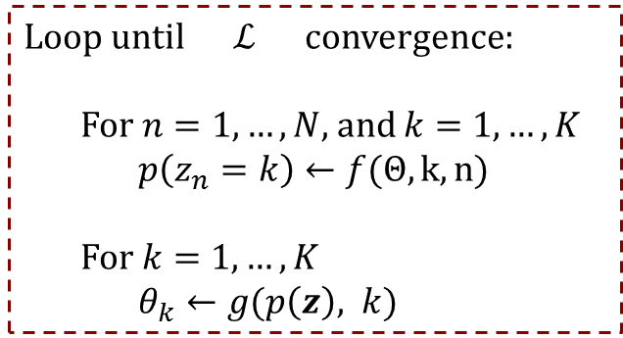

Loop until $ℒ$ convergence:
For $n=1, …, N$, and $k=1, …, K$
$p\left(z_{n}=k\right)←f(Θ, k, n)$
For $k=1, …, K$
$θ_{k}←g(p\left(z\right), k)$
$$K×N$$
Clustering Assignment Estimation
Component Parameter Estimation
$$K$$
What if the data doesn’t fit in the disk?
What if we want to accelerate this?
Assumption:
Independently sampled assignment into batches
Enough samples inside each data batch
For latent components
Divide the data into B batches
$$B≪N$$
Notes:
Assumptions:
Independently assign the data points into the data batches - We need to have enough data points inside each batch → Specifically, we need to have enough data points per latent components, inside each data batch

Slide 7








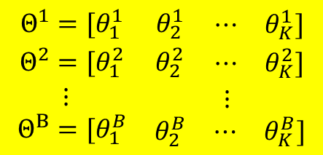




Loop until $ℒ$ convergence:
For $n=1, …, N$, and $k=1, …, K$
$p\left(z_{n}=k\right)←f(Θ, k, n)$
For $k=1, …, K$
$θ_{k}←g(p\left(z\right), k)$
$$K×N$$
Clustering Assignment Estimation
Component Parameter Estimation
$$K$$
Clusters are shared between data batches!
Divide the data into B batches
$$x$$
Define global / local cluster parameters
Global component parameters:
Local component parameter:
$$x_{1}$$
$$x_{2}$$
$$…$$
$$x_{B}$$
$$\begin{matrix}{Θ^{0} = [θ}_{1}^{0} & θ_{2}^{0} & \begin{matrix}⋯ & θ_{K}^{0}\end{matrix}]\end{matrix}$$
$$Θ^{1}$$
$$Θ^{2}$$
$$…$$
$$Θ^{B}$$
$$\begin{matrix}Θ^{1}=[θ_{1}^{1} & θ_{2}^{1} & \begin{matrix}⋯ & θ_{K}^{1}]\end{matrix} \\ Θ^{2}=[θ_{1}^{2} & θ_{2}^{2} & \begin{matrix}⋯ & θ_{K}^{2}]\end{matrix} \\ \begin{aligned}⋮ \\ {Θ^{B}=[θ}_{1}^{B}\end{aligned} & \begin{aligned} \\ θ_{2}^{B}\end{aligned} & \begin{aligned}\begin{matrix}⋮ & \end{matrix} \\ \begin{matrix}⋯ & θ_{K}^{B}]\end{matrix}\end{aligned}\end{matrix}$$
$$Θ^{0}$$
Notes:
Assumptions:
Independently assign the data points into the data batches - We need to have enough data points inside each batch → Specifically, we need to have enough data points per latent components, inside each data batch

Slide 8





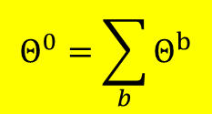
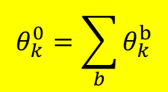






Loop until $ℒ$ convergence:
For $n=1, …, N$, and $k=1, …, K$
$p\left(z_{n}=k\right)←f(Θ, k, n)$
For $k=1, …, K$
$θ_{k}←g(p\left(z\right), k)$
$$K×N$$
Clustering Assignment Estimation
Component Parameter Estimation
$$K$$
How to aggregate the parameters?
Similar rules holds in DPM:
For each component: k
For all components:
$$x$$
K-means example:
The global cluster center, is weighted average of the local cluster centers.
$$x_{1}$$
$$x_{2}$$
$$…$$
$$x_{B}$$
$$Θ^{1}$$
$$Θ^{2}$$
$$…$$
$$Θ^{B}$$
$$θ_{k}^{0}=\sum_{b}{θ_{k}^{b}}$$
?
$$Θ^{0}$$
$$Θ_{}^{0}=\sum_{b}{Θ_{}^{b}}$$
Notes:
Assumptions:
Independently assign the data points into the data batches - We need to have enough data points inside each batch → Specifically, we need to have enough data points per latent components, inside each data batch

Slide 9


Loop until $ℒ$ convergence:
For $n=1, …, N$, and $k=1, …, K$
$p\left(z_{n}=k\right)←f(Θ, k, n)$
For $k=1, …, K$
$θ_{k}←g(p\left(z\right), k)$
$$K×N$$
Clustering Assignment Estimation
Component Parameter Estimation
$$K$$
How does the algorithm look like?
Models and analysis for K-means:
$$x$$
Loop until $ℒ$convergence:
Randomly choose: $b∈\{1, 2, 3,…, B\}$
For $n∈ℬ_{b}$, and $k=1, …, K$
$p\left(z_{n}=k\right)←f(Θ^{0}, k, n)$
For cluster $k=1, 2, 3,…, K$
${θ_{k}^{b}}^{(new)}←g(p\left(z\right), k,b)$
$θ_{k}^{0}←θ_{k}^{0}$ - ${θ_{k}^{b}}^{(old)}$ + ${θ_{k}^{b}}^{(new)}$
${{ θ}_{k}^{b}}^{(old)}←{θ_{k}^{b}}^{(new)}$
$$x_{1}$$
$$x_{2}$$
$$…$$
$$x_{B}$$
$$Θ^{1}$$
$$Θ^{2}$$
$$…$$
$$Θ^{B}$$
$$Θ^{0}$$
Januzaj et al., “Towards effective and efficient distributed clustering”, ICDM, 2003
Notes:
Assumptions:
Independently assign the data points into the data batches - We need to have enough data points inside each batch → Specifically, we need to have enough data points per latent components, inside each data batch

Slide 10




Loop until $ℒ$ convergence:
For $n=1, …, N$, and $k=1, …, K$
$p\left(z_{n}=k\right)←f(Θ, k, n)$
For $k=1, …, K$
$θ_{k}←g(p\left(z\right), k)$
$$K×N$$
Clustering Assignment Estimation
Component Parameter Estimation
$$K$$
Compare these two:
(this work) (Stochastic Optimization for DPM, Hoffman et al., JMLR, 2013)
$\sum_{i}{ρ_{i}→+∞}, \sum_{i}{ρ_{i}^{2}<+∞}$
Loop until $ℒ \left(q\right)$ convergence:
Randomly choose: $b∈\{1, 2, 3,…, B\}$
For $n∈ℬ_{b}$, and $k=1, …, K$
$p\left(z_{n}=k\right)←f(Θ^{0}, k, n)$
For cluster $k=1, 2, 3,…, K$
${θ_{k}^{b}}^{(new)}←g(p\left(z\right), k,b)$
$θ_{k}^{0}←θ_{k}^{0}$ - ${θ_{k}^{b}}^{(old)}$ + ${θ_{k}^{b}}^{(new)}$
${{ θ}_{k}^{b}}^{(old)}←{θ_{k}^{b}}^{(new)}$
Loop until $ℒ \left(q\right)$ convergence:
Randomly choose: $b∈\{1, 2, 3,…, B\}$
For $n∈ℬ_{b}$, and $k=1, …, K$
$p\left(z_{n}=k\right)←f(Θ^{0}, k, n)$
For cluster $k=1, 2, 3,…, K$
${θ_{k}^{b}}^{}←g(p\left(z\right), k,b)$
$θ_{k}^{0}←{(1−ρ_{i})θ}_{k}^{0}$ +$ρ_{i}.θ_{k}^{b}.\frac{n}{|ℬ_{b}|}$
Notes:
Assumptions:
Independently assign the data points into the data batches - We need to have enough data points inside each batch → Specifically, we need to have enough data points per latent components, inside each data batch

Slide 11

Loop until $ℒ$ convergence:
For $n=1, …, N$, and $k=1, …, K$
$p\left(z_{n}=k\right)←f(Θ, k, n)$
For $k=1, …, K$
$θ_{k}←g(p\left(z\right), k)$
$$K×N$$
Clustering Assignment Estimation
Component Parameter Estimation
$$K$$
Note:
They use a nonparametric model!
But ….
the inference uses maximum-clusters
How to get adaptive number of maximum-clusters?
Heuristics to add new clusters, or remove them.
Dirichlet Process Mixture (DPM)
Notes:
Assumptions:
Independently assign the data points into the data batches - We need to have enough data points inside each batch → Specifically, we need to have enough data points per latent components, inside each data batch

Slide 12
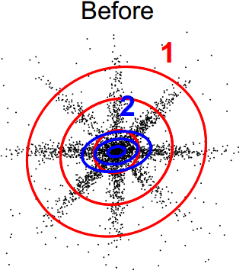
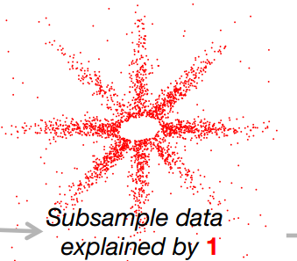
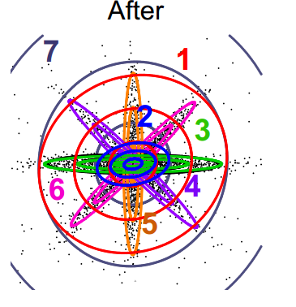
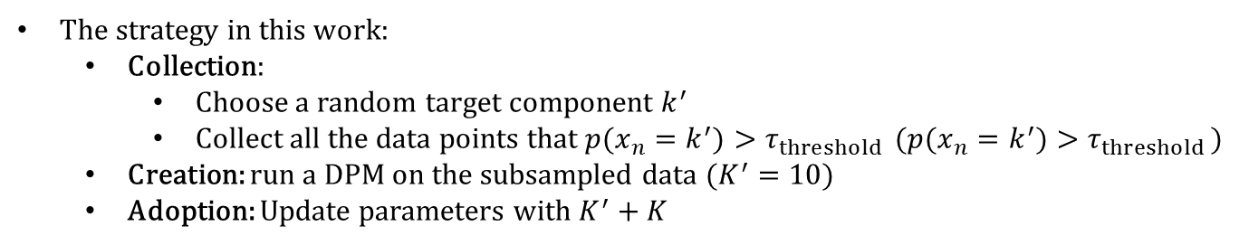
Birth moves
The strategy in this work:
Collection:
Choose a random target component $k^{′}$
Collect all the data points that ${p(x_{n}=k}^{′})>τ_{threshold }$ (${p(x_{n}=k}^{′})>τ_{threshold }$)
Creation: run a DPM on the subsampled data ($K^{′}=10$)
Adoption: Update parameters with $K^{′}+K$
Notes:
Subsample the data: choose a k, and copy its data points to x^’ at random, and for any k^’, if r_{n,k^’} > \tau (0.1) copy it into x^’
Learn a fresh DP-GMM on the subsampled data
Add the fresh components to the original model

Slide 13
Other birth moves?
Past: split-merge schema for single-batch learning
E.g. EM (Ueda et al., 2000), Variational-HDP (Bryant and Sudderth, 2012), etc.
Split a new component
Fix everything
Run restricted updates.
Decide whether to keep it or not
Many similar Algorithms for k-means
(Hamerly & Elkan, NIPS, 2004), (Feng & Hammerly, NIPS, 2007), etc.
This strategy unlikely to work in the batch mode:
Each batch might not contain enough examples of the missing component

Slide 14
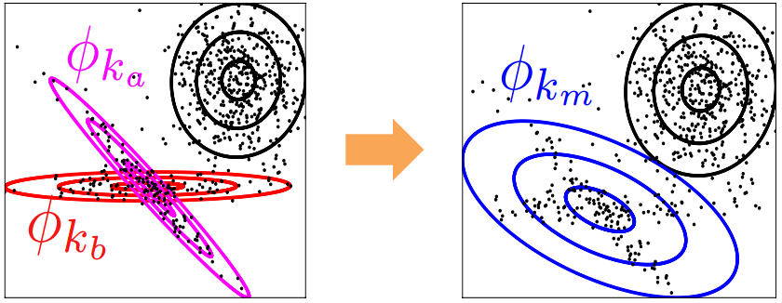
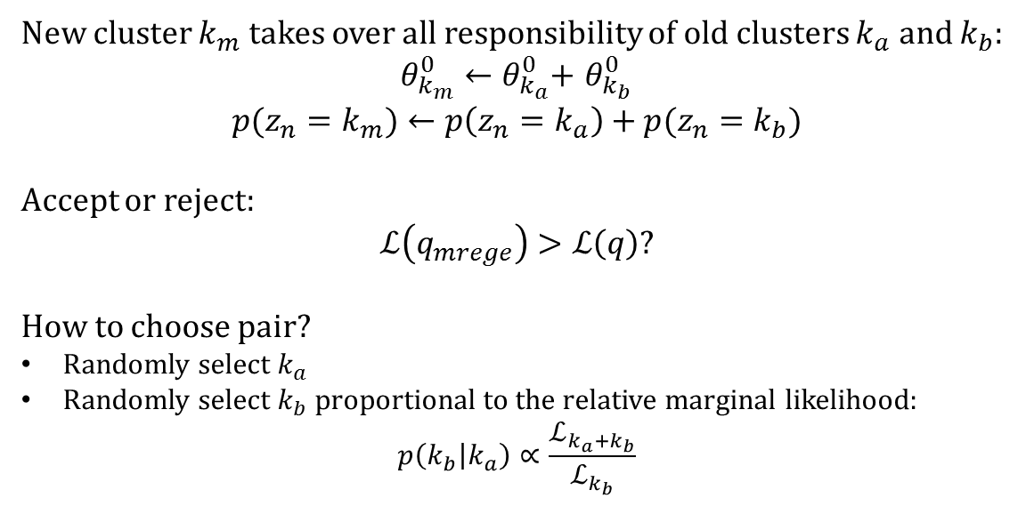
Merge clusters
New cluster $k_{m}$ takes over all responsibility of old clusters $k_{a}$ and $k_{b}$:
$θ_{k_{m}}^{0}←θ_{k_{a}}^{0}$+ $θ_{k_{b}}^{0}$
$$p(z_{n}=k_{m})←p\left(z_{n}=k_{a}\right)+p(z_{n}=k_{b})$$
Accept or reject:
$$ℒ\left(q_{mrege}\right)>ℒ\left(q\right)?$$
How to choose pair?
Randomly select $k_{a}$
Randomly select $k_{b}$ proportional to the relative marginal likelihood:
$$p\left(k_{b} | k_{a}\right)∝\frac{ℒ_{k_{a}+k_{b}}}{ℒ_{k_{b}}}$$
Notes:
Merge two clusters into one for parsimony, accuracy, efficiency Requires memoized entropy sums for candidate pairs of clusters;
Sampling from all pairs is inefficient

Slide 15
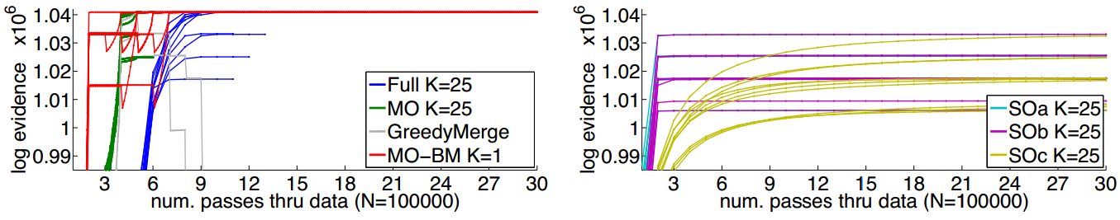
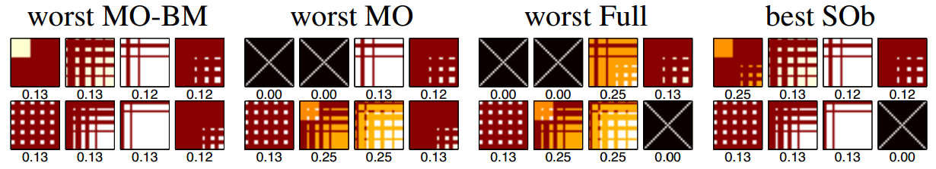
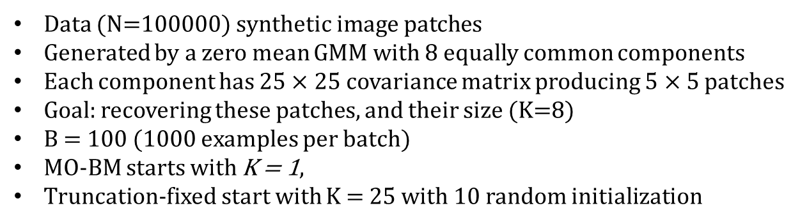
Results: toy data
Data (N=100000) synthetic image patches
Generated by a zero mean GMM with 8 equally common components
Each component has $25×25$ covariance matrix producing $5×5$ patches
Goal: recovering these patches, and their size (K=8)
B = 100 (1000 examples per batch)
MO-BM starts with K = 1,
Truncation-fixed start with K = 25 with 10 random initialization
Notes:
As a first study, a toy example ….
Zero-mean GMM, with 8 equally common components
Each one is defined by a 25*25 covariance matrix
This produces 5*5 patches
Goal:
- can we recover K = 8?
Runs:
- Each truncation-fixed model run 10 times with random initialization, with K=25
MO-BM (Memoized Birth Merge) : starts at K=1 - SO: with 3 different rates - Online methods: B = 100 (# of batches) - GreedyMerge, a memoized online variant that instead uses only the current-batch ELBO
Bottom figures: The covariance matrices and weights w_k, found by one run of each method, aligned to the true component. X: no comparable component found Observation: - SO sensitive to initialization and learning rates Problems:
- For MO-BM and MO they should have run the algorithm for multiple rates, to see how much initialization is important.

Slide 16
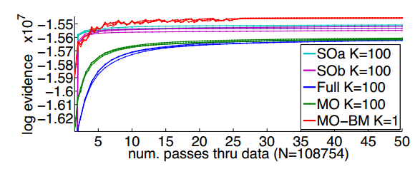

Results: Clustering tiny images
108754 images of size 32 × 32
Projected in 50 dimension using PCA
MO-BM starting at K = 1, others have K=100
full-mean DP-GMM
Notes:
Clustering N = 60000 MNIST images of handwritten digits 0-9.
As preprocessing, all images projected to D = 50 via PCA.
Kuri: split-merge scheme for single-batch variational DPM Right figures: Comparison of final ELBO, for multiple runs of each method, varying initialization and number of batches
Stochastic Variations: with three different learning rates Left: Evaluation of cluster alignment to the true digit label.

Slide 17
Summary
A distributed algorithm for Dirichlet Process Mixture model
Split-merge schema
Interesting improvement over the similar methods for DPM.
Theoretical convergence guarantees ?
Theoretical justification for choosing batches B, or experiments investigating it?
Previous “almost” similar algorithms, specially on k-means ?
Notes:
Not analyzed in the work: What if your data is not sufficient?
Then how do you choose the number of the batches?
Some strategies for batches, might not contain enough data in the missing components. Not strategy is proposed to choose a good batch size and the distribution of points in batches.

Slide 18
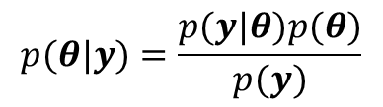
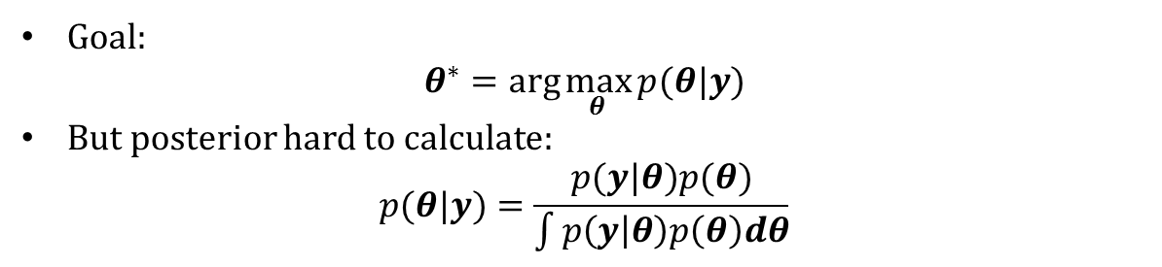
Bayesian Inference
likelihood
$$p(θ|y)=\frac{p(y|θ)p(θ)}{p(y)}$$
Prior
Posterior
Marginal likelihood / Evidence
Goal:
$$θ^{∗}=arg\max_{θ}{p(θ|y)}$$
But posterior hard to calculate:
$$p(θ|y)=\frac{p(y|θ)p(θ)}{\int{p\left(y | θ\right)p\left(θ\right)dθ}}$$
Notes:
So …. We want to Bayesian modeling … we use the Bayes rule
We have a set of parameters \theta, and observations y - Posterior
- Likelihood, like a logistic regression, or any other model. H
ere in this work the likelihood will be a nonparametric mixture model, which is commonly known as Dirichlet Process Mixture …
- Prior
- Marginal Likelihood
Goal is to choose the most probable assignment to the posterior Usually the posterior function is hard to calculate directly, except the conjugate priors. Can we use an equivalent measure to find an approximation to what we want?

Slide 19
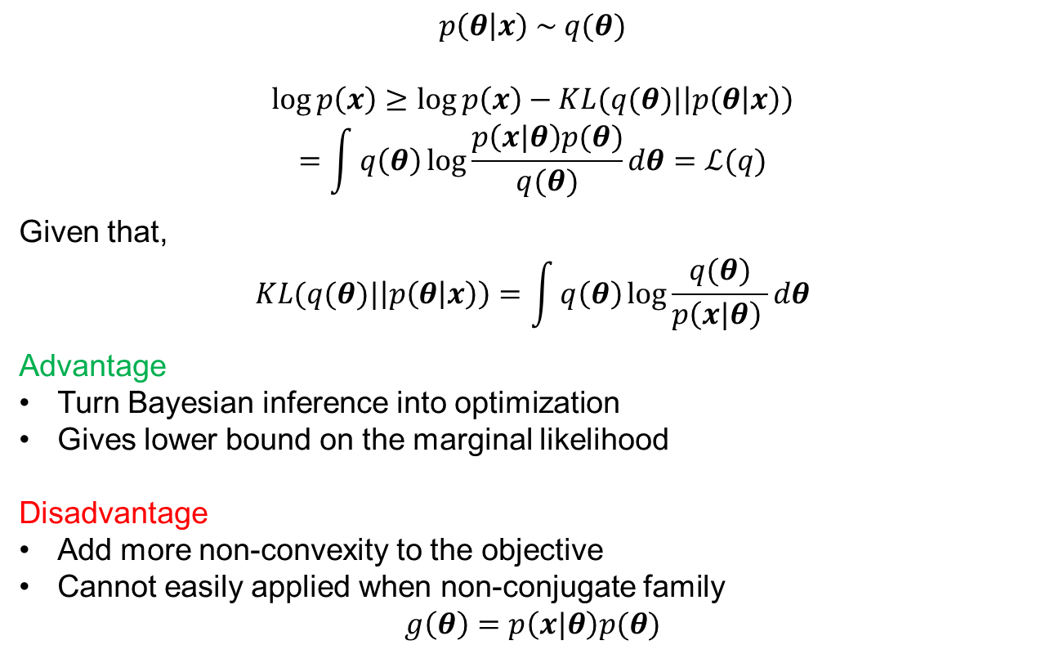
Lower-bounding marginal likelihood
$$p\left(θ | x\right) \sim q(θ)$$
$$\log{p\left(x\right)}≥\log{p\left(x\right)}−KL(q(θ)|\left|p\left(θ | x\right)\right)$$
$$=\int{q\left(θ\right)\log{\frac{p\left(x|θ\right)p(θ)}{q(θ)}dθ=ℒ(q)}}$$
Given that,
$$KL(q(θ)|\left|p\left(θ | x\right)\right)=\int{q\left(θ\right)\log{\frac{q(θ)}{p\left(x|θ\right) }dθ}}$$
Advantage
Turn Bayesian inference into optimization
Gives lower bound on the marginal likelihood
Disadvantage
Add more non-convexity to the objective
Cannot easily applied when non-conjugate family
$$g\left(θ\right)=p\left(x|θ\right)p(θ)$$
Notes:
A popular approach is variational approximation, which is originated from calculus of variations, in which we try to optimize functionals. Let’s say we approximate the posterior with another function We can lower bound marginal likelihood Now define a parametric family for q, and maximuze the lower bound until it converges
Advantages …. Disadvantage ….

Slide 20
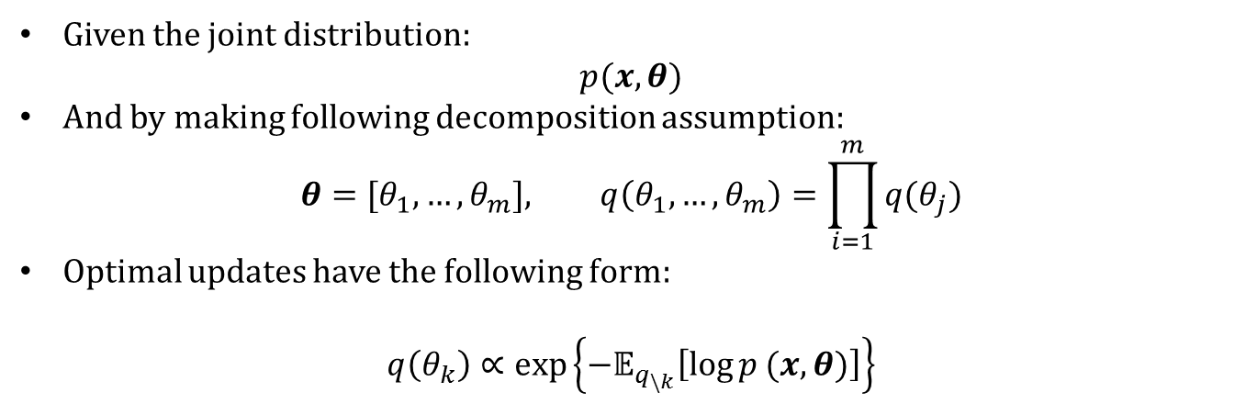
Variational Bayes for Conjugate families
Given the joint distribution:
$$p(x,θ)$$
And by making following decomposition assumption:
$${θ=[θ}_{1}, …,θ_{m}], q\left(θ_{1},…, θ_{m}\right)=\prod_{i=1}^{m}{q(θ_{j})}$$
Optimal updates have the following form:
$$q\left(θ_{k}\right)∝\exp\left\{−𝔼_{q_{\backslash k}}\left[\log{p (x,θ)}\right]\right\}$$
Notes:
Here is the closed form solution

Slide 21
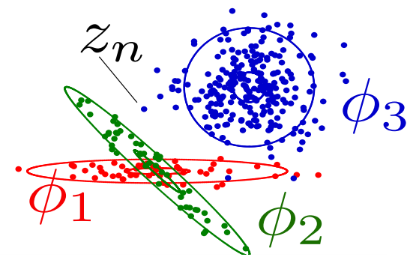
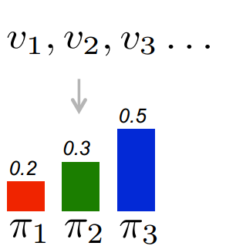
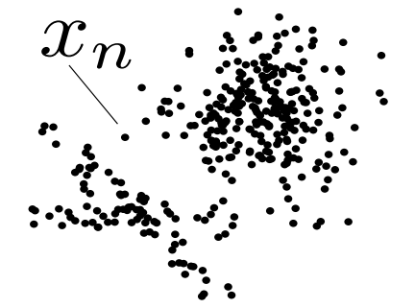

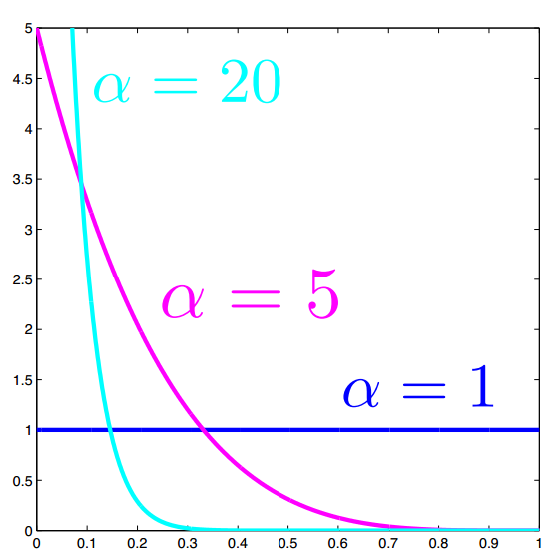




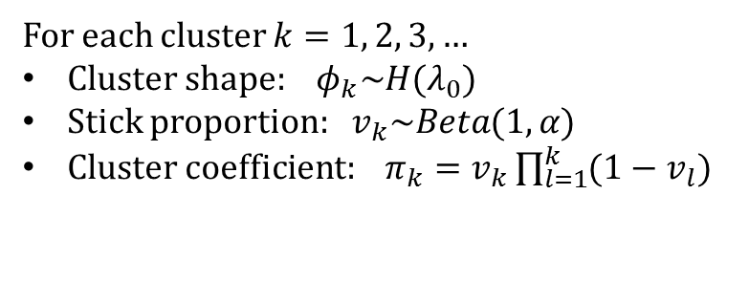
Dirichlet Process (Stick Breaking)
For each cluster $k=1, 2, 3,…$
Cluster shape: $φ_{k}\sim H(λ_{0})$
Stick proportion: $v_{k}\sim Beta(1,α)$
Cluster coefficient: $π_{k}=v_{k}\prod_{l=1}^{k}{(1−v_{l})}$
$$\left.\begin{aligned} \\ \end{aligned}\right\}π\sim Stick(α)$$
Stick-breaking
(Sethuraman,1994)
Notes:
Now let’s switch gears a little gears a little and define Dirichlet process mixture model

Slide 22
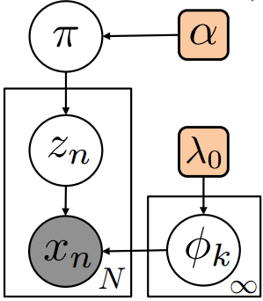


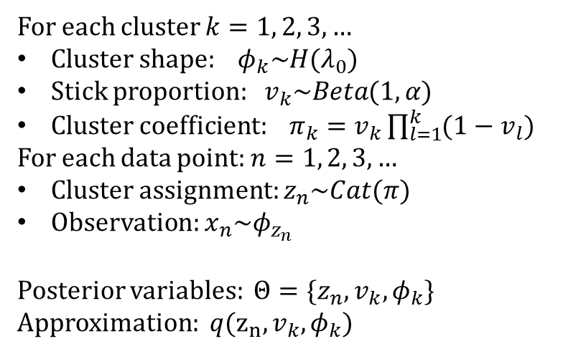
Dirichlet Process Mixture model
$$Stick(α)$$
For each cluster $k=1, 2, 3,…$
Cluster shape: $φ_{k}\sim H(λ_{0})$
Stick proportion: $v_{k}\sim Beta(1,α)$
Cluster coefficient: $π_{k}=v_{k}\prod_{l=1}^{k}{(1−v_{l})}$
For each data point: $n=1, 2, 3,…$
Cluster assignment: $z_{n}\sim Cat(π)$
Observation: $x_{n}\sim φ_{z_{n}}$
Posterior variables: ${Θ=\{z}_{n},v_{k},φ_{k}\}$
Approximation: $q(z_{n},v_{k},φ_{k})$
$$Hyperparameter$$
Notes:
Truncate k: K

Slide 23



Dirichlet Process Mixture model
$$Stick(α)$$
For each data point $n$ and clusters $k$
$q\left(z_{n}=k\right)=r_{nk}∝\exp\left\{𝔼_{q}\left[\log{π_{k}\left(v\right)+log p\left(x_{n}\right|φ_{k}) }\right]\right\}$
For cluster $k=1, 2, 3,…, K$
$N_{k}^{0}←\sum_{n}{r_{nk}}$
$s_{k}^{0}←\sum_{n=1}^{N}{r_{nk}t(x_{n})}$
$λ_{k}←λ_{0}+s_{k}^{0}$
For cluster $k=1, 2, 3,…, K$
$α_{k}^{0}←1+N_{k}^{0}$
$α_{k}^{0}←α+{\sum_{l>k}{N_{l}^{0}}}_{}^{}$
$$Hyper$$
$$parameter$$

Slide 24
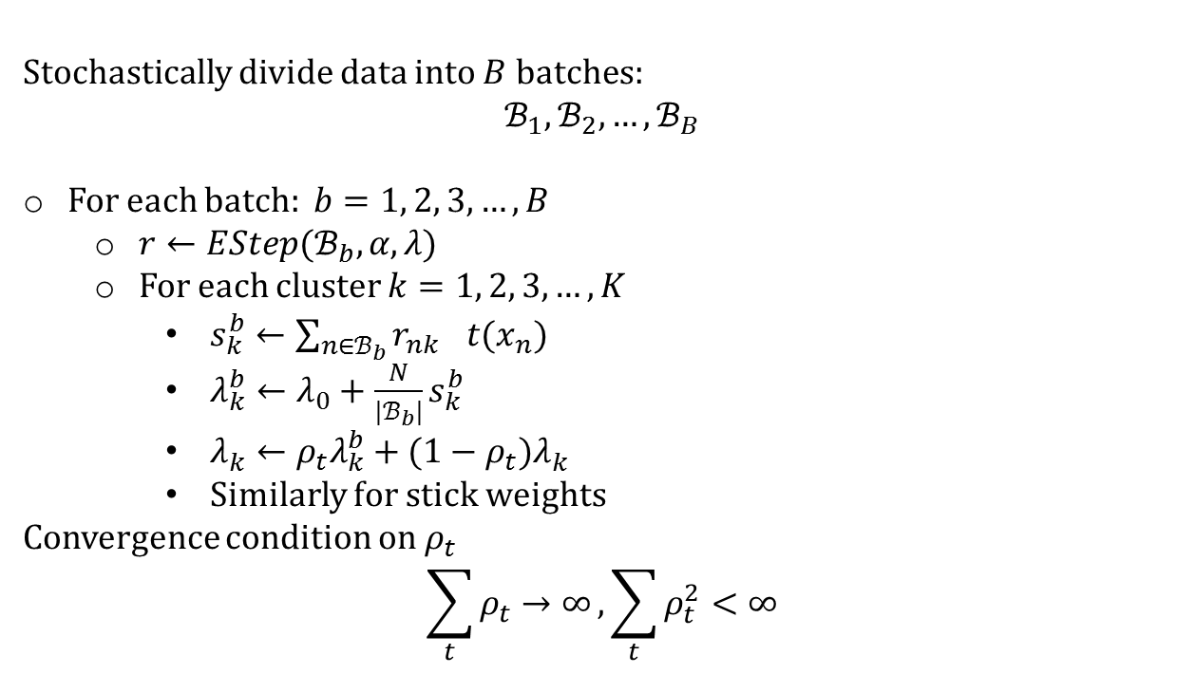
Stochastic Variational Bayes
Hoffman et al., JMLR, 2013
Stochastically divide data into $B$ batches:
$$ℬ_{1}, ℬ_{2}, …, ℬ_{B}$$
For each batch: $b=1, 2, 3,…, B$
$r←EStep(ℬ_{b},α, λ)$
For each cluster $k=1, 2, 3,…, K$
$s_{k}^{b}←\sum_{n∈ℬ_{b}}{{r_{nk}}^{}t(x_{n})}$
$λ_{k}^{b}←λ_{0}+\frac{N}{|ℬ_{b}|}s_{k}^{b}$
$λ_{k}^{}←{ρ_{t}λ}_{k}^{b}+{(1−ρ_{t})λ}_{k}^{}$
Similarly for stick weights
Convergence condition on $ρ_{t}$
$$\sum_{t}{ρ_{t}→∞},\sum_{t}{ρ_{t}^{2}<∞}$$

Slide 25
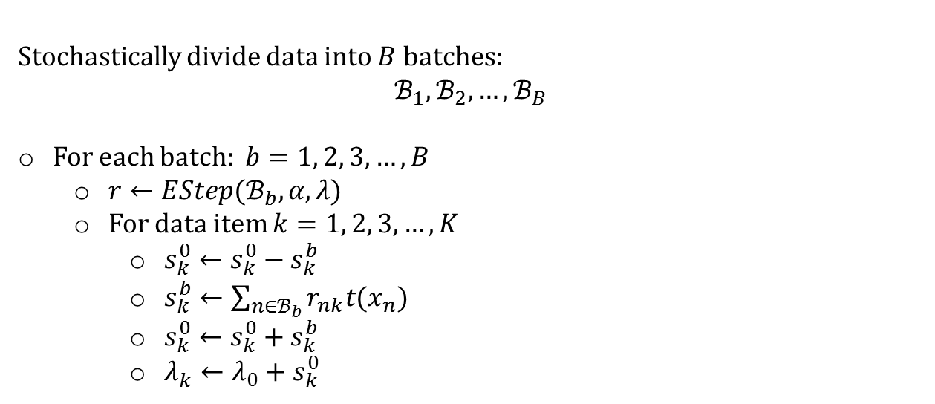
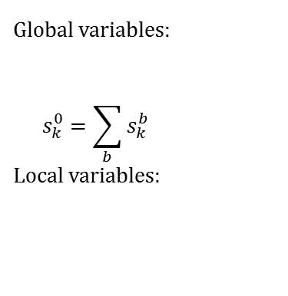


Memoized Variational Bayes
Hughes & Sudderth, NIPS 2013
Stochastically divide data into $B$ batches:
$$ℬ_{1}, ℬ_{2}, …, ℬ_{B}$$
For each batch: $b=1, 2, 3,…, B$
$r←EStep(ℬ_{b},α, λ)$
For data item $k=1, 2, 3,…, K$
$s_{k}^{0}←$ $s_{k}^{0}−s_{k}^{b}$
$s_{k}^{b}←\sum_{n∈ℬ_{b}}{r_{nk}t(x_{n})}$
$s_{k}^{0}←$ $s_{k}^{0}+s_{k}^{b}$
$λ_{k}^{}←λ_{0}+s_{k}^{0}$
Global variables:
$$s_{k}^{0}=\sum_{b}{s_{k}^{b}}$$
Local variables:
$$\begin{matrix}s_{1}^{0} & s_{2}^{0} & \begin{matrix}⋯ & s_{K}^{0}\end{matrix}\end{matrix}$$
$$\begin{matrix}s_{1}^{1} & s_{2}^{1} & \begin{matrix}⋯ & s_{K}^{1}\end{matrix} \\ s_{1}^{2} & s_{2}^{2} & \begin{matrix}⋯ & s_{K}^{2}\end{matrix} \\ \begin{aligned}⋮ \\ s_{1}^{B}\end{aligned} & \begin{aligned}⋮ \\ s_{2}^{B}\end{aligned} & \begin{aligned}\begin{matrix}⋱ & ⋮\end{matrix} \\ \begin{matrix}⋯ & s_{K}^{B}\end{matrix}\end{aligned}\end{matrix}$$

Slide 26
Birth moves
Conventional variatioanl approximation:
Truncation on the number of components
Need to have an adaptive way to add new components
Past: split-merge schema for single-batch learning
E.g. EM (Ueda et al., 2000), Variational-HDP (Bryant and Sudderth, 2012), etc.
Split a new component
Fix everything
Run restricted updates.
Decide whether to keep it or not
This strategy unlikely to work in the batch mode:
Each batch might not contain enough examples of the missing component

Slide 27
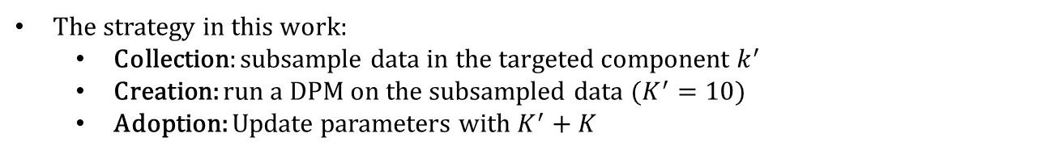
Birth moves
The strategy in this work:
Collection: subsample data in the targeted component $k^{′}$
Creation: run a DPM on the subsampled data ($K^{′}=10$)
Adoption: Update parameters with $K^{′}+K$
Notes:
Subsample the data: choose a k, and copy its data points to x^’ at random, and for any k^’, if r_{n,k^’} > \tau (0.1) copy it into x^’
Learn a fresh DP-GMM on the subsampled data
Add the fresh components to the original model

Slide 28
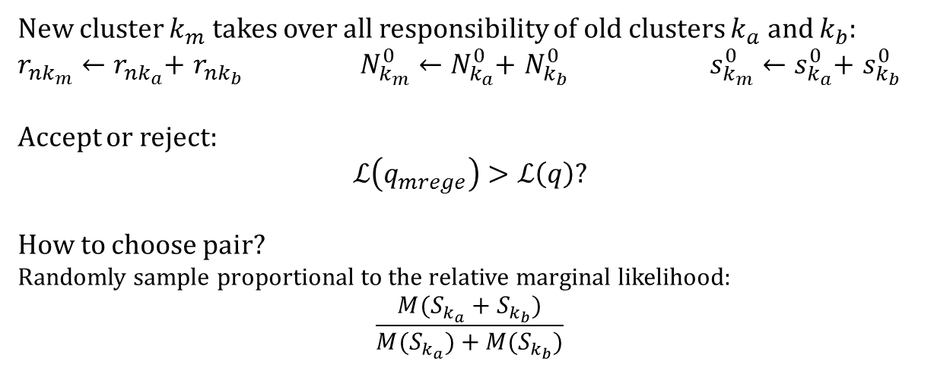
Merge clusters
New cluster $k_{m}$ takes over all responsibility of old clusters $k_{a}$ and $k_{b}$:
$r_{nk_{m}}←r_{nk_{a}}$+ $r_{nk_{b}}$ $N_{k_{m}}^{0}←N_{k_{a}}^{0}$+ $N_{k_{b}}^{0}$ $s_{k_{m}}^{0}←s_{k_{a}}^{0}$+ $s_{k_{b}}^{0}$
Accept or reject:
$$ℒ\left(q_{mrege}\right)>ℒ\left(q\right)?$$
How to choose pair?
Randomly sample proportional to the relative marginal likelihood:
$$\frac{M(S_{k_{a}}+S_{k_{b}})}{M(S_{k_{a}})+M(S_{k_{b}})}$$
Notes:
Merge two clusters into one for parsimony, accuracy, efficiency Requires memoized entropy sums for candidate pairs of clusters;
Sampling from all pairs is inefficient

Slide 29
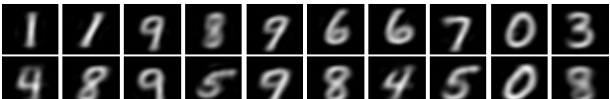
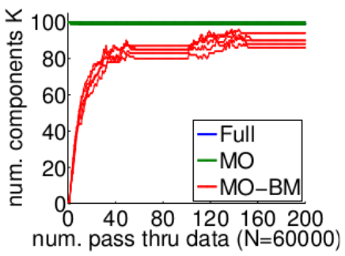
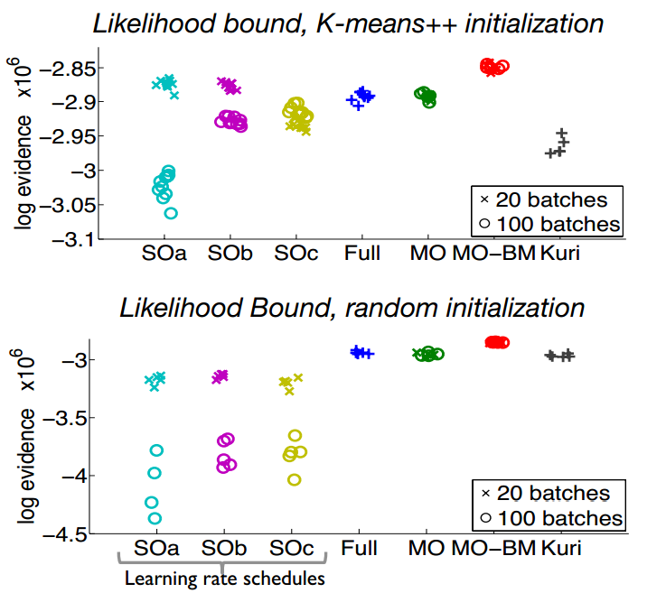
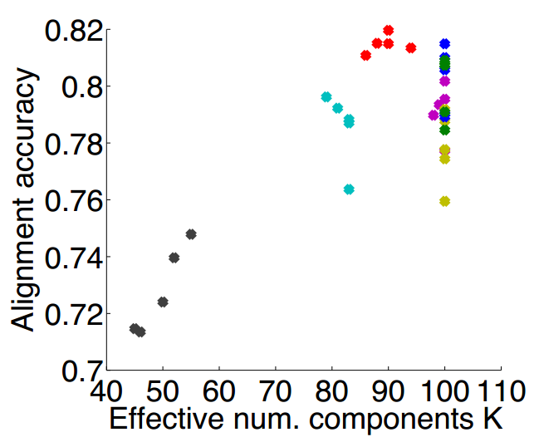
Results: Clustering Handwritten digits
Clustering N = 60000 MNIST images of handwritten digits 0-9.
As preprocessing, all images projected to D = 50 via PCA.
Kuri: Kurihara et al. “Accelerated variational ...”, NIPS 2006
Notes:
Clustering N = 60000 MNIST images of handwritten digits 0-9.
As preprocessing, all images projected to D = 50 via PCA.
Kuri: split-merge scheme for single-batch variational DPM Right figures: Comparison of final ELBO, for multiple runs of each method, varying initialization and number of batches
Stochastic Variations: with three different learning rates Left: Evaluation of cluster alignment to the true digit label.

Slide 30
References
Michael C. Hughes, and Erik Sudderth. "Memoized Online Variational Inference for Dirichlet Process Mixture Models." Advances in Neural Information Processing Systems. 2013.
Erik Sudderth slides: http://cs.brown.edu/~sudderth/slides/isba14variationalHDP.pdf
Kyle Ulrich slides: http://people.ee.duke.edu/~lcarin/Kyle6.27.2014.pdf

