Slide 1
Linguistic Regularities in Sparse and Explicit Word Representations
CONLL 2014
Omer Levy and Yoav Goldberg.

Slide 2
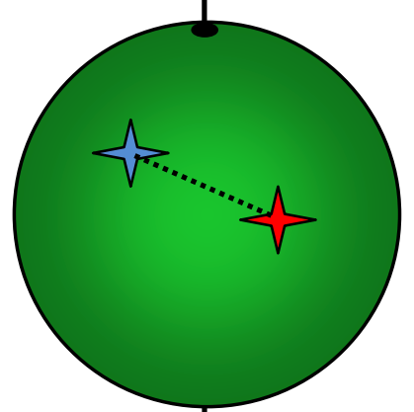
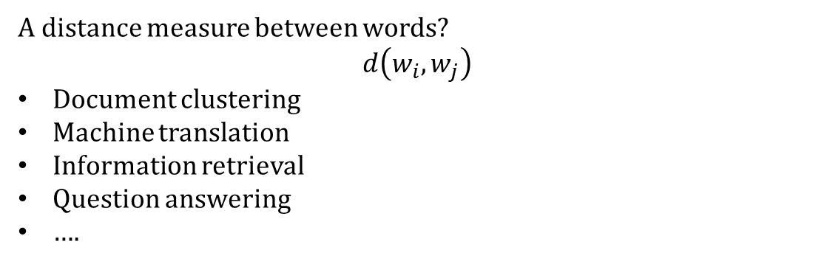
Astronomers have been able to capture and record the moment when a massive star begins to blow itself apart.
International Politics
Space Science
A distance measure between words?
$$d\left(w_{i}, w_{j}\right)$$
Document clustering
Machine translation
Information retrieval
Question answering
….
Vector representation?
Notes:
There are plethora of tasks in NLP that depend on word similarity

Slide 3
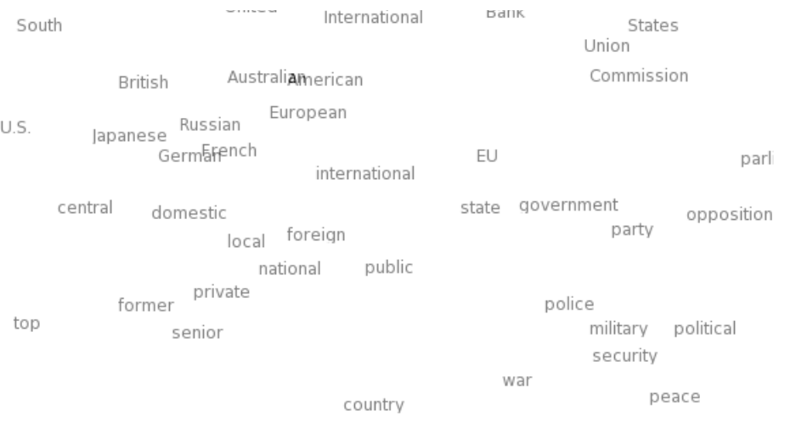
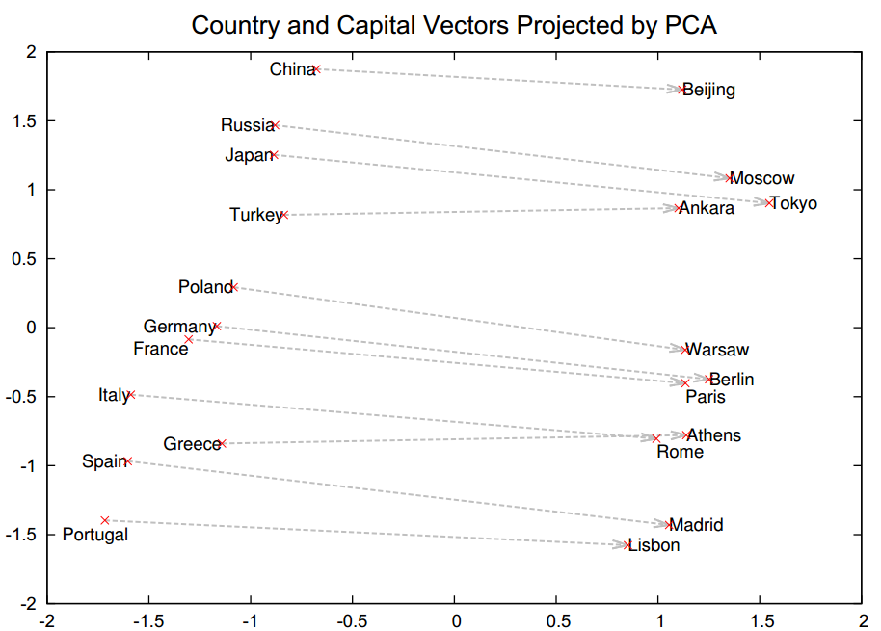

Vector Representation
Explicit
Continuous
~ Embeddings
~ Neural
$Russia$ is to $Moscow$ as $Japan$ is to $Tokyo$
Figures from (Mikolov et al.,NAACL, 2013) and (Turian et al., ACL, 2010)
Notes:
There has been a lot of excitement over deep learning in NLP, and continuous vector representations.
One property observed in Neural continuous language models was the Analogy . For example, consider the “Capital of” relation. Just by adding almost a constant vector to the vector of the country, we end up at the vector of its “capital city”.

Slide 4
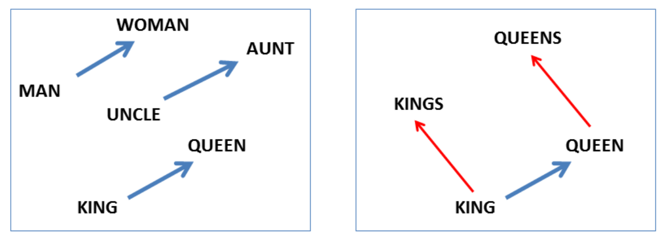

Continuous vectors representation
Interesting properties: directional similarity
Analogy between words:
woman $−$ man $≈$ queen $−$ king
king $−$ man $+$ woman $≈$ queen
Older continuous vector representations:
Latent Semantic Analysis
Latent Dirichlet Allocation (Blei, Ng, Jordan, 2003)
etc.
A recent result (Levy and Golberg, NIPS, 2014) mathematically showed that the two representation are “almost” equivalent.
Figure from (Mikolov et al.,NAACL, 2013)
Notes:
The authors of the work showed the interesting properties of their vectors.
The vectors, capture “relational similarities”,
…. or in other words, analogies.
For example, “man is to woman as king is to queen”.
See, if you take the vector representation of “king”, subtract “man”, and add “woman”… you’ll get a vector that’s very close to “queen”.
This isn’t the only example…

Slide 5
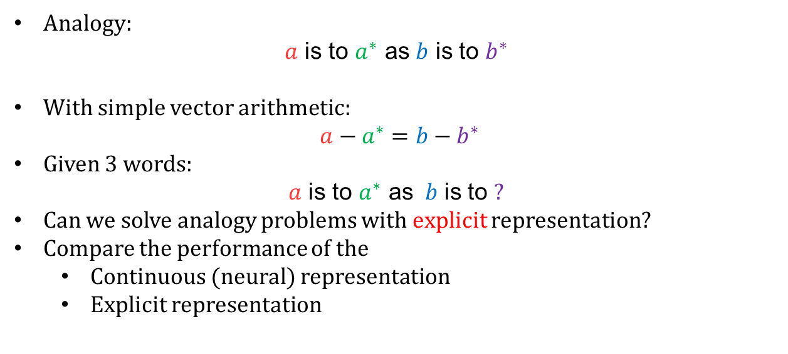
Goals of the paper
Analogy:
$a$ is to $a^{∗}$ as $b$ is to $b^{∗}$
With simple vector arithmetic:
$a−a^{∗}=b−b^{∗}$
Given 3 words:
$a$ is to $a^{∗}$ as $b$ is to $?$
Can we solve analogy problems with explicit representation?
Compare the performance of the
Continuous (neural) representation
Explicit representation
Baroni et al. (ACL, 2014) showed that embeddings outperform explicit
Notes:
As we talked about before, here is an analogy problem.
A vector space interpretation is this
Now consider this problem …..
Many people think neural representations have this special property about analogy of words.
What the paper wants to analyze :
-- Do the explicit representation have these properties ?
--

Slide 6

Explicit representation
Term-Context vector
$Apricot: \left\{Computer:0, data:0, pinch:1,…\right\}∈ℝ^{\left|Vocab\right|≈100,000}$
Sparse!
Pointwise Mutual Information:
Positive PMI:
Replace the negative PMI values with zero.
 | computer | data | pinch | result | sugar
apricot | 0 | 0 | 1 | 0 | 1
pineapple | 0 | 0 | 1 | 0 | 1
digital | 2 | 1 | 0 | 1 | 0
information | 1 | 6 | 0 | 4 | 0
Notes:
Let’s consider a relatively popular explicit word representation created by counting.
We want to create a matrix of counts called matrix-context matrix.
- First column, words
- First row, the context vectors
- The count shows how many times a word was context of a term. So, an example vector of “apricot” is …. We know what their dimensions mean – they’re specific contexts that co-occurred with the word, These vectors are sparse,
A popular measure of distance between these vectors, is PMI and PPMI
But here we will use the vectors directly inside another measure which we will talk about later.

Slide 7
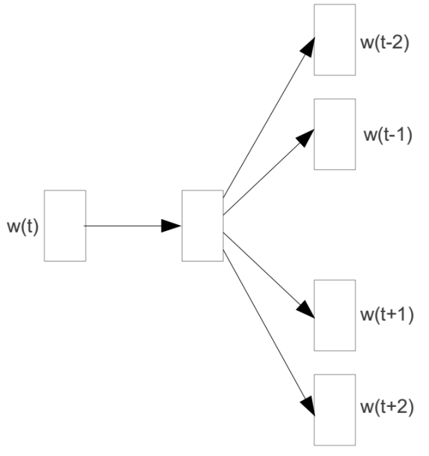
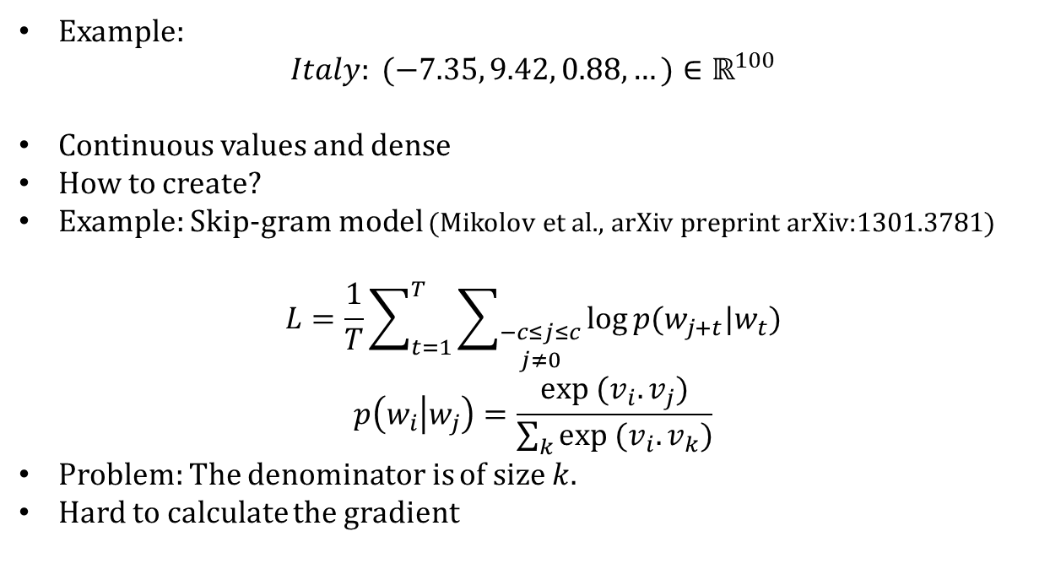
Continuous vectors representation
Example:
$$Italy: (−7.35, 9.42, 0.88,…)∈ℝ^{100}$$
Continuous values and dense
How to create?
Example: Skip-gram model (Mikolov et al., arXiv preprint arXiv:1301.3781)
$$L=\frac{1}{T}\sum_{t=1}^{T}{\sum_{\begin{aligned}−c≤j≤c \\ j≠0\end{aligned}}{\log{p(w_{j+t}|w_{t})}}}$$
$$p\left(w_{i} | w_{j}\right)=\frac{exp (v_{i}.v_{j})}{\sum_{k}{exp (v_{i}.v_{k})}}$$
Problem: The denominator is of size $k$.
Hard to calculate the gradient
Notes:
Here’s an example of how the word “Italy” might be represented in such an embedded space.
These vectors are continuous and dense.
Usually by projections of these continuous vectors into lower dimension, we can observe that semantically similar words lie closer to each other.
There are many ways to build these vectors. One of the ways is using the Skip-gram model. Let me deviate a little from the main subject of this work, and talk a little about Skipgrams. ….
The denominator is hard to calculate, since it is of size the number of tokens. And remember that it is usually trained on Billions of tokens.
How can we train such a model?
They use some more tricks to train this objective functions, but let’s for now skip those details, since they are not the main subject of this work, and I think we more interesting things we can discuss about.

Slide 8
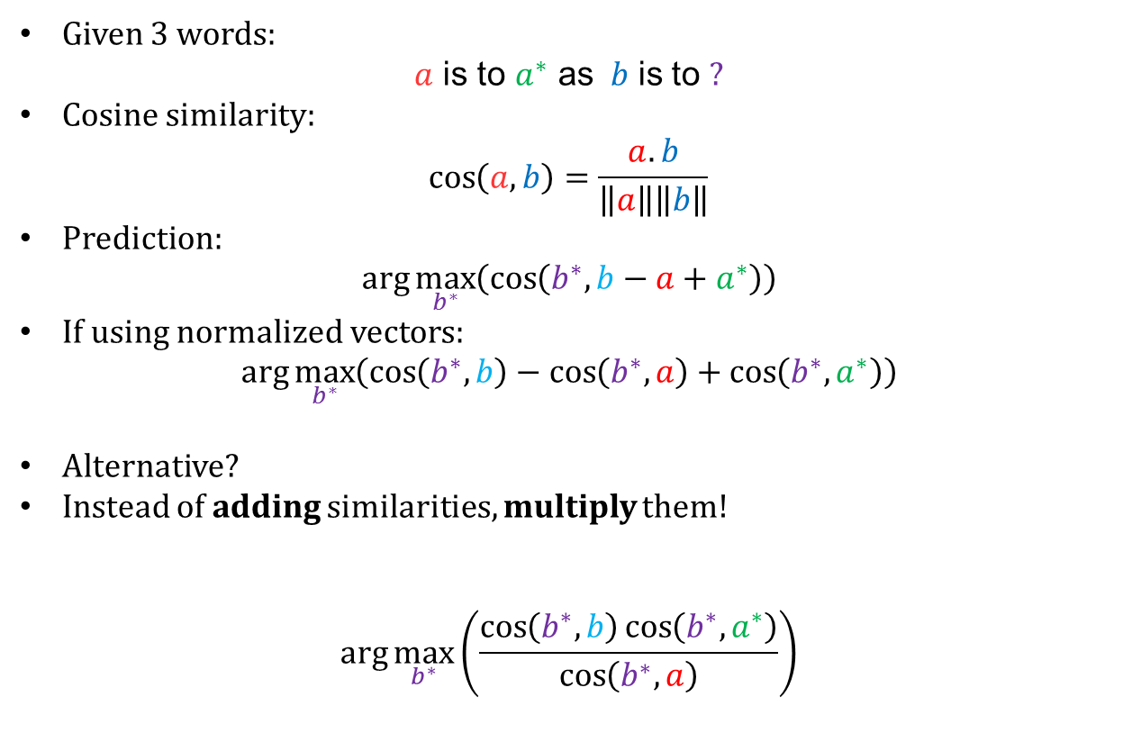
Formulating analogy objective
Given 3 words:
$a$ is to $a^{∗}$ as $b$ is to $?$
Cosine similarity:
$$\cos\left(a,b\right)=\frac{a.b}{\left\|a\right\|\left\|b\right\|}$$
Prediction:
$\arg{\max_{b^{∗}}\left(\cos\left(b^{∗},b−a+a^{∗}\right)\right)}$
If using normalized vectors:
$\arg{\max_{b^{∗}}\left(\cos\left(b^{∗},b\right)−\cos\left(b^{∗},a\right)+\cos\left(b^{∗},a^{∗}\right)\right)}$
Alternative?
Instead of adding similarities, multiply them!
$$\arg{\max_{b^{∗}}\left(\frac{\cos\left(b^{∗},b\right)\cos\left(b^{∗},a^{∗}\right)}{\cos\left(b^{∗},a\right)}\right)}$$
Notes:
We need to be fair to both features, and compare them on the same data, and with the same procedure. The analogy problem ….
Define meaure of distance.
Mathematically ….
If we normalize the vectors, i.e. they have a vector of size one ….
One problem is that, one of the terms might be much bigger than the one ones ….

Slide 9


Corpora
MSR: $\sim$8000 syntactic analogies
Google: $\sim$19,000 syntactic and semantic analogies
Learn different representations from the same corpus:
a | b | a* | b*
Good | Better | Rough | ?
better | good | rougher | ?
good | best | rough | ?
… | … | … | …
Very important!!
Recent controversies over inaccurate evaluations for “GloVe word-representation” (Pennington et al, EMNLP)
Notes:
Here is the datasets they use ….

Slide 10
Embedding vs Explicit (Round 1)
Many analogies recovered by explicit, but many more by embedding.
Notes:
You can see that the explicit representation does recover quite a few analogies, but not as many as the embeddings.
Well, if that’s the case, there must be something really special with embeddings, right?
So this raises another question:

Slide 11

Using multiplicative form
Given 3 words:
$a$ is to $a^{∗}$ as $b$ is to $?$
Cosine similarity:
$$\cos\left(a,b\right)=\frac{a.b}{\left\|a\right\|\left\|b\right\|}$$
Additive objective:
$\arg{\max_{b^{∗}}\left(\cos\left(b^{∗},b\right)−\cos\left(b^{∗},a\right)+\cos\left(b^{∗},a^{∗}\right)\right)}$
Multiplicative objective:
$$\arg{\max_{b^{∗}}\left(\frac{\cos\left(b^{∗},b\right)\cos\left(b^{∗},a^{∗}\right)}{\cos\left(b^{∗},a\right)}\right)}$$
Notes:
We need to be fair to both features, and compare them on the same data, and with the same procedure. The analogy problem ….
Define meaure of distance.
Mathematically ….
If we normalize the vectors, i.e. they have a vector of size one ….
One problem is that, one of the terms might be much bigger than the one ones ….

Slide 12


A relatively weak justification
England $−$ London $+$ Baghdad $=$ ?
Iraq
$\cos\left(Iraq,England\right)−\cos\left(Iraq,London\right)+\cos\left(Iraq,Baghdad\right)$
$0.15$ $0.13$ $0.63$
$0.13$ $0.14$ $0.75$
$\cos\left(Mosul,England\right)−\cos\left(Mosul,London\right)+\cos\left(Mosul,Baghdad\right)$
Notes:
And Baghdad is on an entirely different scale…

Slide 13
Embedding vs Explicit (Round 2)

Slide 15
Summary
On analogies, continuous (neural) representation is not magical
Analogies are possible in the explicit representation
On analogies explicit representation can be as good as continuous (neural) representation.
Objective (function) matters!

Slide 16
Agreement between representations
Objective | Both Correct | Both Wrong | Embedding Correct | Explicit Correct
MSR | 43.97% | 28.06% | 15.12% | 12.85%
Google | 57.12% | 22.17% | 9.59% | 11.12%

Slide 17
Comparison of objectives
Objective | Representation | MSR | Google
Additive | Embedding | 53.98% | 62.70%
 | Explicit | 29.04% | 45.05%
Multiplicative | Embedding | 59.09% | 66.72%
 | Explicit | 56.83% | 68.24%

Slide 18
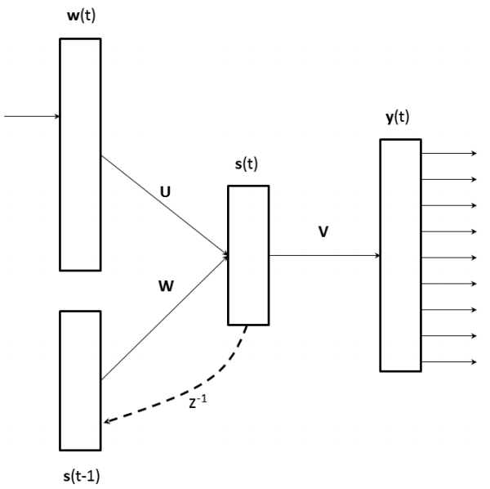

Recurrent Neural Network
Recurrent Neural Networks (Mikolov et al.,NAACL, 2013)
Input-output relations:
$$\left\{\begin{aligned}y\left(t\right)=g(Vs\left(t\right)) \\ s\left(t\right)=f(Ws\left(t−1\right)+Uw(t))\end{aligned}\right.$$
$y∈ℝ^{\left|Vocab\right|}$
$w\left(t\right)∈ℝ^{\left|Vocab\right|}$
$s\left(t\right)∈ℝ^{d}$
$U∈ℝ^{|Vocab|×d }$
$W∈ℝ^{d×d }$
$V∈ℝ^{d×|Vocab| }$
Notes:
Here’s an example of how the word “Italy” might be represented in such an embedded space.
These vectors are continuous and dense.
Usually by projections of these continuous vectors into lower dimension, we can observe that semantically similar words lie closer to each other.
There are many ways to build these vectors. One of the ways is using RNN.
Vectors can be built by neural-network inspired algorithms, such as the ones in word2vec. Create a table of words, and assign a vector for each of them. Given the context vectors, we want to predict future vectors.

Slide 19
Continuous vectors representation
Example:
$$Italy: (−7.35, 9.42, 0.88,…)∈ℝ^{100}$$
Continuous values and dense
How to create?
Example: Skip-gram model (Mikolov et al., arXiv preprint arXiv:1301.3781)
$$L=\frac{1}{T}\sum_{t=1}^{T}{\sum_{\begin{aligned}−c≤j≤c \\ j≠0\end{aligned}}{\log{p(w_{j+t}|w_{t})}}}$$
$$p\left(w_{i} | w_{j}\right)=\frac{exp (v_{i}.v_{j})}{\sum_{k}{exp (v_{i}.v_{k})}}$$
Problem: The denominator is of size $k$.
Hard to calculate the gradient
Notes:
Here’s an example of how the word “Italy” might be represented in such an embedded space.
These vectors are continuous and dense.
Usually by projections of these continuous vectors into lower dimension, we can observe that semantically similar words lie closer to each other.
There are many ways to build these vectors. One of the ways is using the Skip-gram model. Let me deviate a little from the main subject of this work, and talk a little about Skipgrams.
Vectors can be built by neural-network inspired algorithms, such as the ones in word2vec. Create a table of words, and assign a vector for each of them. Given the context vectors, we want to predict future vectors.

Slide 20
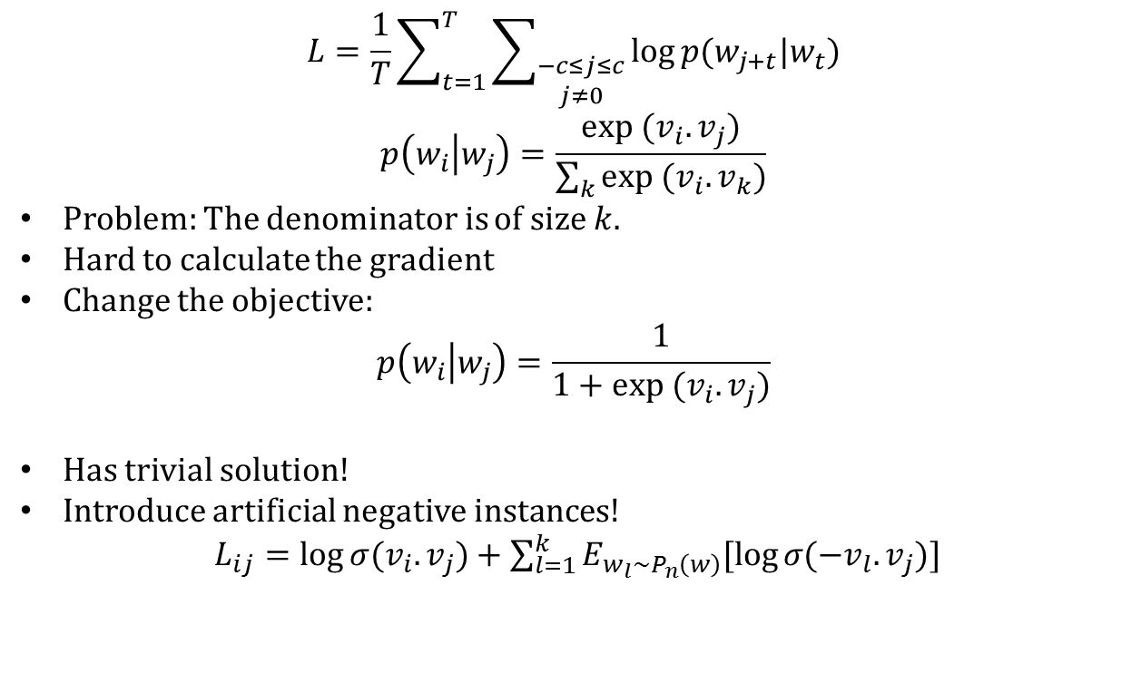
Continuous vectors representation
$$L=\frac{1}{T}\sum_{t=1}^{T}{\sum_{\begin{aligned}−c≤j≤c \\ j≠0\end{aligned}}{\log{p(w_{j+t}|w_{t})}}}$$
$$p\left(w_{i} | w_{j}\right)=\frac{exp (v_{i}.v_{j})}{\sum_{k}{exp (v_{i}.v_{k})}}$$
Problem: The denominator is of size $k$.
Hard to calculate the gradient
Change the objective:
$$p\left(w_{i} | w_{j}\right)=\frac{1}{1+exp (v_{i}.v_{j})}$$
Has trivial solution!
Introduce artificial negative instances!
$L_{ij}=\log{σ(v_{i}.v_{j}\text{)}}+\sum_{l=1}^{k}{E_{w_{l}∼P_{n}\left(w\right)}[\log{σ({−v}_{l}.v_{j}\text{)}}]}$
Notes:
Has trivial solution:
Make the vectors the same, and with very size!
All probabilities will become one.

Slide 21
References
Slides from: http://levyomer.wordpress.com/2014/04/25/linguistic-regularities-in-sparse-and-explicit-word-representations/
Mikolov, Tomas, et al. "Distributed representations of words and phrases and their compositionality." Advances in Neural Information Processing Systems. 2013.
Mikolov, Tomas, Wen-tau Yih, and Geoffrey Zweig. "Linguistic Regularities in Continuous Space Word Representations." HLT-NAACL. 2013.

