Slide 1

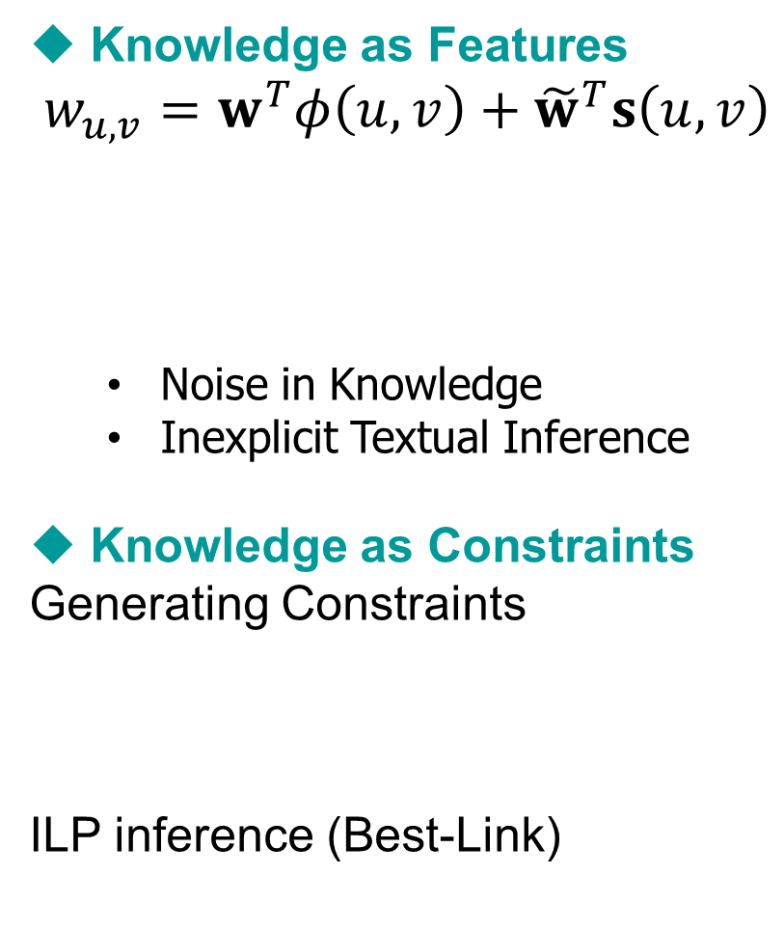
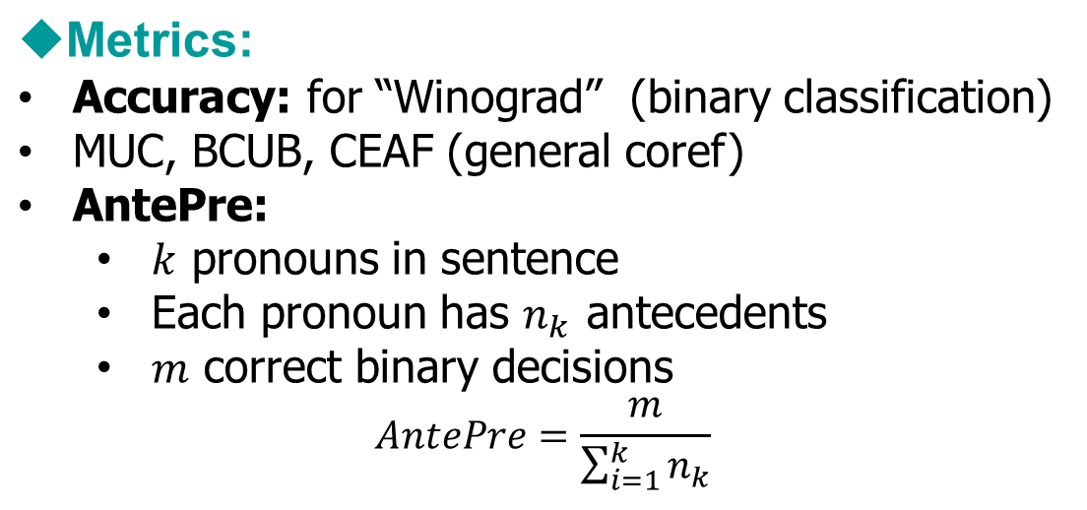
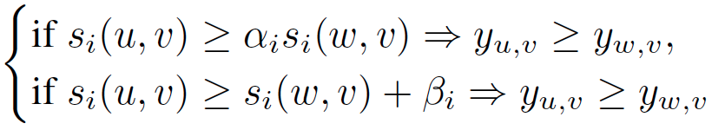

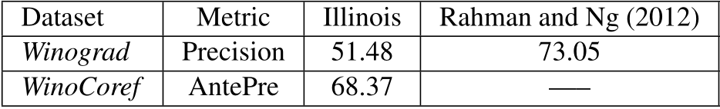


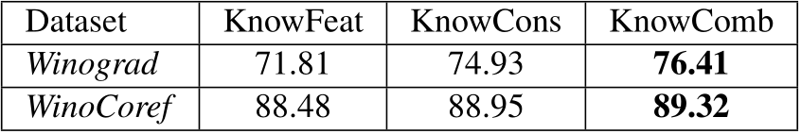
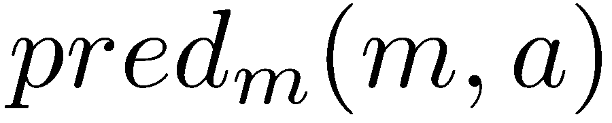

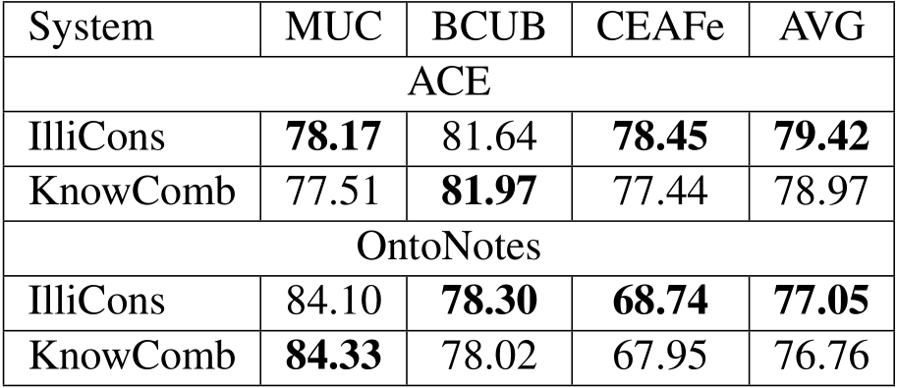


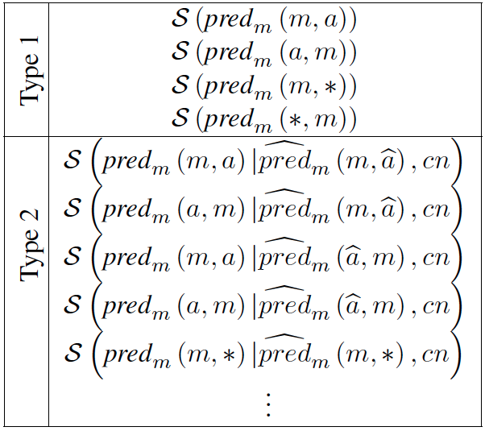
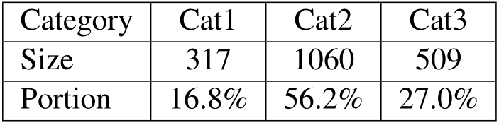
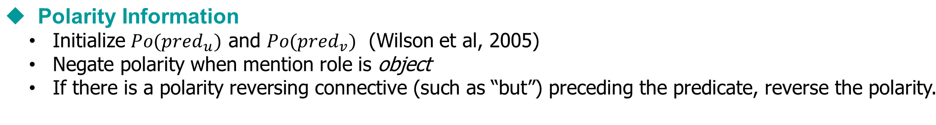
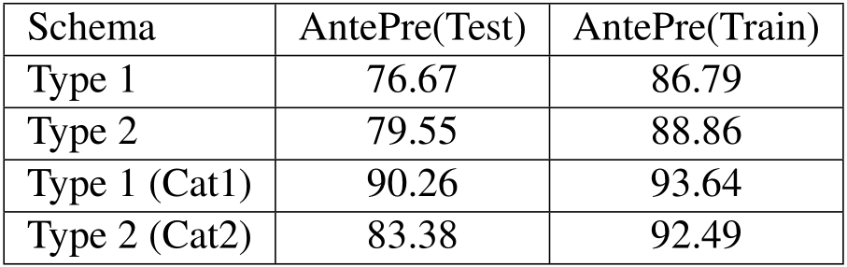
Solving Hard Coreference Problems
Cognitive Computation Group, University of Illinois
Problem Description
Utilizing Knowledge
Learning and Inference Framework
Results
Standard Coreference Instances
[John] adores [Mary] because [she] is pretty.
[Prof. Roth] is satisfied with his [students] because [they] work hard.
Problems with Existing Coref Systems
Rely heavily on gender / plurality information
Hard Coreference Instances
  [A bird] perched on the [limb] and [it] bent.
  [A bird] perched on the [limb] and [it] sang.
Goal
A better overall coreference system
  Improve on solving hard coreference problems
  Maintain the state-of-art performance on standard coreference problems
Documents
Datasets:
  Winograd (Rahman&Ng, 2012)
  Winocoref: Winograd with more mentions
  Standard Coref: ACE-2004, Ontonotes
Pairwise Mention Scoring Function
Inference
Scoring Function for Predicate Schemas
Mention Detection
Coreference Resolver
Learning
Mention-Pair Model
Add as Features
Knowledge
Evaluations:
Hard Coreference Problems
Standard Coreference Problems
Ablation Study
  We categorized instances in Winograd data
  Evaluated on each category:
Predicate
Schemas
Best-Link Inference
Add as Constraints
Predicate Schemas
Type 1 Schema
[The bee] landed on [the flower] because [it] had pollen.
  S(have(m=[the flower], a=[pollen])) >
  S(have(m=[the bee], a=[pollen]))
Type 2 Schema
[Jim] was afraid of [Robert] because [he] gets scared around new people.
S(be afraid of (m=*, a=*) | get scared around (m=*, a=*), because) > S(be afraid of (a=*, m=*) | get scared around (m=*, a=*), because)
Schema Variations
Example Beyond Above Schemas
  [Lakshman] asked [Vivan] to get him some ice cream because [he] was hot.
Result
Knowledge Acquisition
Gigaword co-occurrences
  Extract triples from Gigaword
Wikipedia Disambiguated Co-occurrences
  Extract disambiguated noun, verbs and entities, etc. in Wikipedia (Illinois-Wikifier)
  Collect co-occurrence statistics: 1) immediately after 2) immediately before 3) before 4) after
Web Search Statistics
  Generate queries to get the score
Haoruo Peng, Daniel Khashabi and Dan Roth

