Slide 1
Coreference Resolution with Knowledge
Haoruo Peng
March 20, 2015
Notes:
Welcome to my talk exam.
Thanks for being here today.
My name is Haoruo Peng, I am a second year Phd student, and my advisor is Prof. Dan Roth.
Stop me if necessary

Slide 2
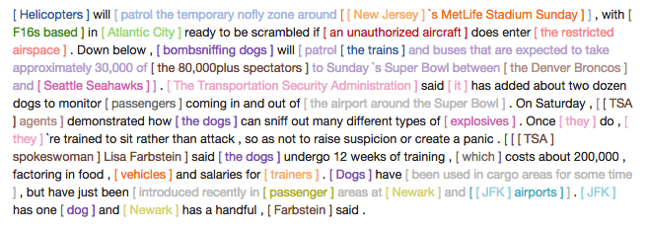
Coreference Problem
Notes:
What is the task of coreference resolution? coreference occurs when two or more expressions in a text refer to the same entity
a well-studied problem in discourse, but far from solved
Anaphora / Cataphora / Split antecedents / Coreferring noun phrases

Slide 3
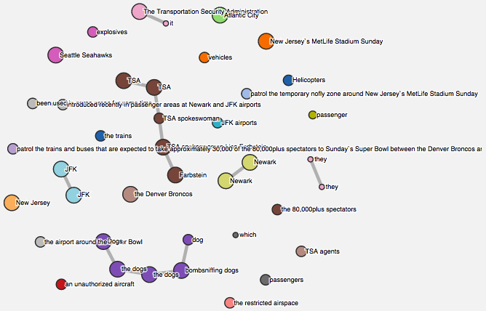
Coreference Problem
Notes:
We can visualize this as clusters of mentions (See it online to form coreference chain)

Slide 4
Online Demo
Please check outhttp://cogcomp.cs.illinois.edu/page/demo_view/Coref
Notes:
Will be updated
Welcome questions at any point.

Slide 5
General Framework
Jack threw the bags of Mary into the water since he is angry with her.
Jack threw the bags of Mary into the water since he is angry with her.
Mention Detection
Pairwise Mention Scoring
Goal: Coreferent Mentions have higher scores
Inference (ILP)
Best-Link
All-Link

Slide 6

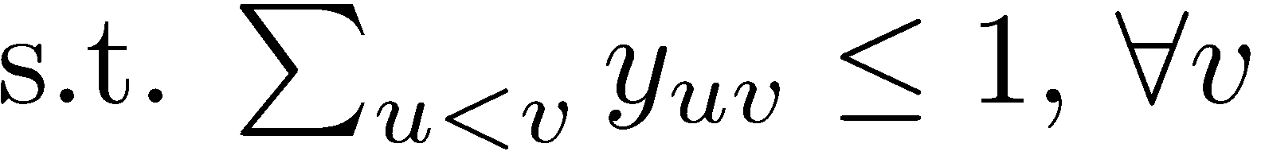

ILP formulation of CR
Best-Link
All-Link
Notes:
Later on, algorithm focus on this inference part

Slide 7
General Framework
Learning (for Pairwise Mention Scores)
Structural SVM
Features:
Mention Types, String Relations, Semantic, Relative Location, Anaphoricity(Learned), Aligned Modifiers, Memorization, etc.
Evaluation
MUC
BCUB
CEAF_e
IllinoisCoref
VS. Stanford Muti-pass Sieve System
VS. Berkeley CR System
Notes:
20 years line of works => Traditional pipelined system
The MUC score (Vilain et al., 1995) counts the minimum number of links between mentions to be inserted or deleted when mapping a system response to a gold standard key set. Although pairwise links capture the information in a set, they cannot represent singleton entities, i.e. entities, which are mentioned only once. Therefore, the MUC score is not suitable for the ACE data.
The B3 algorithm (Bagga & Baldwin, 1998) overcomes the shortcomings of the MUC score. Instead of looking at the links, B 3 computes precision and recall for all mentions in the document, which are then combined to produce the final precision and recall numbers for the entire output.
Luo (2005) criticizes the B 3 algorithm for using entities more than one time, because B 3 computes precision and recall of mentions by comparing entities containing that mention. Hence Luo proposes the CEAF algorithm which aligns entities in key and response. CEAF applies a similarity metric (which could be either mention based or entity based) for each pair of entities (i.e. a set of mentions) to measure the goodness of each possible alignment. The best mapping is used for calculating CEAF precision, recall and F-measure.
Recently, a new coreference resolution evaluation algorithm, BLANC, has been introduced (Recasens & Hovy, 2010). This measure implements the Rand index (Rand, 1971) which has been originally developed to evaluate clustering methods. The BLANC algorithm deals correctly with singleton entities and rewards correct entities according to the number of mentions. However, a basic assumption behind BLANC is, that the sum of all coreferential and non-coreferential links is constant for a given set of mentions. This implies that BLANC assumes identical mentions in key and response. It is not clear how to adapt BLANC to system mentions. We do not address this issue here.

Slide 8
Difficulties in CR
Hard Coreference Problems
[A bird] perched on the [limb] and [it] bent.
[Robert] is robbed by [Kevin], and [he] is arrested by police.
Gender / Plurality information cannot help
-> Requires Knowledge
Notes:
There are a number of …
Hightlight two of them => lead to my research direction

Slide 9
Part 1 Solving Hard Coreference Problems
Notes:
Welcome to my qualification exam.
Thanks for being here today.
My name is Haoruo Peng, I am a second year Phd student, and my advisor is Prof. Dan Roth.

Slide 10
Hard Coreference Problems
Motivating Examples
Category 1
[A bird] perched on the [limb] and [it] bent.
[The bee] landed on [the flower] because [it] had pollen.
Category 2
[Jack] is robbed by [Kevin], and [he] is arrested by police.
[Jim] was afraid of [Robert] because [he] gets scared around new people.
Category 3
[Lakshman] asked [Vivan] to get him some ice cream because [he] was hot.
Notes:
Light verb VS. Phrasal verb
the verb phrase is one headed by a verb. It may be composed of only a single verb, but typically it consists of combinations of main and auxiliary verbs, plus optional specifiers, complements (not including subject complements), and adjuncts.

Slide 11
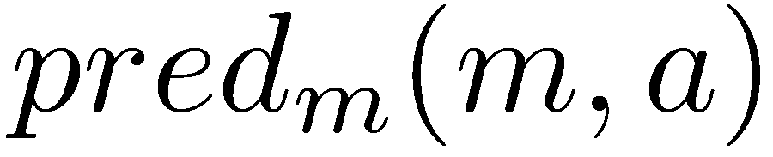
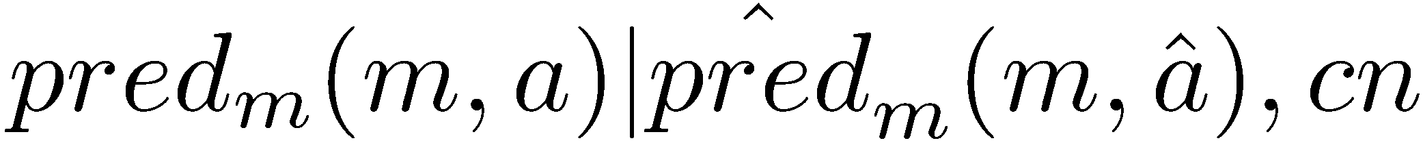
Predicate Schemas
Sub
Obj
Type 1
(Cat1) [The bee] landed on [the flower] because [it] had pollen.
S(have(m=[the flower], a=[pollen])) >
S(have(m=[the bee], a=[pollen]))
Type 2
(Cat2) [Jim] was afraid of [Robert] because [he] gets scared around new people.
S(be afraid of(m=*, a=*) | get scared around(m=*, a=*), because) >
S(be afraid of(a=*, m=*) | get scared around(m=*, a=*), because)
Shared Mention
^
^

Slide 12
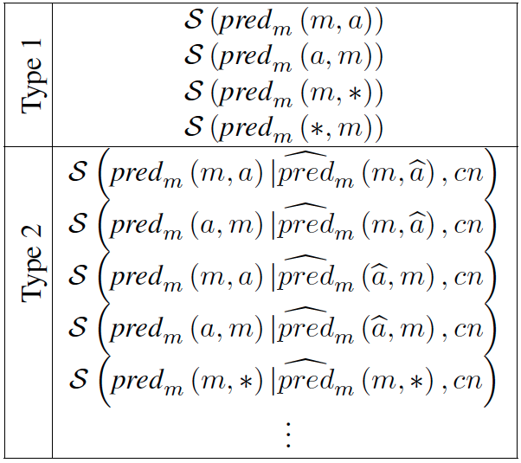
Predicate Schemas
Possible variations for scoring function statistics.

Slide 13


Predicate Schemas in Coreference
Pairwise Mention Scoring Function
Scoring Function for Predicate Schemas
We can add scores of Predicate Schemas as Features
Notes:
Seamlessly

Slide 14
Ways of Using Knowledge
Major Disadvantages of Using Knowledge as Features
Noise in Knowledge
Inexplicit Textual Inference
Alternative way
Using Knowledge as Constraints

Slide 15
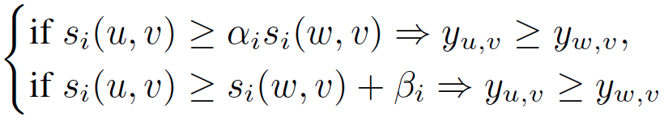
Using Knowledge as Constraints
Generating Constraints
ILP inference (Best-Link)

Slide 16
Scores for Predicate Schemas
Multiple Sources
Gigaword
Wikipedia
Web Search
Polarity Information

Slide 17
Scores for Predicate Schemas
Gigaword
Chunking + Dependency Parsing
=> predicate(subject, object)
=> Type 1 Predicate Schema
Heuristic Coreference
=> Type 2 Predicate Schema
Wikipedia
Entity Linking to ground on Wikipedia Entries (Disambiguation)
Gather Simple Statistics for 1) immediately after 2) immediately before 3) after 4) before
=> predicate(subject, object) (approximation)
=> Type 1 Predicate Schema
Notes:
Did not use OpenIE

Slide 18
Scores for Predicate Schemas
Web Search
Google Query with Quote (counts)
“m predicate”, “m a”, “a m”, “m predicate a”
=> Type 1 Predicate Schema
Polarity Information
Polarity on predicates => Polarity on mentions
Negate polarity if mention is object
Negate polarity for polarity-reversing connective
+1 if polarities for mentions are the same
-1 if polarities for mentions are different
=> Type 2 Predicate Schema
Notes:
Polarity: Wilson

Slide 19
Recap
Things to consider for using knowledge in NLP
Knowledge Representation
Predicate Schema
Knowledge Inference
Features VS. Inference
Knowledge Acquisition
Multiple Sources
Notes:
Questions

Slide 20
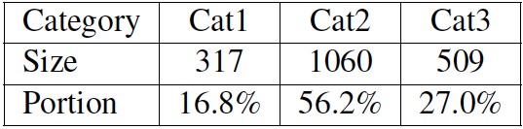
Datasets
Winograd dataset¹
[The bee] landed on [the flower] because [it] had pollen.
[The bee] landed on [the flower] because [it] wanted pollen.
[Jack] threw the bags of [John] into the water since [he] mistakenly asked him to carry his bags.
WinoCoref dataset
¹http://www.hlt.utdallas.edu/~vince/data/emnlp12/

Slide 21
Evaluation on Hard Coreference
Dataset | Winograd | WinoCoref
Metric | Precision | AntePre
Illinois | 51.48 | 68.37
IlliCons | 53.26 | 74.32
Rahman and Ng (2012) | 73.05 | —–
KnowFeat | 71.81 | 88.48
KnowCons | 74.93 | 88.95
KnowComb | 76.41 | 89.32

Slide 22
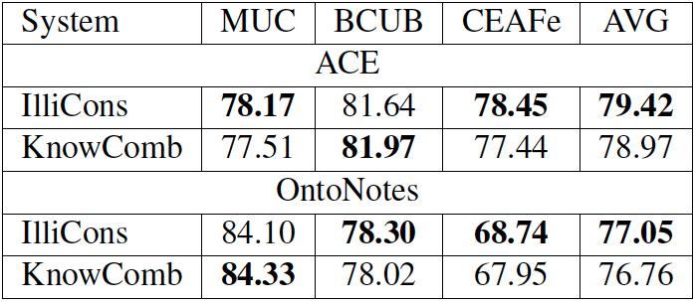
Evaluation on Standard Coreference

Slide 23
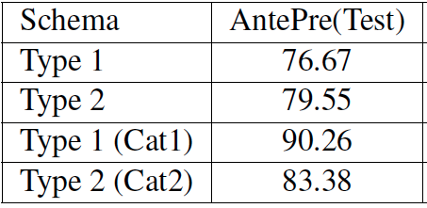
Analysis on Effects of Schemas

Slide 24
Part 2 Profiler: Knowledge Schemas at Scale
Notes:
Expanding Knowledge
Unsupervised
AI-complete

Slide 25
Goal
How to enlarge the Knowledge acquired from text
Data Volume
Schema Richness
Profiler
Demo: http://austen.cs.illinois.edu:60000/

Slide 26
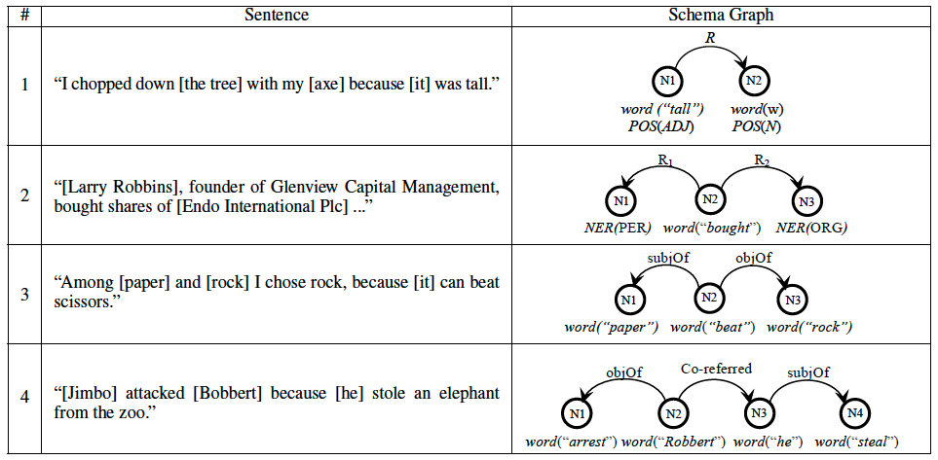
Motivation

Slide 27
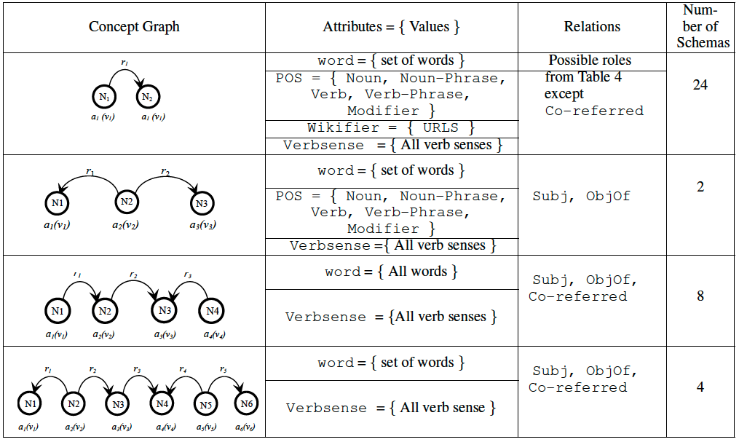
Enriched Schemas

Slide 28
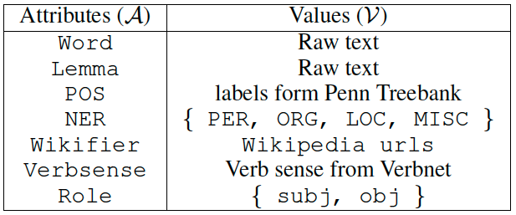
Enriched Schemas

Slide 29
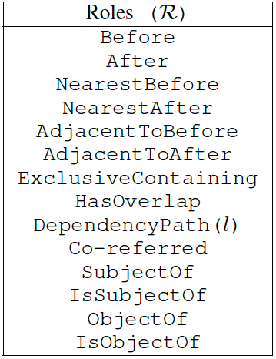
Enriched Schemas
Notes:
Light verbs: I make you do sth, I suggest you do sth

Slide 30
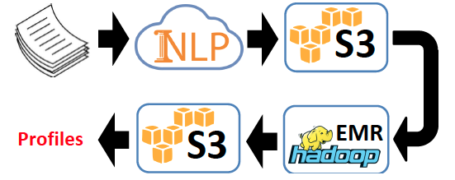
Implementation

Slide 31
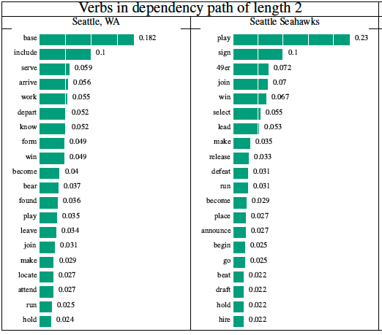
Effect of Wikification (Entity-Linking)

Slide 32
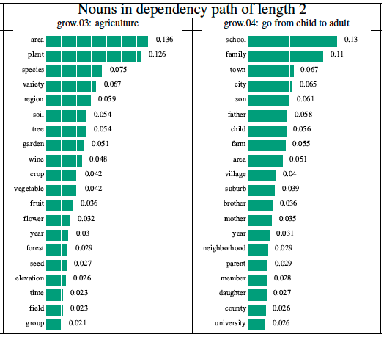
Effect of Wikification (Entity-Linking)

Slide 33
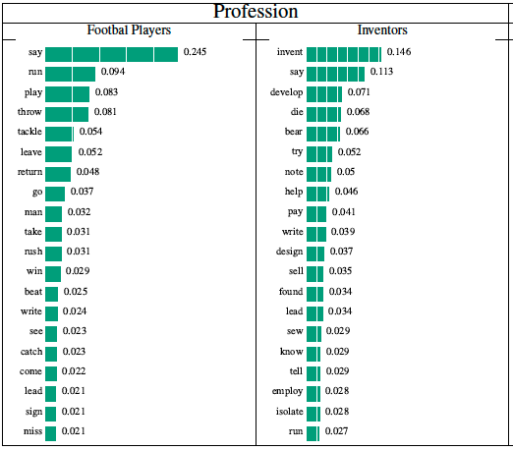
Knowledge Visualization

Slide 34
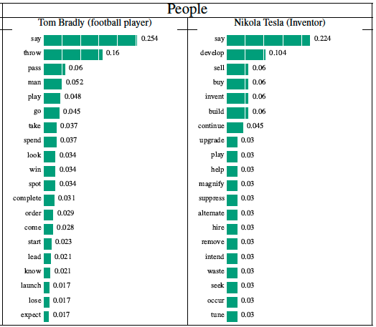
Knowledge Visualization

Slide 35
Publications
[1] Solving Hard Coreference Problems. Haoruo Peng*, Daniel Khashabi* and Dan Roth. NAACL 2015.
[2] A Joint Framework for Mention Head Detection and Coreference Resolution. Submitted to ACL 2015.
[3] Profiler: Knowledge Schemas at Scale. Submitted to Transactions of ACL 2015 .

Slide 36
Future Directions
The use of world knowledge in NLP tasks
Knowledge Representation (schemas)
Is co-occurrence information enough?
Knowledge Inference
Sparsity Issues
Knowledge Acquisition
Which sources to choose?
Interpolation /
Tasks beyond CR (CR can be seen as a subset of AI-complete problems)
Outlier Detection for Singleton Mentions

Slide 37




Collaborators
Daniel Khashabi Zhiye Fei Kaiwei Chang
Prof. Dan Roth

Slide 38
Thank You !

Slide 39
Difficulties in CR
Hard Coreference Problems
Ex.1 [A bird] perched on the [limb] and [it] bent.
Ex.2 [Robert] is robbed by [Kevin], and [he] is arrested by police.
Gender / Plurality information cannot help
-> Requires Knowledge
Performance Gaps
-> Requires Better Mention Detection
System | Dataset | Gold | Predicted | Gap
Illinois | CoNLL-12 | 77.05 | 60.00 | 17.05
Berkeley | CoNLL-11 | 76.68 | 60.42 | 16.26
Stanford | ACE-04 | 81.05 | 70.33 | 10.72
Notes:
There are a number of …
Hightlight two of them => lead to my research direction

Slide 40
A Joint Framework for Mention Head Detection and Coreference Resolution
Goal: Improve CR on predicted mentions (End-to-End)
Solution:
Traditional: MD -> Coref
Our paper: Mention Head -> Joint Coref -> Head to Mention
Joint Learning / Inference Step
Add decision variables to decide whether to choose a head or not
Joint Coref is able to reject some mention head candidates
Results
[Multinational companies investing in [China]] had become so angry that [they] recently set up an anti-piracy league to pressure [the [Chinese] government] to take action. [Domestic manufacturers, [who] are also suffering], launched a similar body this month.
Dataset | Illinois | Baseline | Our Paper
ACE-04 | 68.27 | 68.27 | 71.20
CoNLL-12 | 60.00 | 61.71 | 63.01
Notes:
Mention detection is the task of identifying textual references to an object or the set of objects, namely mentions. Mentions1 can be either proper nouns (e.g. Joe Smith), nominal nouns (e.g. the guy wearing a blue shirt), pronouns (e.g. he, him), or premodifier mentions (e.g. the [Russian] foreign minister).
It‘s raining. He can’t make it

Slide 41


ILP formulation of CR
Best-Link with Knowledge Constraints
Best-Link with Joint Mention Detection

