Slide 1

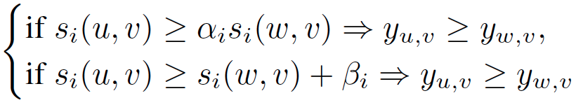


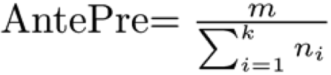



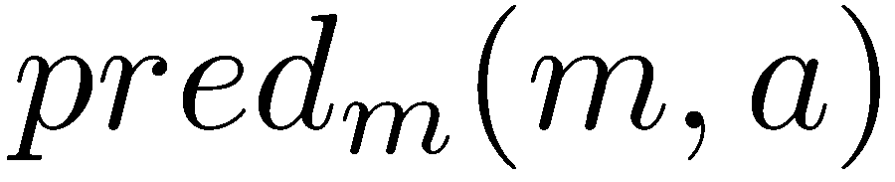

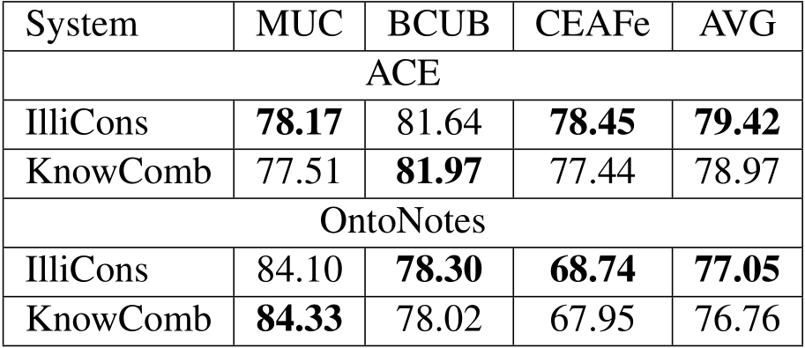
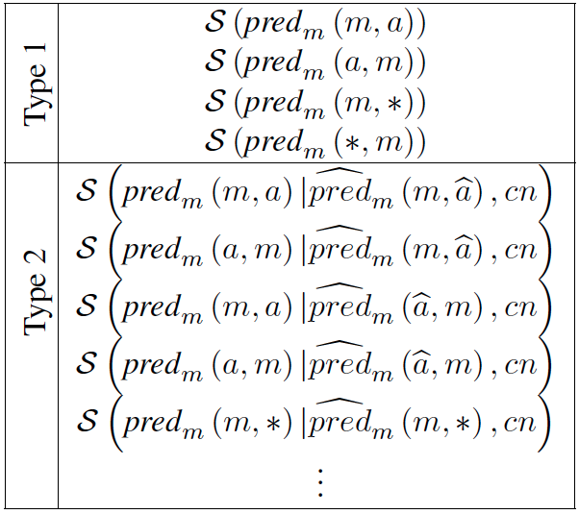
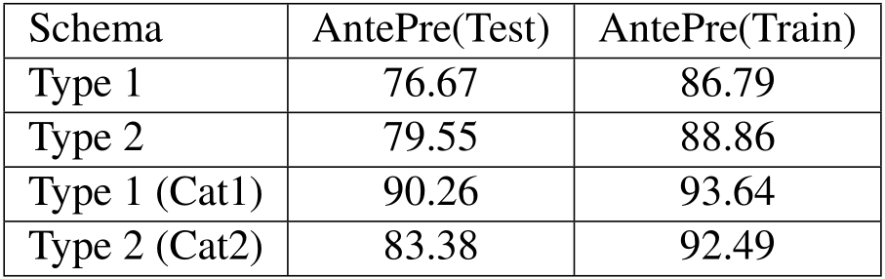
Solving Hard Coreference Problems
Haoruo Peng, Daniel Khashabi and Dan Roth
One fundamental difficulty of coreference resolution is to resolve instances that require background knowledge.
In this work, we propose an algorithmic solution that involves a new representation for the knowledge required to address hard coreference problems, along with a constrained optimization framework that uses this knowledge in coreference decision making.
Utilizing Knowledge
Learning and Inference Framework
Results
Knowledge as Features
  Noise in Knowledge
  Implicit Textual Inference
Knowledge as Constraints
  Generating Constraints
  ILP Inference (Best-Link)
Documents
Datasets
  Winograd (Rahman&Ng, 2012)
  Winocoref: Winograd plus more mentions
  e.g. [Stephen] threw the bags of [Johnny] into the water since [he] mistakenly asked [him] to carry [his] bags.
  Standard Coref: ACE, Ontonotes
Pairwise Mention Scoring Function
Inference
Problem Description
Scoring Function for Predicate Schemas
Mention Detection
Problems with Existing Coref Systems
  Rely heavily on gender / plurality information
e.g. [John] adores [Mary] because [she] is pretty.
  Hard Coreference Instances
  e.g. [A bird] perched on the [limb] and [it] bent.
  [A bird] perched on the [limb] and [it] sang.
Goal
A better overall coreference system
  Improve on solving hard coreference problems
  Maintain the state-of-art performance on standard coreference problems
Coreference Resolver
Metrics
  Precision (Winograd, binary classification)
  AntePre
    pronouns in sentence
    Each pronoun has antecedents
    Altogether correct binary decisions
  MUC, BCUB, CEAF (standard coref)
Learning
Mention-Pair Model
Add as Features
Knowledge
Predicate
Schemas
Best-Link Inference
Add as Constraints
Evaluations:
Hard Coreference Problems
Standard Coreference Problems
Ablation Study
  We categorized instances in Winocoref data
    Cat1 / Cat2: Instances that can be solved using Type 1 / Type 2 Predicate Schemas
    Cat 3: All remaining instances
    Cat1 – 16.8% Cat2 - 56.2% Cat3 - 27.0%
  Schemas evaluated on each category
Predicate Schemas
Datasets | Winograd | Winocoref
Metrics | Precision | AntePre
State of the Art Coref (ILL) | 51.48 | 68.37
Rahman and Ng (2012) | 73.05 | ------
KnowFeat (Our paper) | 71.81 | 88.48
KnowCons (Our paper) | 74.93 | 88.95
KnowComb (Our paper) | 76.41 | 89.32
Characteristic of Required Knowledge
  Associated with “predicate”
Type 1 Predicate Schema
[The bee] landed on [the flower] because [it] had pollen.
  S(have(m=[the flower], a=[pollen])) >
  S(have(m=[the bee], a=[pollen]))
Type 2 Schema
[Jim] was afraid of [Robert] because [he] gets scared around new people.
S(be afraid of (m=*, a=*) | get scared around (m=*, a=*), because) > S(be afraid of (a=*, m=*) | get scared around (m=*, a=*), because)
Schema Variations
Example Beyond Above Schemas
  [Lakshman] asked [Vivan] to get him some ice cream because [he] was hot.
Result
Predicate_of_m(sub, obj)
Knowledge Acquisition
Gigaword co-occurrences
  Extract instances of Type 1 and 2 Predicate Schemas from Gigaword
  Use counts as scores
  e.g. The bee landed on the flower because the bee wanted pollen.
  S_{giga}(land(m=[the bee], a=[flower])) +1 S_{giga}(want(m=[the bee], a=[pollen])) +1
  e.g. The police arrested [John] because [John] robbed Jack.
  S_{giga}(arrest(a=[the police], m=[John]) | rob(m=[John], a=[Jack]), because) +1
Use chunker + dependency parser to extract (sub, predicate, obj) triples)
Use heuristics to determine coreferent mentions in triples
Wikipedia Disambiguated Co-occurrences
  Extract disambiguated noun, verbs and entities, etc. in Wikipedia (Illinois-Wikifier)
  Use statistics: (immediately) after / (immediately) before to approximate Type 1 Predicate Shema
  e.g. S_{wiki}(land(m=[the bee], a=*)) +1 S_{wiki}(want(m=[the bee], a=*)) +1
  e.g. S_{wiki}(land(a=*, m=[flower])) +1 S_{wiki}(want(a=*, m=[pollen])) +1
Web Search Statistics
  Generate web queries to approximate Type 1 Predicate Schema
  Use returned Google counts as scores
  e.g. S_{web}(want(m=[the bee], a=[pollen])): “the bee want”, “the bee want pollen”, “the bee pollen”
  e.g. S_{web}(want(m=[flower], a=[pollen])): “flower want”, “flower want pollen”, “flower pollen”
Polarity Information
  Initialize polarities of the mention according to its predicate (Wilson et al, 2005)
  Negate the polarity when the mention role is object
  Reverse polarity when there is a polarity reversing connective (such as “but”)
  e.g. Steve annoyed Carl, but he liked to hang out with Chris.
  S_{pol}(annoy(m=[Steve], a=[Carl]) | like(m=[he], a=[Chris]), but) = NOT (-1 AND +1) = +1
This work is supported by NSF and DARPA

