Slide 1
Administration
Questions
HW4 will be out next week!
Midterm is close!
Come to sections with questions
Projects proposals are due on Friday 10/16/15

Slide 2
Projects
Projects proposals are due on Friday 10/16/15
Within a week we will give you an approval to continue with your project along with comments and/or a request to modify/augment/do a different project. There will also be a mechanism for peer comments.
We allow team projects – a team can be up to 3 people.
Please start thinking and working on the project.
Your proposal is limited to 1-2 pages, but needs to include references and, ideally, some of the ideas you have developed in the direction of the project (maybe even some preliminary results).
Any project that has a significant Machine Learning component is good.
You can do experimental work, theoretical work, a combination of both or a critical survey of results in some specialized topic.
The work has to include some reading. Even if you do not do a survey, you must read (at least) two related papers or book chapters and relate your work to it.
Originality is not mandatory but is encouraged.
Try to make it interesting!

Slide 3
Neural Networks
Robust approach to approximating real-valued, discrete-valued and vector valued target functions.
Among the most effective general purpose learning method currently known.
Effective especially for complex and hard to interpret input data such as real-world sensory data
The Backpropagation algorithm for neural networks has been shown successful in many practical problems
handwritten character recognition, spoken words recognition, face recognition

Slide 4
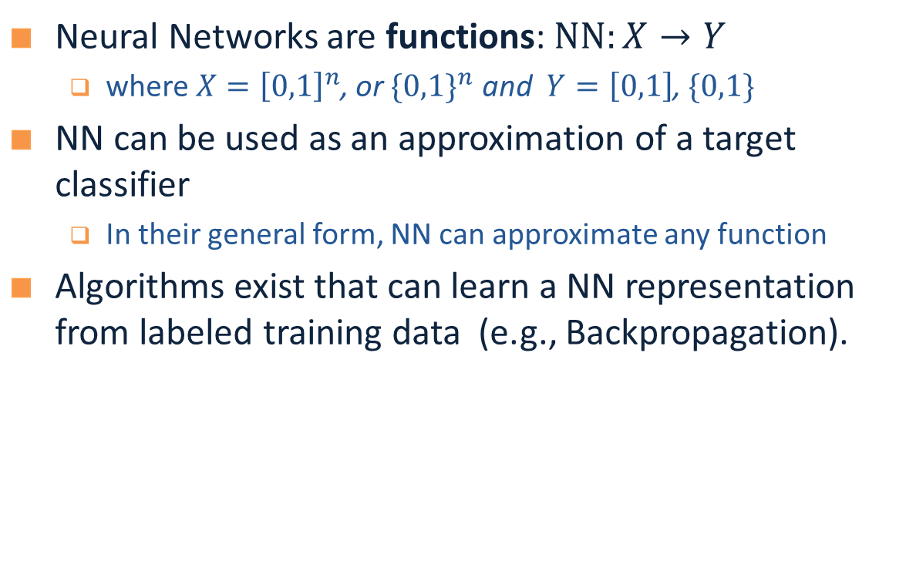
Neural Networks
Neural Networks are functions: $NN:X→Y$
where $X={\left[0,1\right]}^{n}$, or ${\{0,1\}}^{n}$ and $Y=\left[0,1\right]$, $\{0,1\}$
NN can be used as an approximation of a target classifier
In their general form, NN can approximate any function
Algorithms exist that can learn a NN representation from labeled training data (e.g., Backpropagation).

Slide 5
Multi-Layer Neural Networks
Multi-layer network were designed to overcome the computational (expressivity) limitation of a single threshold element.
The idea is to stack several
layers of threshold elements,
each layer using the output of
the previous layer as input.
Multi-layer networks can represent arbitrary functions, but building effective learning methods for such network was [thought to be] difficult.
activation
Output
Hidden
Input

Slide 6
Motivation for Neural Networks
Inspired by biological systems, the best examples we have of robust learning systems
Used to model biological systems (so we understand how they learn)
Massive parallelism that may allow for computational efficiency
Graceful degradation due to distributed representation that spread the representation of knowledge among the computational units.
Intelligent behavior “emerges” from large number of simple units rather than from explicit symbolically encoded rules.

Slide 7
Neural Speed Constraints
Neuron “switching time” is O(milliseconds), compared to nanosecond for transistors.
However, biological systems can perform significant cognitive tasks (vision, language understanding) in fractions of a second.
Even for limited abilities, current AI systems require orders of magnitude more steps.
Human brain has approximately 10^10 neurons, each connected to 10^4; must explore massive parallelism (but there’s more…)

Slide 8
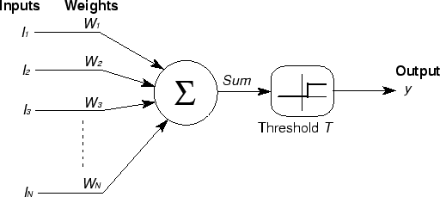

Basic Unit in Multi-Layer Neural Network
Linear Unit: $o_{j}=\vec{w}.\vec{x}$ multiple layers of linear functions produce linear functions. We want to represent nonlinear functions.
Threshold units: $o_{j}=sgn(\vec{w}.\vec{x}−T)$ are not differentiable, hence unsuitable for gradient descent
activation
Output
Hidden
Input

Slide 9
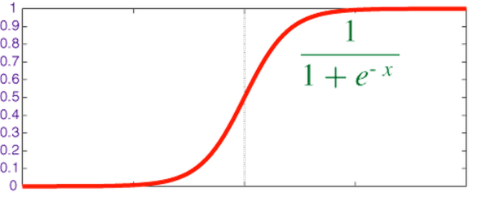

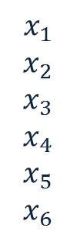
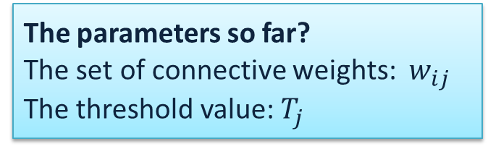
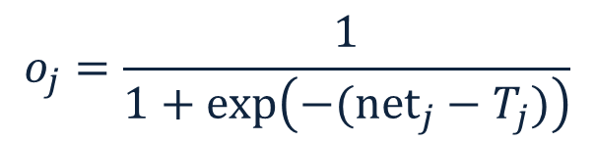



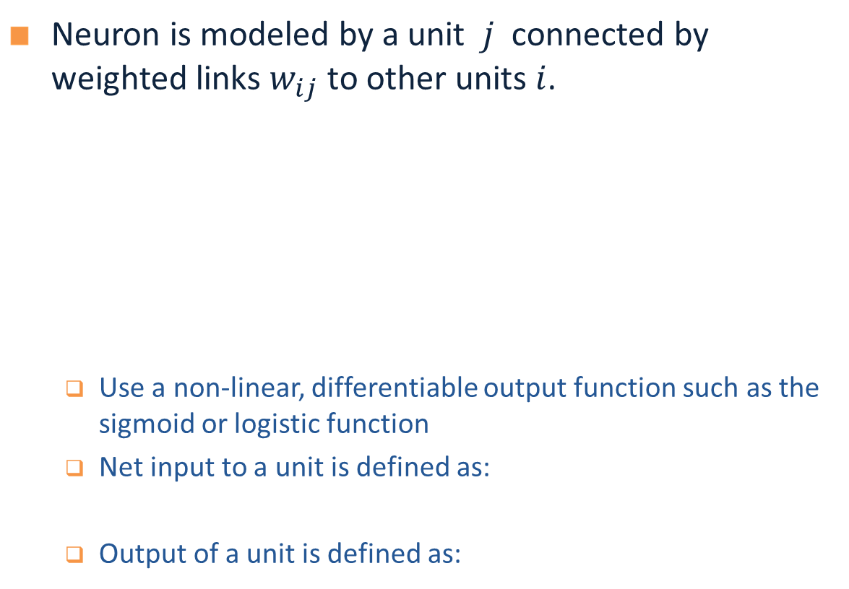

Model Neuron (Logistic)
Neuron is modeled by a unit $j$ connected by weighted links $w_{ij}$ to other units $i$.
Use a non-linear, differentiable output function such as the sigmoid or logistic function
Net input to a unit is defined as:
Output of a unit is defined as:
The parameters so far?
The set of connective weights: $w_{ij}$ The threshold value: $T_{j}$
$$x_{1}$$
$$x_{2}$$
$$x_{3}$$
$$x_{4}$$
$$x_{5}$$
$$x_{6}$$
$$w_{17}$$
$$x_{7}$$
$$o_{j}$$
$$w_{67}$$
Neuron Definition
$${net}_{j}=∑w_{ij}.x_{i}$$
$$o_{j}=\frac{1}{1+exp\left(−({net}_{j}−T_{j})\right)}$$

Slide 10
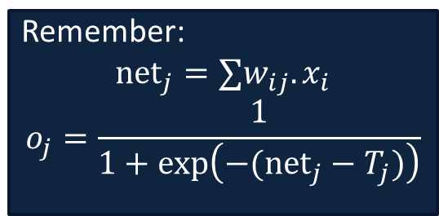


Neural Computation
McCollough and Pitts (1943) showed how linear threshold units can be used to compute logical functions
Can build basic logic gates
AND:
OR:
NOT: One input =1, the input to be inverted have negative weight
Can build arbitrary logic circuits, finite-state machines and computers given these basis gates.
Can specify any Boolean function using two layer network (w/ negation)
DNF and CNF are universal representations
Remember:
$${net}_{j}=∑w_{ij}.x_{i}$$
$$o_{j}=\frac{1}{1+exp\left(−({net}_{j}−T_{j})\right)}$$
$$w_{ij}=T_{j}/n$$
$$w_{ij}=T_{j}$$

Slide 11
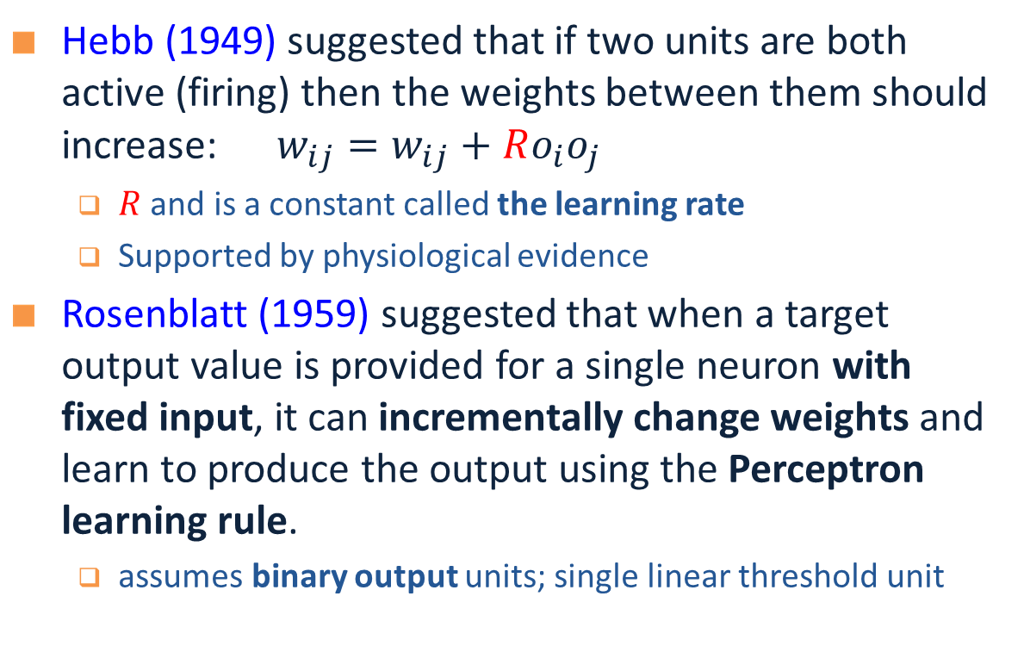
Learning Rules
Hebb (1949) suggested that if two units are both active (firing) then the weights between them should increase: $w_{ij}=w_{ij}+Ro_{i}o_{j}$
$R$ and is a constant called the learning rate
Supported by physiological evidence
Rosenblatt (1959) suggested that when a target output value is provided for a single neuron with fixed input, it can incrementally change weights and learn to produce the output using the Perceptron learning rule.
assumes binary output units; single linear threshold unit
Examples of update rules

Slide 12
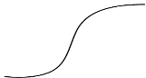


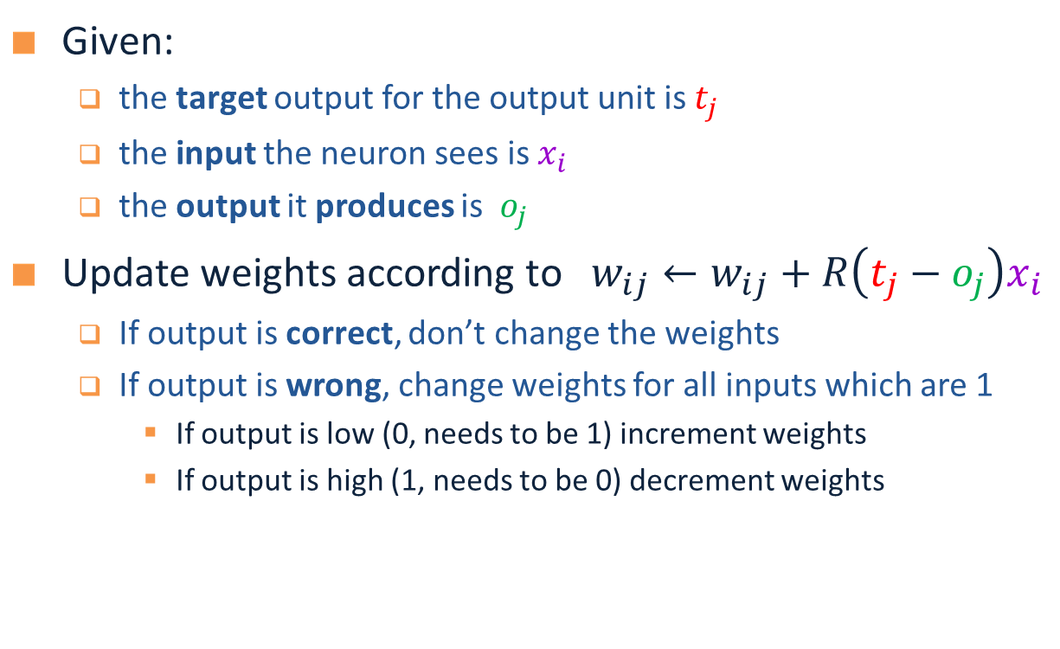




Perceptron Learning Rule
Given:
the target output for the output unit is $t_{j}$
the input the neuron sees is $x_{i}$
the output it produces is $o_{j}$
Update weights according to $w_{ij}←w_{ij}+R\left(t_{j}−o_{j}\right)x_{i}$
If output is correct, don’t change the weights
If output is wrong, change weights for all inputs which are 1
If output is low (0, needs to be 1) increment weights
If output is high (1, needs to be 0) decrement weights
$$x_{1}$$
$$x_{2}$$
$$x_{3}$$
$$x_{4}$$
$$x_{5}$$
$$x_{6}$$
$$w_{17}$$
$$x_{7}$$
$$o_{j}$$
$$T_{j}$$
$$w_{67}$$

Slide 13

Perceptron Learning Algorithm
Repeatedly iterate through examples adjusting weights according to the perceptron learning rule until all outputs are corrected
$$w_{ij}=w_{ij}+R\left(t_{j}−o_{j}\right)x_{i}$$
Initialize all weights to zero (or randomly)
Until outputs for all training examples are correct
For each training example $j$, do
compute the current output $o$
compare it to the target $t$ and update the weights according to the perceptron learning rule
When will this algorithm terminate (converge) ?

Slide 14
Perceptron Convergence
Perceptron Convergence Theorem:
If there exist a set of weights that are consistent with the data (i.e., the data is linearly separable), the perceptron learning algorithm will converge
How long would it take to converge ?
Perceptron Cycling Theorem:
If the training data is not linearly separable the perceptron learning algorithm will eventually repeat the same set of weights and therefore enter an infinite loop.
How to provide robustness, more expressivity ?
Perceptron Guarantees

Slide 15
Perceptron Learnability
Obviously cannot learn what it cannot represent
Only linearly separable functions
Minsky and Papert (1969) wrote an influential book in which they demonstrate the representational limitations of Perceptron
Parity functions cannot be learned (generalization of XOR)
In visual pattern recognition, if patterns are represented using local features, perceptron cannot represent properties like Symmetry, Connectivity
These observations discouraged research on neural network for years.
But, Rosenblatt (1959) asked: “What pattern recognition problems can be transformed so as to become linearly separable”

Slide 16
(x1 Λ x2) v (x3 Λ x4)
y1 Λ y2

Slide 17
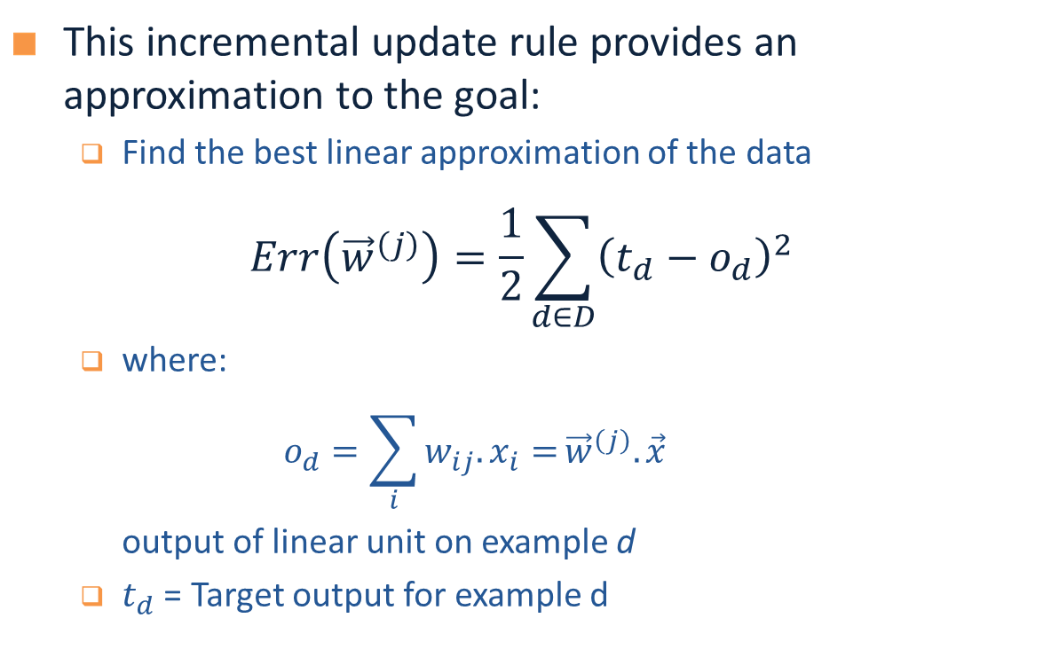
Widrow-Hoff Rule
This incremental update rule provides an approximation to the goal:
Find the best linear approximation of the data
$$Err\left({\vec{w}}^{\left(j\right)}\right)=\frac{1}{2}\sum_{d∈D}{{\left(t_{d}−o_{d}\right)}^{2}}$$
where:
$$o_{d}=\sum_{i}{w_{ij}.x_{i}=}{\vec{w}}^{\left(j\right)}.{\vec{x}}^{}$$
output of linear unit on example d
$t_{d}$ = Target output for example d

Slide 18




Gradient Descent
We use gradient descent determine the weight vector that minimizes $Err\left({\vec{w}}^{\left(j\right)}\right)$;
Fixing the set $D$ of examples, $E$ is a function of ${\vec{w}}^{\left(j\right)}$
At each step, the weight vector is modified in the direction that produces the steepest descent along the error surface.
$Err(w)$
$$w$$
$w_{3}$ $w_{2}$ $w_{1}$ $w_{0}$

Slide 19
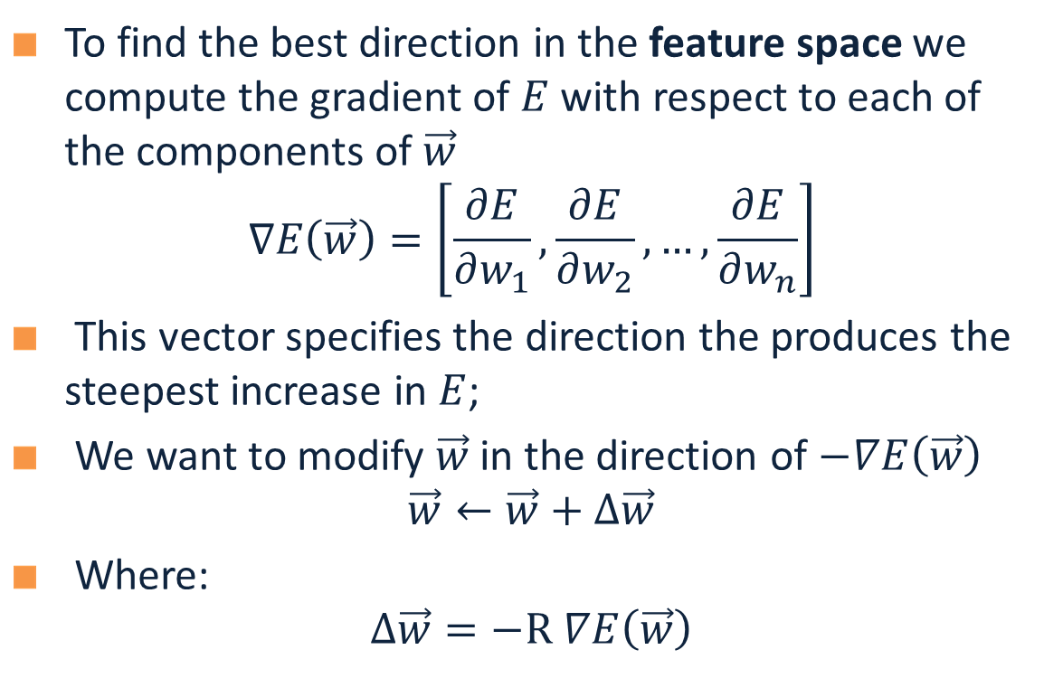
Gradient Descent
To find the best direction in the feature space we compute the gradient of $E$ with respect to each of the components of $\vec{w}$
$$∇E\left(\vec{w}\right)=\left[\frac{∂E}{∂w_{1}},\frac{∂E}{∂w_{2}}, …,\frac{∂E}{∂w_{n}}\right]$$
This vector specifies the direction the produces the steepest increase in $E$;
We want to modify $\vec{w}$ in the direction of $−∇E\left(\vec{w}\right)$
$$\vec{w}←\vec{w}+Δ\vec{w}$$
Where:
$$Δ\vec{w}=−R ∇E\left(\vec{w}\right)$$

Slide 20





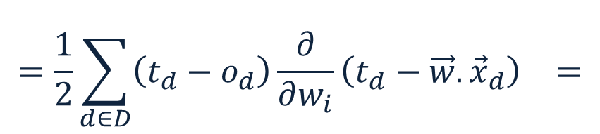
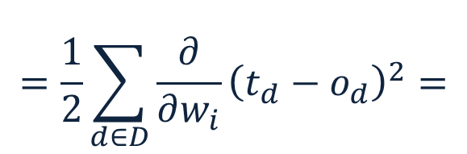
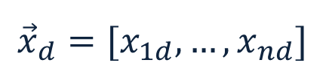
Gradient Descent – LMS
We have: $Err\left({\vec{w}}^{\left(j\right)}\right)=\frac{1}{2}\sum_{d∈D}{{\left(t_{d}−o_{d}\right)}^{2}}$
Therefore:
$$=\frac{∂}{∂w_{i}}\frac{1}{2}\sum_{d∈D}{{\left(t_{d}−o_{d}\right)}^{2}}$$
$$=\frac{1}{2}\sum_{d∈D}{{\frac{∂}{∂w_{i}}\left(t_{d}−o_{d}\right)}^{2}}=$$
$$\frac{∂E}{∂w_{i}}$$
$$=\frac{1}{2}\sum_{d∈D}{\left(t_{d}−o_{d}\right){\frac{∂}{∂w_{i}}\left(t_{d}−\vec{w}.{\vec{x}}_{d}\right)}^{}=}$$
$$=\sum_{d∈D}{\left(t_{d}−o_{d}\right){\left(−x_{id}\right)}^{}}$$
$${\vec{x}}_{d}=[x_{1d}, …, x_{nd}]$$
$$\vec{w}=[w_{1}, …, w_{n}]$$

Slide 21

Gradient Descent – LMS
Weight update rule: $Δw_{i}=R\sum_{d∈D}{\left(t_{d}−o_{d}\right){\vec{x}}_{id}}$
Gradient descent algorithm for training linear units:
Start with an initial random weight vector
For every example d with target value $t_{d}$:
Evaluate the linear unit $o_{d}=\sum_{i}{w_{i}.x_{d}=}{\vec{w}}^{\left(j\right)}.{{\vec{x}}_{d}}^{}$
update $\vec{w}$ by adding $Δw_{i}$ to each component
Continue until $E$ below some threshold
Because the surface contains only a single global minimum the algorithm will converge to a weight vector with minimum error, regardless of whether the training examples are linearly separable
Convergence?

Slide 22

Gradient Descent – LMS
Weight update rule: $Δw_{i}=R\left(t_{d}−o_{d}\right){\vec{x}}_{id}$
Gradient descent algorithm for training linear units:
Start with an initial random weight vector
For every example d with target value $t_{d}$:
Evaluate the linear unit $o_{d}=\sum_{i}{w_{i}.x_{d}=}{\vec{w}}^{\left(j\right)}.{{\vec{x}}_{d}}^{}$
update $\vec{w}$ by incrementally adding $Δw_{i}$ to each component
Continue until $E$ below some threshold
In general does not converge to global minimum
Robbins-Monro: Decreasing $R$ with time, guarantees convergence.
Convergence

Slide 23
Summary: Single Layer Network
Variety of update rules
Multiplicative
Additive
Batch and incremental algorithms
Various convergence and efficiency conditions
There are other ways to learn linear functions
Linear Programming (general purpose)
Probabilistic Classifiers ( some assumption)
Although simple and restrictive -- linear predictors perform very well on many realistic problems
However, the representational restriction is limiting in many applications

Slide 24
Learning with a Multi-Layer Perceptron
It’s easy to learn the top layer – it’s just a linear unit.
Given feedback (truth) at the top layer, and the activation at the layer below it, you can use the Perceptron update rule (more generally, gradient descent) to updated these weights.
The problem is what to do with
the other set of weights – we do
not get feedback in the
intermediate layer(s).
activation
Output
w²_{ij}
Hidden
w¹_{ij}
Input

Slide 25
Learning with a Multi-Layer Perceptron
The problem is what to do with
the other set of weights – we do
not get feedback in the
intermediate layer(s).
Solution: If all the activation
functions are differentiable, then
the output of the network is also
a differentiable function of the input and weights in the network.
Define an error function (e.g., sum of squares) that is a differentiable function of the output, i.e. this error function is also a differentiable function of the weights.
We can then evaluate the derivatives of the error with respect to the weights, and use these derivatives to find weight values that minimize this error function. This can be done, for example, using gradient descent (or other optimization methods).
This results in an algorithm called back-propagation.
activation
Output
w²_{ij}
Hidden
w¹_{ij}
Input

Slide 26

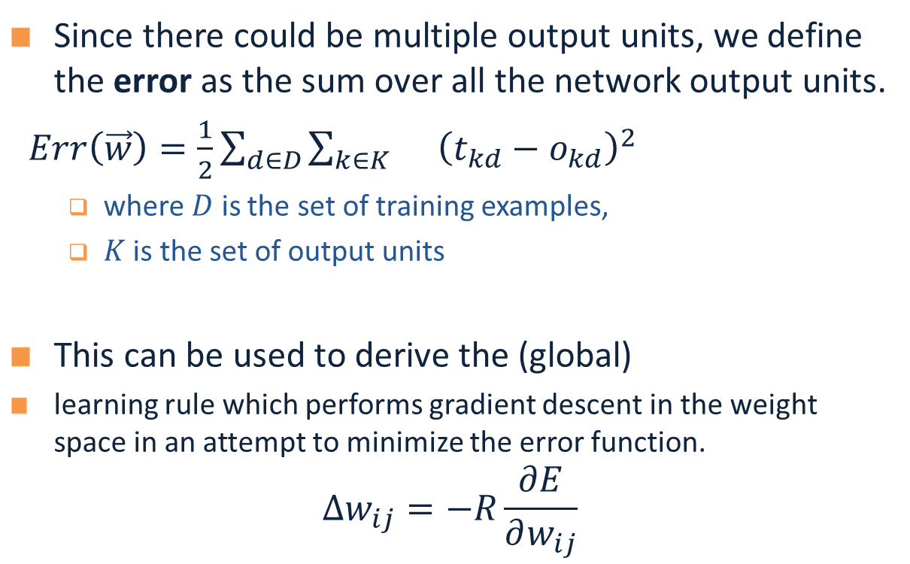
Backpropagation Learning Rule
Since there could be multiple output units, we define the error as the sum over all the network output units.
$Err\left(\vec{w}\right)=\frac{1}{2}\sum_{d∈D}{\sum_{k∈K}{}{\left(t_{kd}−o_{kd}\right)}^{2}}$
where $D$ is the set of training examples,
$K$ is the set of output units
This can be used to derive the (global)
learning rule which performs gradient descent in the weight space in an attempt to minimize the error function.
$$Δw_{ij}=−R\frac{∂E}{∂w_{ij}}$$
$o_{1}$…$o_{k}$
$$(1, 0, 1, 0, 0)$$

Slide 27
Reminder: Model Neuron (Logistic)
Neuron is modeled by a unit $j$ connected by weighted links $w_{ij}$ to other units $i$.
Use a non-linear, differentiable output function such as the sigmoid or logistic function
Net input to a unit is defined as:
Output of a unit is defined as:
$$x_{1}$$
$$x_{2}$$
$$x_{3}$$
$$x_{4}$$
$$x_{5}$$
$$x_{6}$$
$$w_{17}$$
$$x_{7}$$
$$o_{j}$$
$$w_{67}$$
Neuron Definition
$${net}_{j}=∑w_{ij}.x_{i}$$
$$o_{j}=\frac{1}{1+exp\left(−({net}_{j}−T_{j})\right)}$$

Slide 28

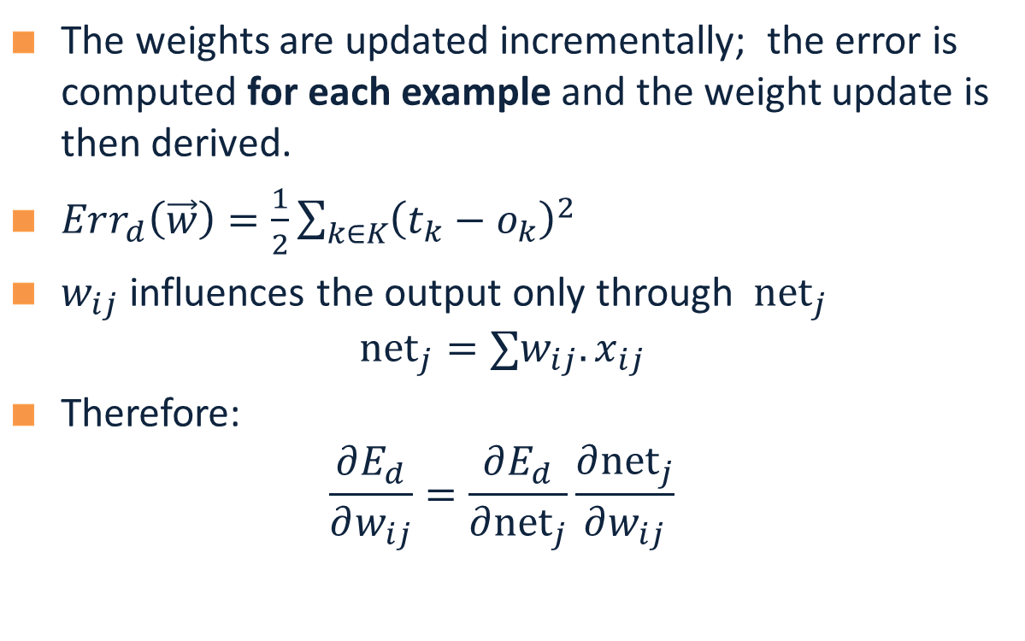

Derivation of Learning Rule
The weights are updated incrementally; the error is computed for each example and the weight update is then derived.
$Err_{d}\left(\vec{w}\right)=\frac{1}{2}\sum_{k∈K}{{\left(t_{k}−o_{k}\right)}^{2}}$
$w_{ij}$ influences the output only through ${net}_{j}$
$${net}_{j}=∑w_{ij}.x_{ij}$$
Therefore:
$$\frac{∂E_{d}}{∂w_{ij}}=\frac{∂E_{d}}{∂{net}_{j}}\frac{∂{net}_{j}}{∂w_{ij}}$$
Propagation error to earlier layer
$o_{1}$…$o_{k}$
$j$
$i$
$$w_{ij}$$

Slide 29
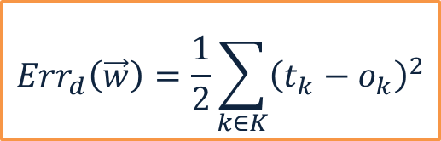
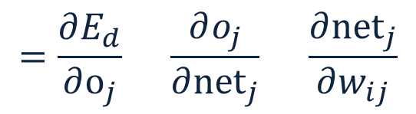
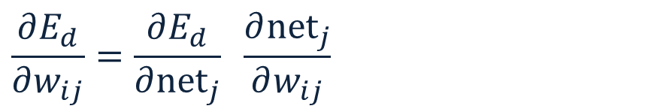






Derivation of Learning Rule (2)
Weight updates of output units:
$w_{ij}$ influences the output only through
Therefore:
$$\frac{∂E_{d}}{∂w_{ij}}=\frac{∂E_{d}}{∂{net}_{j}} \frac{∂{net}_{j}}{∂w_{ij}}$$
$j$
$i$
$$w_{ij}$$
$$=\frac{∂E_{d}}{∂o_{j}} \frac{∂o_{j}}{∂{net}_{j}} \frac{∂{net}_{j}}{∂w_{ij}}$$
$$=−\left(t_{j}−o_{j}\right) o_{j}\left(1−o_{j}\right) x_{ij}$$
$$Err_{d}\left(\vec{w}\right)=\frac{1}{2}\sum_{k∈K}{{\left(t_{k}−o_{k}\right)}^{2}}$$
$$\frac{∂o_{j}}{∂{net}_{j}}=o_{j}(1−o_{j})$$
$$o_{j}=\frac{1}{1+\exp{\{−({net}_{j}−T_{j})\}}}$$
$${net}_{j}=∑w_{ij}.x_{ij}$$

Slide 30
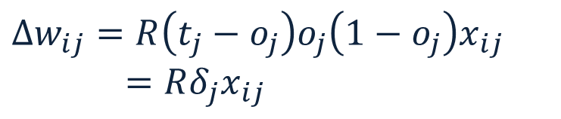





Derivation of Learning Rule (3)
Weights of output units:
$w_{ij}$ is changed by:
where
$$δ_{j}=\left(t_{j}−o_{j}\right)o_{j}\left(1−o_{j}\right)$$
$$o_{j}$$
$j$
$i$
$$w_{ij}$$
$$Δw_{ij}=R\left(t_{j}−o_{j}\right)o_{j}\left(1−o_{j}\right)x_{ij}=Rδ_{j}x_{ij}$$
$$x_{ij}$$

Slide 31

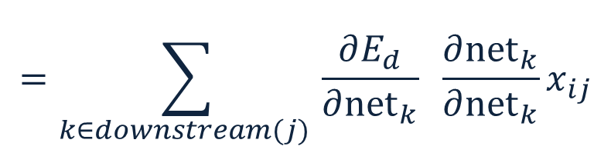

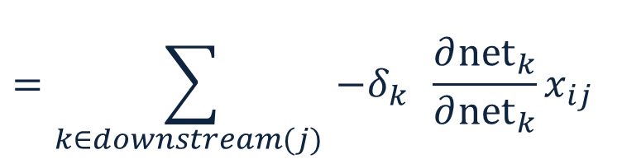


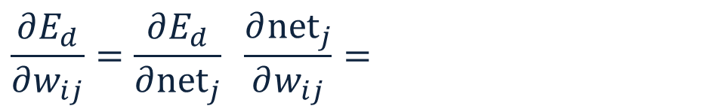

Derivation of Learning Rule (4)
Weights of hidden units:
$w_{ij}$ Influences the output only through all the units whose direct input include $j$
$$o_{k}$$
$k$
$j$
$i$
$${net}_{j}=∑w_{ij}.x_{ij}$$
$$\frac{∂E_{d}}{∂w_{ij}}=\frac{∂E_{d}}{∂{net}_{j}} \frac{∂{net}_{j}}{∂w_{ij}}=$$
$$w_{ij}$$
$$=\sum_{k∈downstream(j) }{\frac{∂E_{d}}{∂{net}_{k}} \frac{∂{net}_{k}}{∂{net}_{k}}x_{ij}}$$
$$=\sum_{k∈downstream(j) }{−δ_{k} \frac{∂{net}_{k}}{∂{net}_{k}}x_{ij}}$$

Slide 32
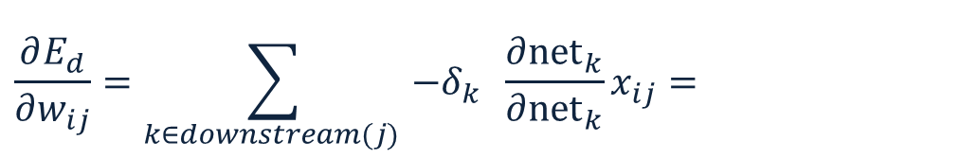
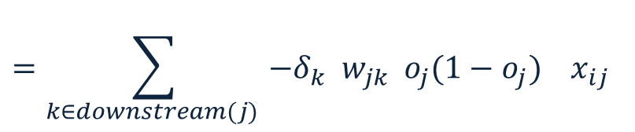

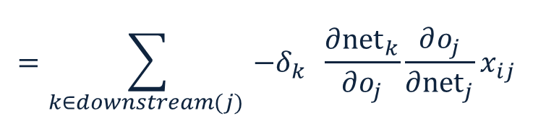



Derivation of Learning Rule (5)
Weights of hidden units:
$w_{ij}$influences the output only through all the units whose direct input include $j$
$$o_{k}$$
$k$
$j$
$i$
$$w_{ij}$$
$$\frac{∂E_{d}}{∂w_{ij}}=\sum_{k∈downstream(j) }{−δ_{k} \frac{∂{net}_{k}}{∂{net}_{k}}x_{ij}}=$$
$$=\sum_{k∈downstream(j) }{−δ_{k} \frac{∂{net}_{k}}{∂o_{j}}\frac{∂o_{j}}{∂{net}_{j}}x_{ij}}$$
$$=\sum_{k∈downstream(j) }{−δ_{k} w_{jk}{ o}_{j}(1−o_{j}) x_{ij}}$$

Slide 33

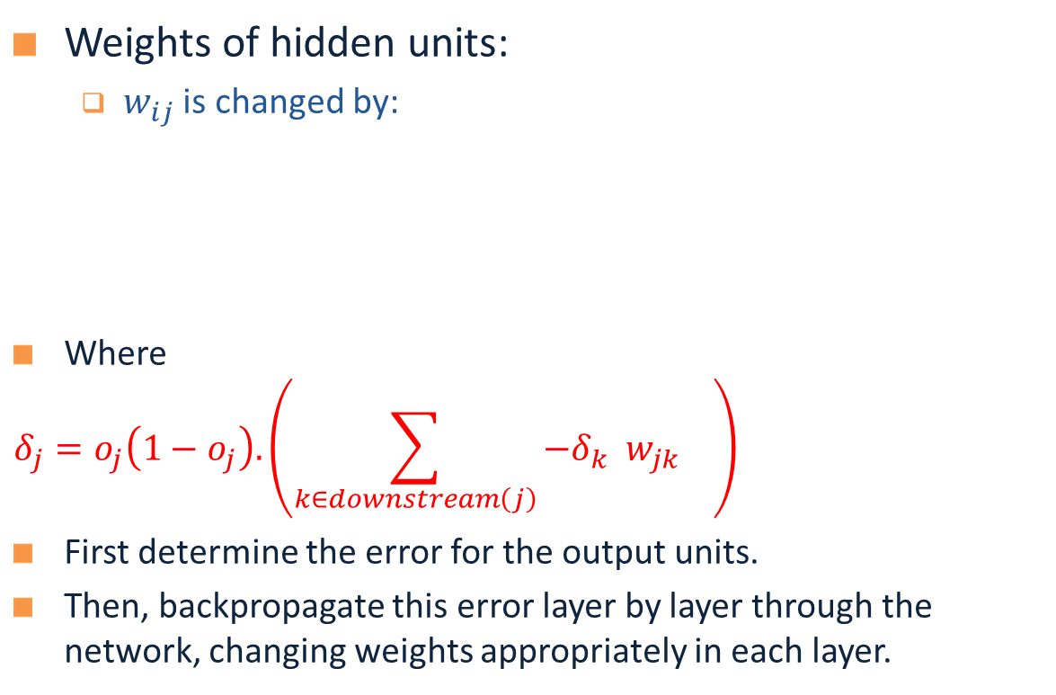
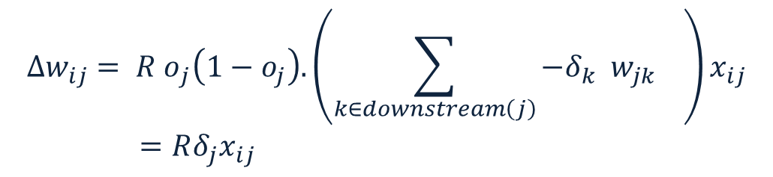


Derivation of Learning Rule (6)
Weights of hidden units:
$w_{ij}$ is changed by:
Where
$$δ_{j}=o_{j}\left(1−o_{j}\right).\left(\sum_{k∈downstream\left(j\right)}{−δ_{k} w_{jk} }\right)$$
First determine the error for the output units.
Then, backpropagate this error layer by layer through the network, changing weights appropriately in each layer.
$${Δw_{ij}= R o}_{j}\left(1−o_{j}\right).\left(\sum_{k∈downstream\left(j\right)}{−δ_{k} w_{jk} }\right)x_{ij}=Rδ_{j}x_{ij}$$
$$o_{k}$$
$k$
$j$
$i$
Delta Rule
$$w_{ij}$$

Slide 34

The Backpropagation Algorithm
Create a fully connected three layer network. Initialize weights.
Until all examples produce the correct output within $ε$ (or other criteria)
For each example in the training set do:
Compute the network output for this example
Compute the error between the output and target value
$$δ_{k}=\left(t_{k}−o_{k}\right)o_{k}\left(1−o_{k}\right)$$
For each output unit k, compute error term
$${δ_{j}= o}_{j}\left(1−o_{j}\right).\sum_{k∈downstream\left(j\right)}{−δ_{k} w_{jk} }$$
For each hidden unit, compute error term:
$$Δw_{ij}=Rδ_{j}x_{ij}$$
Update network weights
End epoch

Slide 35
More Hidden Layers
The same algorithm holds for more hidden layers.
input $h_{1}$ $h_{2}$ $h_{3}$ output

Slide 36
Comments on Training
No guarantee of convergence; may oscillate or reach a local minima.
In practice, many large networks can be trained on large amounts of data for realistic problems.
Many epochs (tens of thousands) may be needed for adequate training. Large data sets may require many hours of CPU
Termination criteria: Number of epochs; Threshold on training set error; No decrease in error; Increased error on a validation set.
To avoid local minima: several trials with different random initial weights with majority or voting techniques

Slide 37
Over-training Prevention
Running too many epochs may over-train the network and result in over-fitting. (improved result on training, decrease in performance on test set)
Keep an hold-out validation set and test accuracy after every epoch
Maintain weights for best performing network on the validation set and return it when performance decreases significantly beyond that.
To avoid losing training data to validation:
Use 10-fold cross-validation to determine the average number of epochs that optimizes validation performance
Train on the full data set using this many epochs to produce the final results

Slide 38
Over-fitting prevention
Too few hidden units prevent the system from adequately fitting the data and learning the concept.
Using too many hidden units leads to over-fitting.
Similar cross-validation method can be used to determine an appropriate number of hidden units. (general)
Another approach to prevent over-fitting is weight-decay: all weights are multiplied by some fraction in (0,1) after every epoch.
Encourages smaller weights and less complex hypothesis
Equivalently: change Error function to include a term for the sum of the squares of the weights in the network. (general)

Slide 39

Dropout training
Proposed by (Hinton et al, 2012)
Each time decide whether to delete one hidden unit with some probability p

Slide 40

Dropout training
Dropout of 50% of the hidden units and 20% of the input units (Hinton et al, 2012)

Slide 41

Dropout training
Model averaging effect
Among models, with shared parameters
H: number of units in the network
Only a few get trained
Much stronger than the known regularizer
What about the input space?
Do the same thing!

Slide 42
Input-Output Coding
Appropriate coding of inputs and outputs can make learning problem easier and improve generalization.
Encode each binary feature as a separate input unit;
For multi-valued features include one binary unit per value rather than trying to encode input information in fewer units.
For disjoint categorization problem, best to have one output unit for each category rather than encoding N categories into log N bits.

Slide 43
Representational Power
The Backpropagation version presented is for networks with a single hidden layer,
But:
Any Boolean function can be represented by a two layer network (simulate a two layer AND-OR network)
Any bounded continuous function can be approximated with arbitrary small error by a two layer network.
Sigmoid functions provide a set of basis function from which arbitrary function can be composed.
Any function can be approximated to arbitrary accuracy by a three layer network.

Slide 44
Hidden Layer Representation
Weight tuning procedure sets weights that define whatever hidden units representation is most effective at minimizing the error.
Sometimes Backpropagation will define new hidden layer features that are not explicit in the input representation, but which capture properties of the input instances that are most relevant to learning the target function.
Trained hidden units can be seen as newly constructed features that re-represent the examples so that they are linearly separable

Slide 45
Auto-associative Network
An auto-associative network trained with 8 inputs, 3 hidden units and 8 output nodes, where the output must reproduce the input.
When trained with vectors with only one bit on
INPUT HIDDEN
1 0 0 0 0 0 0 0 .89 .40 0.8
0 1 0 0 0 0 0 0 .97 .99 .71
….
0 0 0 0 0 0 0 1 .01 .11 .88
Learned the standard 3-bit encoding for the 8 bit vectors.
Illustrates also data compression aspects of learning
1 0 0 0 1 0 0 0
1 0 0 0 1 0 0 0

