Slide 1
Knowledge Representation: How far we have come?
Daniel Khashabi
Notes:
Welcome to my talk.
Thanks for being here today.
As you probably all know, I am Daniel, grad student with Dan.
Stop me if necessary

Slide 2
Hayes&McCarthy
Frame Problem
Brooks
Subsumption
Quillian
Semantic Networks
ConceptNet
Minsky, Filmore
Frames
McCarthy
Formalizing Commonsense
Description Logic
Bobrow
STUDENT
Simon&Newell
General Problem Solver
Lenant
Cyc
Winograd
SHRDLU
2000 1990 1980 1970 1960 1950 1940
SHRUTI
Rumelhart et al
BackPropagation
Series of Neural-Symbolic Models
McCulloch
&Pitts
Artificial Neurons
Minsky
&Pappert
“Perceptrons”
Systematicity Debate
Notes:
I will go over a couple works that were interesting to me from the perspective of “knowledge representation”. For some of these pieces I will just give a very brief explanation, but hopefully it will be enough to see how different pieces of puzzle are connected together ….

Slide 3



AI Goal:
Enabling machines to solve any problems, as good as human
How to measure the progress?
Notes:
Let’s start with what we wanted to achieve.
We wanted to make machines that solve problems, as good as human, or preferably than us.
But how do we measure how good our AI system is?
Find a problem humans can solve
Give it to a robot and see how good works
OK, … how to define a problem? What are right inputs and outputs? Indeed defining the right form for problem highly affects our solutions and is not a trivial issue.

Slide 4
Natural Input
“Yo …what’s up?”
AI System
Natural Output
“Yo …not much!
Sup yourself?!”
Notes:
Since we want to give computers human-level problem solving power, when defining problems, we need to define the same way we define it for human, which I call “Natural Input”
Similarly, we should expect it to give the its answer the way humans give “Natural Output”.
So what’s gong on inside this green box?

Slide 5
Natural Input
“What is the sum
of five and two?”
AI System
Intermediate Input
x = 5, y = 2
Goal=x+y=?
Representation Problem
Computer Brain
Goal=2+5=7
Intermediate Output
Goal=7
Natural Output
“seven”
Notes:
But can computers directly understand “natural input”?
Perhaps we can simplify it into easier form, so that it is more understandable for computers? So maybe we can have an intermediate form of input which is cleaner and it is more understandable for computers? Let’s call it “intermediate input”. Similarly, let’s define the ``intermediate output”.
So what connects the ``intermediate input” to ``intermediate output”?
There must be a reasoning engine which connects input to output.
But how to define the ``Intermediate Input/output”? There comes the problems of ``representation”!

Slide 6
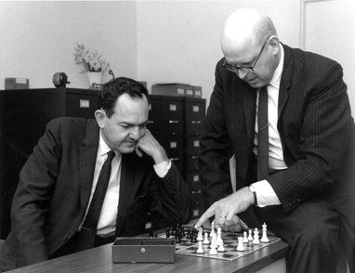
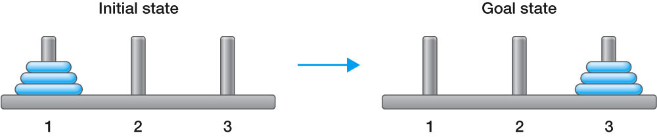
General Problem Solver
(Simon&Newell, 1956)
Goal: Program for proving theorems !
Necessity: Representation with symbols!
Hypothesis (physical symbol system hypothesis):
“A physical symbol system has the necessary and sufficient means for general intelligent action."
Reasoning: Problem solving as Search!
Notes:
program for proving theorems by Alan Newell & Herbert Simon
Too much optimisim about future of AI.
Resulted in General Problem Solver, Newell & Simon
Intentionally solved puzzles in a similar way as humans do (order of subgoals, etc)
Geometry Theorem Prover, Herbert Gelernter, 1959
Arthur Samuel’s learning checkers program 1952

Slide 7
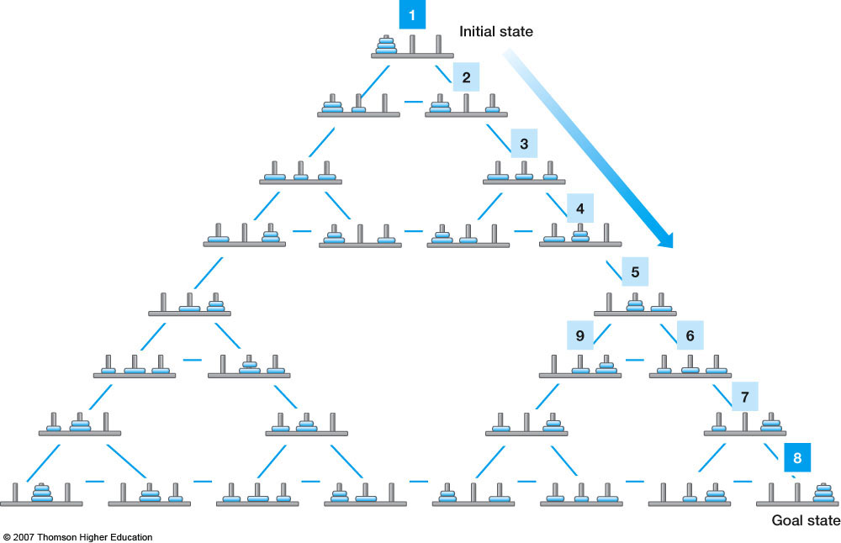
General Problem Solver
(Simon&Newell, 1956)
Notes:
While GPS solved simple problems such as the Towers of Hanoi that could be sufficiently formalized, it could not solve any real-world problems because search was easily lost in the combinatorial explosion of intermediate states.

Slide 8
Hayes&McCarthy
Frame Problem
Brooks
Subsumption
Quillian
Semantic Networks
ConceptNet
Minsky, Filmore
Frames
McCarthy
Formalizing Commonsense
Description Logic
Bobrow
STUDENT
Simon&Newell
General Problem Solver
Lenant
Cyc
Winograd
SHRDLU
2000 1990 1980 1970 1960 1950 1940
SHRUTI
Rumelhart et al
BackPropagation
Series of Neural-Symbolic Models
McCulloch
&Pitts
Artificial Neurons
Minsky
&Pappert
“Perceptrons”
Systematicity Debate
Notes:
I will go over a couple works that were interesting to me from the perspective of “knowledge representation”. For some of these pieces I will just give a very brief explanation, but hopefully it will be enough to see how different pieces of puzzle are connected together ….

Slide 9
Natural Input
“Jack is my brother.
Is he my sibling?”
AI System
Premise:
brother(“Jack”,“I”)
Proposition:
sibling(“Jack”,“I”)
Intermediate Input
Computer Brain
Intermediate Output
sibling(“Jack”,“I”): TRUE
Natural Output
“yes”
Notes:
What if the information in the input is not enough to solve the problem?
Consider this problem …
But we need additional information here … how about having an additional memory to keep the extra knowledge? … good; then we solved this question with some additional information …
But what if I change “brother” to “sister”? … let me add more information this external memory … now we have an external memory with lots of information we need to solve the problem. Our power is bound to the amount of the information we have!

Slide 10




Natural Input
“Jack is my brother.
Is he my sibling?”
AI System
Premise:
brother(“Jack”,“I”)
Proposition:
sibling(“Jack”,“I”)
$∀x,y$[brother(x,y)
$⟹$ sibling(x,y)]
KNOWLEDGE BASE
Intermediate Input
$∀x,y$[sister(x,y)
$⟹$ sibling(x,y)]
Computer Brain
$∀x,y$[sibling(x,y)
$⟹$ sibling(y,x)]
$∀x,y$[sibling(x,y) $⟹$
brother(x,y)$⋀$sister(x,y)]
….
Intermediate Output
sibling(“Jack”,“I”): TRUE
Knowledge Representation
Natural Output
“yes”
Notes:
What if the information in the input is not enough to solve the problem?
Consider this problem …
But we need additional information here … how about having an additional memory to keep the extra knowledge? … good; then we solved this question with some additional information …
But what if I change “brother” to “sister”? … let me add more information this external memory … now we have an external memory with lots of information we need to solve the problem. Our power is bound to the amount of the information we have!

Slide 11
Logical Reasoning
Deduction:
Conclusion from given axioms (facts or observations)
Generalization from background knowledge or observations
Simple and mostly likely explanation, given observations
All humans are mortal. (axiom) Socrates is a human. (fact/ premise)
Therefore, it follows that Socrates is mortal. (conclusion)
Induction:
Socrates is a human (background knowledge) Socrates is mortal (observation/ example)
Therefore, I hypothesize that all humans are mortal (generalization)
Abduction:
All humans are mortal (theory) Socrates is mortal (observation)
Therefore, Socrates must have been a human (diagnosis)
Notes:
Most of you know these …but just to remind you a but … Deduction:
→ The conclusion can be derived by applying the modus ponens inference rule (Aristotelian logic).
→ Theorem proving is based on deductive reasoning techniques.
Induction:
→

Slide 12
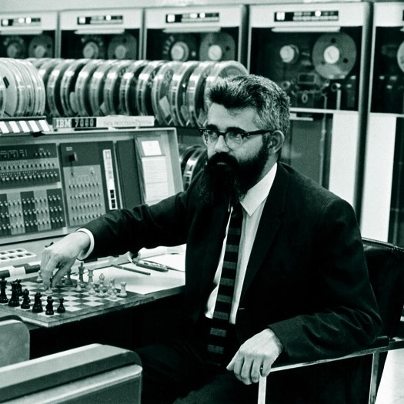
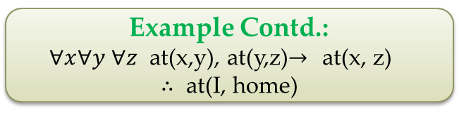
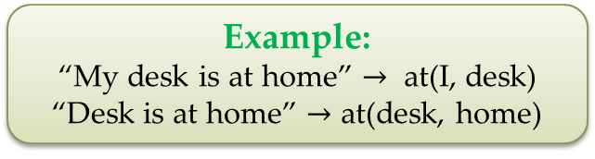
Programs With Commonsense
(John McCarthy, 1959)
Formalize world in logical form!
Example:
“My desk is at home” $→$ at(I, desk)
“Desk is at home” $→$ at(desk, home)
Hypothesis: Commonsense knowledge can be formalized with logic.
Do reasoning on formal premises!
Example Contd.:
$∀x∀y$ $∀z$ at(x,y), at(y,z)$→$ at(x, z)
$∴$ at(I, home)
Hypothesis: Commonsense problems are solved by logical reasoning
Notes:
McCarthy's philosophy is that commonsense knowledge and reasoning can be formalized with logic. Representing facts in declarative and formal logical language
"My desk is at home" ---> at(I, desk)
"Desk is at home" ---> at(desk, home)
- a particular system is described by a set of sentences in logic.
- the logical sentences represent all known about the world
- commonsense knowledge is formalized by logic and commonsense problems are solved by logical reasoning .
- Modular that expressing segments of computer
- The premises and facts can be used in many contexts/problems
----> the same fact can be used for many purposes

Slide 13
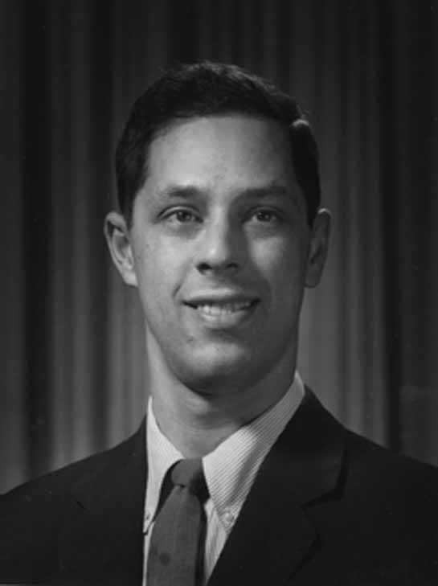
STUDENT
(Daniel G Bobrow, 1964)
Goal: Elementary school algebra problem solver
Input: Natural Language
Example: The sum of two numbers is 111. One of the numbers is consecutive to the other number. Find the two numbers.
Example: Bill s father s uncle is twice as old as bills father. 2 years from now bill s father will be 3 times as old as bill. The sum of their ages is 92. Find Bill s age.
Example: The distance between New York to Los Angeles is 3000 miles. If the average speed of a jet place is 600 miles per hour find the time it takes to travel from New York to Los Angeles by jet.

Slide 14
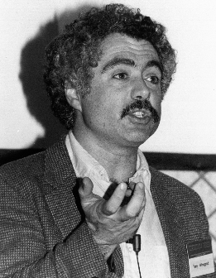
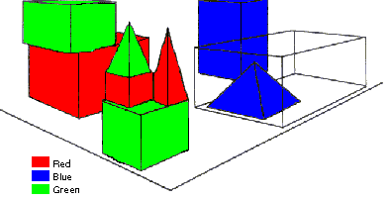
SHRDLU
(Terry Winograd, 1968)
Basic rules:
Small world
Memory
Deduction rule
Learn new names
Person: Pick up a big red block.
Computer: OK.
Person: Grasp the pyramid.
Computer: I DON'T UNDERSTAND WHICH PYRAMID YOU MEAN.
Person: Find a block which is taller than the one you are holding and put it into the box.
Computer: BY "IT", I ASSUME YOU MEAN THE BLOCK
WHICH IS TALLER THAN THE ONE I AM HOLDING.
Computer: OK.
Person: What does the box contain?
Computer: THE BLUE PYRAMID AND THE BLUE BLOCK.
Person: What is the pyramid supported by?
Computer: THE BOX.
Person: How many blocks are not in the box?
Computer: FOUR OF THEM.
Person: Is at least one of them narrower than the one which i told you to pick up?
Computer: YES, THE RED CUBE.
Person: Is it supported?
Computer: YES, BY THE TABLE.
Person: Can the table pick up blocks?
Computer: NO.
Person: Can a pyramid be supported by a block?
Computer: YES.`
Too narrow and brittle!
Notes:
SHRDLU, Computer program that has conversation with user, via Natural Language interface
-> About “block world”, virtual box filled with different blocks, different shapes, sizes and colors: e.g. Red block, white box, blue pyramid
The robot can pick the objects, move them, count them ..
Combination of a few principles made the simulation of robot behavior very realistic
SHRDLU's world was so simple that the entire set of objects and locations could be described by including as few as perhaps 50 words:
nouns like "block" and "cone", verbs like "place on" and "move to", and adjectives like "big" and "blue".
The possible combinations of these basic language building blocks were quite simple, and the program was fairly adept at figuring out what the user meant.
SHRDLU also included a basic memory to supply context. One could ask SHRDLU to "put the green cone on the red block" and then "take the cone off"; "the cone" would be taken to mean the green cone one had just talked about. SHRDLU could search back further through the interactions to find the proper context in most cases when additional adjectives were supplied. One could also ask questions about the history, for instance one could ask "did you pick up anything before the cone?“
Deduction rules: Could deduce that blocks could be stacked by looking for examples, but would realize that triangles couldn't be stacked
Learn new names: For instance one could say "a steeple is a small triangle on top of a tall rectangle"; SHRDLU could then answer questions about steeples in the blocks world, and build new ones.

Slide 15


Frame Problem
(John McCarthy & Patrick J. Hayes, 1959)
Axioms:
Paint(x,c,t) $⟹$ Color(x,c,t)
Move(x,p,t) $⟹$ Position(x,p,t)
Initial State:
Color(A,Red,t)
Position(A,House,t)
Action:
Move(A,Garden,t+1)
Expected State:
Color(A,Red,t+1)
Position(A,Garden,t+1)
Actual State:
Color(A,Red,t+1) / Color(A,Blue,t+1)
Position(A,Garden,t+1)
Notes:
The frame problem in AI is concerned with the question of what piece of knowledge is relevant to the situation.
Representing the state of a robot with traditional FOL requires the use of many axioms that simply imply that things in the environment do not change arbitrarily.
Let’s start with these axioms about the world, in which we only care either about color or position….
Also consider the intial states of the our world ….
Under the “deductive” logical model, what is the state of the world after the action ….

Slide 16

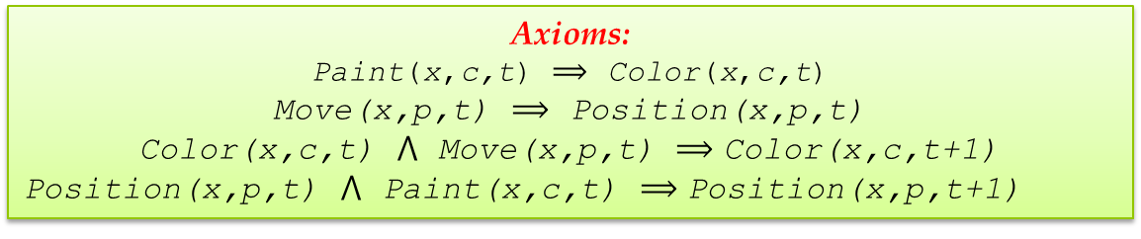
Frame Problem
(John McCarthy & Patrick J. Hayes, 1959)
Axioms:
Paint(x,c,t) $⟹$ Color(x,c,t)
Move(x,p,t) $⟹$ Position(x,p,t)
Color(x,c,t) $⋀$ Move(x,p,t) $⟹$ $\text{Color}\text{(}\text{x}\text{,}\text{c}\text{,}\text{t}\text{+}\text{1}\text{)}$
$\text{Position}\text{(}\text{x}\text{,}\text{p}\text{,}\text{t}\text{)}$ $⋀$ Paint(x,c,t) $⟹$ $\text{Position}\text{(}\text{x}\text{,}\text{p}\text{,}\text{t}\text{+}\text{1}\text{)}$
Initial State:
Color(A,Red,t)
Position(A,House,t)
Action:
Move(A,Garden,t)
Expected State = Actual State:
Color(A,Red,t+1)
Position(A,Garden,t+1)
Notes:
The most obvious way to augment such a formalisation so that the right common sense conclusions fall out is to add a number of formulae that explicitly describe the non-effects of each action….
In other words, painting an object will not affect its position, and moving an object will not affect its colour. With the addition of these two formulae (written more formally in predicate logic), all the desired conclusions can be drawn. However, this is not at all a satisfactory solution. Since most actions do not affect most properties of a situation, in a domain comprising M actions and N properties we will, in general, have to write out almost MN frame axioms. Whether these formulae are destined to be stored explicitly in a computer's memory, or are merely part of the designer's specification, this is an unwelcome burden.

Slide 17
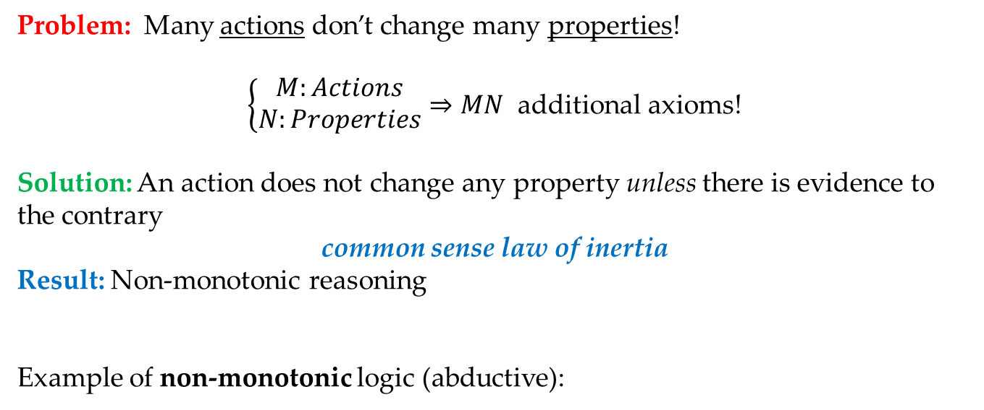
Frame Problem
(John McCarthy & Patrick J. Hayes, 1959)
Problem: Many actions don’t change many properties!
$\left\{\begin{aligned}M:Actions \\ N:Properties\end{aligned}⇒MN\right.$ additional axioms!
Solution: An action does not change any property unless there is evidence to the contrary
common sense law of inertia
Result: Non-monotonic reasoning
Example of non-monotonic logic (abductive):
Monotonicity of classical logic: $S⊨R ⇒ S∪B⊨R$
Observation 1: Your daughter’s messy room
Conclusion 1: She has school problem, or relationship problem, etc.
Observation 2: Bookshelf has broken.
Conclusion 2: The heavy weight of things on the shelf has broken it.
Notes:
The most obvious way to augment such a formalisation so that the right common sense conclusions fall out is to add a number of formulae that explicitly describe the non-effects of each action….
In other words, painting an object will not affect its position, and moving an object will not affect its colour. With the addition of these two formulae (written more formally in predicate logic), all the desired conclusions can be drawn. However, this is not at all a satisfactory solution. Since most actions do not affect most properties of a situation, in a domain comprising M actions and N properties we will, in general, have to write out almost MN frame axioms. Whether these formulae are destined to be stored explicitly in a computer's memory, or are merely part of the designer's specification, this is an unwelcome burden. an action can be assumed not to change a given property of a situation unless there is evidence to the contrary. This default assumption is known as the common sense law of inertia. The (technical) frame problem can be viewed as the task of formalising this law…

Slide 18
Hayes&McCarthy
Frame Problem
Brooks
Subsumption
Quillian
Semantic Networks
ConceptNet
Minsky, Filmore
Frames
McCarthy
Formalizing Commonsense
Description Logic
Bobrow
STUDENT
Simon&Newell
General Problem Solver
Lenant
Cyc
Winograd
SHRDLU
2000 1990 1980 1970 1960 1950 1940
SHRUTI
Rumelhart et al
BackPropagation
Series of Neural-Symbolic Models
McCulloch
&Pitts
Artificial Neurons
Minsky
&Pappert
“Perceptrons”
Systematicity Debate
Notes:
I will go over a couple works that were interesting to me from the perspective of “knowledge representation”. For some of these pieces I will just give a very brief explanation, but hopefully it will be enough to see how different pieces of puzzle are connected together ….

Slide 19
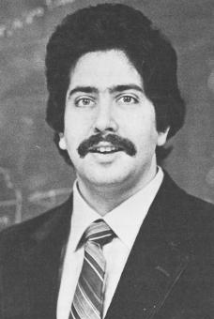
Cyc (1984-present)
(Douglas Lenant, 1984)
Goal:
Knowledge representation schema utilizing first-order relationships.
Example assertions :
“Every tree is a plant”
“Plants die eventually”
In 1986, Doug Lenat estimated the effort to complete Cyc would be 250,000 rules and 350 man-years of effort!
500k concepts, 17k relations, ~10M logical facts
Notes:
Cyc is an artificial intelligence project that attempts to assemble a comprehensive ontology and knowledge base of everyday common sense knowledge, with the goal of enabling AI applications to perform human-like reasoning.
Knowledge representation schema that utilized first-order relationships
In 1986, Doug Lenat estimated the effort to complete Cyc would be 250,000 rules and 350 man-years of effort
Typical pieces of knowledge represented in the database are "Every tree is a plant" and "Plants die eventually". When asked whether trees die, the inference engine can draw the obvious conclusion and answer the question correctly. The Knowledge Base (KB) contains over one million human-defined assertions, rules or common sense ideas. These are formulated in the language CycL, which is based on predicate calculus and has a syntax similar to that of the Lisp programming language.

Slide 20
Cyc (1984-present)
(Douglas Lenant, 1984)
Example entries:
Constants: #$OrganicStuff
Variable: (#$colorOfObject #$Grass ?someColor)
Expressions: (#$colorOfObject #$Grass #$Green)
Assertions: “Animals sleep at home”
(ForAll ?x (ForAll ?S (ForAll ?PLACE
(implies (and (isa ?x Animal) (isa ?S SleepingEvent) (performer ?S ?x) (location ?S ?PLACE)) (home ?x ?PLACE)))))

Slide 21
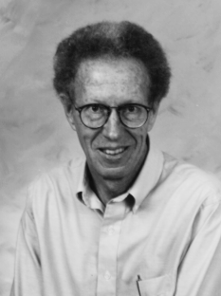
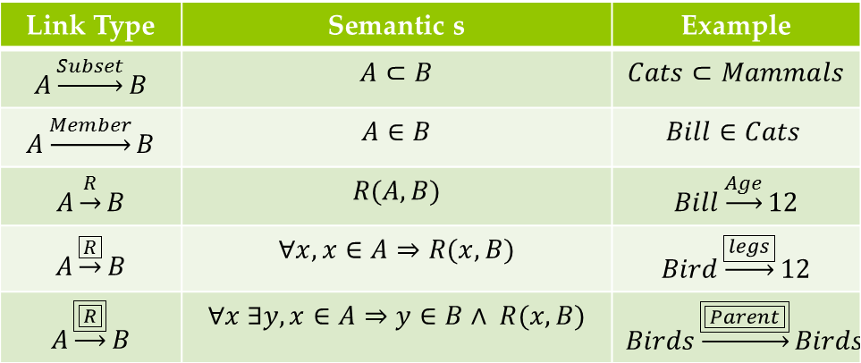
Semantic Networks
(Ross Quillian, 1963)
A graph of labeled nodes and labeled, directed arcs
Arcs define binary relationships that hold between objects denoted by the nodes.
Link Type | Semantic s | Example
$$A\underset{→}{Subset}B$$ | $$A⊂B$$ | $$Cats⊂Mammals$$
$$A\underset{→}{Member}B$$ | $$A∈B$$ | $$Bill∈Cats$$
$$A\underset{→}{R}B$$ | $$R(A,B)$$ | $$Bill\underset{→}{Age}12$$
$$A\underset{→}{\boxed{R}}B$$ | $$∀x, x∈A⇒R(x,B)$$ | $$Bird\underset{→}{\boxed{legs}}12$$
$$A\underset{→}{\boxed{\boxed{R}}}B$$ | $$∀x ∃y, x∈A⇒y∈B∧ R(x,B)$$ | $$Birds\underset{→}{\boxed{\boxed{Parent}}}Birds$$
Animal
isa
hasPart
Bird
isa
Wing
Robin
isa
isa
Rusty
Red
Notes:
A semantic network is a simple representation scheme that uses a graph of labeled nodes and labeled, directed arcs to encode knowledge.
Usually used to represent static, taxonomic, concept dictionaries
Semantic networks are typically used with a special set of accessing procedures that perform “reasoning”
e.g., inheritance of values and relationships
Semantic networks were very popular in the ‘60s and ‘70s but are less frequently used today.
Often much less expressive than other KR formalisms
The graphical depiction associated with a semantic network is a significant reason for their popularity.

Slide 22
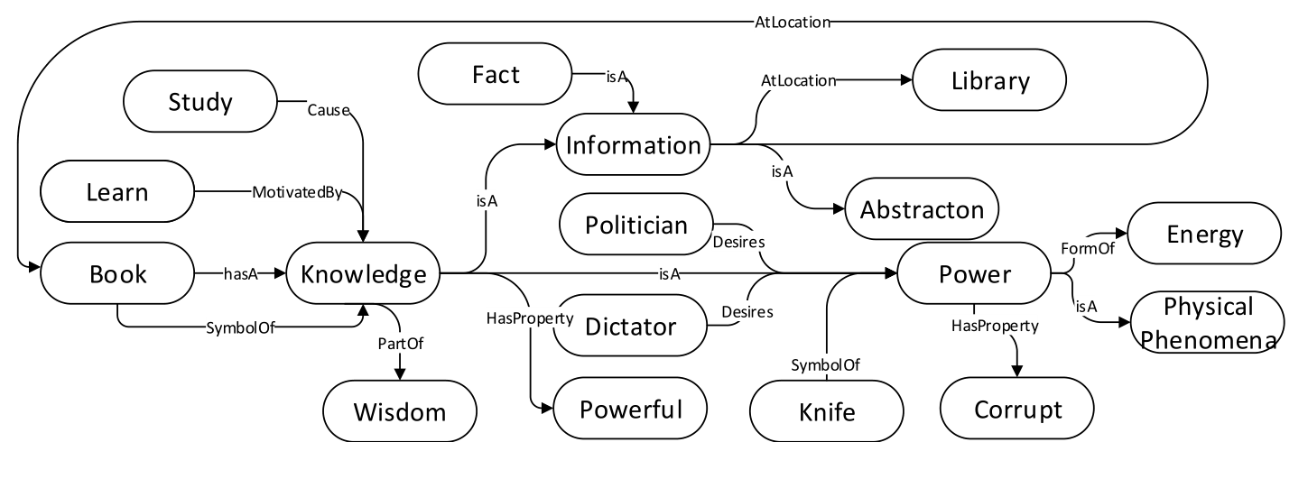
ConceptNet (2000-present)
Based on Open Mind Common Sense (OMCS)
goal was to build a large commonsense knowledge base
from the contributions of many people across the Web.
A network represents semantic relation between concepts.
Notes:
Open Mind Common Sense (OMCS) is an artificial intelligence project based at the Massachusetts Institute of Technology (MIT) Media Lab whose goal is to build and utilize a large commonsense knowledge base from the contributions of many thousands of people across the Web.

Slide 23
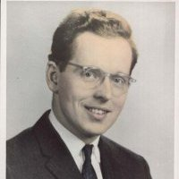
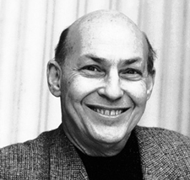
Frames
(Minsky, 1974; Fillmore, 1977)
Premise: Meaning is based on prototypical abstract scenes
Cynthia sold a car to Bob
SELLER PREDICATE GOODS BUYER
Bob bought a car from Cynthia.
BUYER PREDICATE GOODS SELLER
SELLER:
PREDICATE:
GOODS:
BUYER:
Cynthia
sold
a car
to Bob
Notes:
Semantic networks morphed into Frame Representation Languages in the ‘70s and ‘80s. … Similarly, in linguistics, Charles J. Fillmore in the mid-1970s started working on his theory of frame semantics, which later would lead to computational resources like FrameNet.[6] Frame semantics was motivated by reflections on human language and human cognition.
…
frames consist of a group of slots and fillers to define a stereotypical objects
A frame has a set of slots. A slot represents a relation to another frame (or value). A slot has one or more facets.
A facet represents some aspect of the relation.
frames are organized hierarchically --> A frame is a lot like the notion of an object in OOP, but has more meta-data
similar to human knowledge organization
slots can contain all kinds of items: rules, facts, images, video, comments, debugging info, questions, hypotheses, other frames
slots can also have procedural attachments:
procedures that are invoked in specific situations involving a particular slot on creation, modification, removal of the slot value
Slot values
can inherit the value directly
can get a default value
Cons:
not appropriate because there may be valid instances of a concept that do not fit the stereotype
exceptions can be used to overcome this
can get very messy
→ Inheritance issues:
not all properties of a class stereotype should be propagated to subclasses
alteration of slots can have unintended consequences in subclasses

Slide 24
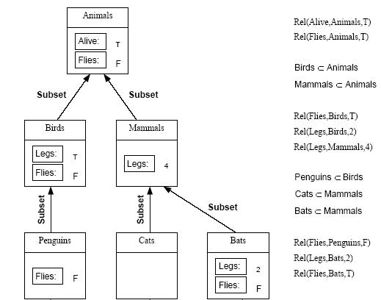
Frames
(Minsky, 1974; Fillmore, 1977)
Hierarchical Representation with Frames
Notes:
frames are organized hierarchically --> A frame is a lot like the notion of an object in OOP, but has more meta-data
similar to human knowledge organization
Slot values
can inherit the value directly
can get a default value
Cons:
not appropriate because there may be valid instances of a concept that do not fit the stereotype
exceptions can be used to overcome this
can get very messy
→ Inheritance issues:
not all properties of a class stereotype should be propagated to subclasses
alteration of slots can have unintended consequences in subclasses

Slide 25
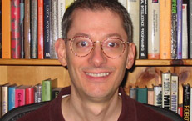
ThoughtTreasure (1994-2000)
(Erik Mueller, 2000)
Procedural knowledge: For typical actions, like inter-personal relations, sleeping, attending events, sending a message
work-box-office(B, F) :-
dress(B, work-box-office),
near-reachable(B, F),
TKTBOX = FINDO(ticket-box);
near-reachable(B, FINDO(employee-side-of-counter)),
/* HANDLE NEXT CUSTOMER */
100: WAIT FOR attend(A = human, B) OR
pre-sequence(A = human, B), may-I-help-you(B, A),
/* HANDLE NEXT REQUEST OF CUSTOMER */
103: WAIT FOR request(A, B, R)
AND GOTO 104 OR WAIT FOR post-sequence(A, B)
AND GOTO 110,
104: IF R ISA tod
{ current-time-sentence(B, A) ON COMPLETION GOTO 103 }
ELSE IF R ISA performance
{ GOTO 105 }
ELSE
{ interjection-of-noncomprehension(B, A) ON COMPLETION GOTO 103}
...

Slide 26
Hayes&McCarthy
Frame Problem
Brooks
Subsumption
Quillian
Semantic Networks
ConceptNet
Minsky, Filmore
Frames
McCarthy
Formalizing Commonsense
Description Logic
Bobrow
STUDENT
Simon&Newell
General Problem Solver
Lenant
Cyc
Winograd
SHRDLU
2000 1990 1980 1970 1960 1950 1940
SHRUTI
Rumelhart et al
BackPropagation
Series of Neural-Symbolic Models
McCulloch
&Pitts
Artificial Neurons
Minsky
&Pappert
“Perceptrons”
Systematicity Debate
Notes:
I will go over a couple works that were interesting to me from the perspective of “knowledge representation”. For some of these pieces I will just give a very brief explanation, but hopefully it will be enough to see how different pieces of puzzle are connected together ….

Slide 27
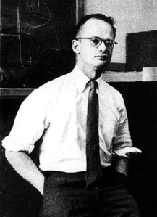
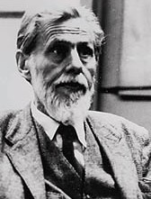
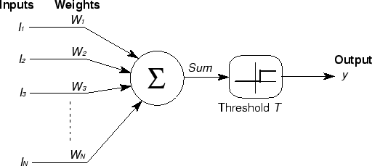
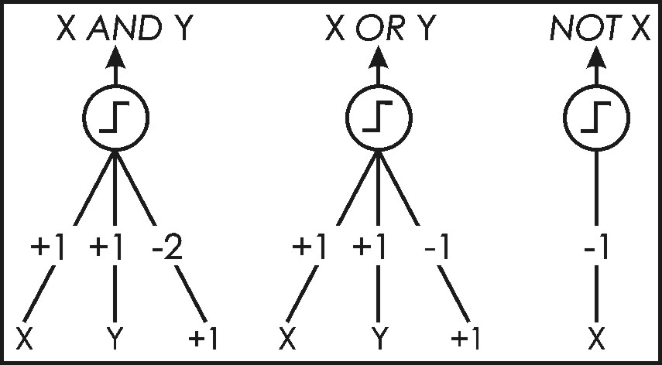
Neuron
(McCulloch,Pitts, 1943)
Notes:
…. Ok; what kind of information can be represented with this? …
Ok, let’s start with basic logical forms … you can construct the weights in a way that we can simulate logical operators …

Slide 28
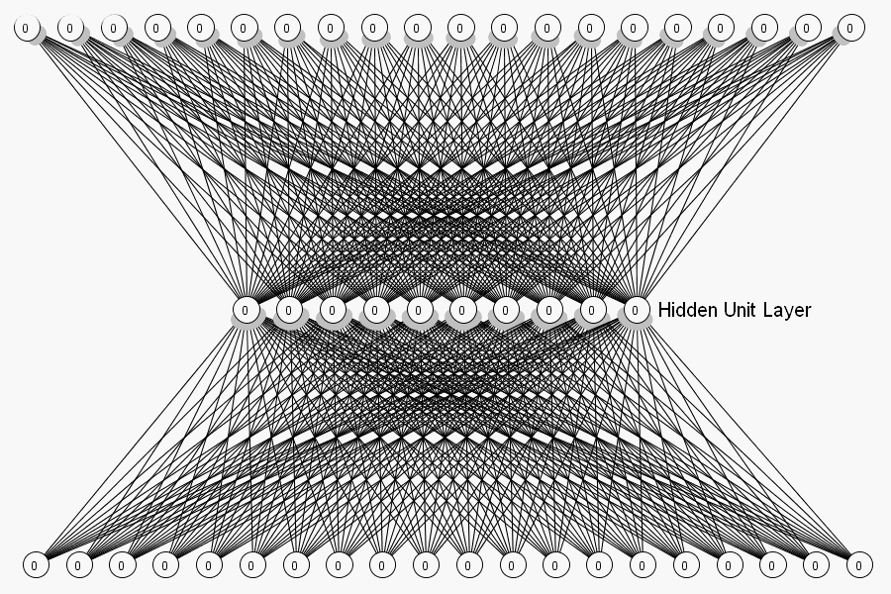
Connectionism
1949-69: Basic forms for updates for perceptron
1969: Negative results on approximating ability of perceptron
1986: Advent of backpropagation and training multi-layer networks
80s: popularization of “parallel distributed models” aka “Connectionism”
Notes:
…. Ok; what kind of information can be represented with this? …
Ok, let’s start with basic logical forms … you can construct the weights in a way that we can simulate logical operators …

Slide 29



Distributed vs. Classical Representation
$$x_{1}$$
Classical representations:
Distributed representation:
a symbol is encoded across all elements of the representation
each element the representation takes part in representing the symbol.
Jack
Flower
$$x_{2}$$
Jack’s dad
$$x_{3}$$
Jack

Slide 30
Distributed vs. Classical Representation
$$x_{1}$$
Classical representations:
Distributed representation:
a symbol is encoded across all elements of the representation
each element the representation takes part in representing the symbol.
Jack
Flower
$$x_{2}$$
Jack’s dad
$$x_{3}$$
Jack’s dad

Slide 31
Distributed vs. Classical Representation
$$x_{1}$$
Classical representations:
Distributed representation:
a symbol is encoded across all elements of the representation
each element the representation takes part in representing the symbol.
Jack
Flower
$$x_{2}$$
Jack’s dad
$$x_{3}$$
Flower

Slide 32
Distributed vs. Classical Representation
Activity | Connectionist | Classical Symbolic Systems
Knowledge base And computation elements | Connections, network architecture Nodes, Weights, Thresholds | Rules, Premises, conclusions, rule strengths
Processing | Continuous activation | Discrete symbols

Slide 33
Distributed vs. Classical Representation
 | Connectionist | Classical Symbolic Systems
Pro | Robust | Given rules, the reasoning can formally be done.
Con | Need a lot of training data No (logical) reasoning, just mapping from input to output | Brittle and crisp Need for many rules
Systematicity debate: (Fodor and Pylyshyn)
“John loves Mary”
“Mary loves John”
Connectionists do not account for systematicity, although it can be trained to.
Responses: Elman (1990), Smolensky (1990), Pollak (1990), etc.
Notes:
feature of human intelligence called systematicity which they feel connectionists cannot explain.
The systematicity of language refers to the fact that the ability to produce/understand/think some sentences is intrinsically connected to the ability to produce/understand/think others of related structure.
argue in detail that connectionists do not account for systematicity. Although connectionist models can be trained to be systematic, they can also be trained, for example, to recognize ‘John loves Mary’ without being able to recognize ‘Mary loves John.’ Since connectionism does not guarantee systematicity, it does not explain why systematicity is found so pervasively in human cognition. Although some responses, … , specifically Emnan’s RNN, …. but none of the side seem to be satisfied

Slide 34

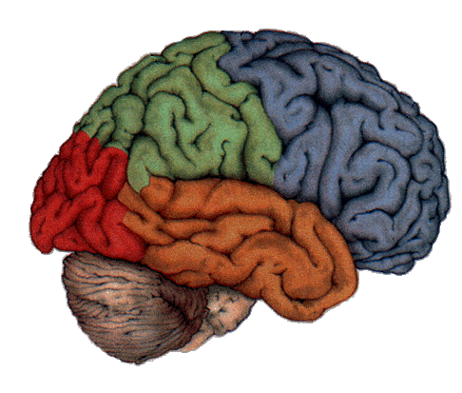



SHRUTI
(Shastri, 1989)
Red Blue Green
Variable binding:
conjunctive of elements and properties
Variables of logical forms
Circle
Rectangle
Triangle

Slide 35
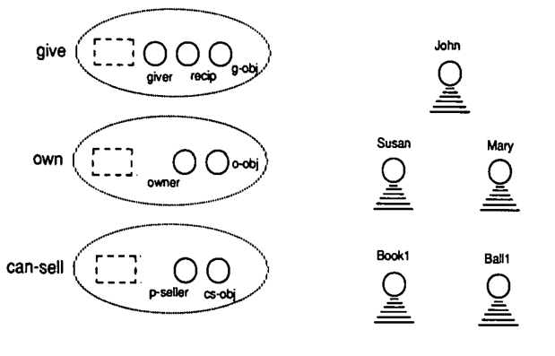
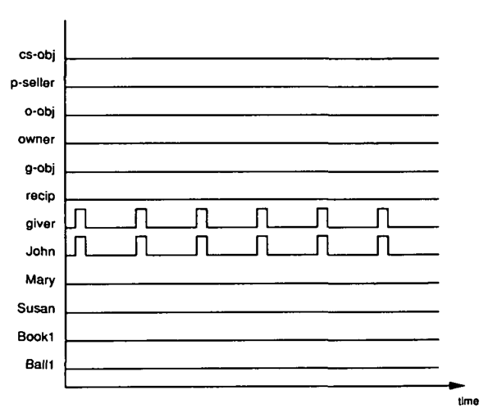
SHRUTI
(Shastri, 1989)
Variable binding by synchronization of neurons.

Slide 36
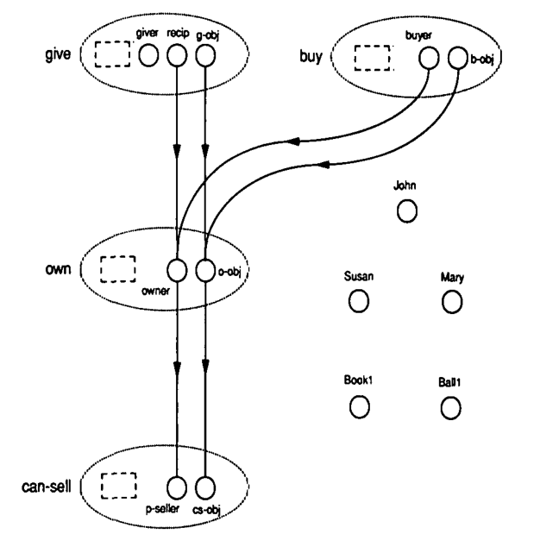
SHRUTI
(Shastri, 1989)
Dynamic binding for First order logic!

Slide 37
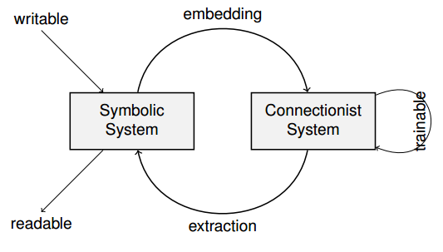
Neural-Symbolic models
(90s-now)

Slide 38
Hayes&McCarthy
Frame Problem
Brooks
Subsumption
Quillian
Semantic Networks
ConceptNet
Minsky, Filmore
Frames
McCarthy
Formalizing Commonsense
Description Logic
Bobrow
STUDENT
Simon&Newell
General Problem Solver
Lenant
Cyc
Winograd
SHRDLU
2000 1990 1980 1970 1960 1950 1940
SHRUTI
Rumelhart et al
BackPropagation
Series of Neural-Symbolic Models
McCulloch
&Pitts
Artificial Neurons
Minsky
&Pappert
“Perceptrons”
Systematicity Debate
Notes:
I will go over a couple works that were interesting to me from the perspective of “knowledge representation”. For some of these pieces I will just give a very brief explanation, but hopefully it will be enough to see how different pieces of puzzle are connected together ….

Slide 39
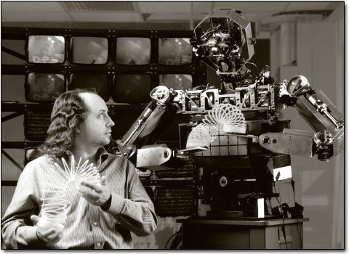
Representation Necessary?
(Rodney Brooks, 1991)
MIT CSAIL, Roboticist
Brooks, R.A. (1990) Elephants don’t play chess. In Pattie Maes (Ed.) Designing autonomous agents. Cambridge, Mass, MIT Press
Brooks, R.A. (1991) Intelligence without Representation. Artificial Intelligence, 47, 139-159.
Brooks, R.A. (1991) Intelligence without Reason. In Proceedings of the 12th International Joint Conference on Artificial Intelligence. Morgan Kauffman.
Elephants don’t play chess – but still intelligent
Notes:
Now I am going to deviate a little ...
Rodney Brooks, a roboticist in MIT-CSAIL, writes a series of papers which are completely against the general trend…
Well the first … elephants don’t play chess, but still “seem” smart …. Then why our AI systems are able to solve chess but still we are not able to make a robot which works perfectly “elephants”? In his sequence of papers he suggest that the current form of AI systems, which we inherited from McCarthy, might not be the right way of modelling “reasoning”’, “knowledge representation” and their interaction.

Slide 40
Representation Necessary?
(Rodney Brooks, 1991)
Allen:
Can approach goal, while avoiding obstacles –without plan or map of environment
Distance sensors, and 3 layers of control
Tight connection of perception to action
Layerwise design, working independently and in parallel.
Like combination of Finite State Machines
No symbolic representation
implicit and distribution inside FSMs.
Layer 1: avoid static and dynamic objects – repulsed through distance sensors
Layer 2: randomly wander about
Layer 3: Head towards distant places
Notes:
To show his ideas, he creates a robot “Allen” which avoids obstacles while trying to reach a goal state…
Here is how the internal system of the robot organized…
Three layers of decision making …. The actual direction of move, is determined by sum of the repulsive forces by each layer (suitably thresholded).
→ The first layer makes sure that the robot does hit objects … Due to this layer it could avoid static and dynamic obstacles, but it could not move. … It sat in the middle of the room, waiting for obstruction. When the obstruction came, Allen ran away, avoiding collisions as it went.
It used following internal representation, and every sonar return represented a repulsive force with, and inverse square drop off in strength.
Second layer randomly wander about every 10 seconds.
The third layer made the robot try to explore. Allen could look for distant places (with its sonars), then tried to reach them. "This layer monitored progress through odometry, generating a desired heading”
Things to point out here:
-> There is a tight connection between perception and decision making. There is no intermediate “symbolic” representation.
---→ here you might say natural language is very different from robotic distance sensors but ... We human can communicate without written English. Maybe strings/symbols are no the right way of representing basic form of information.
-> There are multiple layers of decision making …
-> The design can be interpreted as a combination of multiple state machines
-> The knowledge is mingled with the decision making inside each layer.

Slide 41
Representation Necessary?
(Rodney Brooks, 1991)
Subsumption Architecture
No central model of world
Internal symbolic system be given meaning, only with physical grounding
Robot says “pig” in response to a real pig detected in the world
No central locus of control.
Layers, or behaviours run in parallel
No separation into perceptual system, central system, and actuation system
Behavioural competence built up by adding behavioural modules
Critiques:
Scaling?
How does it solve our AI problem?!
Notes:
More generally he called his framework “Subsumption Architecture” which resulted in some success in robotics but not much in NLP….
Here is how he described its properties as following:
No central knowledge representation
No symbolic representation; everything is with interaction with environment. Then what is grounding? It has meaning only with interaction with environment. You see “pig”, you say “pig”.
- No central reasoning; layers of reasoning.
- The competence is achieved by adding layers … s
Surely it had its critiques:
-> Can subsumption-like approaches scale up to arbitrarily complex systems?
-> Seriously what part of AI is solved by this?

Slide 42
Hayes&McCarthy
Frame Problem
Brooks
Subsumption
Quillian
Semantic Networks
ConceptNet
Minsky, Filmore
Frames
McCarthy
Formalizing Commonsense
Description Logic
Bobrow
STUDENT
Simon&Newell
General Problem Solver
Lenant
Cyc
Winograd
SHRDLU
2000 1990 1980 1970 1960 1950 1940
SHRUTI
Rumelhart et al
BackPropagation
Series of Neural-Symbolic Models
McCulloch
&Pitts
Artificial Neurons
Minsky
&Pappert
“Perceptrons”
Systematicity Debate
Notes:
I will go over a couple works that were interesting to me from the perspective of “knowledge representation”. For some of these pieces I will just give a very brief explanation, but hopefully it will be enough to see how different pieces of puzzle are connected together ….

Slide 43
So what now?!
Questions left to answer
"symbolic" representation necessary?
Unify reasoning with representation?
Separate knowledge base?
Represent uncertainty better than “probability theory”?
Unify distributed and logic-based representation?
Or do logical reasoning with statistical models ?
Or make more robust logical systems?
How knowledge should be accessed?
How this can be made dynamics in the case when there are multiple types of information?

Slide 44
Thanks for coming!

Slide 45

Programs With Commonsense
(John McCarthy, 1959)
Scenario: I am seated at my desk at home and I wish to go to the airport. My car is at my home also.
Solution: the problem is to walk to the car and drive the car to the airport.
at(I, desk)
at(desk, home)
at(car, home)
at(home, county)
at(airport, county)
at(x, y), at(y,z) $→$at(x,z)
[example is incomplete …. ]

Slide 46
ThoughtTreasure (1994-2000)
(Erik Mueller, 2000)
Minsky (1988) : there is no single “right” representation for everything,
Facts: 27,000 concepts and 51,000 assertions
[isa soda drink]
(Soda is a drink.)
[is the-sky blue]
(The sky is blue.)
@19770120:19810120|[President-of country-USA Jimmy-Carter]
(Jimmy Carter was the President of the USA from January 20, 1977 to January 20, 1981.)
Notes:
ThoughtTreasure is a comprehensive platform for natural language processing and commonsense reasoning
Inspired by Cyc
Has multiple form of representation

Slide 47
Natural Input
AI System
Intermediate Input
Why intermediate representation for input?
Computer Brain
Intermediate Output
Natural Output

Slide 48
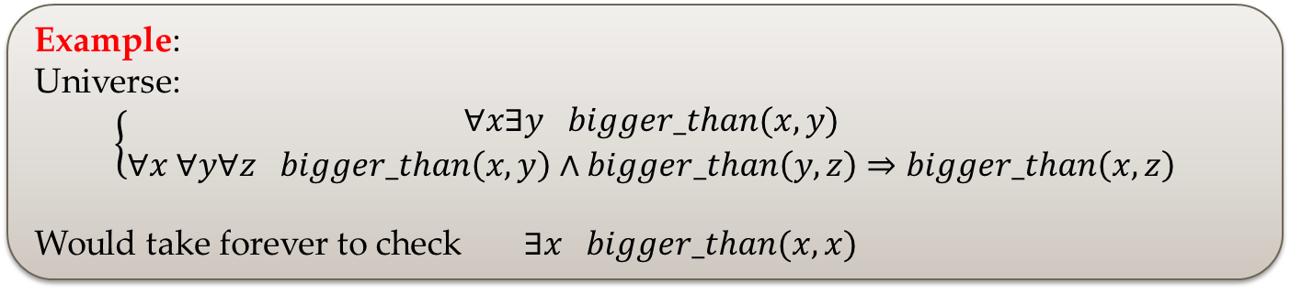
Description Logic
First Order Logic is undecidable!
[More details here… ]
Example:
Universe:
$$\left\{\begin{aligned}∀x∃y bigger_than(x,y) \\ ∀x ∀y∀z bigger_than\left(x,y\right)∧bigger_than\left(y,z\right)⇒bigger_than\left(x,z\right)\end{aligned}\right.$$
Would take forever to check $∃x bigger_than(x,x)$
Notes:
FOL is not always able to not able to be firmly established or refuted.

Slide 49
Prolog

