Slide 1


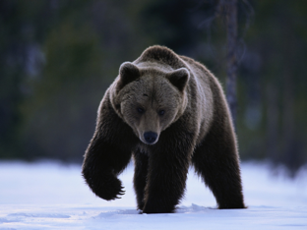


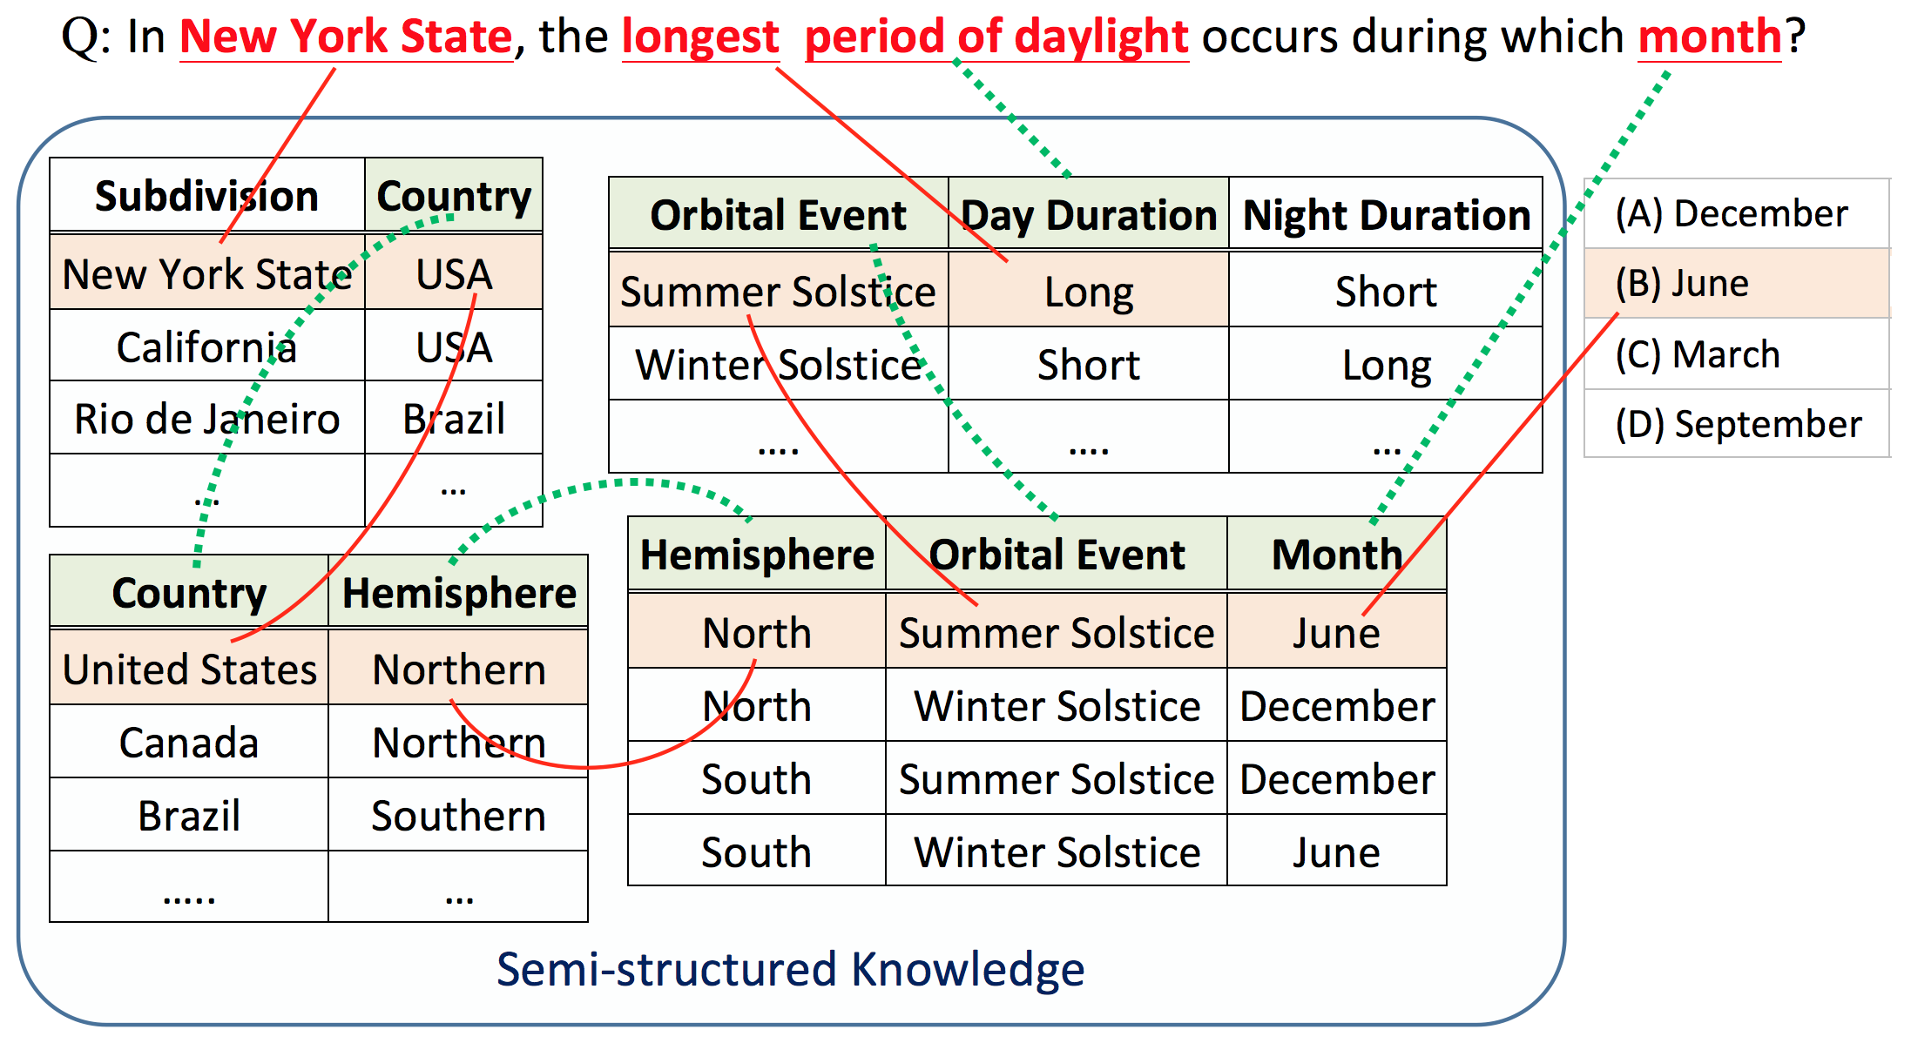
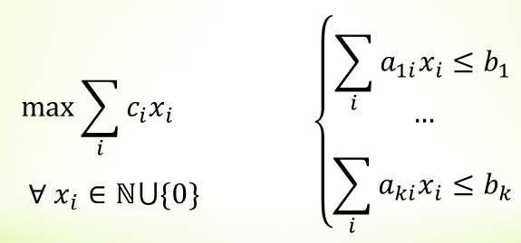
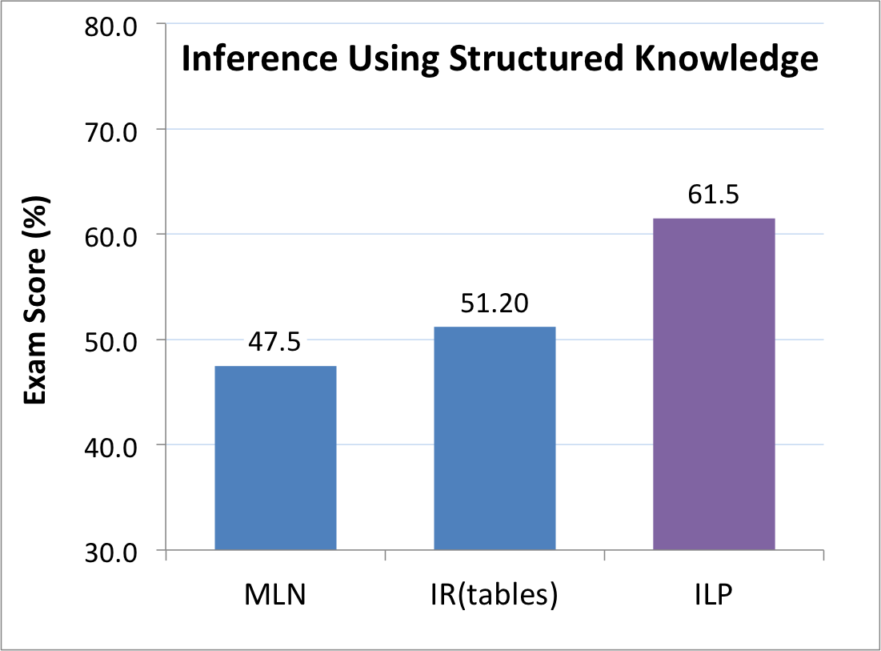
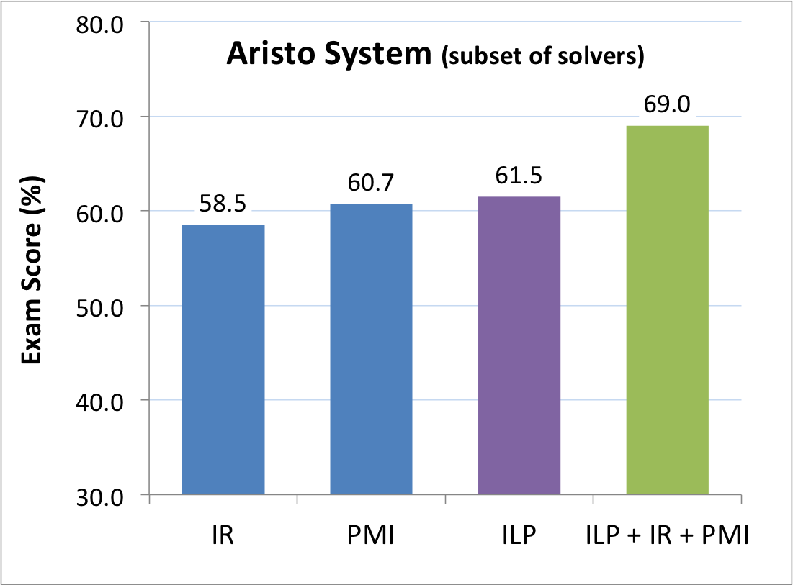
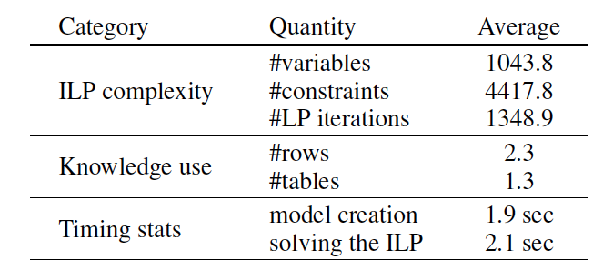
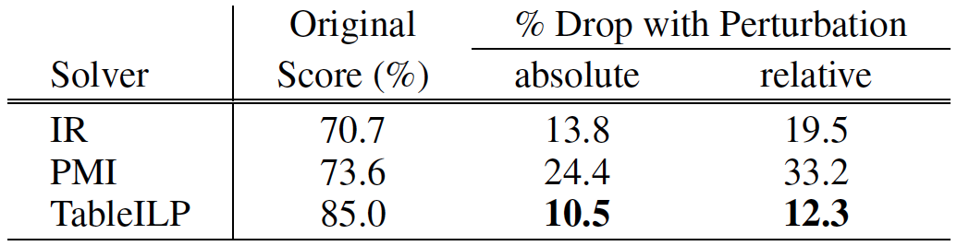
Semi-Structured Reasoning for Answering Science Questions
Daniel Khashabi, Dan Roth (UIUC)
Tushar Khot, Ashish Sabharwal, Peter Clark, Oren Etzioni (Allen Institute for Artificial Intelligence)
Overview
Which physical structure would best help a bear to survive a winter in New York State? (A) big ears (B) black nose (C) thick fur (D) brown eyes
Challenge: Build an AI system that demonstrates human-like intelligence by passing standardized science exams as written; examples:
Intermediate Goal: Elementary Science: A simple embodiment of this challenge, requires question-answering significantly beyond retrieval techniques
Approach: A discrete optimization approach to QA for multiple-choice questions
Results: State of the art performance on 4th grade science (NY Regents exam)
A student puts two identical plants soil. She gives them the same amount of water. She puts one of these plants near a sunny window and the other in a dark room. This experiment tests how the plants respond to (A) light (B) air (C) water (D) soil
Main Idea
Architecture
Search for the best Support Graph connecting the Question to an Answer through Tables.
A discrete optimization (Integer Linear Program) approach to QA for multiple-choice questions
Given as input a question, candidates answers, and a generic set of tables,
and generates a constrained optimization problem
Question Q with answer options A
ILP model builder
M(T,Q,A)
ILP solver
Knowledge Tables T
Phrasal alignment
A with support graph + score
Word and short-phrase level entailment / similarity
M(T,Q,A)
4th Grade NY Regents Science Exam
108 training set
129 questions in completely unseen Test set
Baselines:
PMI Solver: Statistical correlation using pointwise mutual info (280 GB of text)
IR Solver: Information Retrieval using Lucene search (280GB of text)
IR Solver (table): using only Tablestore
MLN Solver: using rules from 80K sentences
Variables define the space of “support graphs” connecting Q, A, T
Which nodes + edges between lexical units are active?
Objective “better” support graphs = higher objective value
Reward active units, high lexical match links, column header match, …
WH-term boost (which form of energy), science-term boost (evaporation)
Penalize spurious overuse of frequently occurring terms
Structural Constraints
Meaningful proof structures
connectedness, question coverage, appropriate table use
parallel evidence => identical multi-row activity signature
Simplicity appropriate for 4th / 8th grade
Semantic Constraints
Chaining => table joins between semantically similar column pairs
Relation matching (ruler measures length, change from water to liquid)
69 tables, ~7.6K rows
Tablestore
Objective function
Constraints
Evaluation
Exploiting Structured Knowledge
Complementary Strengths
Assessing Brittleness:
Question Perturbation
ILP complexity, scalability
We compare the accuracy of our approach against the previous structured (MLN-based) reasoning solver and IR(tables).
TableILP and IR-based methods clearly approach QA very differently. This analysis highlights the complementary strengths of these solvers.
How robust are approaches to simple question perturbations that would typically make the question easier for a human? We consider a simple, automated way to perturb each 4-way multiple-choice question using Bing:
The table below summarizes various ILP and support graph statistics for TableILP, averaged across all test question
In New York State, the longest period of daylight occurs during which month?
(A) eastern (B) June (C) history (D) years
1. TableILP is substantially better than IR & MLN, when given knowledge derived from the same, domain-targeted sources (6 years of exams; 95% C.I. = 9%)
2. Performance: % correct on 6 years of unseen questions (129 questions). The solvers ensemble performs 8-10% higher than IR baselines.
3. On 1080 perturbed question of the regents train, TableILP has the smallest drop among the solvers.
4. Speed: 4 sec per question, reasoning over 140 rows across 7 tables. Contrast: 17 sec for MLN using only 1 rule per answer option!
Authors acknowledge the support from AI2 and DARPA (under the DEFT program).

