Slide 1









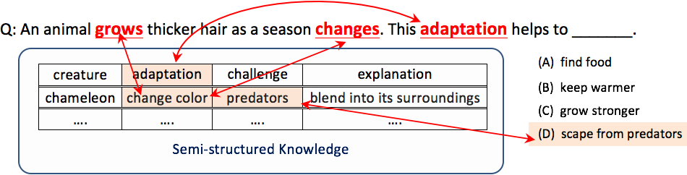
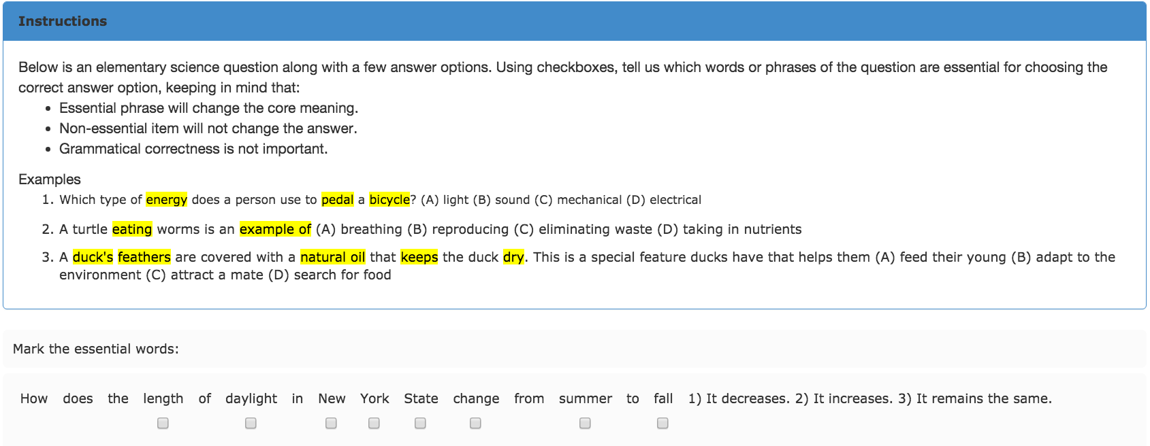
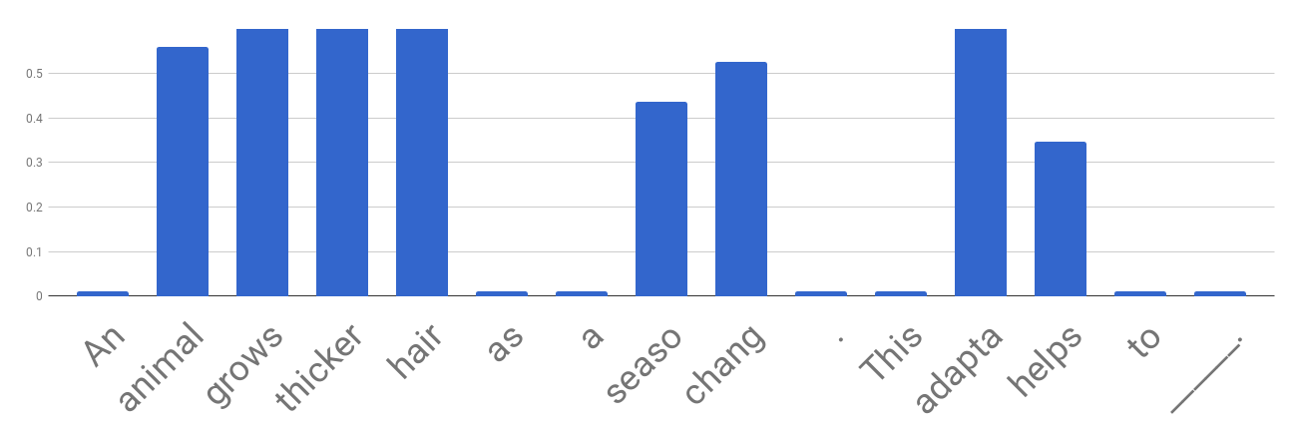
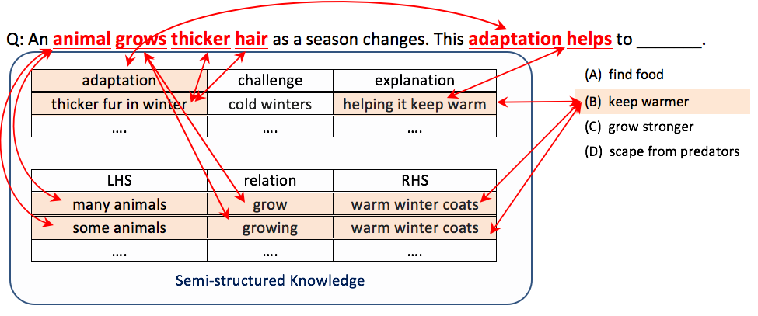
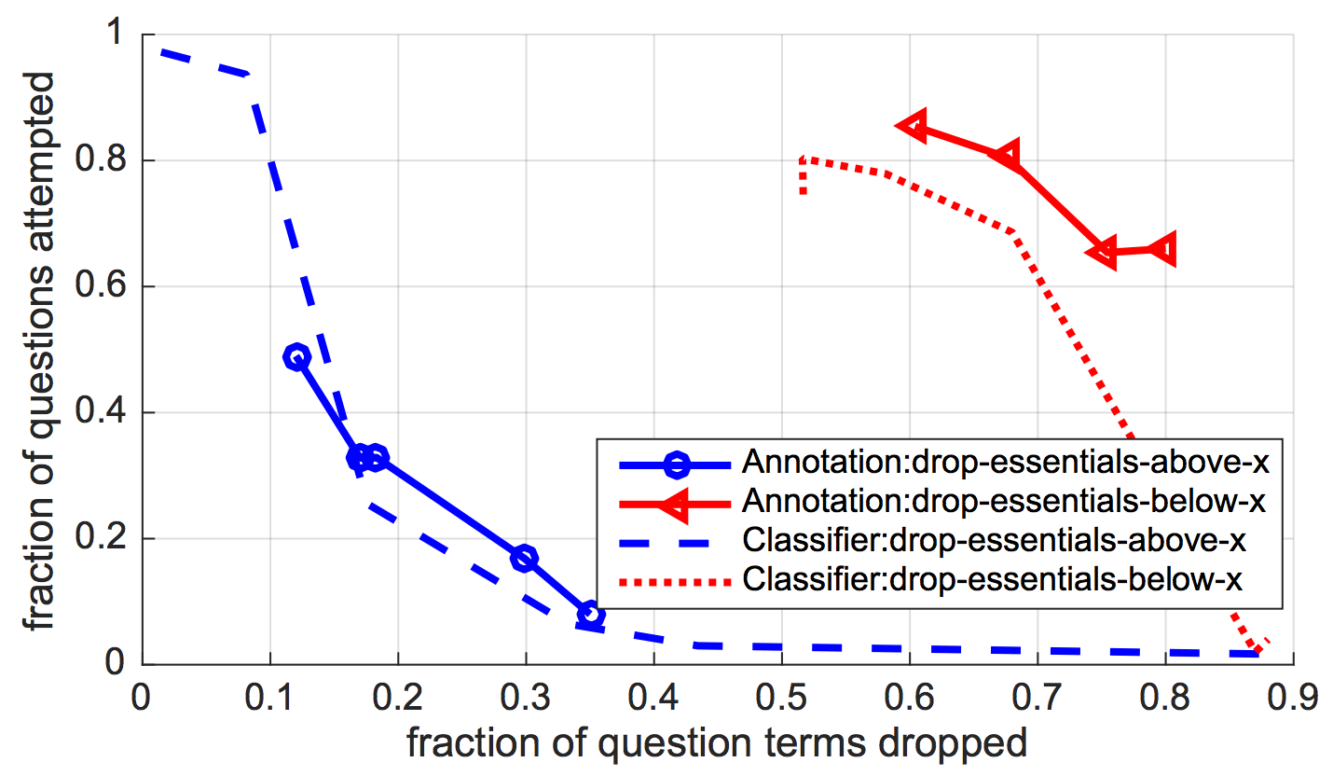
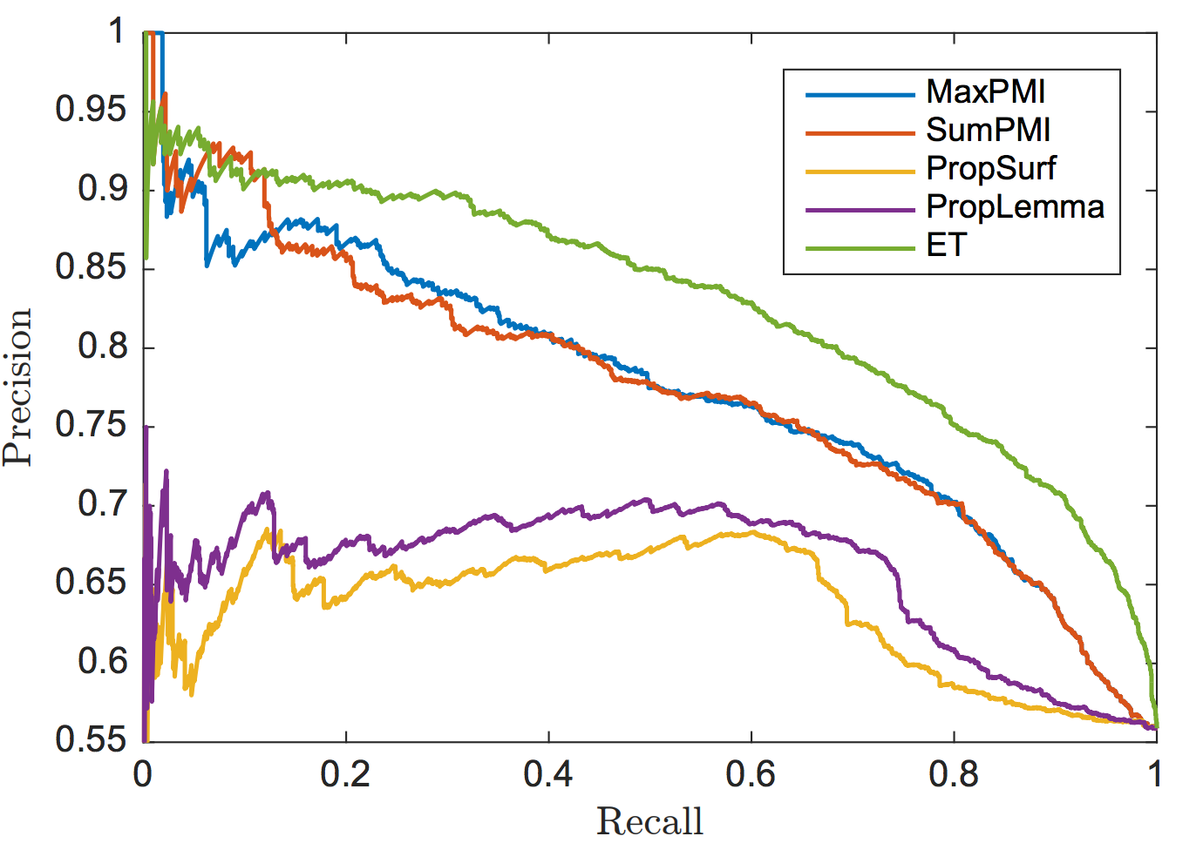
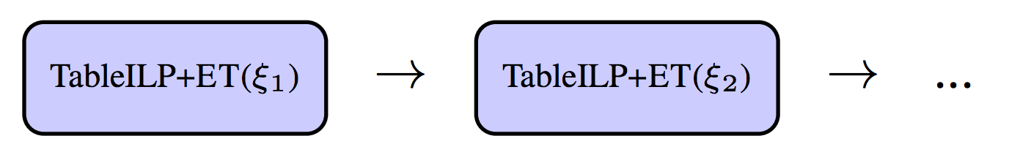
Learning What is Essential in Questions
Daniel Khashabi, Dan Roth (University of Pennsylvania)
Tushar Khot, Ashish Sabharwal (Allen Institute for Artificial Intelligence)
Overview
An animal grows thicker hair as a season changes. This adaptation helps to _______. (A) find food (B) keep warmer (C) grow stronger (D) scape from predators
1
Challenge: QA systems are unable to reliably identify which question words are redundant, irrelevant, or even intentionally distracting. (example)
Proposal: We introduce and study the notion of essential question terms with the goal of improving such QA solvers.
Results: We then develop a classifier that reliably (90% mean average precision) identifies and ranks essential terms in questions. We use the classifier to improve state-of-the-art QA solvers for elementary-level science questions by up to 5%.
TableILP (Khashabi et al., 2016) performs reasoning by aligning the question to semi-structured knowledge, aligns only ‘grow’, ‘changes’, ‘adaptation’ when answering this question.
Not surprisingly, TableILP chooses an incorrect answer. The issue is that it does not recognize that “thicker hair” is an essential aspect of the question. This problem is solved by augmenting the solver with essentiality scores:
Crowd-Sourced Essentiality Dataset
Collected 2,223 elementary school science exam questions for the annotation.
The questions were annotated by 5 crowd workers and resulted in 19,380 annotated terms.
The Fleiss’ kappa of κ = 0.58 (inter-annotator agreement very close to ‘substantial’)
2
The Importance of Essential Terms
A crowd-sourcing experiment to validates our hypothesis:
Is the question still answerable by a human, if a fraction of the essential question terms are eliminated?
Average fraction of terms dropped on the horizontal axis and the corresponding fraction of questions attempted on the vertical axis.
Blue lines: effect of eliminating essential sets
Red lines: effect of eliminating non-essentials
PR curves for methods as the threshold is varied
3
The solid blue line demonstrates that dropping even a small fraction of question terms marked as essential dramatically reduces the QA performance of humans.
The solid red line, on the other hand, shows the opposite trend for terms marked as not-essential: even after dropping 80% of such terms, 65% of the questions remained answerable.
ET Classifier has a 5% higher AUC (area under the curve) and outperforms baselines by roughly 5% throughout the precision-recall spectrum.
ET Classifier
Given a question q , answer options a, we seek a classifier that predicts whether a given term is essential.
Trained a linear SVM classifier on real-valued essentiality scores are binarized to 1 if they are at least 0.5, and to 0 otherwise.
Features include syntactic (e.g., dependency parse based) and semantic (e.g., Brown cluster representation of words, a list of scientific words) properties of question words, as well as their combinations. In total, we use 120 types of features.
Baselines
Supervised: Score for a term is proportional to times it was marked as essential in the annotated dataset. PropSurf based on surface string and PropLem based on lemmatizing the surface string.
Unsupervised: MaxPMI and SumPMI score the importance of a word x by max-ing or summing, resp., PMI scores p(x, y) across all answer options y for q.
Binary Classification of Terms.
Consider all question terms pooled together, resulting in a dataset of 19,380 terms annotated independently as essential or not.
We evaluate binary predictions on these terms.
System | F1
MaxPMI | 0.75
SumPMI | 0.75
PropSurf | 0.66
PropLem | 0.69
ET Classifier | 0.80
The ET classifier achieves an F1 score of 0.80, which is 5%-14% higher than the baselines. Its accuracy at 0.75 is statistically significantly better than all baselines based on the Binomial exact test (p-value 0.05).
Learning Essential Terms
Ranking Question Terms.
Evaluating when systems rank all terms within a question in the order of essentiality.
For the ranked list produced by each classifier for each question, we compute the average precision, and take the mean of these AP values across questions to obtain the mean average precision (MAP) score.
System | MAP
MaxPMI | 0.87
SumPMI | 0.85
PropSurf | 0.85
PropLem | 0.86
ET Classifier | 0.90
Our ET classifier achieves a MAP of 90.2%, which is 3%-5% higher than the baselines, and demonstrates that one can learn to reliably identify essential question terms.
IR Solver + ET
A modified IR system where it query (q’, a), with q’ being the essential subset of q.
TableILP + ET
We employ a cascade system that starts with a strong essentiality requirement and progressively weakens it:
Questions unanswered by the first system are delegated to the second, and so on.
4
On a dataset adversarially generated with TableILP mistakes, TableILP + ET, corrects 41.7% of the mistakes made by vanilla TableILP.
This error-reduction illustrates that the extra attention mechanism added to TableILP via the concept of essential question terms helps it cope with distracting terms.
End-to-end QA
Dataset | Basic IR | IR+ET
Regents | 59.11 | 60.85
AI2Public | 57.90 | 59.10
RegtsPertd | 61.84 | 66.84
On RegtsPertd set ET improves IR by 4.26% to 63.4% where the previous state-of-the-art solver, TableILP, achieves a score of 61.5%, thus achieving a new state of the art.
Authors acknowledge the support from AI2 and DARPA (under the DEFT program).

